Slide 1
Filling Out Your Ethics Application: Tips, Tricks, & Pitfalls
Joshua W. Katz, PhD Candidate (Department of Psychology & Health Studies) Fall 2024

Slide 2
What is the purpose of this PowerPoint?
To show you what the behavioural ethics form looks like
To provide you with some standard statements that may be useful
To give you tips and tricks for how to complete a strong ethics application
To inform you of some of the common mistakes that are made while filling out ethics applications, and how they can be avoided

Slide 3
General Tips
Talk to your supervisor early and often about your project
Attention to detail
Keep it as simple and straightforward as possible (within reason)
BE CONSISTENT!!!!!!!! NO CONTRADICTIONS!!!!!!!!
Submit your form on time
Consult your supervisor about how to properly complete each section of the ethics form prior to submitting it (Forms with an excess of mistakes/omissions will be returned immediately)

Slide 4
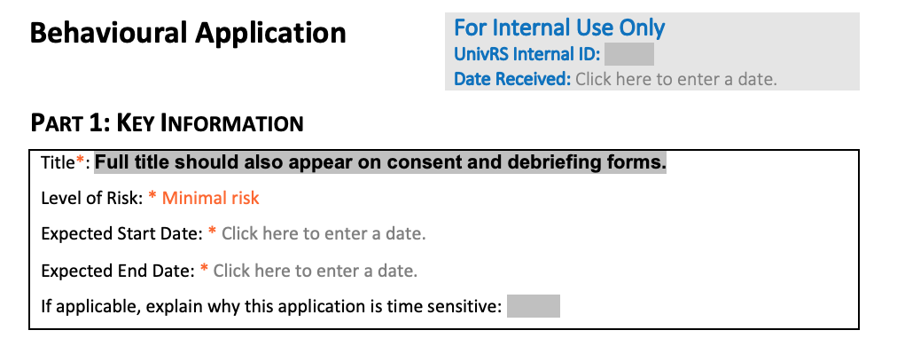

Slide 5
Key Information – Suggestions
Your title needs to be the same across all forms
This applies for anything that appears in multiple sections/on multiple documents
The level of risk NEEDS to be minimal for your project
Make sure you talk to your instructor about what this looks like; you may need to deviate from your original idea
The estimated start and end dates should correspond with the academic calendar year
You will be working on this project until the end of the Winter semester
Because you may still be collecting data at the last minute, you will want to provide a generous expected end date (i.e., April 2025)

Slide 6
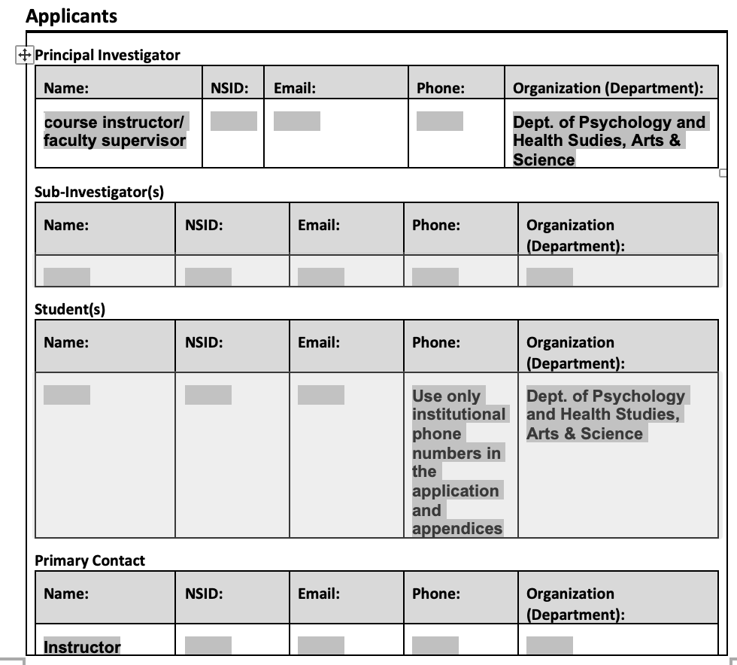

Slide 7
Applicants – Suggestions
Keep it professional (i.e., use your university contact information); you are representing the university
Your instructor will act as the primary investigator/contact; you can list yourself as a student researcher
For your purposes, you will likely not have a sub-investigator(s)

Slide 8
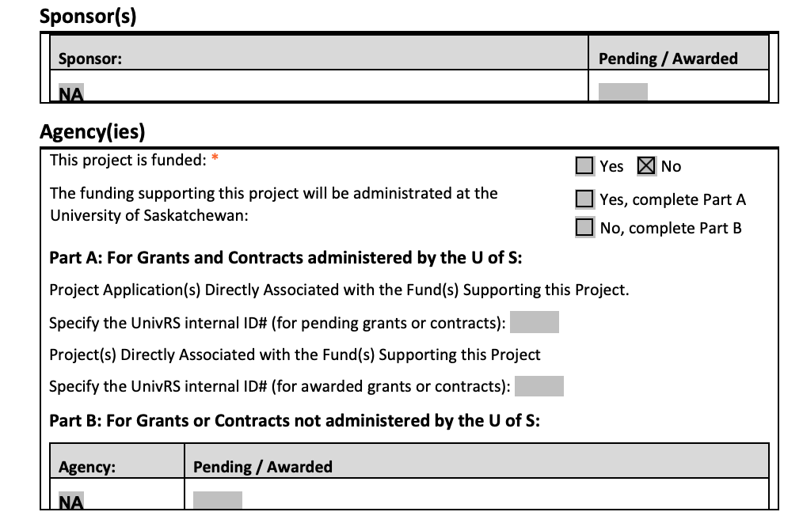

Slide 10
Locations – Suggestions
Be specific when listing the locations where the research will be conducted
It is easier to make note of something (e.g., a location) on your initial ethics application which you do not end up using than to have to go back to Psy-REC a second time
If you are collecting data online, note that you may have participants from other countries/locations
You need permission to recruit participants through specific groups
Make sure to attach your contact letters as appendices to your ethics application
Also ensure that you provide a different version of all forms for EACH type of participant that you plan on recruiting (i.e., a friend vs. a member of the participant pool)

Slide 12
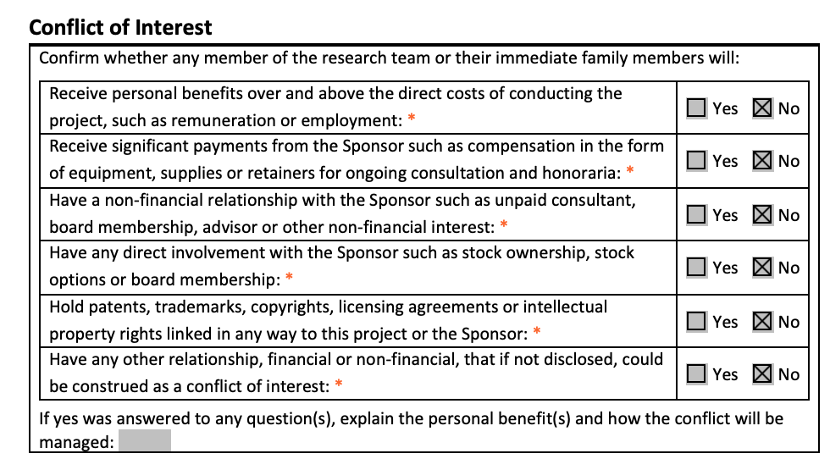

Slide 14
Project Overview – Suggestions
IMPORTANT: The primary purpose of your research project is to train you as a researcher. This point must be included and must be treated as the primary objective.
You do not need to write pages upon pages of information about your project, but you should make sure that your descriptions are detailed enough so as to provide the reader with a strong sense of what your research will entail.
Use specific language where necessary but try to limit academic “jargon” where possible.
Make sure that all of your appendices are complete and submitted alongside the application. Ensure that recurring information is consistent across all documents. Be sure that it is clear which appendix you are referring to in your description.
Consider including the university letterhead on your documents to make it look more professional. Remember: you are representing the university.

Slide 15
Example of a Description of Research Design and Methods
This study makes use of a quantitative online survey. Participants will be recruited through the online forum, Reddit. After, first, obtaining explicit permission from the moderators of the relevant Reddit pages (see Appendix A for letters of initial contact), we will post an advertisement containing a link to the survey in the forum (see Appendix B) asking Redditors to participate. Upon clicking on the link, participants will be directed to a consent form which describes the purpose and details of the study (see Appendix C). Should participants elect to continue, they will be provided with one of two of vignettes describing either a feminine (see Appendix D) or a masculine (see Appendix E) gay man. Following this, participants will be asked the fill out the Traditional Masculinity-Femininity (TMF) scale (Kachel et al., 2016) (see Appendix F). Having completed this survey, participants will be directed to a debriefing form which will describe in detail the purpose of this study (see Appendix G) (note: any deception or otherwise unclear information NEEDS to be explained in detail here). Participants will then be thanked for their time.

Slide 16
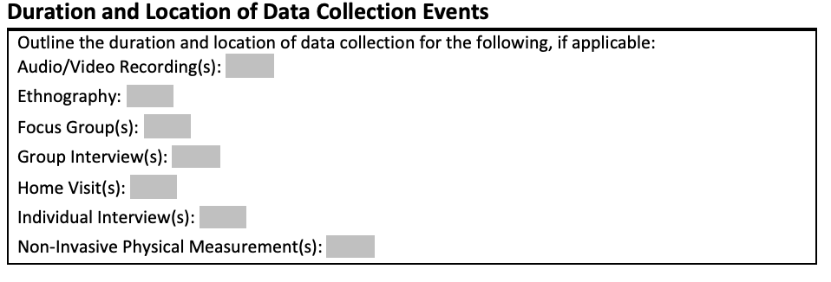

Slide 17
Duration and Location – Suggestions
What type of study are you conducting? How are you going to obtain your data?
Studies utilizing publicly available data may NOT require ethics approval
Where is the data actually going to be collected (e.g., at a skatepark; in a psychology lab on campus)?
How long will it take to run one participant through your study?
Try not to make your study take too long. Participant fatigue is a real thing. Also, the more data you collect, the more you are going to have to deal with later.
Side note: Try to avoid collecting data that you will not actually analyze

Slide 19
Internet-Based Interaction – Suggestions
Many of you may choose to utilize online surveys
However, internet-based interactions are not limited to online surveys (e.g., email interviews)
You will likely make use of a third-party platform to collect data (e.g., SurveyMonkey)
You will need to state explicitly how the relevant platform handles their data; bear in mind that data collected via certain third-party sites may or may not be stored elsewhere
For example, data collected using Surveymonkey is stored in data centers located in the USA, Ireland, and Canada
If using Suveymonkey, it may be helpful to reference the following links:
https://help.surveymonkey.com/en/surveymonkey/policy/data-processing-agreements-eu/#:~:text=As%20a%20global%20company%2C%20SurveyMonkey,Privacy%20Notice%20and%20white%20paper.
https://www.surveymonkey.com/mp/legal/security/
IMPORTANT: The SONA System will rarely, if ever, be the platform through which you actually obtain consent/collect data

Slide 20
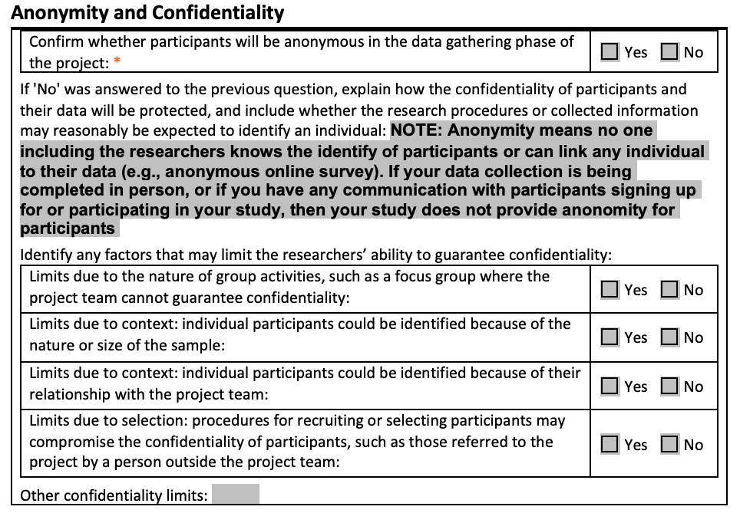

Slide 23
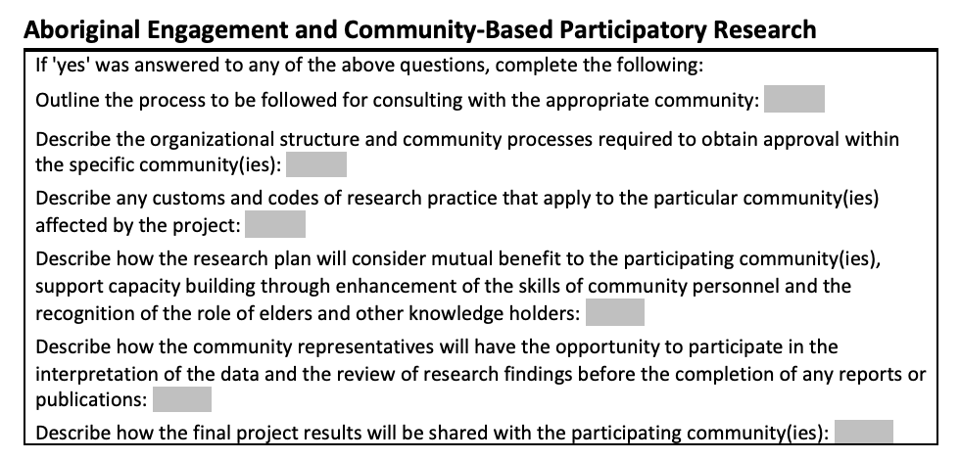

Slide 25
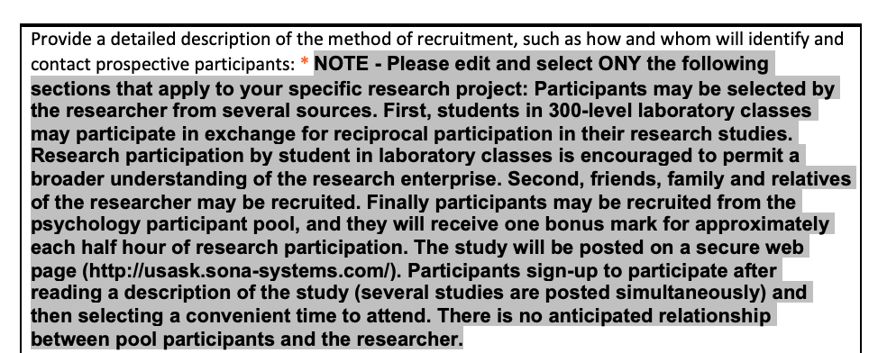

Slide 26
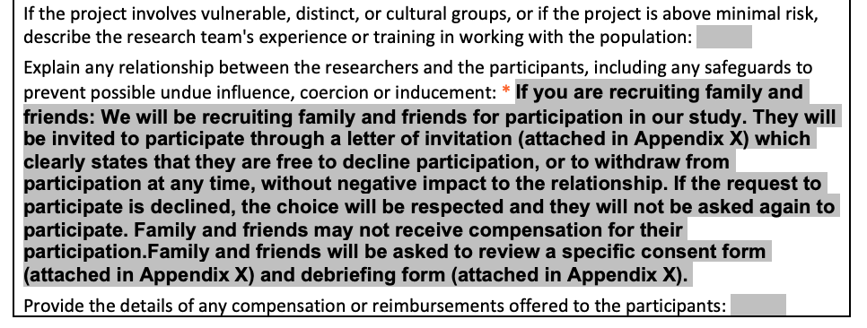

Slide 27
Recruitment – Suggestions
You are not limited to the recruitment strategies listed on the application form/in this PowerPoint
If you are having trouble determining how many people you will need to recruit for your study, consider the following:
Is my study quantitative or qualitative? Recall that qualitative studies tend to require fewer participants.
Do I have enough information to conduct a power analysis?
How many participants have other similar studies recruited? What was their justification?
What is actually feasible as part of an honours project? Your supervisor should be able to help you with this.

Slide 28
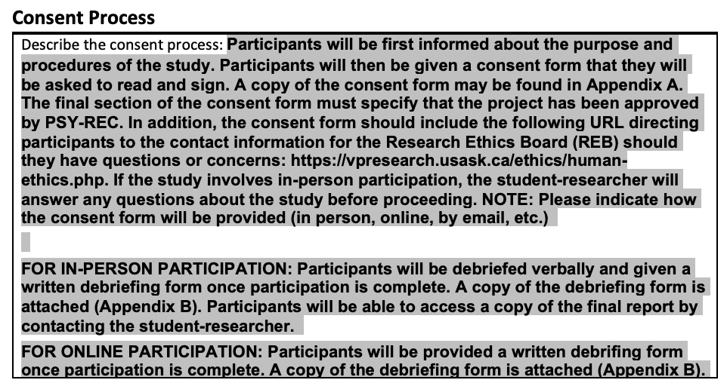

Slide 29
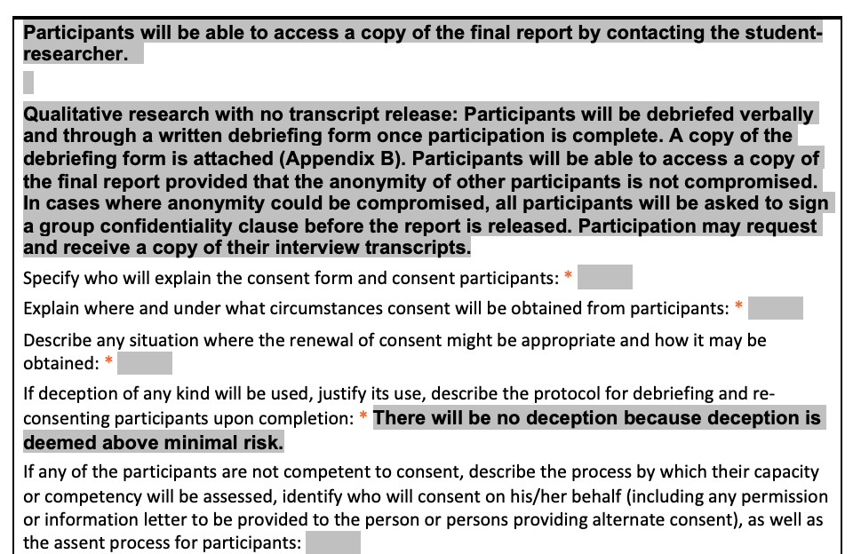

Slide 30
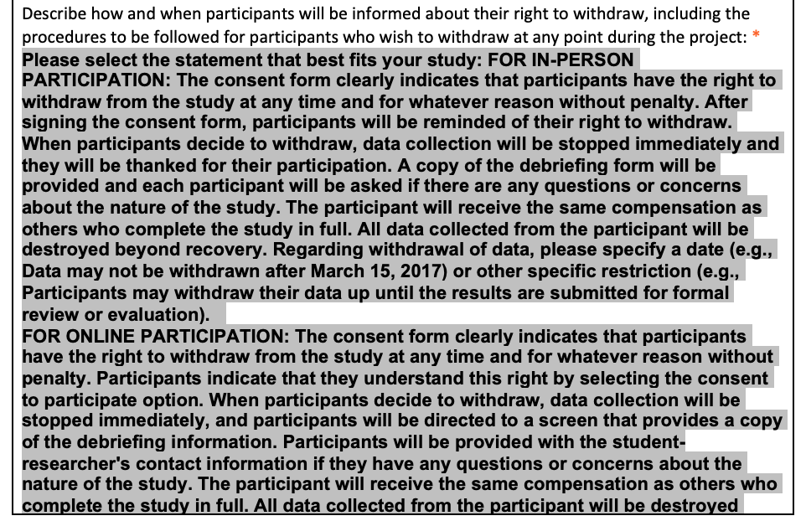

Slide 32
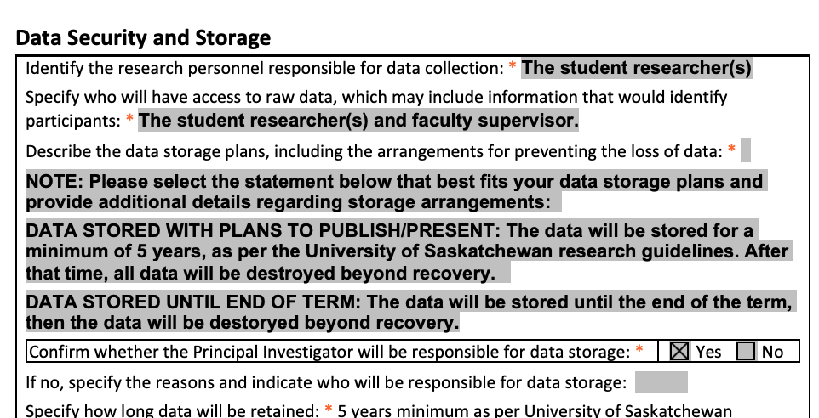

Slide 33
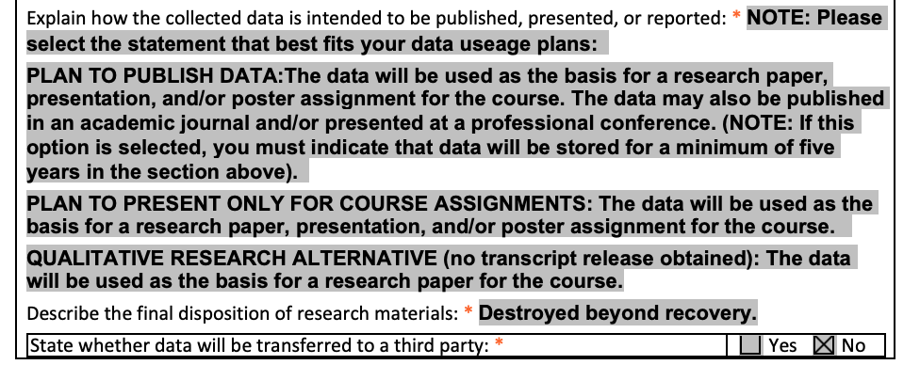

Slide 35
Ways of Storing Data
Hard Copy
On Computer
Ensure that any physical records are stored in a secure location on campus
This is often either a lab or your supervisor’s office
Ideally, any physical data should be locked in a cabinet which only the people involved in the project have access to
Talk to your instructor about the best way forward
Ensure that data is stored on a password protected computer with anti-virus software
Ideally, you should store your data on OneDrive; OneDrive does not save data to your computer’s hard drive; this is especially important if you are using a personal computer/laptop
Talk to your instructor about the best way forward

Slide 36
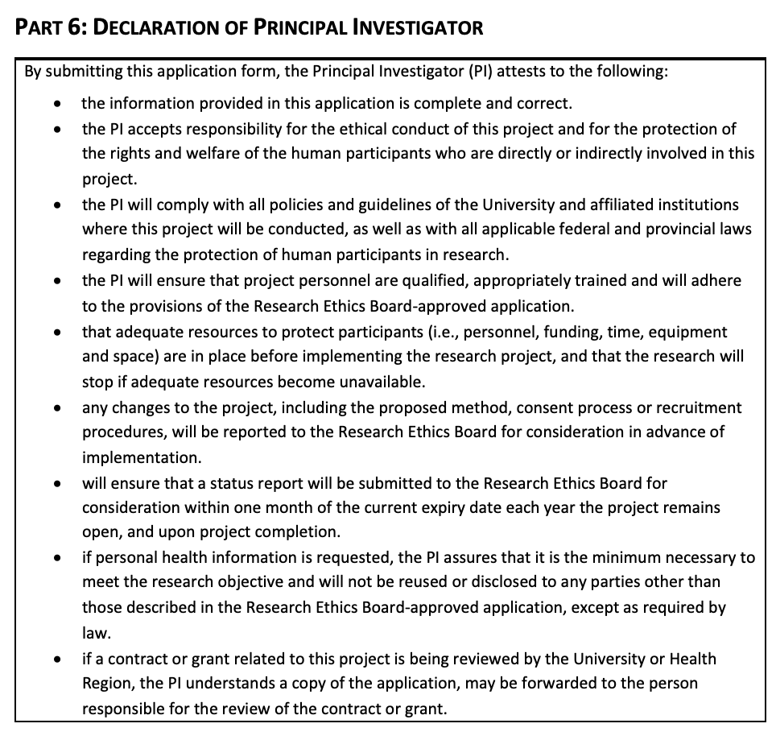

Slide 38
Documents – Suggestions
This should be a list of all of the documents that you are attaching alongside the ethics application form (e.g., consent form; debriefing form; inventories)
Be sure to specify which document on the list corresponds with each attachment (i.e., label both the document name and the attachment with the same signifier [e.g., Appendix A])

Slide 39
Appendices - Example
Documents
Appendix A: Letter of Invitation (for use with SONA Systems)
Appendix B: Letter of Invitation (to be provided to friends)
Appendix C: Consent Form (for use with SONA Systems)
Appendix D: Consent Form (to be provided to friends)
Appendix E: Demographic Questions/Inventories
Appendix F: Debriefing Form
*Note: The above list is incomplete and should be adjusted based on the particulars of your individual project.

Slide 40
Overview
Start working on your application as soon as possible
Establish the specifics of what your study will look like with your supervisor prior to filling out the ethics application
Ask your supervisor to clarify any parts of the application form that you are unsure about even if they seem trivial
Have your supervisor go over the application with you after completing the form but prior to submitting it
Provide specific information where relevant
It is better to over-explain something than to not explain it in enough detail
Pay attention to detail
Be consistent across all documents
Submit your form on time
Should you have to make revisions, be sure to get those in quickly
TAKE THE TIME TO FILL OUT A QUALITY APPLICATION

