Slide 1


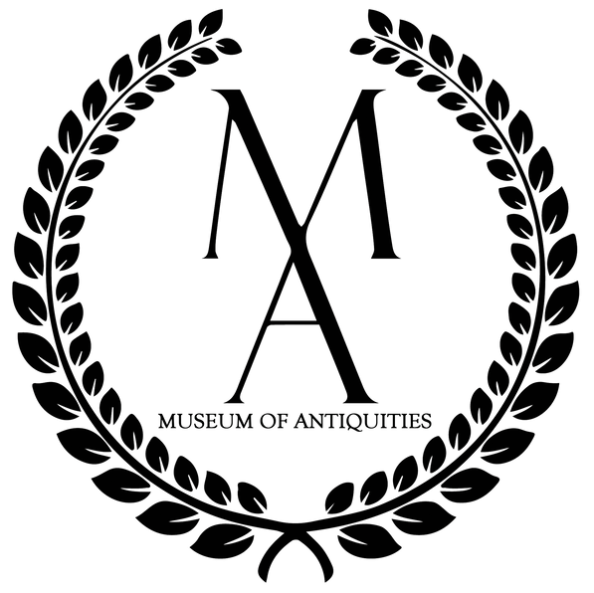


ANCIENT ART & CULTURES AT THE MUSEUM OF ANTIQUITIES:
A BRIEF HISTORY

Slide 2




Outline
  The history of the Museum of Antiquities.
  Significance and historical importance of replica artifacts.
  Nudity in ancient art.
  How art can be used to represent and understand different cultural worldviews.

Slide 3


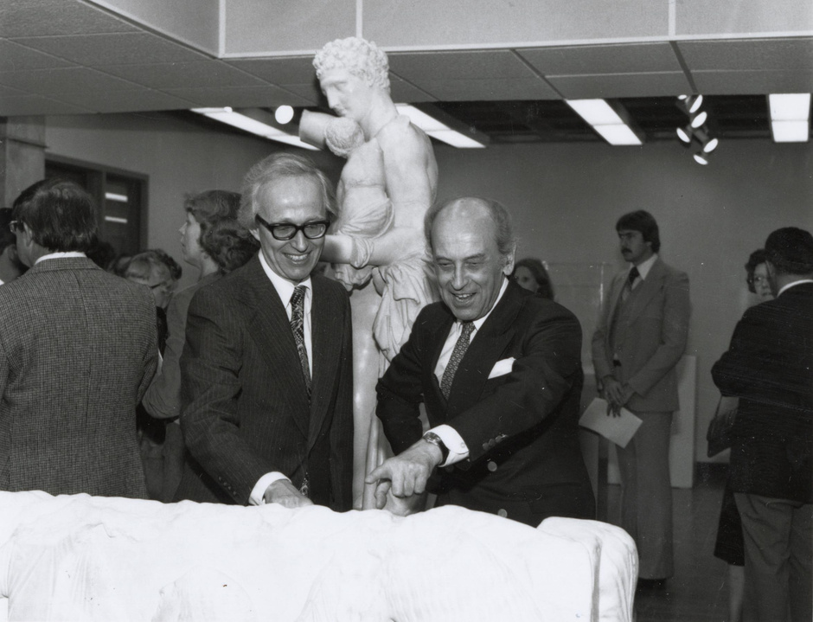
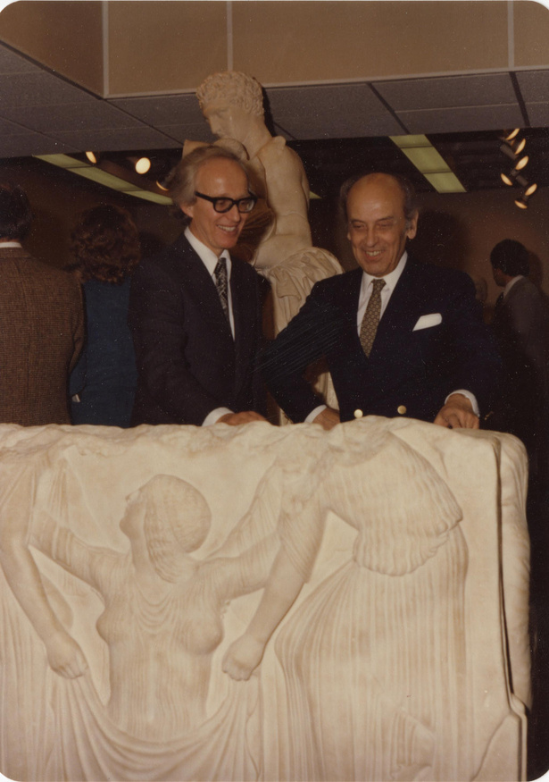
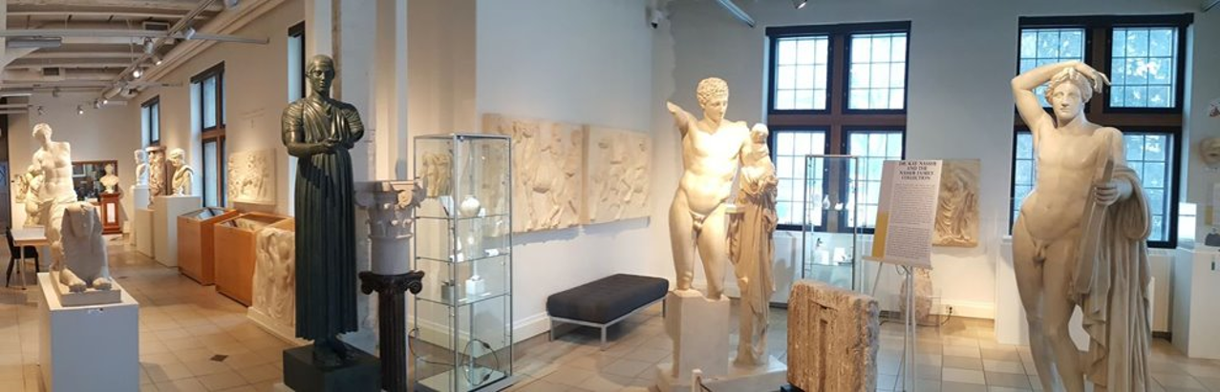
History of
the Museum of Antiquities
Museum in Murray Library
The Museum Today
Museum of Antiquities (Murray Library)
Michael Swan (left) and Nicholas Gynes (right).
University of Saskatchewan, University Archives and Special Collections, Photograph Collection, A-10146, “Museum of Antiquities - Official Opening,” 1981, Photographer: Gibson.
Museum of Antiquities (Peter MacKinnon Building)
University of Saskatchewan, University Archives and Special Collections, Nicolas Gynes Fonds, MG 76 B. University of Saskatchewan, h) [File Name], Photograph of P. Michael Swan and Nicolas Gynes at the Museum of Antiquities opening, 1981.
Notes:
The Museum of Antiquities began in 1974. It was started by University of Saskatchewan professors: ancient Historian Michael Swan (left) and art historian Nicholas Gyenes (right).
The collection began as a small group of replicas that were purchased from the Louvre in Paris, France (image on the left). The small group of replicas was intended to serve as a study collection for students and professors at the university. As time went on the collection grew due to the generosity of the university and private donors and now includes approximately 170 original artifacts and 110 replicas from other museums. The Museum of Antiquities moved into the Murray Library in 1981 and then moved to its current location in the Peter MacKinnon Building in 2005 where it is now open to the public!

Slide 4
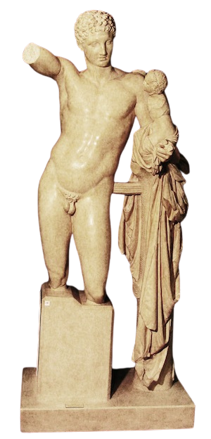
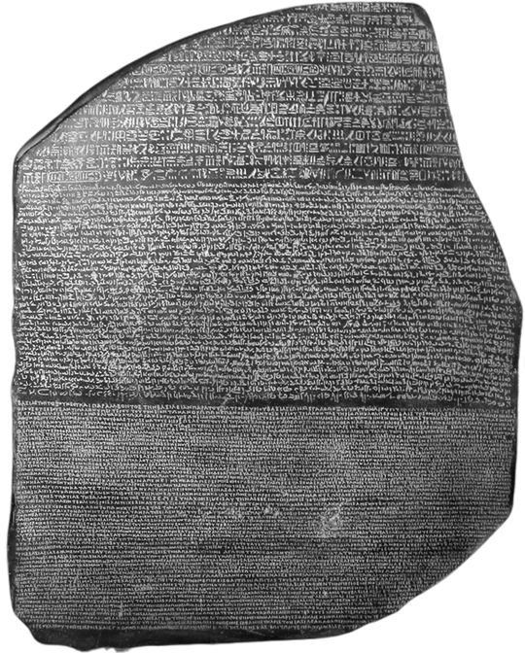
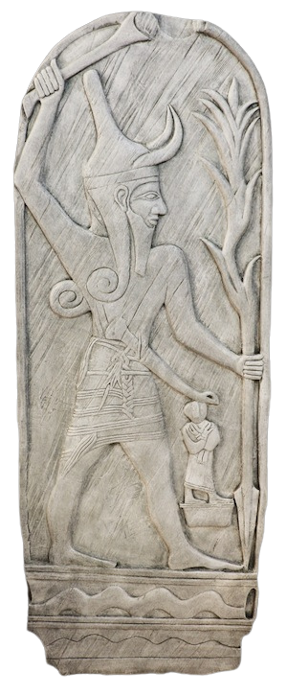
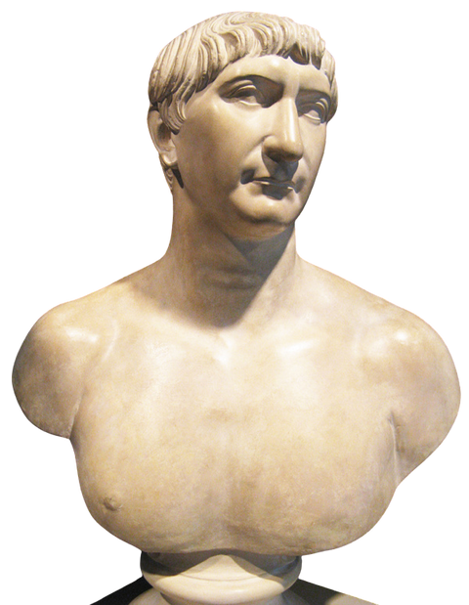

Replicas
Hermes with the Infant Dionysus (Classical Greek)
Plaster Replica
Parian Marble Original (mid-4th century BCE)
Rosetta Stone (Egyptian (Hellenistic))
Black Resin Block Replica
Black Basalt Original (196 BCE)
Trajan (Roman)
Plaster Replica
Marble Original (98-117 AD)
Baal (Near Eastern)
Plaster Replica
Limestone Original (18th-15th Century BCE)
Notes:
Does anyone know what a replica is?
These are some replicas that are found in the Museum of Antiquities. The Rosetta Stone, the god Baal, and the god Hermes. Some of you may have heard of these artifacts or heard of the Parthenon or gods.
A replica is a work that is created directly from the original. When complete, the replica should be indistinguishable from the original piece. Replicas are made with casts.
Does anyone know what a cast is?
(possible answers: broken arm cast, paper Mache cast)
How was a cast made?
Molds of the original sculpture were made and then the plaster or resin medium was poured into the mold to create an exact copy.
Why would replicas have damage to them?
because any damage that was done to the original before the cast was made would also be visible on the replica.
The casts that are found at the Museum of Antiquities are mainly made of plaster or resin and were made from places all around the world such as the British Museum in London, the Louvre in Paris, and the Gipsformerei der Staatlichen Museen in Berlin).

Slide 5


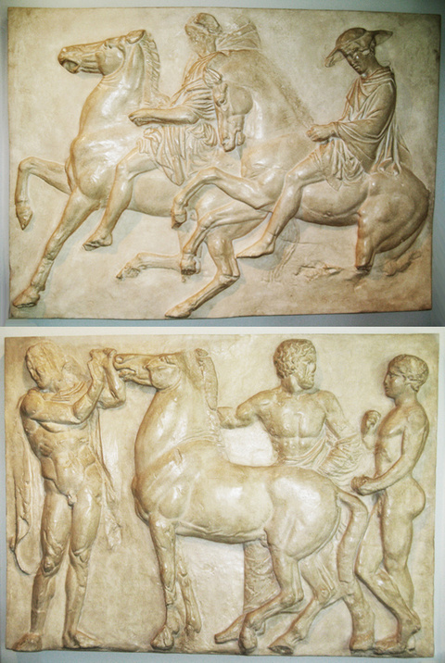

benefits of copying artifacts
  Provides access to artifacts that you generally wouldn’t see
  Some originals are not in the best shape and are not on display
  Copied artifacts are sometimes in better condition than the originals
  Roman copies of Greek originals
Parthenon Frieze Panels (Classical Greek)
Plaster Replica
Pentelic Marble Original 442-438 BCE
Notes:
What are some benefits of copying artifacts?
[click - first bullet]
Having copies and replicas provide people with access to artifacts that you generally wouldn't get to see otherwise. This could be because it is hard to travel to these places to see originals for example; London, Paris, Berlin, or Egypt. [click - second bullet] As well some originals are not in the best shape and aren't on display.
So, having replicas can help preserve the artifacts.
[click] Parthenon Frieze
This is a famous sculpture from the Parthenon, a famous building from Ancient Greece.
Until recently the originals panels were on the building in Athens. But due to pollution in Athens the panels were removed and copied. [click - bullet three] The copy that the Museum of Antiquities has was copied when there was only minimal damage, so this copy is actually in better condition than the originals.
[Click - fourth bullet]
Art and sculpture has been replicated and copied for a very long time. The Romans loved and admired Greek art, so they would copy the Greek bronze statues into marble.
Most of the Classical Greek statues in the Museum are copies of Roman copies of Greek originals.

Slide 6


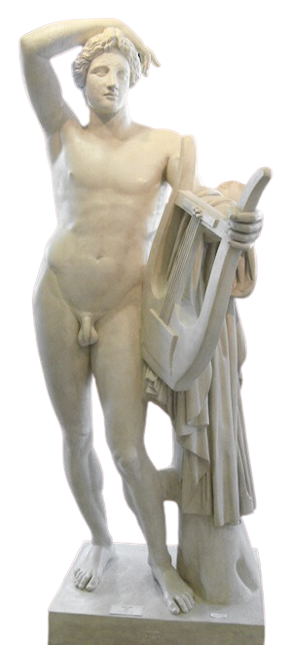
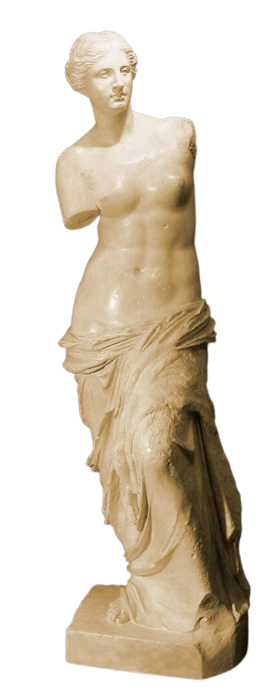
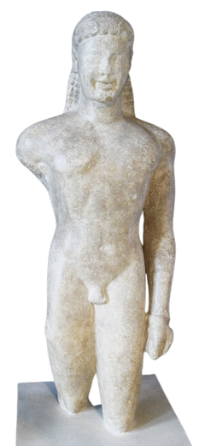

Aphrodite of Melos (Hellenistic Greek)
Plaster Replica
Parian Marble Original 2nd Century BCE
Nudity in Ancient Art
  The ancient Greeks admired the human form and beauty
  Athletes were models
  Very hot climate
  Male vs. female nudity
Apollo Lykeios (Classical Greek)
Plaster Replica
Marble Original 442-438 BCE
Kouros of Paros (Archaic Greek)
Plaster Replica
Pentelic Marble Original 442-438 BCE
Notes:
Many Greek statues are nude. As seen in the images on the left nude Greek statues began in the Archaic Greek period and are seen throughout the Hellenistic Greek Period. (could state the dates).
[click - first bullet]
The Ancient Greeks admired the human form and beauty, and they thought that humans were modeled after the gods.
[click - second bullet]
Even though the statues were modeled after the gods, the actual models would have been athletes!
Why would they have chosen athletes?
(possible answers - athletes would work out and go to the gym, muscular, gods were thought of in this way)
[click - bullet three]
Ancient Greece, located in the Mediterranean, very close to the sea and oceans, was very hot, so it made sense that they would do physical exercise in the nude because it was much cooler.
Male Greek gods were seen more often in the nude. Female nudity was not as common, the goddess Aphrodite was typically depicted in the nude as she was the goddess of love and beauty.

Slide 7

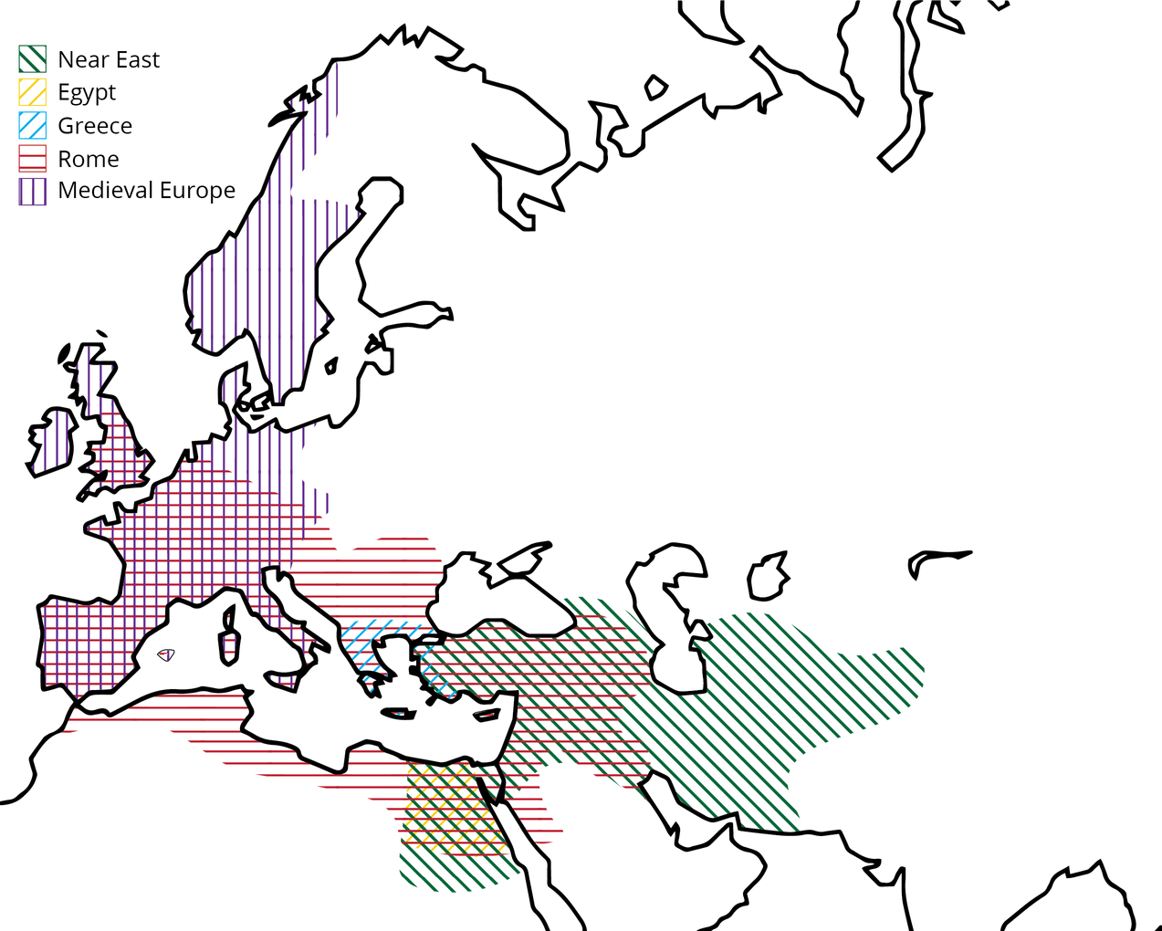
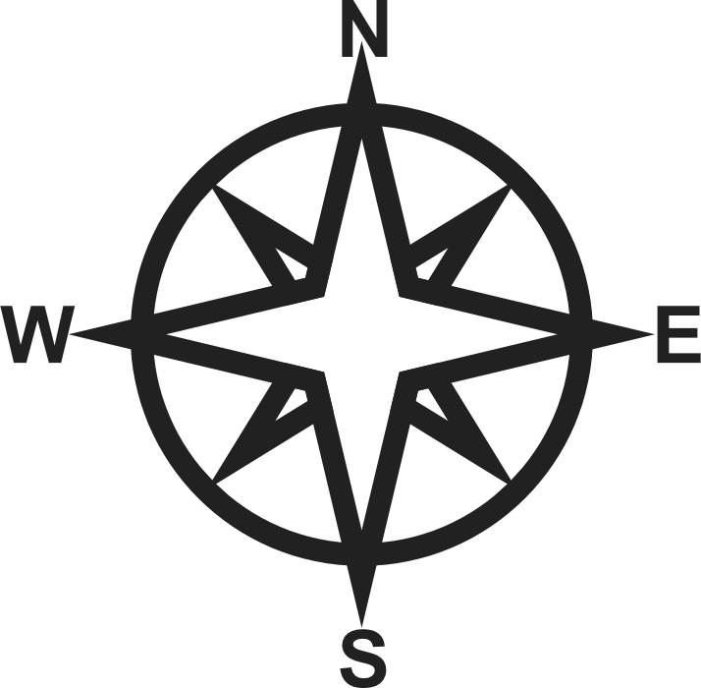
Ancient Cultures at the Museum
Near East
(c. 4000 - 330 BCE)
Egypt
(3150 - 30 BCE)
Greece
(750 -146 BCE)
Rome
(750 BCE - 476 CE)
Notes:
Near East - Modern day countries such as Afghanistan, Iran, Iraq - and stretched from the regions of the Levant through Anatolia, Mesopotamia, Elam and central Asia.
Egypt: same area as modern Egypt, 31 CE is when Egypt was conquered by Rome
Near East: dates vary, though this end date marks the beginning of the Hellenistic period in the area, when much of the area was conquered by Alexander and other kingdoms or empires from further west.
Greece: rough date, though Rome conquered Greece in 146 BCE so many people consider that the end of the Greek period.
Rome: from the founding of the city to the fall of the Western Roman Empire.

Slide 8

The Ancient Near East
Baal (Near Eastern)
Plaster Replica
Limestone Original (18th-15th Century BCE)
Notes:
It was in the ancient Near East that the birth of art took place. It was also considered the Cradle of Civilization since it was the first place where permanent urban centers (cities) developed thanks to great advancements in areas like agriculture which allowed people to stay in one place. Many different styles can be seen in this period as well as distinct religious, cultural, and social beliefs and worldviews.
For instance, the god Baal was a Canaanite fertility and rain god. (fertility meaning the growth of agriculture). Humans depended on Baal because he brought rain and helped crops grow. On the image on the right Baal is seen holding a staff which is also a lightening bolt. The Canaanites believed that when Baal struck the ground with his lightening bolt that it would help the crops grow. This is indeed true as modern scientists and agriculturalists have found that lightening produces nitrates that are needed for crops to grow.

Slide 9
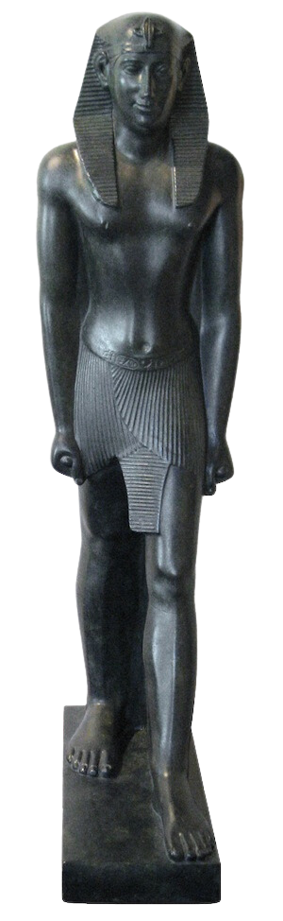
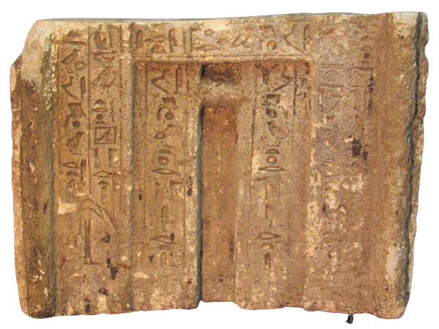
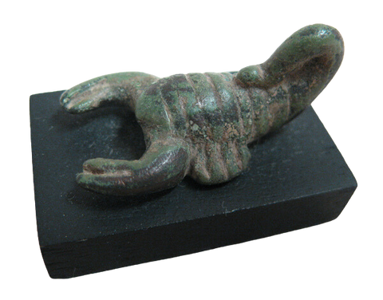
Pharaoh Psammeticus II (Egypt)
Plaster Replica
Limestone Original (4th-3rd century BCE)
Ancient Egypt
False Door from the Tomb of a Priestess of Hathor, Irti (Egypt)
Limestone Original (c. 2200 BCE)
Scorpion Amulet (Egypt)
Bronze Original (date unknown).
Notes:
Egypt, centered on the fertile Nile Valley tended towards natural imagery and iconic presentations of human and animal forms. Representations of Egyptian deities as anthropomorphic animals were popular in all art forms and amulets of animals and deities were often worn as necklaces or bracelets and provided protection for the living and dead.
Much of the artwork had a practical purpose such as recording objects and activities of people that they wished to take into the afterlife.
The figure on the left is the Pharaoh Psammeticus II. This statue shows him in the classic Egyptian stance with left foot forward and hands clenched by the sides. On the back of the statue is inscribed the name of the Pharaoh in hieroglyphs.
The Scorpion Amulet may represent the Egyptian goddess Serqet. She was one of the protective goddesses of the Nile and was often depicted as a woman with a scorpion head or headdress, or as a scorpion with a woman's head.
Finally, the False Door is one of the Museum's original artifacts, and it is over 4000 years old. False doors were thought to be like portals to the afterlife, allowing spirits to pass through them and collect offerings like food from people who visited their tombs.

Slide 10
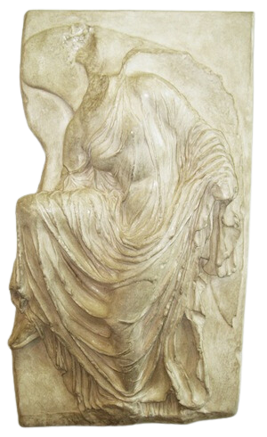
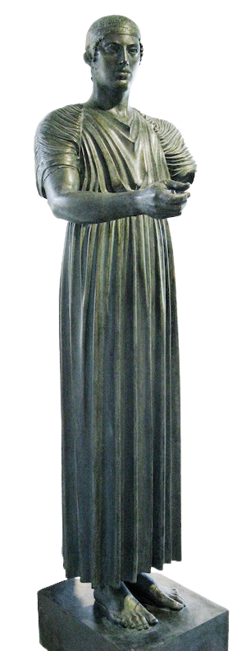
Ancient Greece
Nike Loosening Her Sandal (Classical Greek)
Plaster Replica
Pentelic Marble Original (420 BCE)
Charioteer of Delphi (Transitional Greek)
Plaster Replica
Bronze Original (474 BCE)
Notes:
Ancient Greece, famous for its art, architecture, athletics and philosophy made up mainland Greece, the surrounding islands, and much of the coastal regions of the Aegean and Ionian Seas. Historically, the establishment of the Olympic Games in 776 BCE has been the official start of ancient Greece, but modern scholars have pushed back that date to include the Greek modification of the Phoenician alphabet and the establishment of the first poleis, i.e. the city-state that would characterize Greek culture. Unlike modern Greece, ancient Greece was not one big country, but a series of city-states that had religion, language and culture in common.
This relief is of the Greek god Nike, the goddess of victory. Is anyone wearing Nike shoes? You'll notice the Nike "swoosh" looks just like the wing on the sculpture turned sideways.
This statue is the Charioteer of Delphi, and it shows the victor of the chariot races at the Pythian games. The Greeks held athletic competitions between the different city-states in honour of the gods. The Pythian games were in honour of Apollo. Did you know that we get the Olympics from the ancient Olympic games held in Olympia, Greece in honour of Zeus?

Slide 11
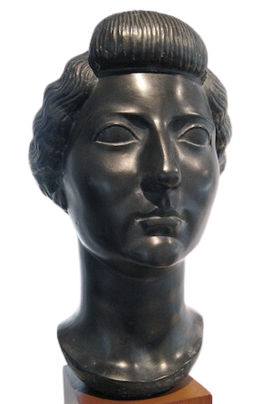
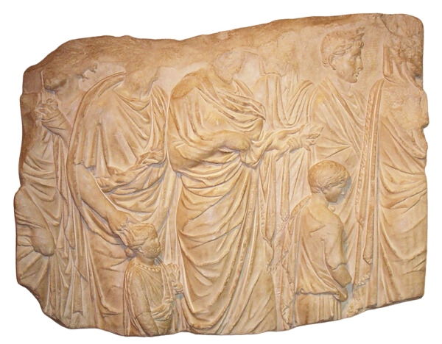
Panel from the Ara Pacis Augustae (Roman) Plaster Replica
Marble Original (9 BCE)
Ancient Rome
Livia (Roman)
Black Plaster Replica
Dark grey Basanite Original (11 BCE)
Notes:
Finally, we arrive at ancient Rome. According to legend, the city of Rome was founded by twins, Romulus and Remus, sons of the Roman god Mars - the god of War. It was named Rome after Romulus after he killed his twin to become the city's sole founder. Rome eventually became a huge empire in the ancient world and at its largest, it encompassed 20% of the world's population.
This relief on the left is from the Ara Pacis Augustae a.k.a the Altar of Augustan Peace in Rome. Augustus was the first emperor of Rome. When he became emperor, he brought great stability to Rome. The next two centuries were referred to as the Pax Romana, the years of Roman peace. This relief shows members of the imperial family taking part in a religious ritual to inaugurate the Ara Pacis Augustae.
The bust on the right is of the empress Livia, Augustus' third and final wife. Her son Tiberius would become the second emperor of Rome after Augustus' death. Livia had a lot of political influence during her husband and her son's reigns. She became a sort of role model for the ideal Roman woman, and her hairstyle seen on this bust was famous for decades after her death.

Slide 12
THANK YOU
Notes:
Thank you for listening!
All information sourced from the Museum of Antiquities website and catalogue.

