Slide 1
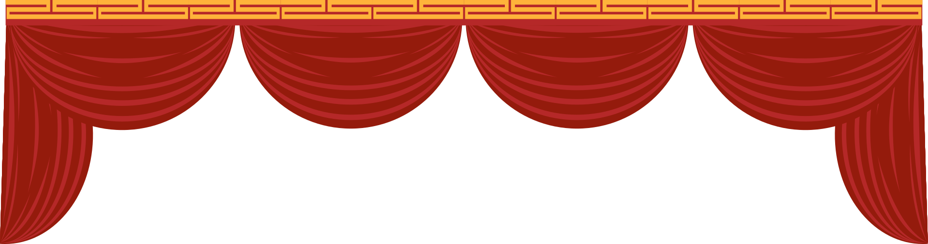
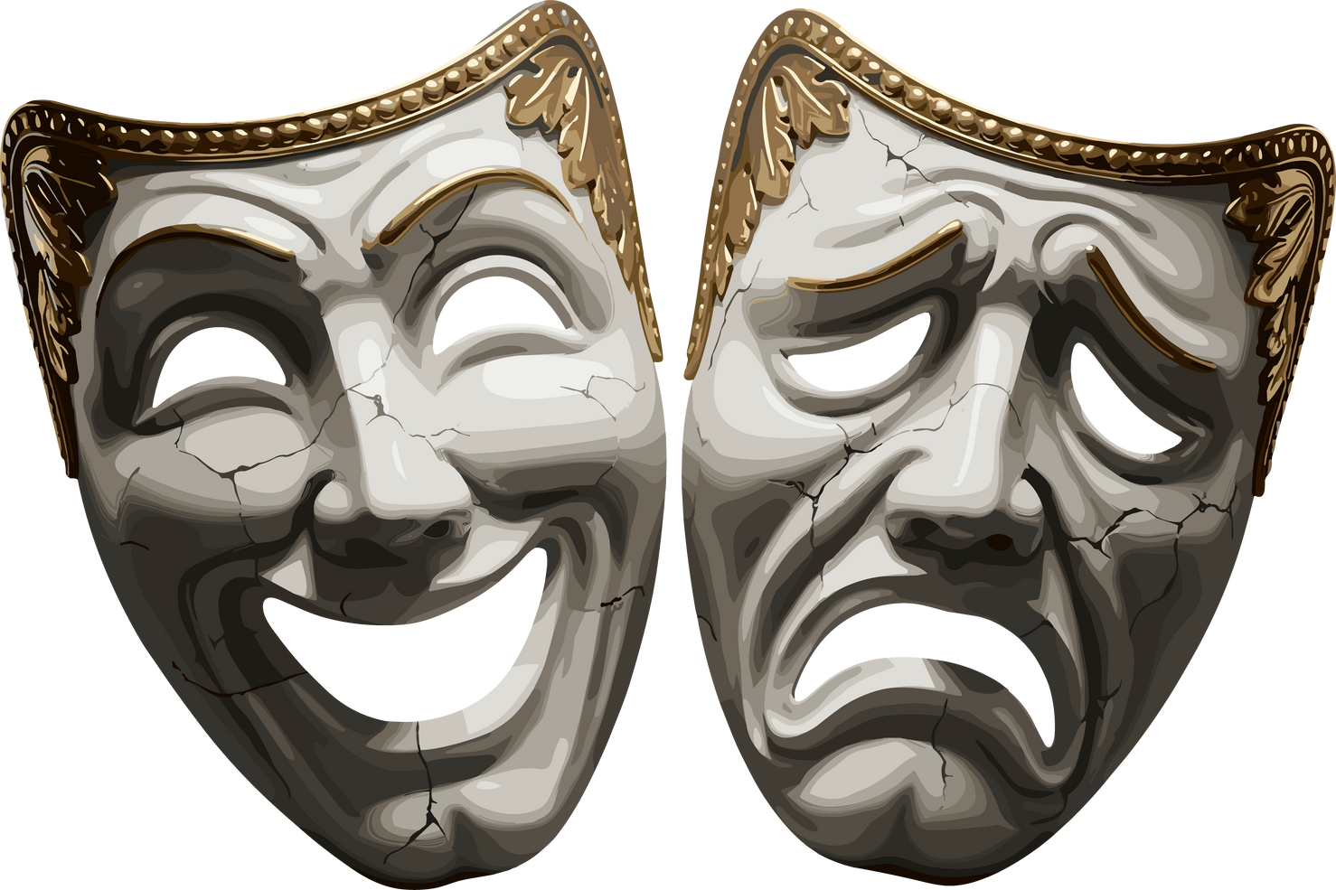


The Theatre of Dionysus :
The Ancient Greek Origins of Theatre

Slide 2
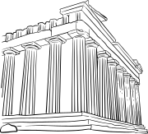
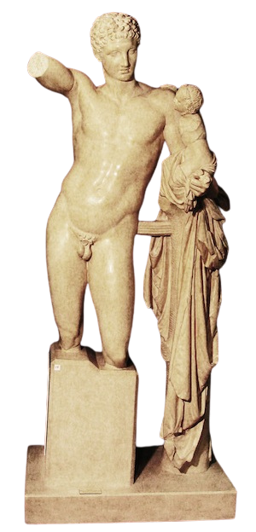

Dionysus
The Greek god of wine, theatre, ritual madness, fertility and ecstasy.
City Dionysia
The City Dionysia was a Greek festival established in the 6th century BCE that celebrated Dionysus.
Hermes with the Infant Dionysus
Classical Greek, Replica.
Museum of Antiquities
Notes:
Dionysus was the Greek god of wine, ritual madness, fertility, ecstasy, and of course, theatre!
Theatre was not simply a form of entertainment in ancient Greece. It also had strong religious, political, and social connotations.
Theatrical performances and competitions were held at the City Dionysia to honour Dionysus as part of religious ritual, so it was important for the community to be involved.

Slide 3
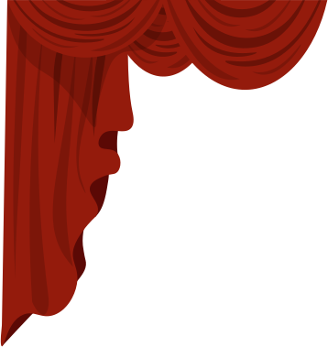
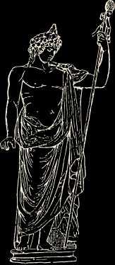
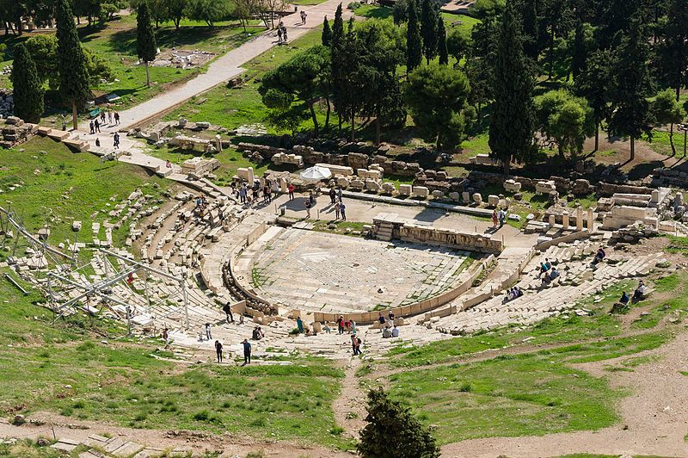
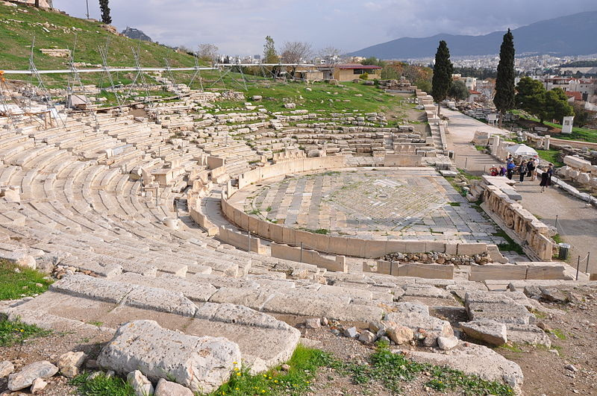
The Theatre of Dionysus
The theatrical performances at the City Dionysia were performed here.
Notes:
This theatre in Athens is considered the first example of a Greek theatre and the birthplace of Greek drama. The theatrical performances at the City Dionysia were performed here.

Slide 4


Who Performed in the
Greek Theatre?
Only three male actors were allowed to perform at a time. Women were not allowed to perform, so men would also play the female roles.
A vital part of Greek theatre was the chorus, who would sing, dance, and act as a unit.
Notes:
Greek plays featured very few actors, and oftentimes each actor would be required to play multiple characters. The different characters would be differentiated through theatre masks, which we will talk about more in a moment.
A large part of the story would be told through the chorus, who would sing, dance, and act throughout the play as a unit. They would often help provide information and context to the audience, and either fight against or help the main characters. In comedies, the chorus would often wear funny costumes, like wasps or birds. In tragedy, the often represented a community or group of people from a single city.
- Only male performers would be in the chorus.

Slide 5

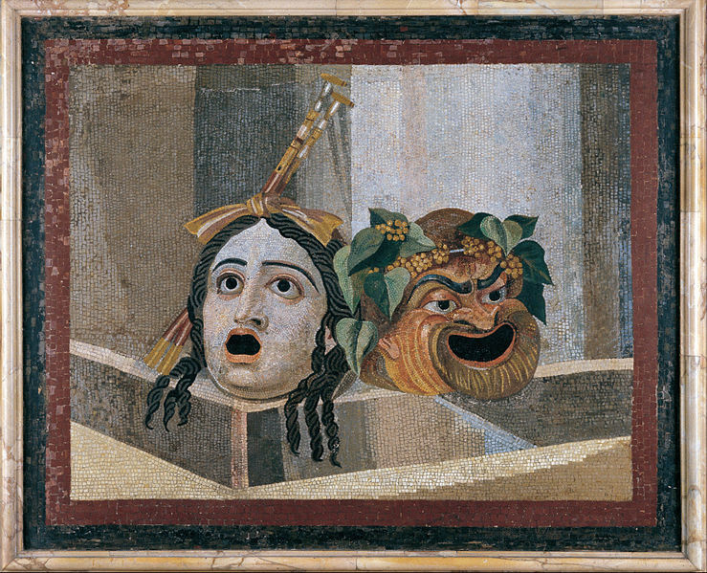
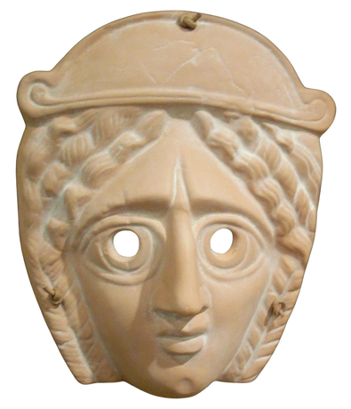
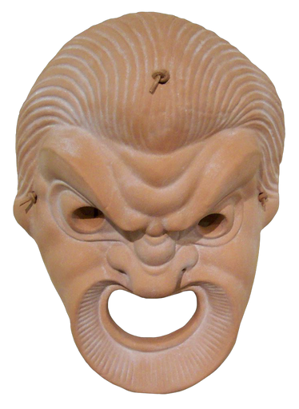
The Masks
Masks were worn so that an actor could play more than one role.
The masks were made of stiffened and painted linen and would sometimes have real animal or human hair on them!
Clay Comic Theatrical Mask
Roman Imperial, Replica.
Museum of Antiquities
Clay Tragic Theatrical Mask
Roman Imperial, Replica.
Museum of Antiquities
Notes:
A maximum of 3 actors were allowed on stage at a given time, meaning that actors often had to play more than one role. The actors would wear different mask throughout the place so the audience could tell who was who. Both comedies and tragedies involved the use of masks. The tragic ask often embodied the melancholy and vulnerability of the character, while the comedy masks were meant to be more absurd.
Theatrical masks were also said to have added resonance to the voice of an actor so that everyone in the theater could hear him.
The masks were made of stiffened and painted linen and would sometimes have real animal or human hair on them!

Slide 6
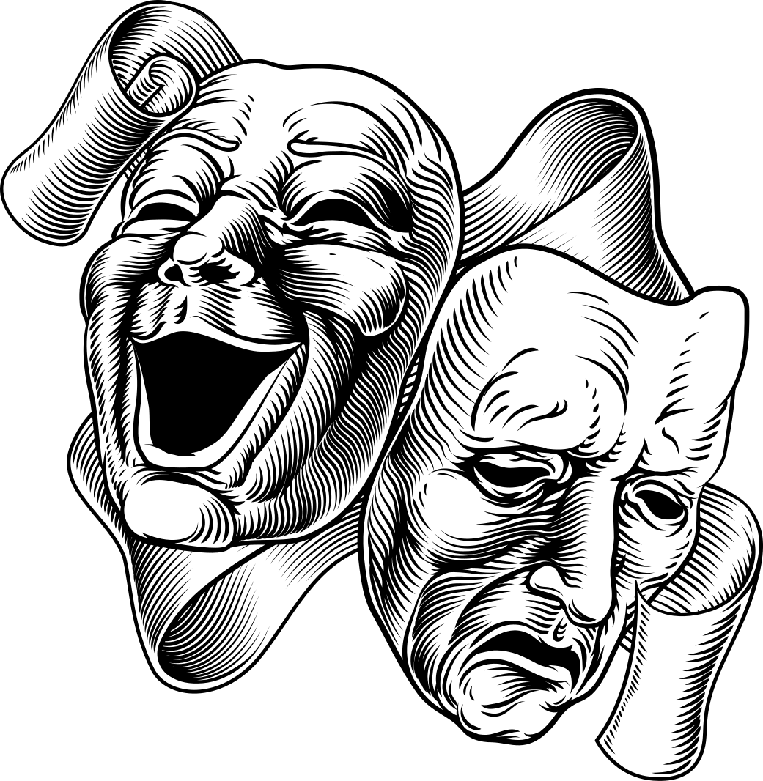

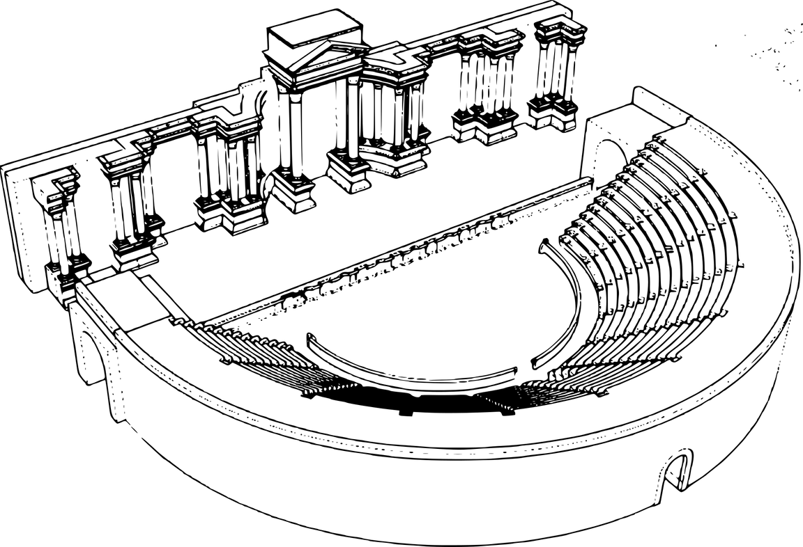


Greek Theatre Vocabulary
Skene
Parodoi
The word 'theatre' comes from the Greek word theatron which translates to "place for seeing."
Orchestra
Parodoi
Cavea
Notes:
Talk about different parts of the theatre
Skene (SKEE-NAY): translates to "tent." In Greek theatre, a tent was located at the back of the stage to hold props and give the actors a place to change. Over time, the tent became a permanent part of all Greek theatres. It even eventually began to be painted to serve as a backdrop for the different plays. Gives us our English word of "scene"!
Parodoi: Translates to "entrance." The Parodoi Served as the two side entrances to the theatre.
Cavea: From the Latin for "enclosure." The cavea is the seating area where the spectators would sit.
Orchestra: The orchestra is a circular area at the base of the theatre where the chorus performed, sang, and danced.

Slide 7
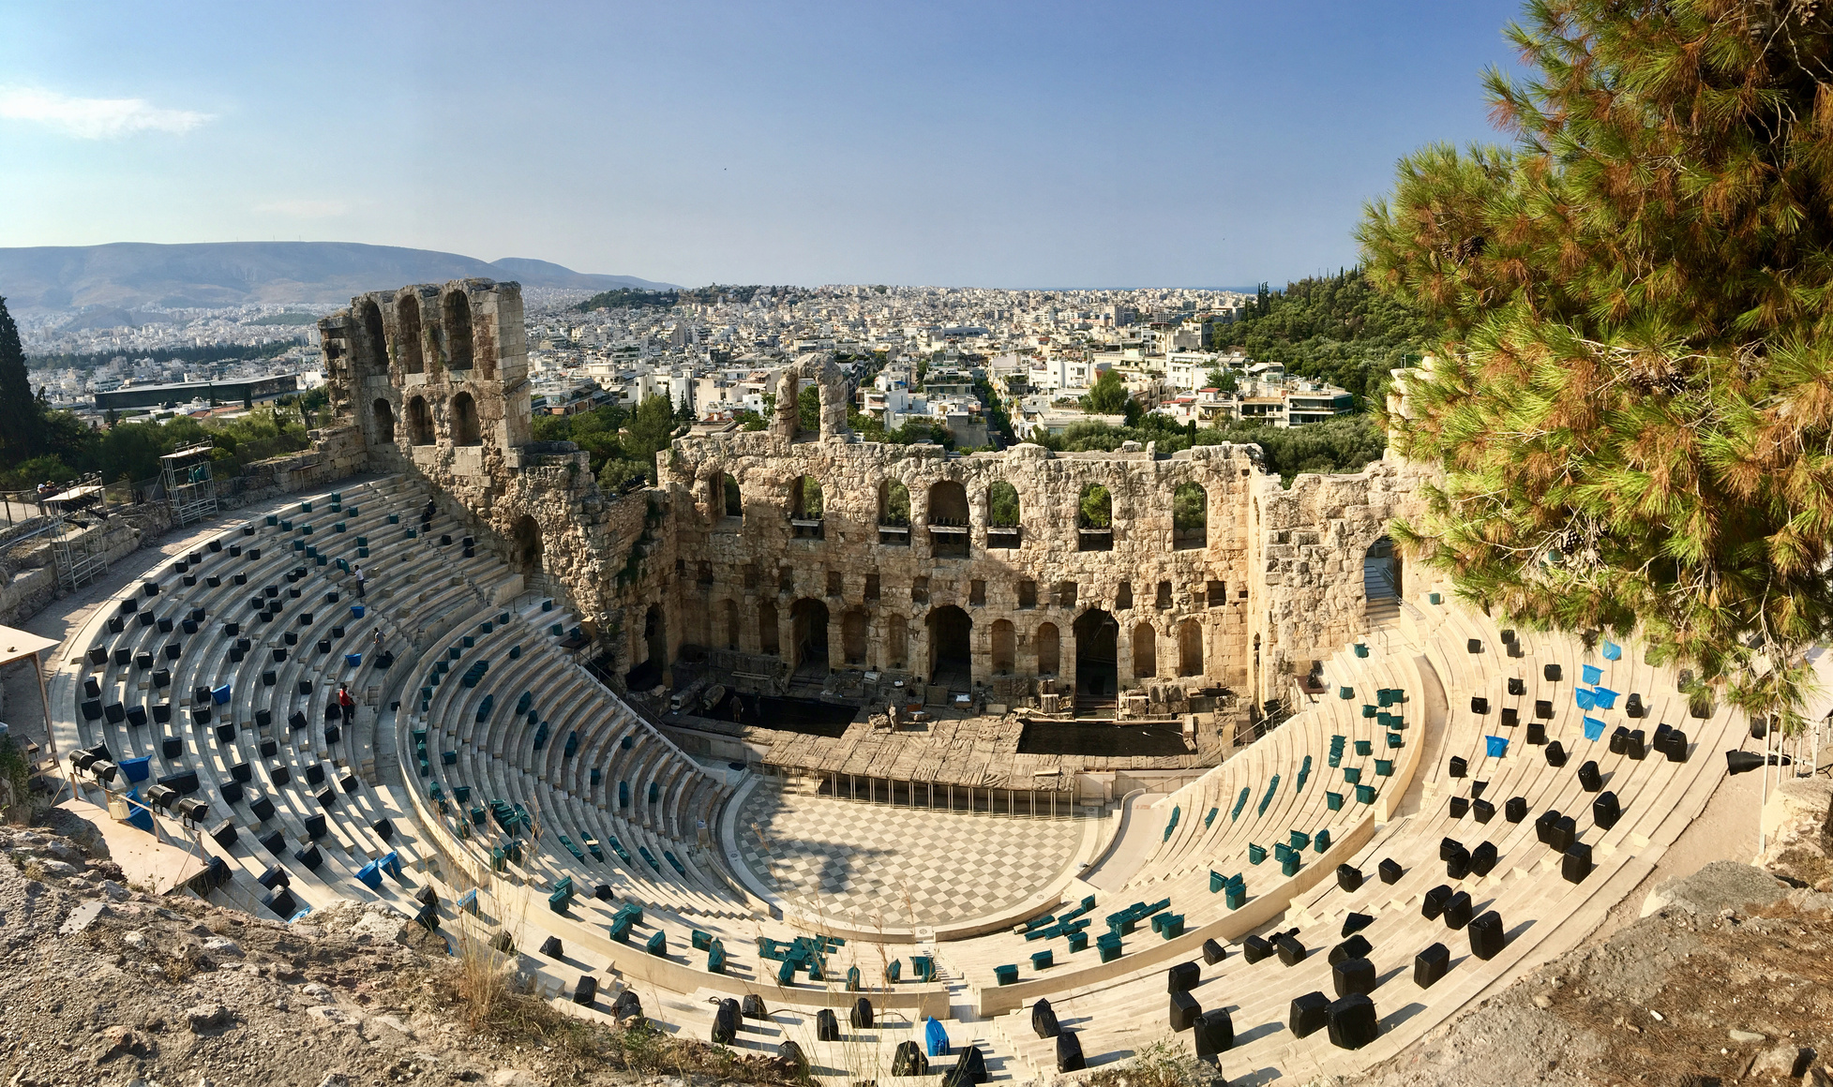
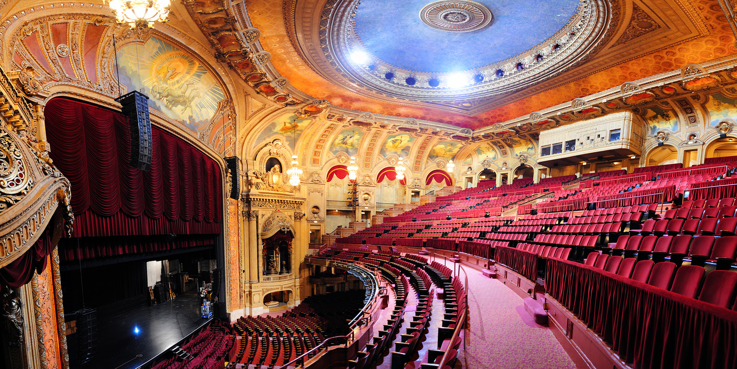
What are some similarities and differences that you can see between
ancient and modern theatres?
Notes:
List similarities and differences
Similarities
- They both have seating angled around the central stage
- They both have a stage and a backdrop (scene)
- both have semicircular seating arranged around the stage
Differences
- Ancient theatres were open air, most modern theatres are covered with a roof
- modern seatings have fancier lighting, sound, systems, etc

Slide 8


Tragedy, Comedy and Satyr : The 3 Genres of Ancient Greek Plays
Tragedy :
Explored themes like death, loss, pride, abuse of power and the relationship between men and the gods.
Comedy :
There were two types of comedy in ancient Greece, Old Comedy and New Comedy.
Satyr :
Satyr plays were performed during tragedies in between acts and featured crude humour.
Notes:
Tragedies were, as the name suggests, tragic. They Explored themes like death, loss, pride, abuse of power and the relationship between men and the gods.
Greek Comedies were funny, just like they are today. There are two types of Greek Comedies - Old Comedy (c. 6th century BCE-4th century BCE) and New Comedy (c. 4th century BCE-3rd century BCE).
Old Comedy was often satirical, meaning it used irony and exaggeration to criticize people and things, often politics and current issues.
New Comedy was more similar in style to modern-day sitcoms (think: Friends, The Office). New Comedy featured more plays about daily-life and everyday shenanigans and featured stock characters like the stern father or young lovers.
Satyr plays were performed during tragedies in between acts. They often made fun of the struggles of the characters in the tragedies and used more crude humour.

Slide 9
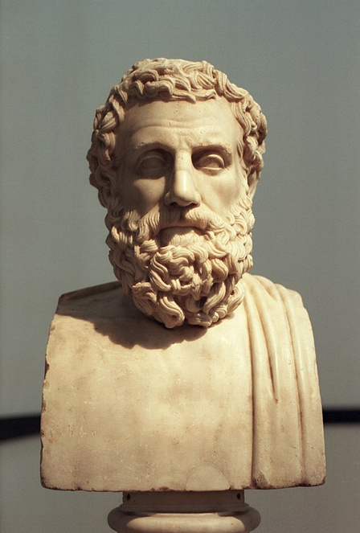
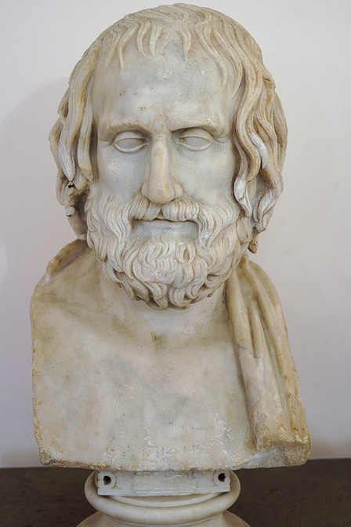
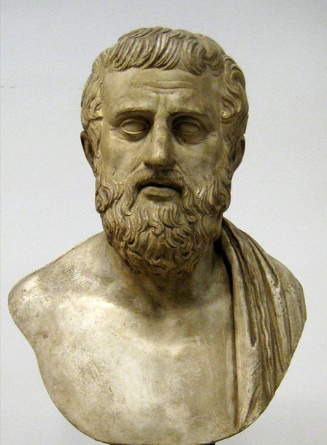
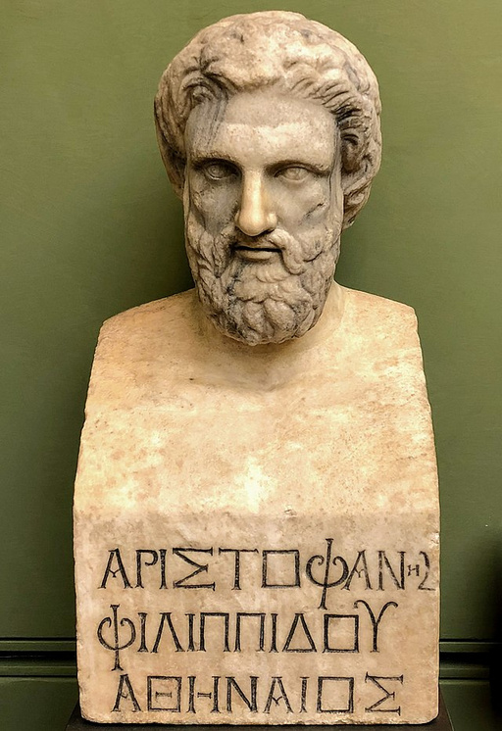
The Playwrights
Aeschylus
Euripides
525/524 -456 BCE
480 - 406 BCE
Sophocles
Aristophanes
497/496 -
406/405 BCE
446 - 386 BCE
Notes:
While there were many different authors writing plays in antiquity, only a handful of plays survive.
Aeschylus, Sophocles, and Euripides are the only 3 ancient Greek tragedians who have works that have survived in full.
Aristophanes, a comic playwright, wrote in total 40 plays, but only 11 survive in full today. He is known as the father of comedy.
All other plays that we know of are incomplete, fragmented or completely lost to history.

Slide 10

Crash Course Video
Notes:
https://youtu.be/VeTeK9kvxyo

Slide 11
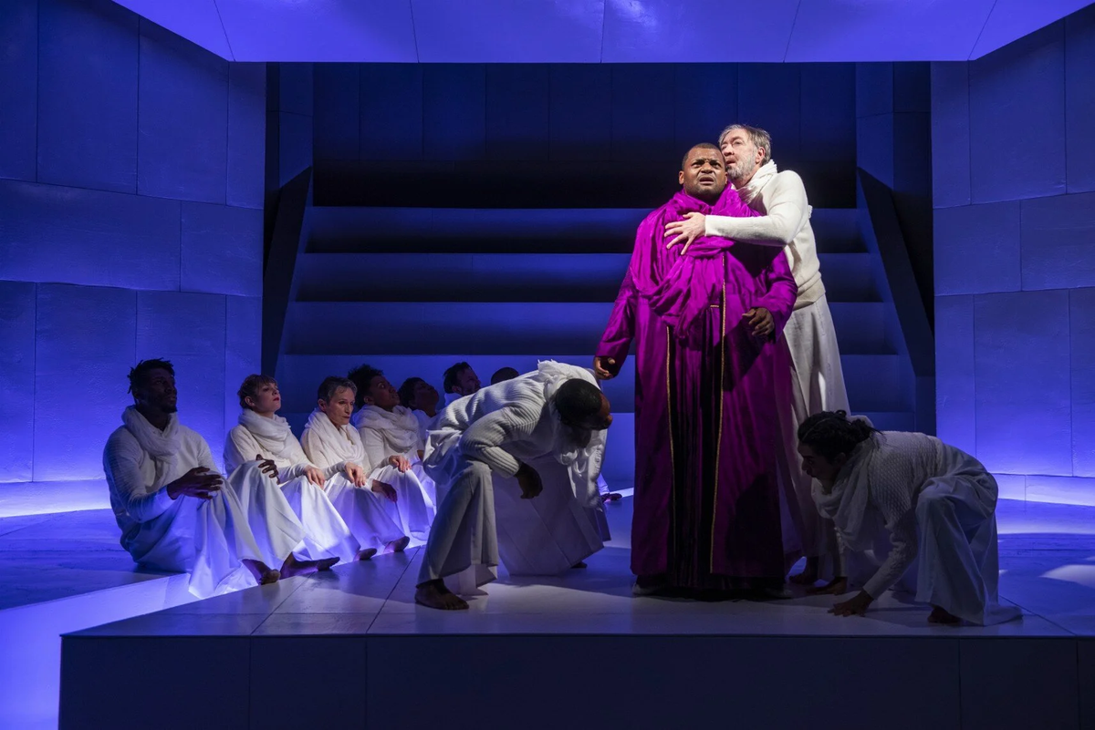
How do you think ancient theatre might have influenced medieval or modern theatre, films, and television?
Oedipus Rex Play from London Theatre
Notes:
**Possible Answers**
- The chorus: similar to what we see in musical theatre today
- ancient Greek theatre had the seating arranged in a semicircular formation around the stage, similar to modern theatres!
- ancient comedy influenced modern day satire, ancient tragedy influenced modern day drama
- In medieval times, it was still only men who could perform on stage. Men would play the parts of both women and men, just like in ancient Greek theatre.

Slide 12
Bibliography
Giordano, Manuela. Out of Athens. Ritual Performances, Spaces, and the Emergence of
Tragedy. Berlin and Boston, 2014. 151-177
https://www.academia.edu/30606057/_Out_of_Athens_Ritual_Performances_Spaces_and_the_Emergence_of_Tragedy_in_G_Colesanti_M_Giordano_Submerged_Literature_in_Ancient_Greek_Culture_An_Introduction_Berlin_and_Boston_2014_151_177?email_work_card=view-paper
? Kassem, Asmaa. The Origins of Theatre in Ancient Greece and Beyond. Cambridge
University Press, 2007.
https://www.academia.edu/50756550/The_Origins_of_Theater_in_Ancient_Greece_and_Beyond?email_work_card=view-paper
Meineck, Peter. “The Embodied Space: Performance and Visual Cognition at the
Fifth Century Athenian Theatre.” New England Classical Journal. 39.1
(2012) 3-46. https://www.academia.edu/1490388/The_embodied_space_performance_and_visual_cognition_at_the_Theatre_of_Dionysos?email_work_card=view-paper
Papastamani-von Moock, Christina. “The Theatre of Dionysus as a Landmark for the Birth
of Theatre.” European Heritage Label. (2018) 1-5. https://www.academia.edu/40734564/The_Theatre_of_Dionysus_as_a_landmark_site_for_the_birth_of_theatre?email_work_card=view-paper
Vozani, Ariadni. The Architectural Correspondence of Space and Speech in Tragedy.
2003.
https://www.academia.edu/39389977/THE_ARCHITECTURAL_CORRESPONDENCE_OF_SPACE_AND_SPEECH_IN_TRAGEDY?email_work_card=view-paper
Wallace Pickard, Arthur. The Theatre of Dionysus in Athens. Oxford Clarendon Press. 1946.
https://www.academia.edu/44326516/The_Theatre_of_Dionysus_in_Athens_by_Arthur_Wallace_Pickard_Cambridge_1946_?email_work_card=view-paper

Slide 13
Image Sources
“Bacchus by Caravaggio” https://upload.wikimedia.org/wikipedia/commons/0/02/Bacchus_by_Caravaggio_1.jpg
“Dionysus Theater” https://upload.wikimedia.org/wikipedia/commons/2/2e/DionysiusTheater.jpg
“Theatre of Dionysus” By Farai Gandiya https://upload.wikimedia.org/wikipedia/commons/7/7a/Theatre_of_Dionysus_Panorama.jpg
“Ancient Times, Greek - Costumes of All Nations” https://upload.wikimedia.org/wikipedia/commons/7/70/Ancient_Times%2C_Greek._-_009_-_Costumes_of_All_Nations_%281882%29.JPG
“Ancient Greek Terracotta Mask” By Dorieo https://upload.wikimedia.org/wikipedia/commons/4/4f/Ancient_Greek_terracotta_mask_-_AGMA.jpg
“Dionysos mask Louvre” By Marie-Lan Nguyen https://upload.wikimedia.org/wikipedia/commons/4/44/Dionysos_mask_Louvre_Myr347.jpg
“Sophocles pushkin” By Shakko https://upload.wikimedia.org/wikipedia/commons/1/19/Sophocles_pushkin.jpg
“Euripide” https://upload.wikimedia.org/wikipedia/commons/6/67/Euripide.jpg
“Herma of Aeschylus” https://upload.wikimedia.org/wikipedia/commons/b/ba/Herma_of_Aeschylus%2C_Klas08.jpg
“Bust of Aristophanes” By Alexander Mayatsky https://upload.wikimedia.org/wikipedia/commons/0/08/Bust_of_Aristophanes.jpg
“Doppelseitiges Maskenrelief” By A, Ocram
https://upload.wikimedia.org/wikipedia/commons/0/0f/Doppelseitiges_Maskenrelief.JPG
“Masks Pushkin” By Shakko
https://upload.wikimedia.org/wikipedia/commons/0/09/Masks_pushkin.jpg
“Mosaic of the theatrical masks” https://upload.wikimedia.org/wikipedia/commons/3/3c/Mosaic_of_the_theatrical_masks_-_Google_Art_Project.jpg
“Sousse mosaic theatre masks” By Ad Meskens
https://upload.wikimedia.org/wikipedia/commons/6/66/Sousse_mosaic_theatre_masks.JPG
“Ancient Greece Terracotta Theater Figures” By Gary Todd
https://upload.wikimedia.org/wikipedia/commons/6/62/Ancient_Greece_Terracotta_Theater_Figures_%2828123059103%29.jpg
“Mousai Helikon Staatliche Antikensammlungen Schoen” https://upload.wikimedia.org/wikipedia/commons/6/63/Mousai_Helikon_Staatliche_Antikensammlungen_Schoen80_n1.jpg
“Aulos player Met” By Brygos Painter https://upload.wikimedia.org/wikipedia/commons/e/e4/Aulos_player_Met_24.97.28.jpg
Oedipus Rex Play from London Theatre https://images.squarespace-cdn.com/content/v1/56bfaee52b8dde7190c18cf1/1574700622254-6U7XUIWO83DU5L6ZOLX5/Gallery+1.jpg

