Slide 1
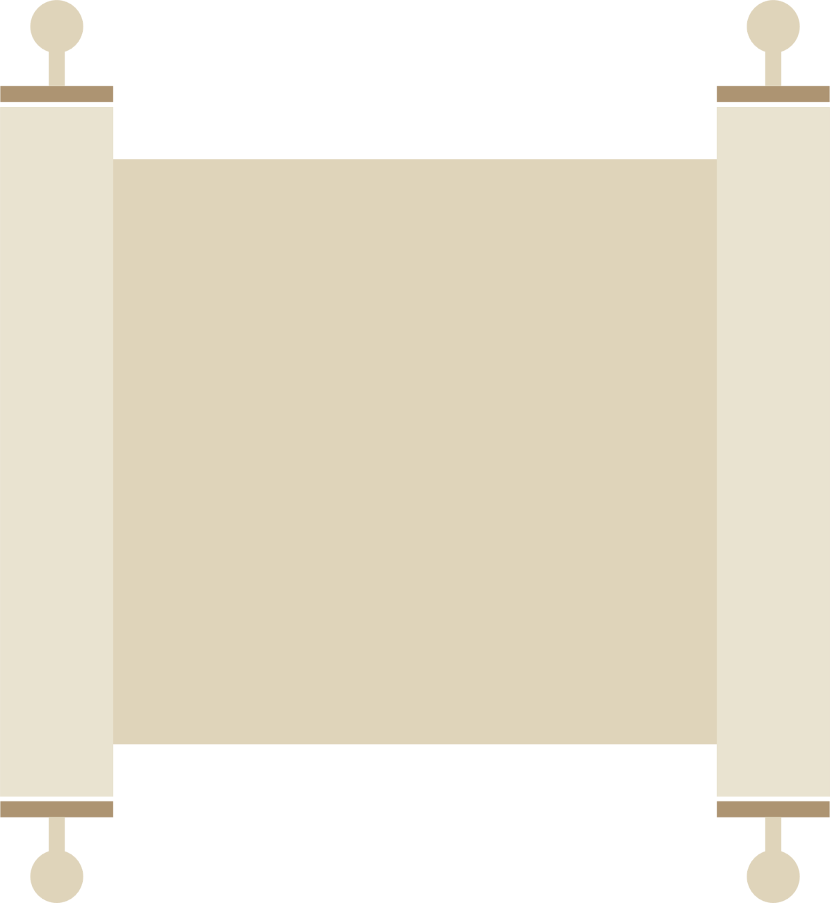
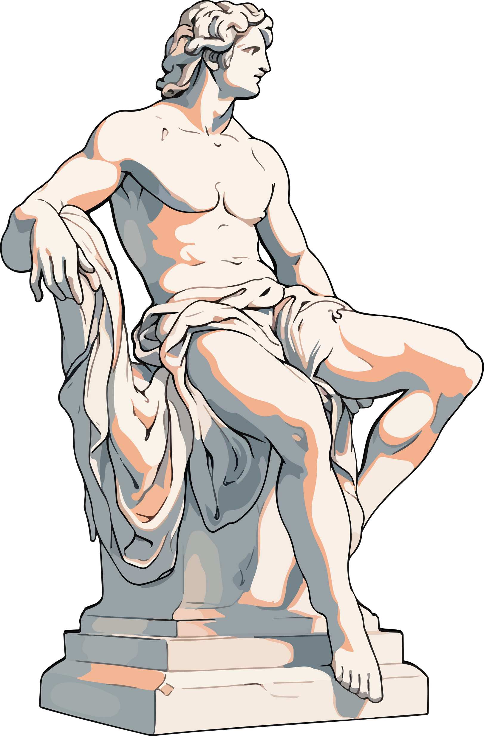
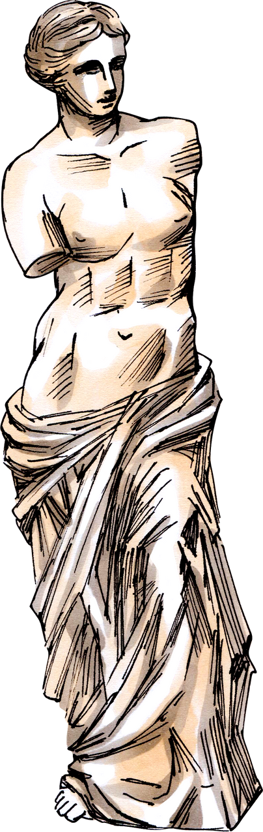
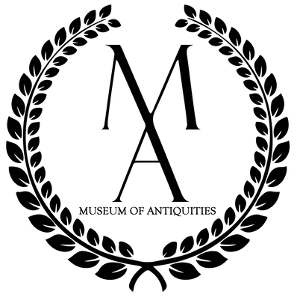

Ancient Greek Sculpture:
An exploration of art, anatomy, and more!
Notes:
Hi everyone! Thank you for coming. Today we will be talking about anatomy and bodies in ancient art. For right now, I'm going to give you a quick rundown about what you're going to see when you get into the museum and tell you a little bit about what the ancients would have known about the bodies you're going to see soon.

Slide 2
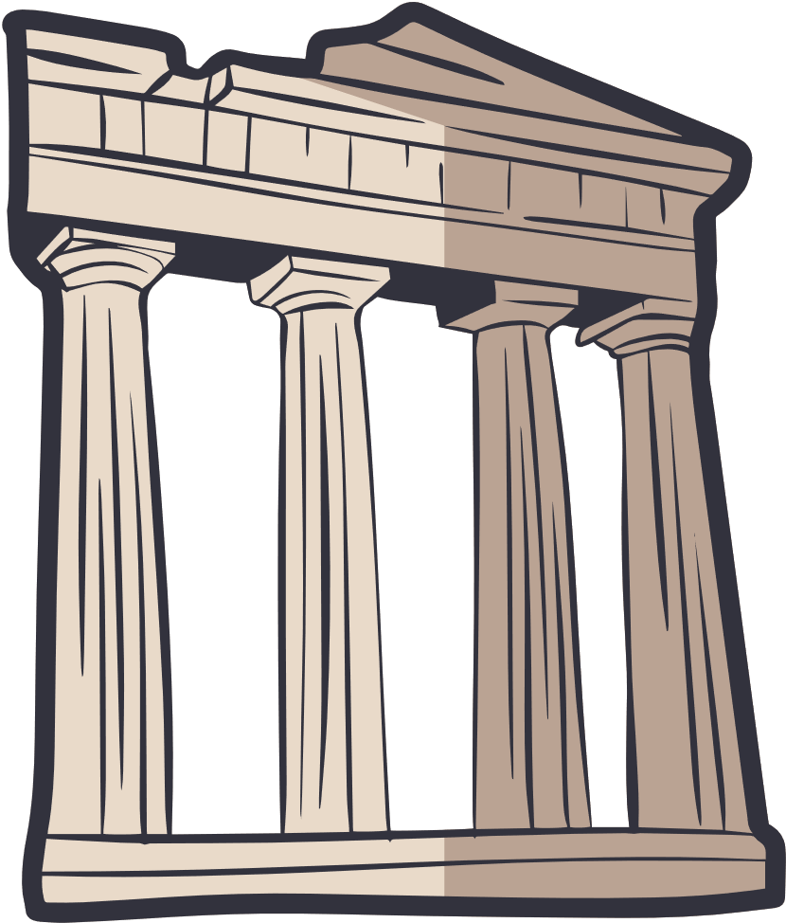
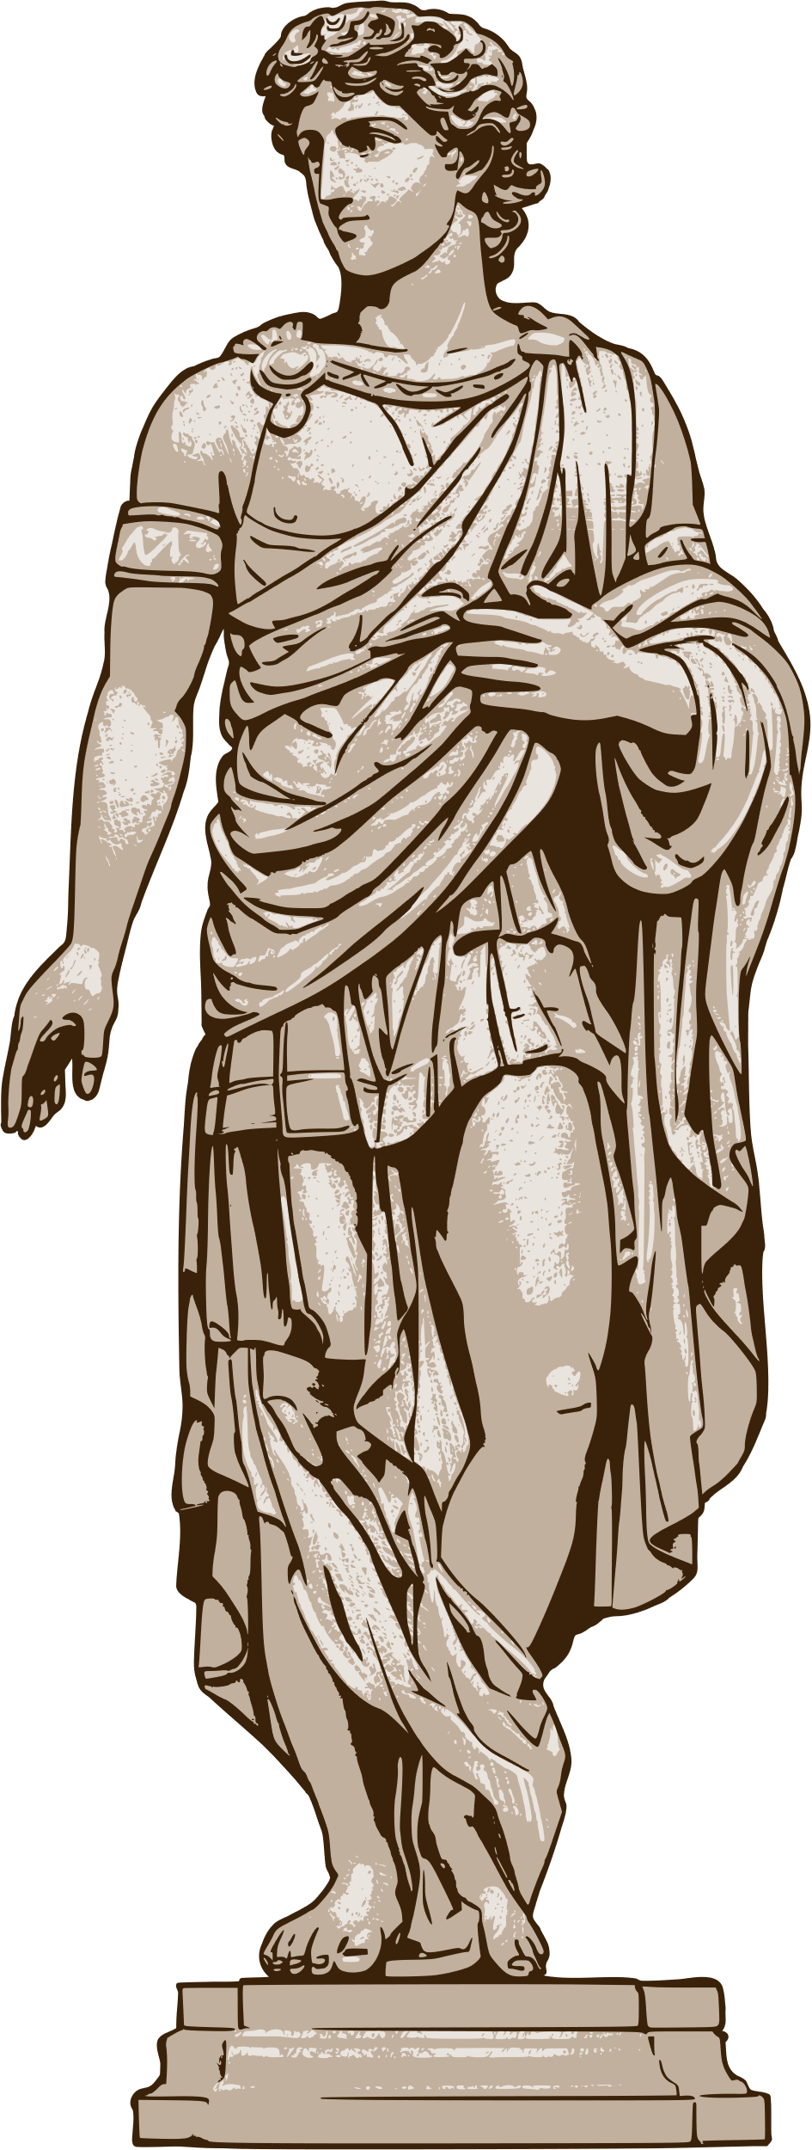
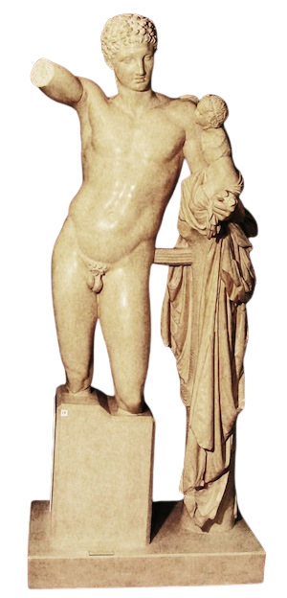
Nudity
The Elephant in the Room
Hermes and the Infant Dionysus
Mid-4th c. BCE
Nudity was common in Ancient Greece, but how common? When was it allowed? And for whom was it allowed?
Nudity was different for men and women, lets take a look at why and how.
Notes:
When you get into the museum, one thing you're going to notice right away is that there is a lot of nudity. Nudity in ancient art is very very common, especially in Ancient Greek art which is where a lot of pieces in our collection are from originally. While people in Ancient Greece would not necessarily have been roaming the streets unclothed, nudity was viewed as the natural human form. There were cultural boundaries just like today that established when nudity was appropriate, but nudity was much less sexualized in Ancient Greece than it is today. It was also very different for men and for women, let's take a look why at how.

Slide 3
Male Nudity: A Reflection of Athleticism
To the Ancient Greeks, the human body was perfect, made in the image of the gods.
Sculptors used great athletes as models to best represent the gods.
Notes:
In Greek Mythology, the Gods looked like humans and thus the human body was in the image of the gods. Naturally, when sculptors wanted to portray the gods, they had plenty of models all around them. As the gods were the perfect version of humans, sculptors chose men with ideal physiques to represent the ideal version of humans - the gods. Many male nude statues actually show off the physiques of Greece's finest athletes as a tribute to the perfection of the gods. It was also common for men to be nude during their military training and exercise so nudity was a reflection of their athleticism, lifestyle and religious devotion.

Slide 4
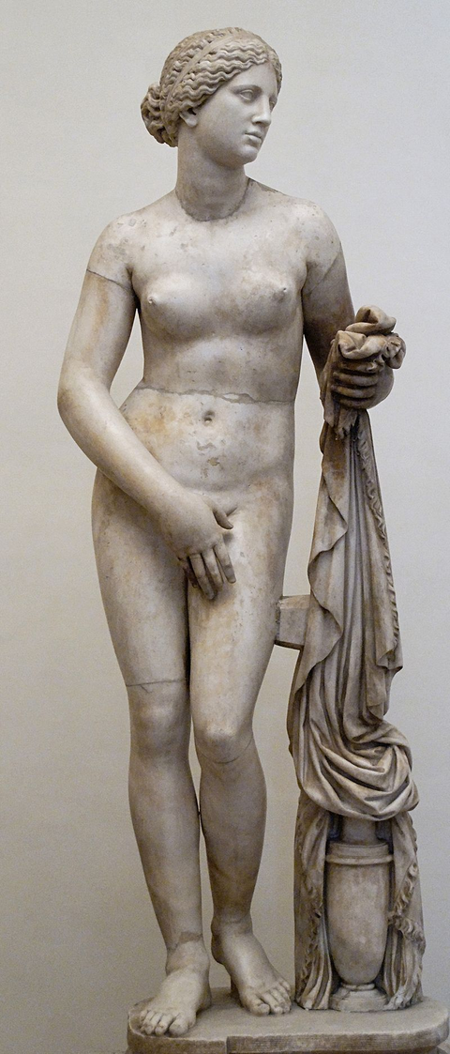
Female Nudity
Unlike male nudity, female nudity was not often seen in art until the Classical and Hellenistic periods.
The first female nude was Aphrodite of Cnidos, by Praxiteles, and Aphrodite was the only goddess to be shown nude.
Aphrodite of Cnidos
c. 364 BCE
There are many myths where men face untimely ends after seeing a goddess naked, which is part of the reason they're usually covered up.
Notes:
Unlike male nudity, female nudity was not as common. The female nude only became a large part of Greek sculpture in the Classical and Hellenistic periods. The first female nude was in the classical period, Aphrodite of Cnidos by Praxiteles, she is the lady on our slide. You'll get to see her when you get into the museum. By creating her, Praxiteles set the standard for what female nude sculptures should look like and even then - Aphrodite was the only goddess who was ever portrayed fully nude. Why? Well, there are many mythological stories about men happening upon Goddesses bathing and in those stories, the men don't exactly live for very long after this. Women, even in ancient times, were expected to be modest whereas men were nude even in public areas like the gymnasium. When you get into the museum, take a look at how nudity is shown in the sculptures of Aphrodite, notice ways it is different from the male statues and think about why this might be.

Slide 5
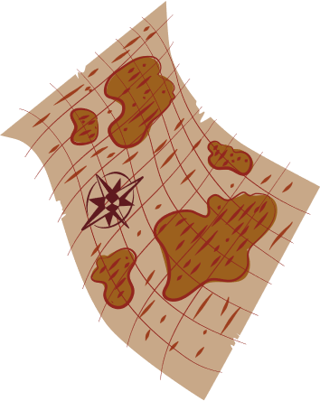

Ancient Science
What did the Ancients know about human anatomy?
All over the world and since the beginning of time, people have tried to improve the quality of human life by treating diseases and injuries.
Ancient Greece was home to some of the most well-known philosophers, scientists, physicians and anatomists, who made great strides in their fields.
Notes:
The Ancients knew a great deal about human anatomy. Across cultures, there is clear evidence that all civilizations sought to understand the human condition and improve quality of life by treating diseases and injuries. Ancient Greece, the home of some of the finest surviving human sculptures, was home to some of the most well-known and accomplished scientists, philosophers, physicians and anatomists. Lets take a look at a few very important scientists whose accomplishments have outlived them.

Slide 6

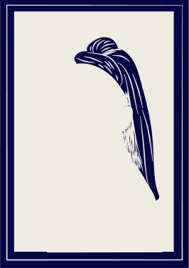

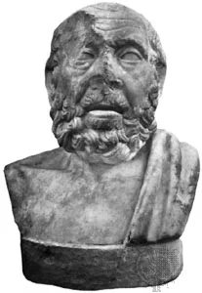
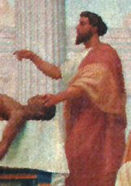
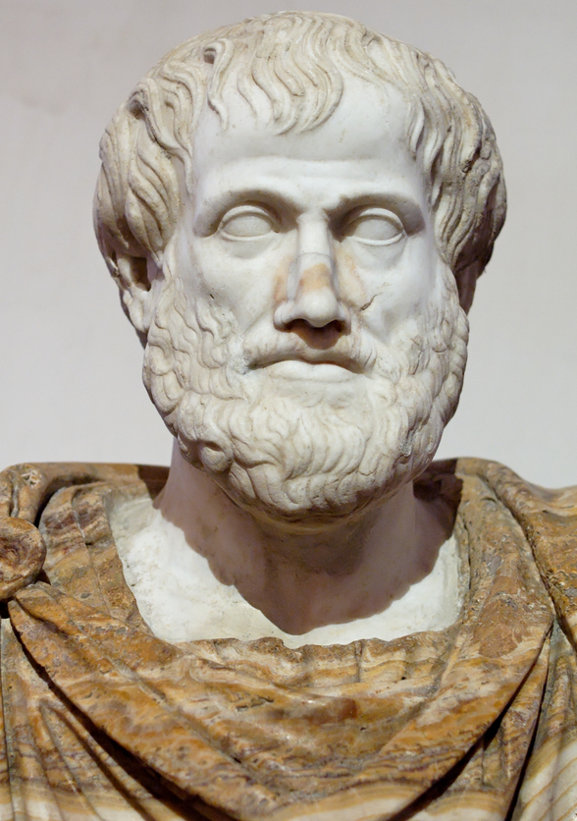
Famous Physicians
Aristotle
384-322 BCE
Hippocrates
460-370 BCE
Herophilus
late 4th-early 3rd c. BCE
Philosopher
Physician
Anatomist
The Father of Many Things (including biology!)
The Father of Medicine
The Father of Anatomy
Notes:
I'm sure a lot of you have heard of Aristotle. Aristotle, who was best known for his career as a famous philosopher, lived from 384 - 322 BCE. He lived in Athens for most of his life, eventually leaving to tutor Alexander the Great.
While not a physician by trade, Aristotle's work was foundational to scientific study both in his lifetime and centuries later in the Middle Ages and the Renaissance. He came up with what's called the preformation theory, where he believed that from the very beginning stages of life, humans grew from a microscopic human, complete with arms, legs, fingers and toes. While he was proven wrong many hundreds of years later, he has been called by many the father of biology for that theory and his attempts to classify plant and animal species.
Hippocrates, the gentleman in the middle here, lived from 460-370 in Athens and founded the Hippocratic School of Medicine, establishing medicine as a practice and an academic discipline. He and his students were among the first to describe and categorize many diseases. His style of clinical observation and rigorous precision influence the way we practice medicine today. He is also the name-sake of the Hippocratic oath, an oath taken by all new doctors as they begin their careers.
Finally, this is Herophilus in the long robe. He was one of the great Greek physicians who lives from the late 4th, early 3rd century BCE (we aren't exactly sure when he lived). Born in Chalcedon, he spent most of his life in Alexandria, Egypt. He studied under another great physician named Praxagoras who taught at the Hippocratean medical school, the school Hippocrates founded. Herophilus completed the first scientific human cadaveric dissections with the help of his contemporary, Erasistratus, who is the on the left in this picture here. Very soon after, human dissection was forbidden and not allowed again until around 1530 CE in the Renaissance, so Herophilus' work became very important to understanding the human body.

Slide 7
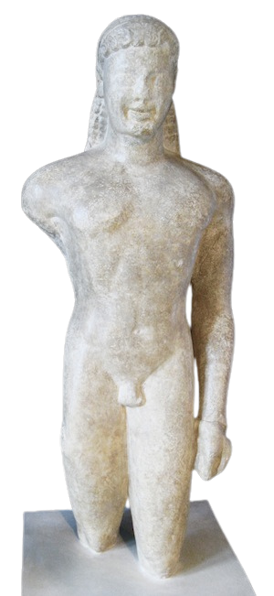
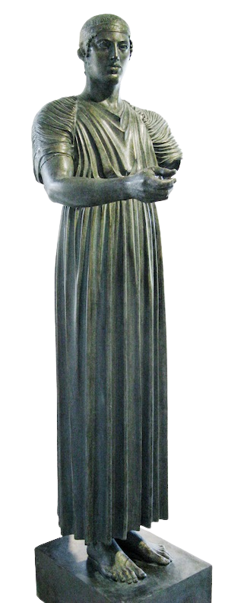
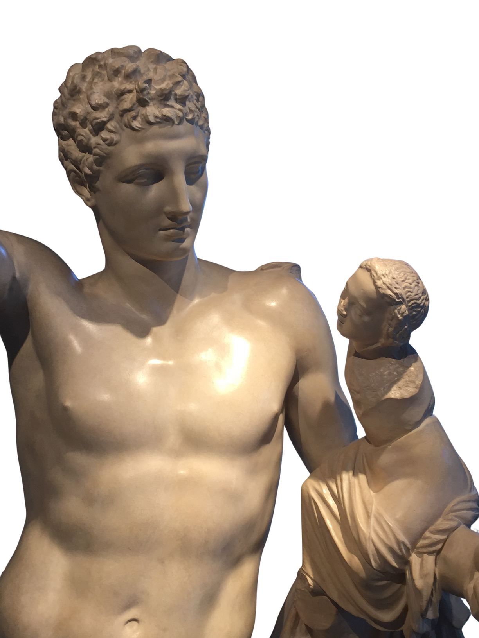
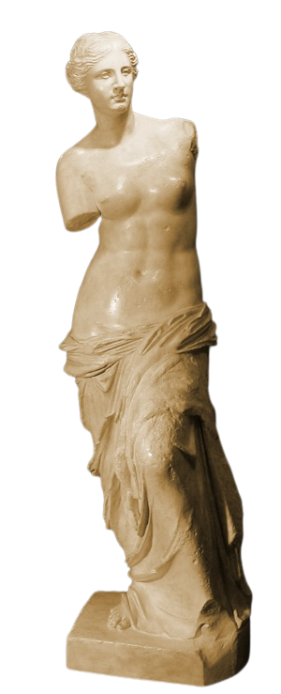
Timeline
750-480 BCE: Archaic Greek
480-450 BCE: Transitional Greek
450-323 BCE: Classical
Art
323-100 BCE: Hellenistic Art
Kouros of Paros
mid 6th c. BCE
The Charioteer of Delphi
c.474 BCE
Hermes and the Infant Dionysus
Mid-4th c. BCE
Venus de Milo
150-125 BCE
Notes:
Before we jump in to any more art, let's take a look at the time periods we will be looking at. First, we'll take a look at the Archaic period, from 750-480 BCE. Then, we'll look at the Transitional period from 450-323 BCE. After that, we get into the periods you probably all think of when we talk about Greek statues, the Classical period from 450-323 BCE and the Hellenistic period from 323-100 BCE. We'll talk about some key features from each period so that when you get into the museum, you know exactly what to expect.

Slide 8
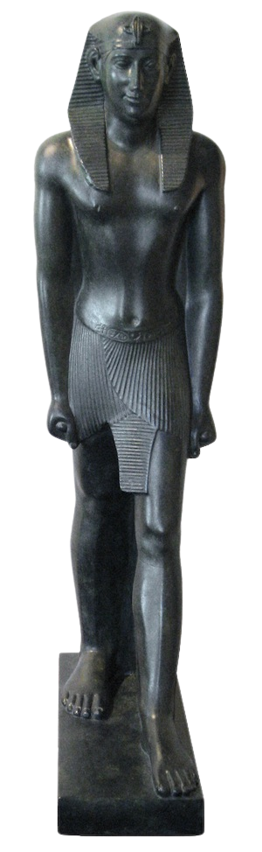

Archaic Greek
750-480 BCE
Figures began to look more realistic and less two-dimensional.
The 'power stance': one foot forward, fist clenched, body stiff.
This demonstrates a connection to Near-Eastern or Egyptian Art.
Pharoah Psammeticus II
595-589 BCE
Kouros of Paros
mid 6th c. BCE
Notes:
The first main period in Greek sculpture is the Archaic period. Art was produced in this style from 750-480 BCE, about twenty five hundred years ago. This is when Greek artists first began to make statues that looked more realistic than they had in the past, however they couldn’t quite shake the influential and less life-like artistic styles of the Near East. When I say the Near East, I'm talking about regions like Assyria and Mesopotamia, civilizations that existed in modern day Iraq or Iran. Does this sound familiar? (react) Why did these statues have Near-Eastern influence? Basically, Greece came into contact with many Near-Eastern civilizations through war, trade and colonization, especially in the 7th and 8th centuries. Now, the statue I have here on the left is the Kouros of Paros, you'll get to see him in the museum. Kouros is Greek for a young boy, and this one would have probably been noble. There are a couple of defining characteristics of the Archaic period on display in these pieces. First, take a look at the way that the Kouros is standing. He’s got his left foot forward, fist clenched, and his posture is stiff. This is known as a “power stance” and was very common in Ancient Mesopotamian artwork and is how pharaohs are often standing in Egyptian art just like the statue on the right of Pharoah Psammeticus II.

Slide 9
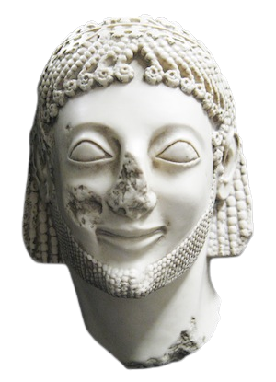

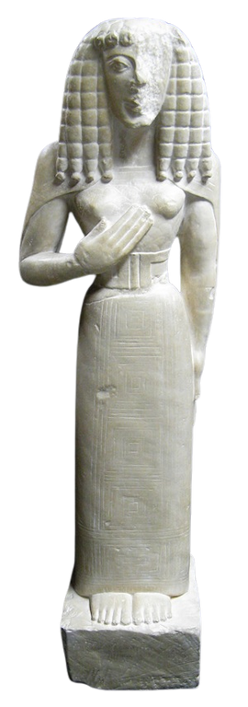
Rampin Head
(c.560-520 BCE):
- Archaic smile
- Hair and beard perhaps of Mesopotamian influence
Archaic Features
The Archaic Smile
Stiff Posture and Hair
Almond Shaped Eyes
The Lady of Auxerre
(c. 650-625 BCE):
- Rigid stance including arms
- Right arm raised - notice the size of her hand
- Wig-like hair
Notes:
There are some other features of Archaic statues that are very noticeable and distinct. Take a look at the mouth of the statue here, the Rampin Head, and you’ll see what’s known as the “archaic smile.” This means that the lips are in a straight line across with just the corners curving upwards. Go ahead and try smiling like this at home. It’s physically impossible to smile like this! The hair on Archaic statues also typically doesn’t look very realistic and almost looks like a stiff wig with tight knots and braids instead of real hair. Archaic figures generally have these same almond-shaped eyes as well. If you look at the Lady of Auxerre on the right, you'll notice she has a similar still posture, wig-like hair and almond-shaped eyes. Notice on her, the proportions of her hands and feet, they are not terribly realistic either, but attention is really drawn to her hands, perhaps showing that the sculptor favoured that effect over realism.

Slide 10
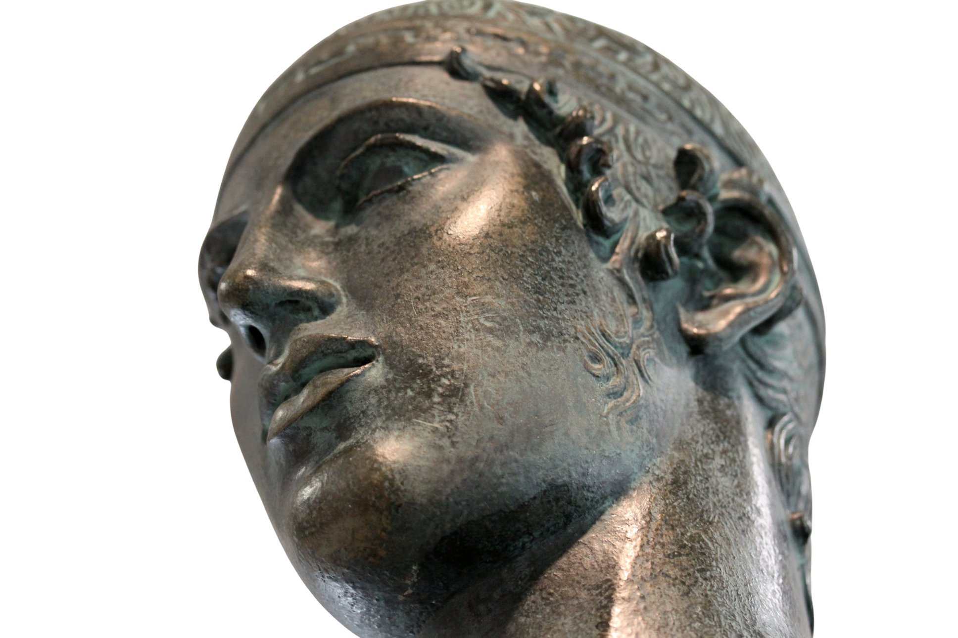
Transitional Greek
The Charioteer of Delphi
c.474 BCE
480-450 BCE
Figures are beginning to look a little more realistic than they had in the past.
There is some more movement here, a clear attempt at making things more lifelike, but they're still pretty rigid.
Notes:
As we move into the next period of ancient Greek Art, called the Transitional Period, you can see that the artists skills were beginning evolve a little bit or become more sophisticated. In this period, which lasted from about 480-450 BCE, we can see them starting to create more movement and more realistic features in the statues. Some ancient sculptures were of athletes or other notable humans rather than of gods. This piece is called the Charioteer of Delphi and is from the Transitional period. He was obviously, a charioteer, who was competing in a chariot race to honor the god Apollo at Delphi, his sanctuary which is where this man was found (hence his name being the Charioteer of Delphi). You can see some remnants of the Archaic period in this statue, he still has that rigid posture and those almond-shaped eyes. However, we see a bit more movement in this statue than we see in the Archaic period pieces, particularly in his hand extending outward to hold on to what would have been the reigns of his chariot. There is also more attention given to detail overall, such as the curls in his hair, at the way his chiton, or robes, look to be naturally draped, and the attention to detail paid in sculpting the Charioteer’s feet. Although it might not seem very important now, the feet of this Charioteer were particularly admired in the ancient world.

Slide 11
Classical Greek
450-323 BCE
Hermes and the Infant Dionysus
Mid-4th c. BCE
Notes:
And that leads us into the third phase of Ancient Greek Art. This is called the Classical Period, which lasted from 450-323 BCE, and is referred to as the height of Greek art. Statues in this period looked more beautiful, natural and lifelike than ever before. This alive-ness is partially due to the fact that sculptors were experimenting with different poses for statues. Rather than have statues stand straight and tall, they began carving statues standing in the contrapposto pose.

Slide 12
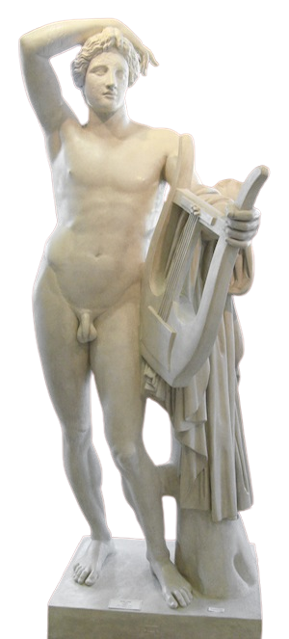
Lean on Me
The random cloths and trees and not accidental! Marble statues don't have real muscles and will fall over if they lean over without extra help.
This figure is standing contrapposto, leaning on this cloth, so that the sculpture would not have to sacrifice his posture.
Apollo Lykeios
c.370-360 BCE
Notes:
A little bit more about the contrapposto stance. Contrapposto means that the statues looked like they were leaning on one leg when they were standing, which is the natural standing position of most people. With these figures in a most natural position, artists also started adding supports like trees and draped clothing to statues, so that the figures could appear to be moving in interesting ways without falling over. Remember that when you lean over, your body has muscles to support you and keep you from falling down, but stone is heavy and sculptures would fall over without those seemingly random pieces of trees or cloth carved onto them. This sculpture, Apollo Lykeios, leans over, so that his sculptor is able to have him in such an interesting and more natural position.

Slide 13
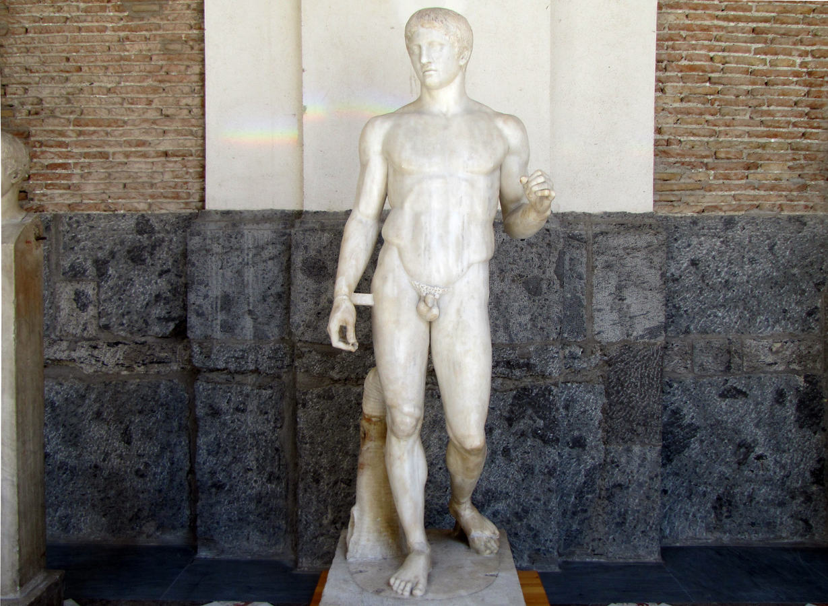
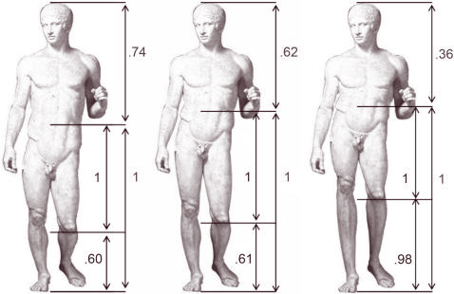
The Gold Standard of Beauty
DORYPHOROS OF POLYKLEITOS
C.440 BCE
Notes:
When we're talking about Classical art, sculptors wanted to capture human perfection so as to best exemplify the divine image of gods and great heroes. There are two particular sculptures that set the bar for human perfection. The figure on the left is Doryphoros of Polykleitos, the spear-bearer. He is thought by some scholars to have been a representation of the hero Achilles from Homer's Iliad. The sculptor who created him, Polykleitos, established a canon for human beauty, using Doryphoros to relate perfection to ratios and mathematics that sculptors should follow to create their masterpieces. If we look at this image on the right here, it is a recreation of the sorts of ratios Polykleitos was working with. In the middle, is Doryphoros, the way Polykleitos designed him, along with specific ratios for each aspect of the body. Polykleitos used math to establish standards of what he thought other artists should use to create the perfect sculpture.

Slide 14


Divine Subjects
It was natural to portray gods and heroes without clothing, it was a testament to Greek culture.
Athletes were models, used by sculptors to represent the ideal human and the image of the gods.
Faces of sculptures are more androgynous and attributes can help you determine the identity of the sculpture.
Notes:
In ancient Greece through the end of the Classical period, most of the sculptures produced were of gods, goddesses, or religious or mythological scenes. It was natural to portray these figures nude as it was a testament to Greek Culture. The Ancient Greeks were frequently at war and valued physical fitness, athleticism and militarism. Not only were athletic activities often done nude, but the body was a demonstration of their power. What was valued even higher than their military prowess was their religious devotion. Athletes were used as models to show the ideal human form and in their athleticism, honored the gods. When you get into the museum, take a look at some of these sculptures and think about whether they're truly realistic or if classical sculptors took some liberties in order to honour the gods. Another feature of classical sculpture is that the faces of many figures are androgynous, or don’t look specifically male or female. Thankfully, usually, a statue is found with certain attributes that can help solve the puzzle of the statue's identity. Attributes are items associated with characters from mythology. For example, a lyre, or a small harp, indicates that a statue is of Apollo, the god of poetry and music, or an apple and mirror are generally shown with Aphrodite, the goddess of love and beauty.

Slide 15
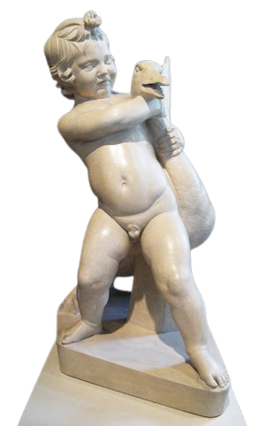
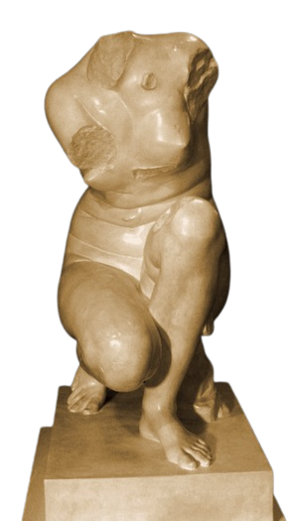
Hellenistic Greek
323-100 BCE
During the Hellenistic period...
Art was hyper realistic in pose and anatomy and there was a lot of movement in sculptures.
Wealthy people in Greece wanted to fill their homes with art, so gods were not always the subjects, regular people were subjects too!
Child and Goose
Middle 2nd century BCE
Crouching Aphrodite
Middle 3rd century BCE
Notes:
And finally, we arrive in the Hellenistic period, when we see the peak of Greek sculpture. In this period, from 323-100 BCE, art progressed even further. You can see very complex movement in statues such as the crouching Aphrodite or the child struggling with a goose here. Due to the social context in the Greek world at the time, people were beginning to commission artists to create sculptures that were more personal in nature, not necessarily just religious figures anymore. Art was now being made for private homes and personal use rather than just public monuments. When you get into the museum, think about some differences you see between the Hellenistic period and the Classical period. What do you notice about the Crouching Aphrodite when you compare her to the Aphrodite of Cnidos? Getting a closer look will help you understand these changes.

Slide 16
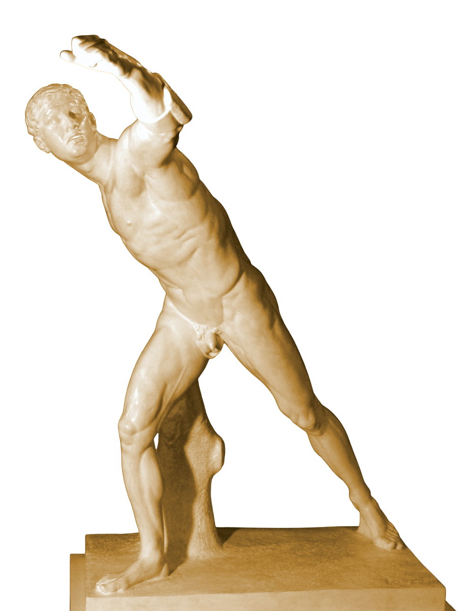
The Bourghese Warrior
Early 1st century BCE
The Bourghese Warrior
Notes:
Almost done, I wanted to give you a sneak peek of the Borghese Warrior. His motion and muscles make him look like he could be an actual gladiator, frozen in time. However, if you look at him a little bit closer, you’ll notice that he’s tensing every single muscle in his body seemingly at once, which is actually physically impossible. So, instead of being realistic, do you think the sculptor is trying to show off a bit? When you see him at the museum, take a close look at how detailed he is and consider how interested the Greeks were in science and anatomy.

Slide 17


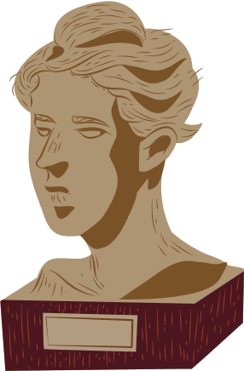
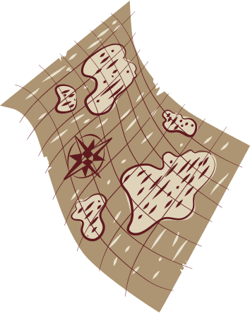
Thank You for listening!

Slide 18
Images
The Golden Beauty: Brain Response to Classical and Renaissance Sculptures - Scientific Figure on ResearchGate. Available from: https://www.researchgate.net/figure/The-original-image-Doryphoros-by-Polykleitos-is-shown-at-the-centre-of-the-figure-This_fig1_5817749 [accessed 18 May, 2022]
Polykleitos, Doryphoros (Spear-Bearer) or Canon, Roman marble copy of a Greek bronze, c. 450–440 BCE (Museo Archaeologico Nazionale, Naples; photo: Steven Zucker, CC BY-NC-SA 2.0)
Hippocrates, Roman bust from Greek original, c. 3rd century BCE; Antichità di Ostia, Italy. https://www.britannica.com/biography/Hippocrates
A Medicina Científica (1906) - Veloso Salgado (NOVA Medical School, Lisbon) https://en.wikipedia.org/wiki/Herophilos
Aristotle by Lysippos, c. 330 BCE. Roman marble copy. https://en.wikipedia.org/wiki/Aristotle

Slide 19
Images
Hermes with the Infant Dionysus. Plaster replica. Museum of
Antiquities, Saskatoon, Saskatchewan. https://artsandscience.usask.ca/antiquities/collections/items/greek-items/classical/classical-greek.php#Sculpture
Aphrodite of Cnidos. Plater Replica. Museum of Antiquities, Saskatoon Saskatchewan. https://artsandscience.usask.ca/antiquities/collections/items/greek-items/classical/classical-greek.php
Kouros of Paros. Plaster replica. Museum of Antiquities,
Saskatoon, Saskatchewan. https://artsandscience.usask.ca/antiquities/collections/items/greek-items/archaic/archaic-greek.php#Sculpture
Charioteer of Delphi. Plaster replica with verdigris finish.
Museum of Antiquities, Saskatoon, Saskatchewan. https://artsandscience.usask.ca/antiquities/collections/items/greek-items/transitional/transitional-greek.php#Sculpture
Aphrodite of Melos (Venus de Milo). Plaster replica. Museum
of Antiquities, Saskatoon, Saskatchewan. https://artsandscience.usask.ca/antiquities/collections/items/greek-items/hellenistic-items/hellenistic.php#Scupture

Slide 20
Images
Pharaoh Psammeticus II. Plaster replica. Museum of
Antiquities, Saskatoon, Saskatchewan. https://artsandscience.usask.ca/antiquities/collections/items/egyptian-items/egyptian.php#Sculpture
Rampin Head. Plaster replica. Museum of Antiquities, Saskatoon,
Saskatchewan. https://artsandscience.usask.ca/antiquities/collections/items/greek-items/archaic/archaic-greek.php#Sculpture
Lady of Auxerre. Plaster replica. Museum of Antiquities,
Saskatoon, Saskatchewan. https://artsandscience.usask.ca/antiquities/collections/items/greek-items/archaic/archaic-greek.php#Sculpture
Apollo Lykeios. Plaster replica. Museum of Antiquities,
Saskatoon, Saskatchewan. https://artsandscience.usask.ca/antiquities/collections/items/greek-items/classical/classical-greek.php#Sculpture

Slide 21
Images
Child and Goose. Plaster replica. Museum of Antiquities,
Saskatoon, Saskatchewan. https://artsandscience.usask.ca/antiquities/collections/items/greek-items/hellenistic-items/hellenistic.php#Scupture
Crouching Aphrodite. Plaster replica. Museum of Antiquities,
Saskatoon, Saskatchewan. https://artsandscience.usask.ca/antiquities/collections/items/greek-items/hellenistic-items/hellenistic.php#Scupture
Borghese Gladiator or Warrior. Plaster replica. Museum of Antiquities,
Saskatoon, Saskatchewan. https://artsandscience.usask.ca/antiquities/collections/items/greek-items/hellenistic-items/hellenistic.php#Scupture

