Slide 1






Researching History:
Primary vs Secondary Sources

Slide 2

What We Will Learn
Historical context
The 5 W’s: Who, What, When, Where, Why?
Importance of evidence
Importance of interpretation
Difference between primary and secondary sources
Notes:
Today we will learn the ins and outs of how to do historical research!
Here are the main points we will be talking about.

Slide 3





How to Approach Historical Research
WHO WHAT WHEN WHERE WHY
Notes:
When doing research in the realm of history, it is important to ask 5 questions: who, what, when, where and why? This helps us gain an understanding of historical context.
Who: Who was involved in the events? Who are important to the event? (EX. Who was the prime minister of Canada during WW2?)
What: What tools or weapons were used? (EX. What tools did the Egyptians use to make Papyrus paper?)
When: What time period did this happen in? What are the relevant politics? (EX. When did Alexander the Great rule Macedon?)
Where: Where are the areas of interest? What places are involved/affected by the event in question? (EX. Where was the first successful French settlement in Canada?)
Why: Why did this event happen? (EX. Why did the Greeks put such importance on athletics?)
Asking these questions can help us gather information about the context of the historical event or person. Important aspects of context include the influence of science, religion, politics, education, social features and culture. All of these things work with each other.

Slide 4
Evidence and Interpretation
Historians are influenced by the world around them, therefore influencing their opinions and writing.
Be aware of the different perspectives historians can have when writing sources.
Comparing sources can be a great tool to understand the different perspectives of these historians.
Notes:
When doing historical research, it is important to consider WHO is involved, and who is writing certain sources. Historians are influenced by their own interests, as well as the place and time in which they live. Understanding the perspective from which a historian approaches the past provides insight on how they thought.
For example, a historian who is more focused on social issues will write differently than one focused on economics.
Approach with caution and take into account the context of who is writing the source.
Comparing sources is a great way to point out these different ways of thinking and perspectives.

Slide 5
Evidence and Interpretation
To study history, we need evidence.
The evidence should be scholarly or peer reviewed.
Do not believe everything you see. Think critically about the source.
Understanding the audience helps our understanding of the intent of the source. This can reveal biases of the author and unspoken assumptions.
Notes:
When you are looking for sources for historical research, you need to ask a few questions about the source:
Who was this document written/intended for?
Who created this document?
After reading these documents years after they are written, sometimes it is difficult to see biases of different time periods and people. Asking these questions helps us uncover the author's possible biases and unspoken assumptions.
Knowing who the intended audience is helps us understand the purpose of the document.

Slide 6
Primary Sources
Primary sources: materials written by people or groups directly involved in the event or topic, either as bystanders or witnesses.
These types of sources allow you to create your own interpretation of the content.
EX. Magazines, letters, household objects
Notes:
When researching using historical sources, it is really important to distinguish between primary and secondary sources.
According to Mary Lynn Rampolla, primary sources are materials produced by people or groups directly involved in the event or topic under consideration, either as participants or as witnesses.
Some examples of primary sources are written documents like letters, diaries, newspapers, magazine articles, birth and death certificates.
Primary sources are not necessarily written, like films, recordings, clothing, household objects, tools and archeological remains.
Primary sources allow you to peer into the past, allowing you to create your own interpretation rather than rely on the interpretation of another historian.
As we have talked about, historian's opinions and interpretations are a product of their biases and environment, so it is important to keep this in mind.

Slide 7

Primary Sources Example
Play of Romeo and Juliet by William Shakespeare
Notes:
An example of a primary source is the tragic play of Romeo and Juliet by William Shakespeare. This is a literary source that is used to this day as a base or example for great writing and entertainment.
Reading this play in-class or by yourself allows you to create your own opinion and interpretation of the material.

Slide 8
Secondary Sources
Secondary sources: books, articles, documentary films etc... who were NOT eyewitnesses of the event.
Reveals past interpretations and biases of historians.
EX. Documentary films, articles, books.
Notes:
According to Mary Lynn Rampolla, secondary sources are texts like books, articles or documentary films that are written or created by people who were NOT eyewitnesses to the events or period in question. In this case, authors and historians are studying and using primary sources in their work.
These are often the simplest and quickest to deal with, as it reveals what is already widely known. It also shows you how previous historians interpreted previous events, revealing past biases of people and time periods.
Often it is difficult to find good primary sources, or even good secondary sources about the topic you are researching. Using secondary sources, you can look in the bibliography or footnotes to see related primary and secondary sources to help your research.

Slide 9
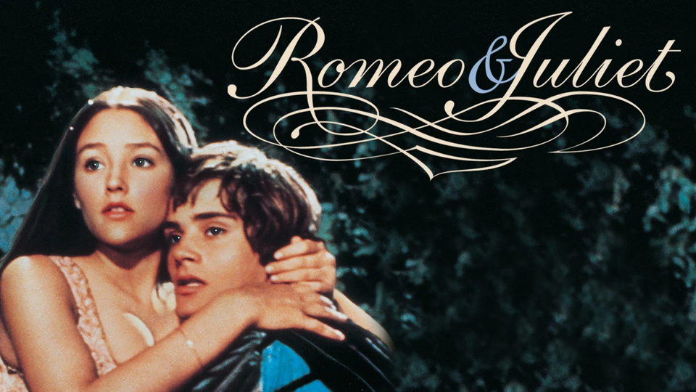
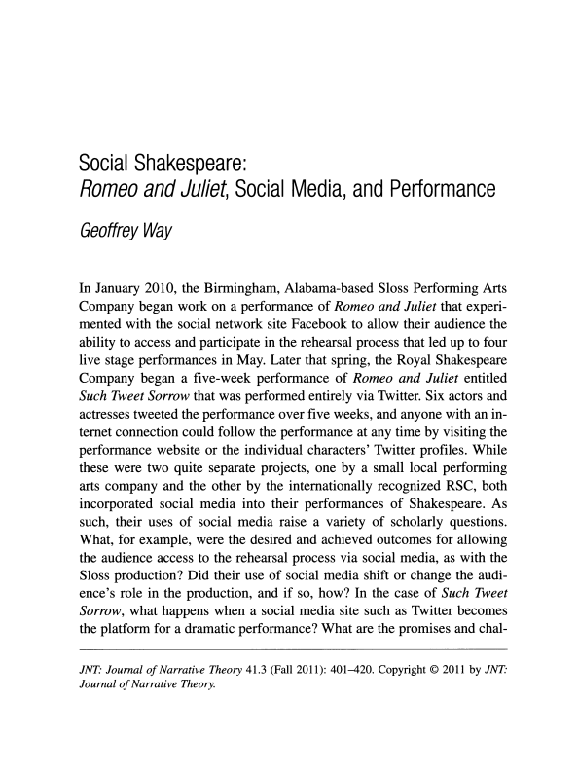
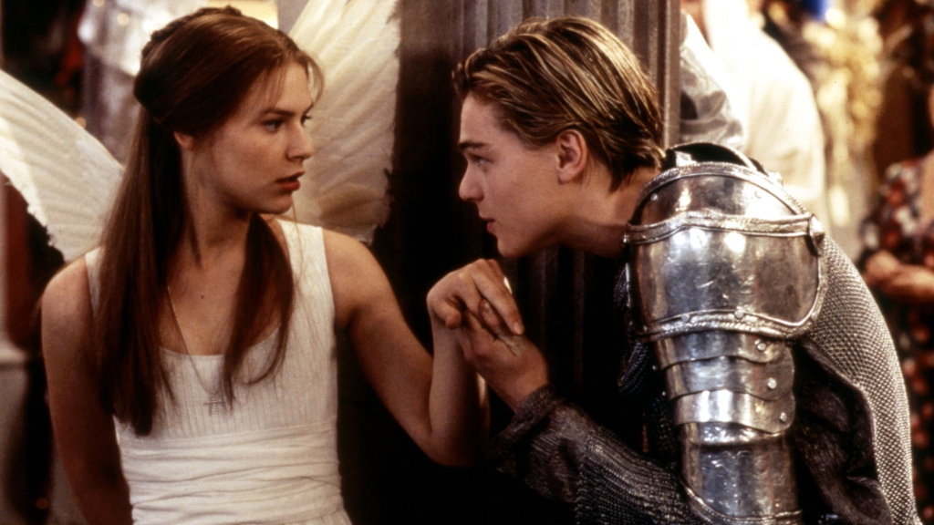
Secondary Sources Example
1968 Film Adaption of Romeo and Juliet
Article by Geoffrey Way using the primary source of the original play
1996 Film Adaption of Romeo and Juliet
Notes:
These are secondary sources from the primary source of the play Romeo and Juliet by Shakespeare.
On the left are film adaptations of Romeo and Juliet. Both the 1968 and 1996 film adaptations use the original play as a base.
On the right is an article written by Geoffrey Way, using the primary source of the original play in terms of more modern performances and social media. This is a secondary source in the more academic sense.

Slide 10
Summary
Primary sources: materials written by people or groups directly involved in the event or topic, either as bystanders or witnesses.
Secondary sources: books, articles, documentary films etc... who were NOT eyewitnesses of the event.
It is important to keep in mind the biases and interpretations of past historians.
The 5 W’s
Notes:
Here are some points you should take away from this presentation.

Slide 11
Bibliography
Rampolla, Mary Lynn. A Pocket Guide to Writing in History. United States: Bedford/ St. Martins, 2021.
Romeo and Juliet Book Image: https://cdn.kobo.com/book-images/ca07820a-192c-4ec8-a3a6-684a3a7ee2e3/1200/1200/False/romeo-and-juliet-320.jpg.
Romeo and Juliet Film Image 1968: https://image.tmdb.org/t/p/original/7E0ABo12nVk3z3JjChL6d1Bz3oq.jpg.
Romeo and Juliet Film Image 1996: https://cdn.mos.cms.futurecdn.net/mxxoXLZLkw4Ji4Ne4abwfF.jpg.
Way, Geoffrey. “Social Shakespeare: “Romeo and Juliet”, Social Media, and Performance.” Journal of Narrative Theory 3, no. 41 (2011): 401-420.

Slide 12
Thank you!

