Slide 1
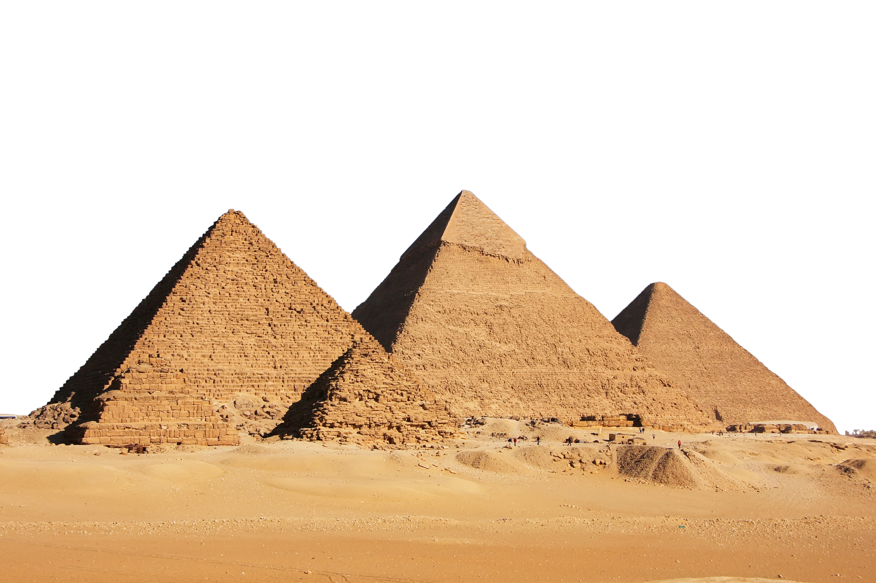
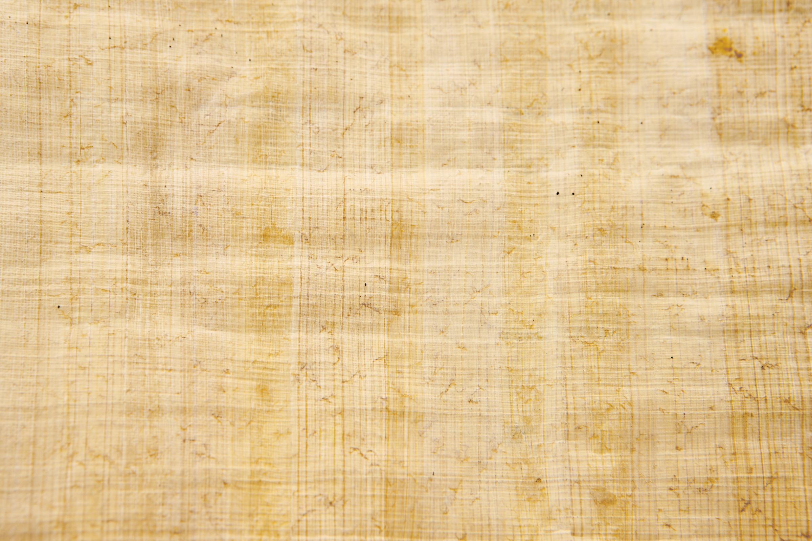

Egyptian Pyramids: Myth vs. Reality
Notes:
Have you ever wondered how the pyramids were built? Who built them? What did they look like in their prime thousands of years ago? What was their purpose?
We will be going over all that today, as well as the misconceptions that often come up.

Slide 2
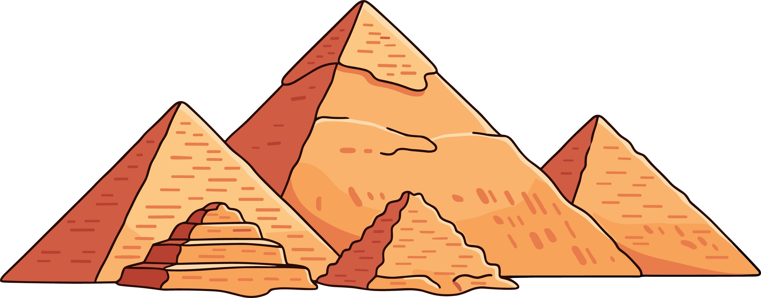
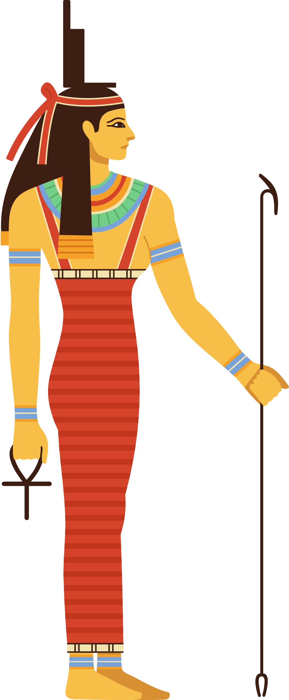

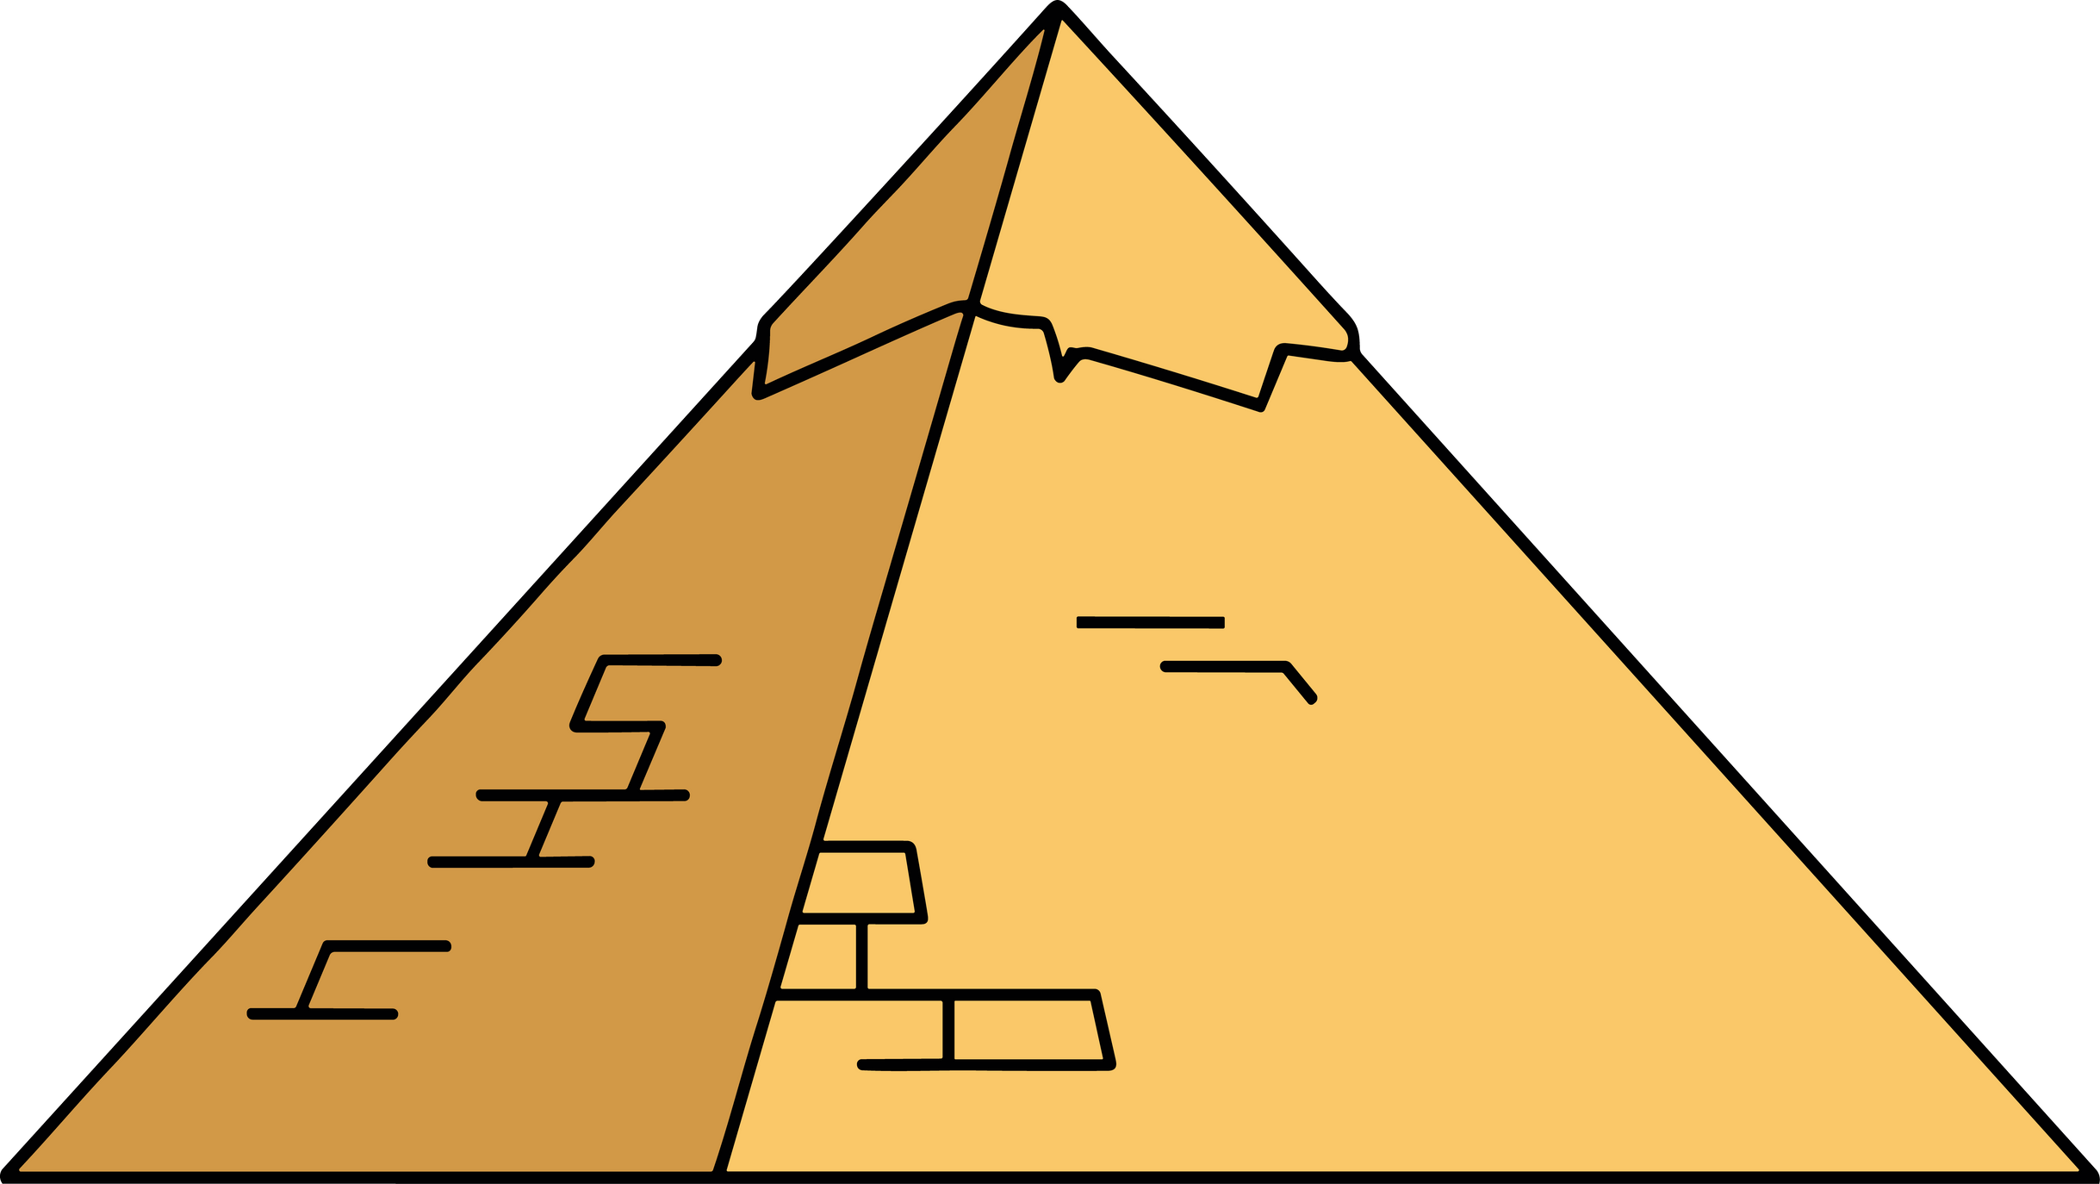
Myths of Ancient Egypt
Notes:
There are many misnomers and misconceptions about ancient Egypt, specifically the pyramids.
Even coming from the History Channel, most of what is said is untrue. Just because they reveal it as "evidence", it does not mean that said evidence is credible.
https://www.youtube.com/watch?v=-pS7Jf24dQY
https://www.youtube.com/watch?v=YBRrQqDhj28
Here are a couple videos that use "evidence" to prove multiple theories such as:
- salt coated on the walls combining creating hydrogen, with the vibrations of the earth shaking the pyramid. The pyramid also shot out a microwave ray due to this reaction.
-tomb of Akhenaten contains "heretic inscriptions" and worship to only one god, Aten. He must be from extraterrestrial origin.
Reality of these circumstances:
- the limestone used to construct the pyramid naturally creates salt
- Aten did worship only one god during his reign. This is a rare occurrence in Egyptian history, but he was human and simply changed the religion from what it had previously been. When he died, they resumed polytheism (worshipping multiple gods).
What are some myths and concepts you have heard of regarding the Pyramids?
- EX. Aliens built the pyramids, mummies are magic...

Slide 3
Pyramids and their Purpose
  Old Kingdom was the golden age of the pyramids.
  Pyramids as a religious and funerary structure.
  Some had tura limestone casing, making it shine a bright white.
Notes:
Pyramids were used for funerary and religious purposes, as the bodies of pharaohs and other elites were set to rest here. Often, pyramids were part of a larger complex involving courts, chapels and temples.
The Old Kingdom (2686-2181 BCE) of ancient Egypt was the golden age of Pyramids. The king had ultimate power as the religious intermediary, and these grand structures were physical representations of that.
Pyramids varied in style and complexity based on when they were built. Early on in the Old Kingdom, the pyramids began as simple and small step pyramids. Later on, pyramids were covered in a Tura limestone casing, leaving a blazing white over the limestone blocks. Some also had a gold capstone at the top of the structure.

Slide 4
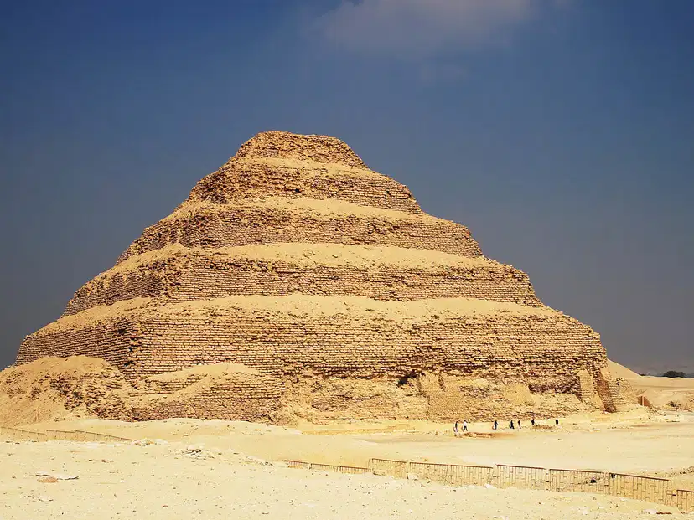
The First Pyramids
  One of the earliest pyramids made were in a step-pyramid style.
  Contains a burial chamber below.
Djoser’s Pyramid
Notes:
The first pyramids were smaller in scale, and more of a step-pyramid style.
An example is the step pyramid of Djoser. Built in the beginning of the Old Kingdom by architect Imhotep, it lies in a complex with an alter, a chapel and courts.
Beneath the pyramid itself is a burial chamber with a massive stone sealing the vault. There was evidence of attempted robbery, as little objects remained when the tomb was found.

Slide 5
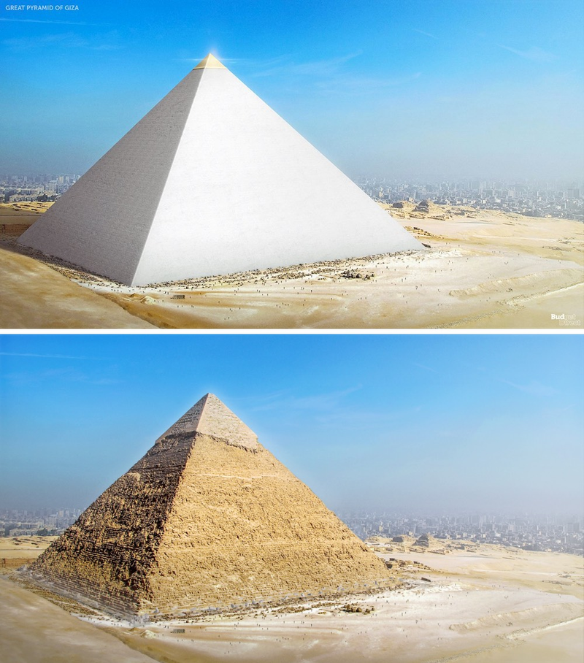
Pyramids of Giza
  Over 2 million limestone blocks at 2.5 tons each.
  Tura limestone casing that let it shine bright white with a gold top.
  Airshafts and antechambers.
  Pyramids were vulnerable to plenty of tomb raiding.
Khufu’s Pyramid Then vs. Now
Notes:
The pyramids of Giza have the pyramids of Khufu, Khafre and Menkaure. The most recognizable is Khafre's as his has the sphynx within its complex.
The largest and most grand at this site is the great pyramid of Khufu, made from 2,300,000 limestone blocks weighing 2.5 tons each. This pyramid had a blazing white limestone casing in its original state, making it recognizable from large distances. There would have also been a gold capstone at the top of the pyramid.
In the pyramid itself are several antechambers that contained the king and queens chambers. There were airshafts in the pyramid as well, likely for the diseased spirit to follow out of the pyramid to the forefathers and gods in the sky.
Khufu's pyramid, along with most pyramids, was robbed of its goods. The tomb of Tutankhamun is the exception, being the only royal burial left untouched. To avoid tomb raiding, pyramids are used less and less for burial after this period in Egyptian history. Temples are used afterward.

Slide 6
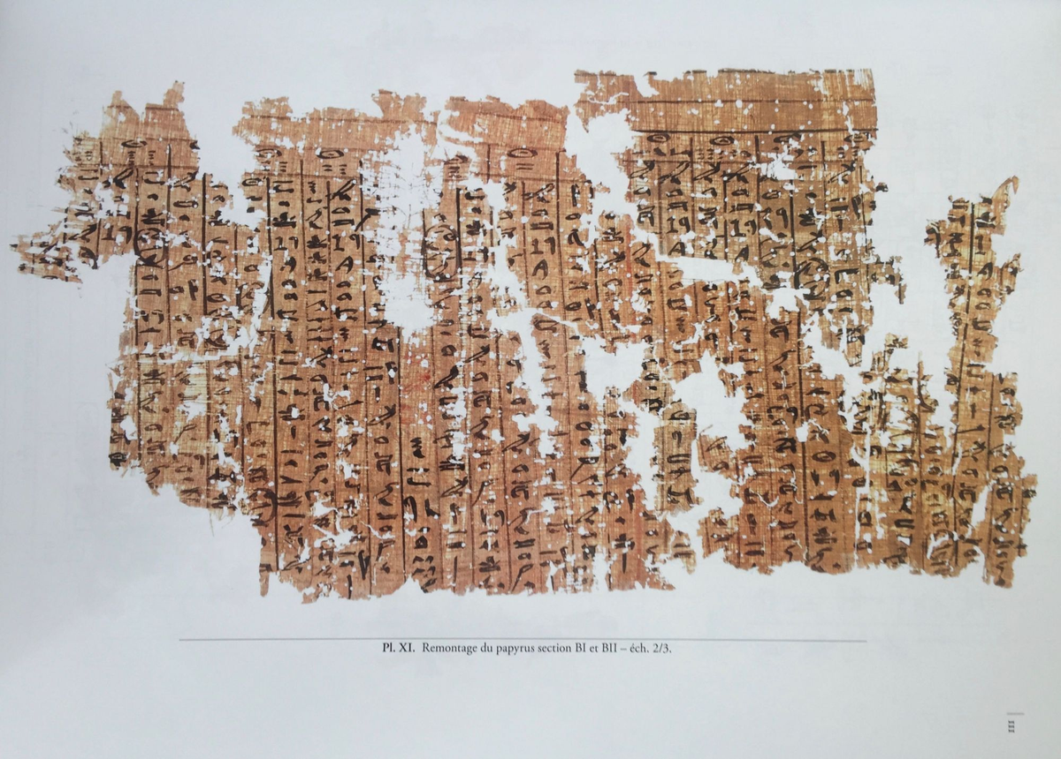
Papyrus Jarf
  A document that tracks the transportation of limestone, as well as documents jobs given to the workers at the site.
Papyrus Jarf
Notes:
How do we know what material was used?
The Papyrus Jarf is an ancient receipt of sorts found by archeologists. It shows where supplies used, for the pyramid of Khufu, came from. It is the oldest known papyrus with text rather than images, documenting the transportation of limestone from Tura to Giza. It was from the Diary of Merer, a man who would have been the over-seer of Khufu's pyramid construction. It also documents tasks given to his 40 men.

Slide 7
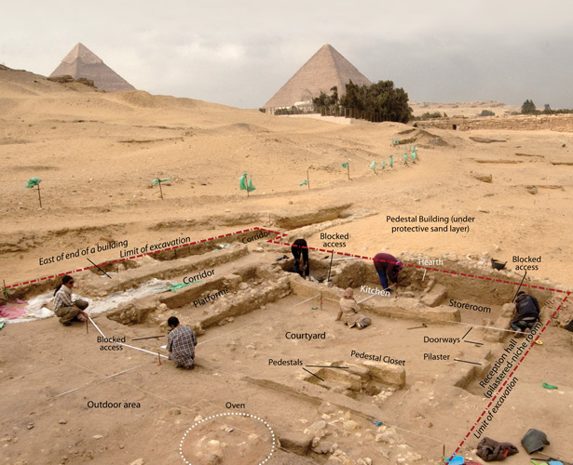
Workers village: Heit el-Ghurab
  Bakeries.
  Barracks.
  Higher food quality.
  Hired workers, not slaves.
Workers Village Housing Layout
Notes:
Who built the pyramids? There were hired workers who lived nearby, in Heit el-Ghurab, a village that housed and fed them.
In the village, archeologists have found the layout of barracks that housed the workers, an administrative building and a cattle corral. Each barrack held about 40 workers, making it a tight but doable space. The animal bones found in the cattle corral consisted of sheep, goats and catfish, which are proteins that the more elite eat. There were small hearths or ovens that were used to bake bread for the village. The workers were not slaves, but we are unsure how happy they would have been with all the hard labour.

Slide 8
Summary
  It is important to consider the credibility of “evidence”, even from the History channel.
  There is archeological evidence of buildings and materials to demonstrate that the pyramids were built by humans in ancient Egypt, not aliens.
  It is okay to enjoy media that is not exact to Egyptian history, but it is important to know what the facts are.
Notes:
Here are some of the main points you should consider.

Slide 9
Bibliography
Djoser's Pyramid Image: https://cdn.thecollector.com/wp-content/uploads/2021/08/first-egyptian-pyramid-djoser.jpg?width=828&quality=55
Khufu’s Pyramid image 1: https://www.tripsinegypt.com/wp-content/uploads/2018/10/History-of-the-Great-Pyramid-of-Giza-Trips-in-Egypt-1.jpg
Papyrus Jarf Image: https://www.meretsegerbooks.com/pictures/M4956-32.jpg?v=1510947243
Workers Village Image: https://aeraweb.org/wp-content/uploads/2022/06/HeG_AAS_AG16.jpg
All information: Arbuckle, Caroline. University of Saskatchewan, St. Thomas Moore. Anthropology 257, Winter 2025.

Slide 10
Thank you!
Notes:
Thank you for listening!

