Slide 1
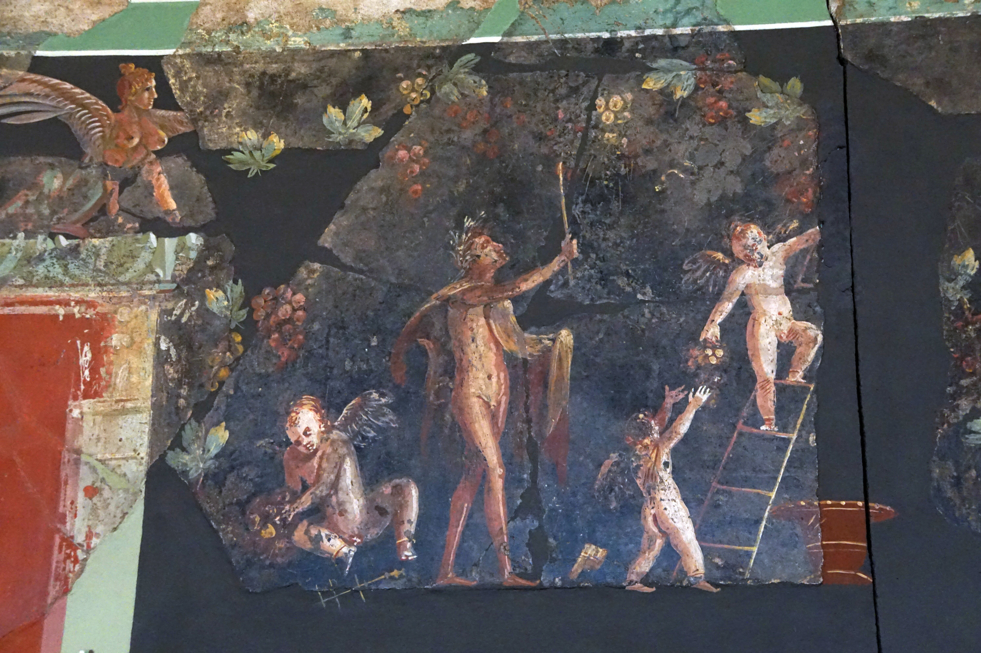

The Museum of Antiquities Presents:
The Science of Fresco Painting
Notes:
Hello everyone, today we are going to explore some ancient Roman frescoes and then you will get to make a sort of fresco of your own to take home with you! Let's get started.

Slide 2

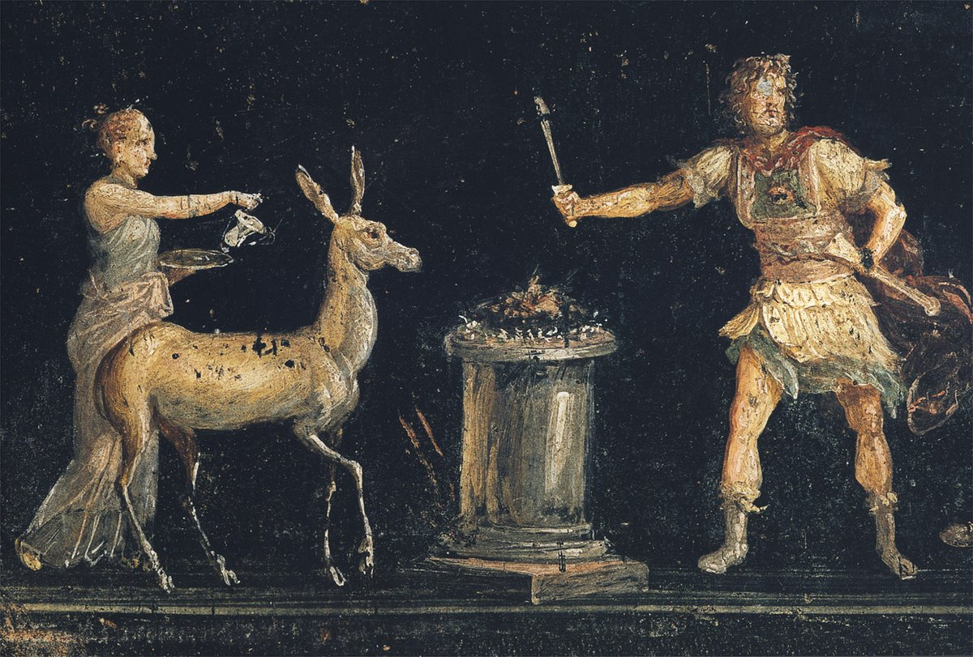
What are frescoes?
Fresco is a style of painting where artists paint their designs on top of wet plaster.
Since the plaster is still wet, the paint is absorbed into the plaster and usually does not get worn down. The decorated walls can also be wiped down and cleaned.
House of the Vettii, Pompeii.
Notes:
What are frescoes? The term fresco, which comes from the Italian affresco, meaning 'fresh' refers to a style of painting where artists paint their designs over top of wet plaster, a paste made of water and minerals like sand, lime and gypsum (pretty dusty materials). This was generally done on walls and often in private homes.
The artist would begin preparing for the painting by laying up to six layers of plaster over a wall. They would start with the most coarse plaster, made of rougher materials so that the next layers would have some grip and the very last layer would be made of fine dust (sometimes crushed marble) and would be smooth so that the painting looked good. The artist would draw an outline of their design over the plaster and they would paint while the plaster was still wet.
When they did this, the paint would be absorbed into the plaster and would bind with it, meaning that the painting would be preserved and usually wouldn't wear down. This also meant that homeowners could wipe down and clean the walls without worrying about ruining their lovely art.

Slide 3



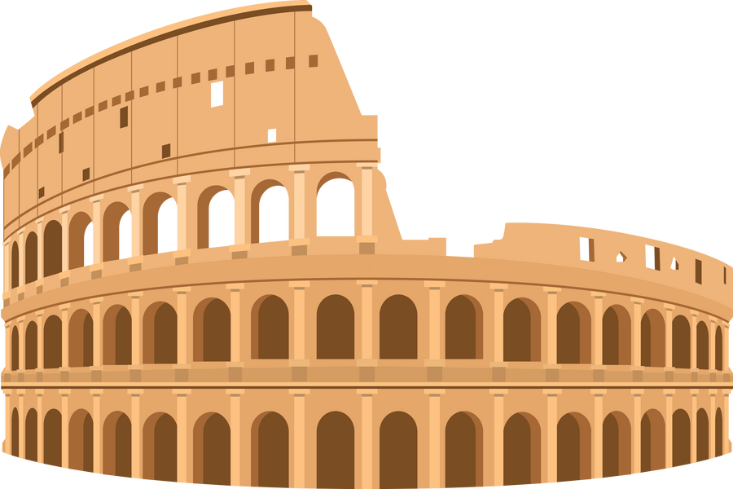
Perfectly Preserved Pompeii
The ancient roman city of Pompeii is home to some of the most well preserved frescoes in world.
When Mount Vesuvius erupted in 79 CE, Pompeii, Herculaneum and other towns in the region were covered in ash.
As a result, their wall paintings were left untouched for almost 2000 years and are still in good shape today.
Notes:
Some of the most well-preserved frescoes in the entire world are found in the ruins of the ancient city of Pompeii in Italy. Have we heard of Pompeii before? What do we know about Pompeii? In 79 CE, Mount Vesuvius erupted and Pompeii and other towns in the area like Herculaneum, where covered in ash. The way that this ash fell over the town allowed many things, including these frescoes to be preserved and since the town was no longer a good place to live, the artwork was left untouched for a very very long time. All of this means that the artwork that filled the homes of Pompeii's citizens is still in excellent condition today and we can use those walls to understand how frescoes were made and why. We are going to take a look at some frescoes in Pompeii today.

Slide 4

Creating Colours
Before they had easy access to lots of different art supplies, people would create their own paints using mineral powders or other chemical concoctions.
Lets take a look at how the Romans made the basic colours needed to create a masterpiece.
Notes:
But, before we look at the frescoes, let's talk a little bit about the science behind fresco painting, specifically about how the ancient artists would make their paints. Today if you need paint, you can just run out to a craft store and buy some. There are many companies that make all kinds of colours and types of paint. Things were a little bit different back in ancient Rome and paints were made with mineral powders and chemical reactions. Lets take a look at some basic colours that all fresco painters would have needed to have in their supplies.

Slide 5




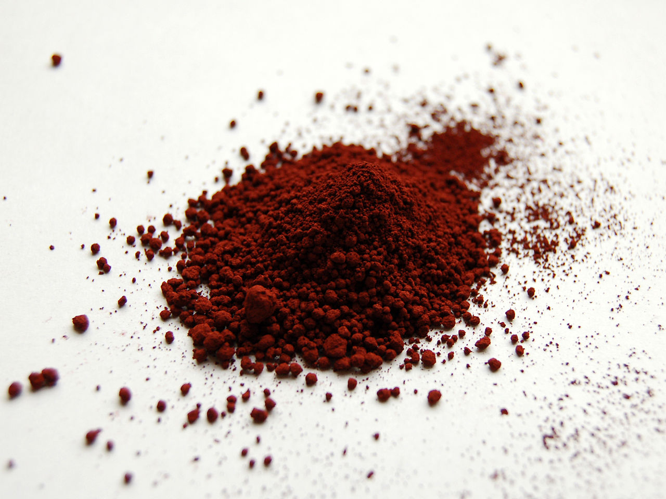
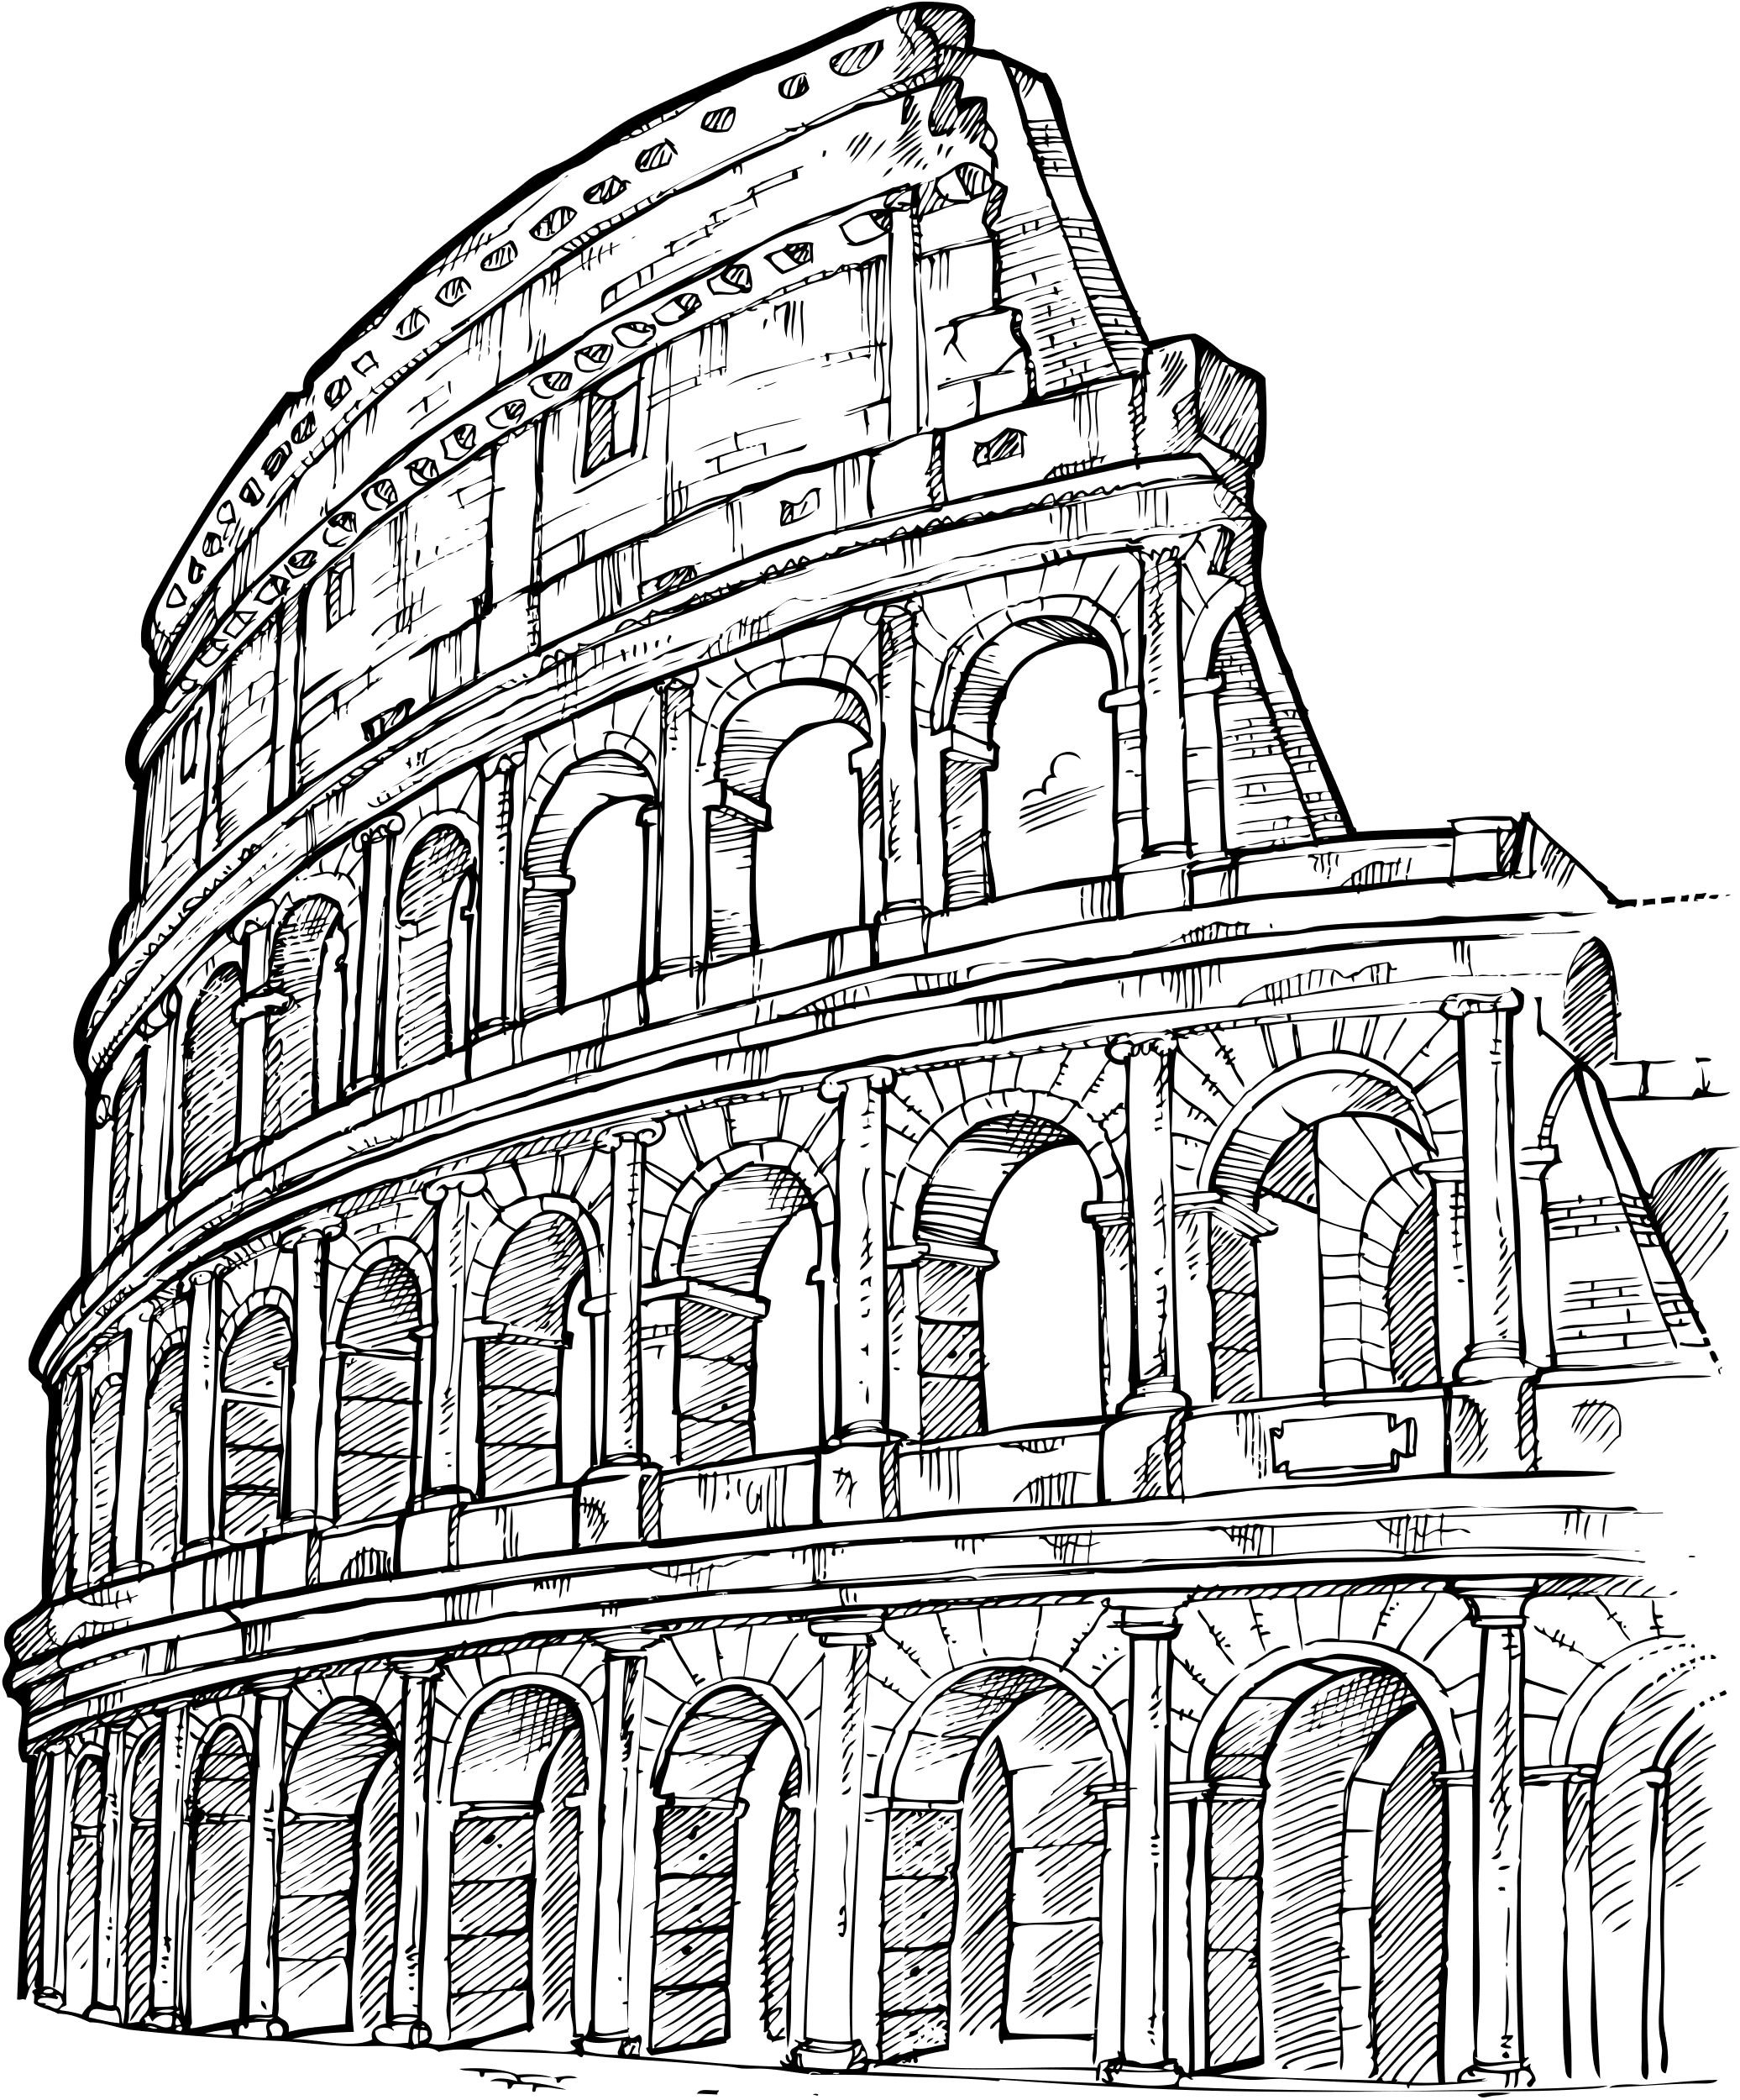
RED
This is anhydrous ferric Oxide or ferric (III) oxide, its vibrant red colour makes it perfect for creating red paint.
Notes:
First is red, which was made of a powder called anhydrous ferric oxide or ferric (III) oxide. This is what the powder looks like. It's a very vibrant red and it is formed when iron oxidizes or when it is exposed to oxygen. Oxidization also produces rust, so this is a similar process.

Slide 6
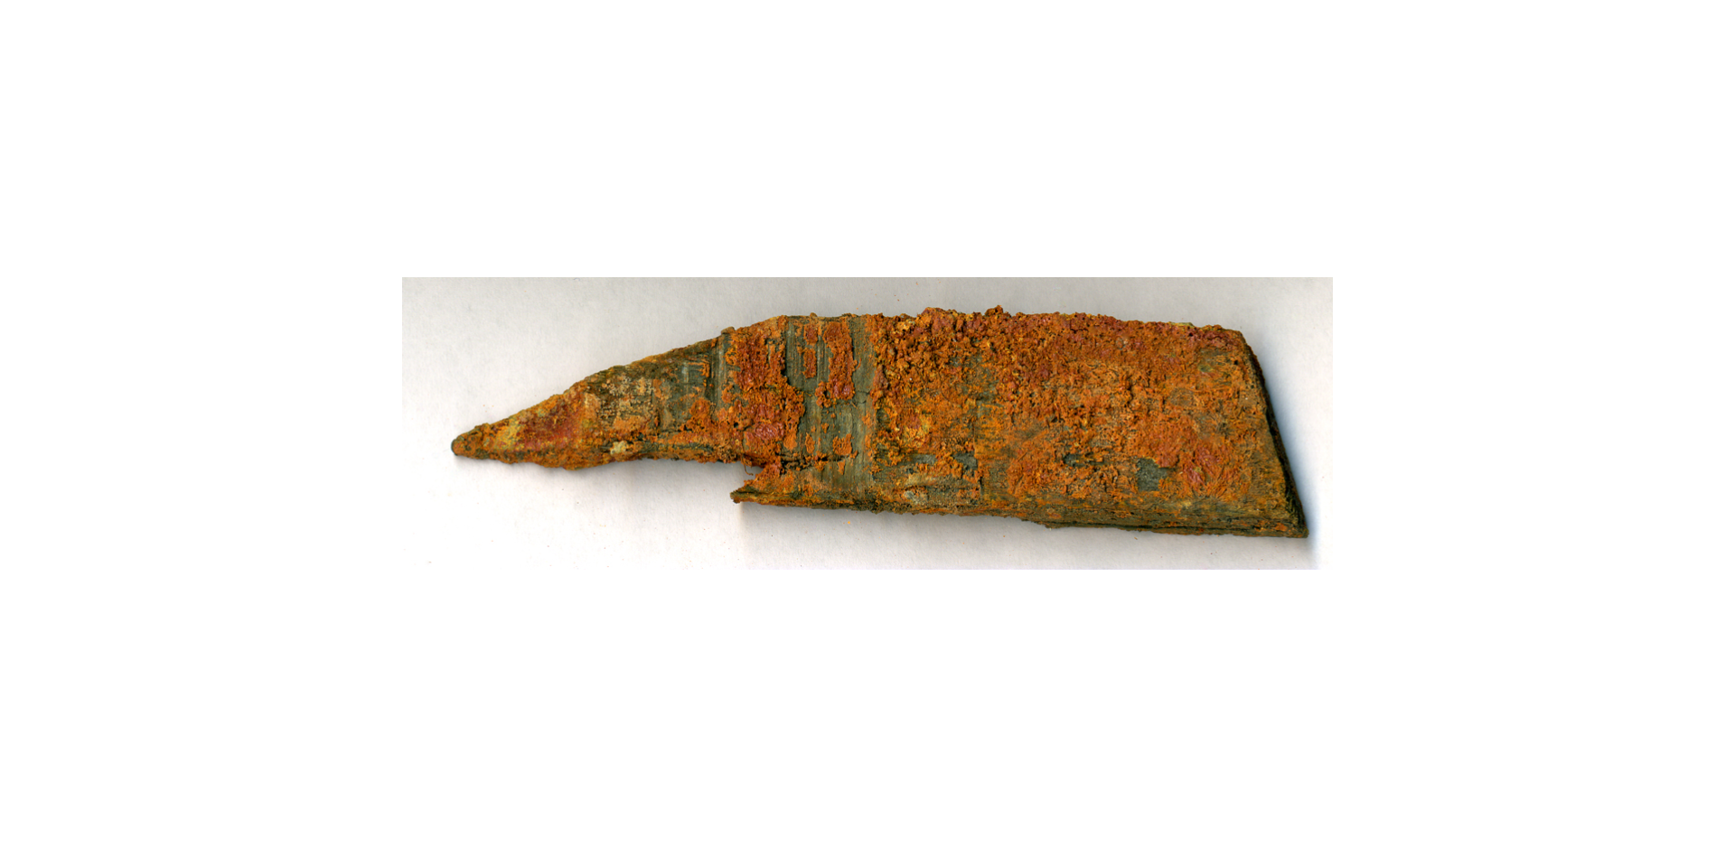



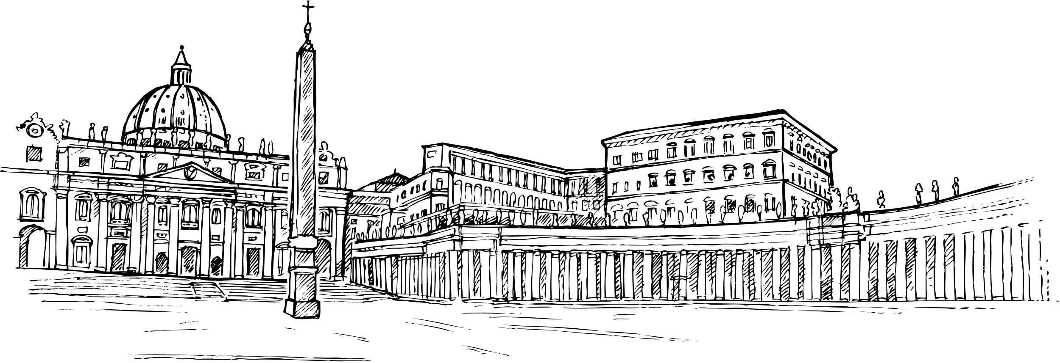
Yellow
This is Hydrated Ferric Oxide or Ferrihydrite, what the Romans would use to create yellow paint!
Notes:
Yellow came from hydrated ferric oxide or ferrihydrite. Ferrihydrite is kind of like the ferric oxide that makes the red pigment except it is hydrates which means it is exposed to cool moist conditions. Water contains the molecules oxygen and hydrogen which hydrate the ferric oxide and the chemical process that occurs creates this yellow pigment.

Slide 7

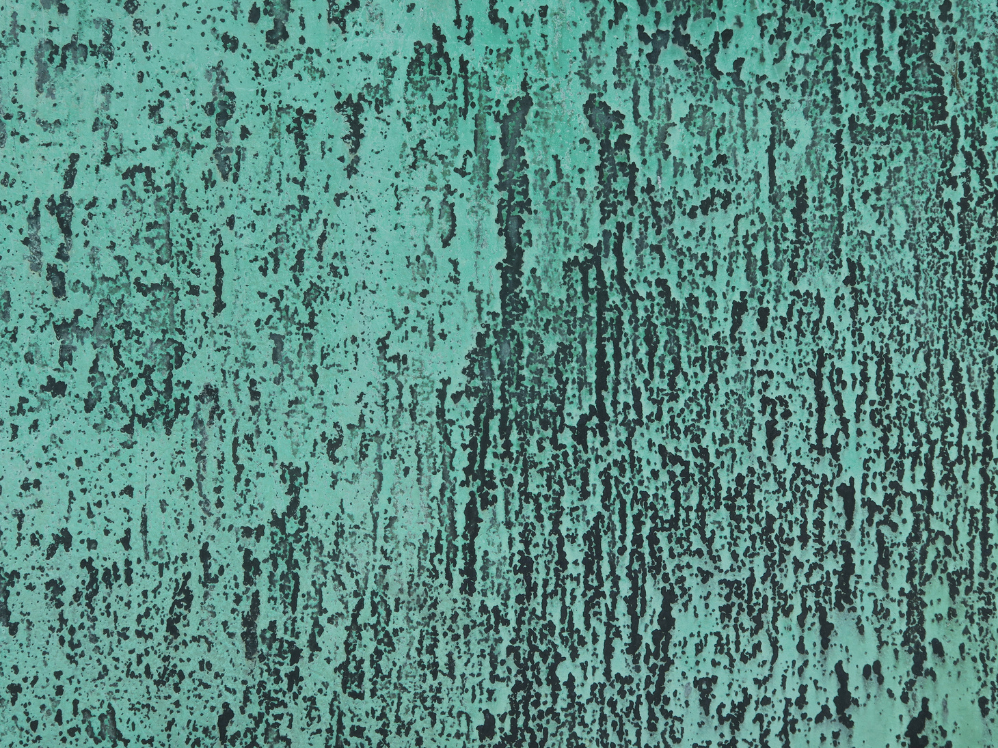
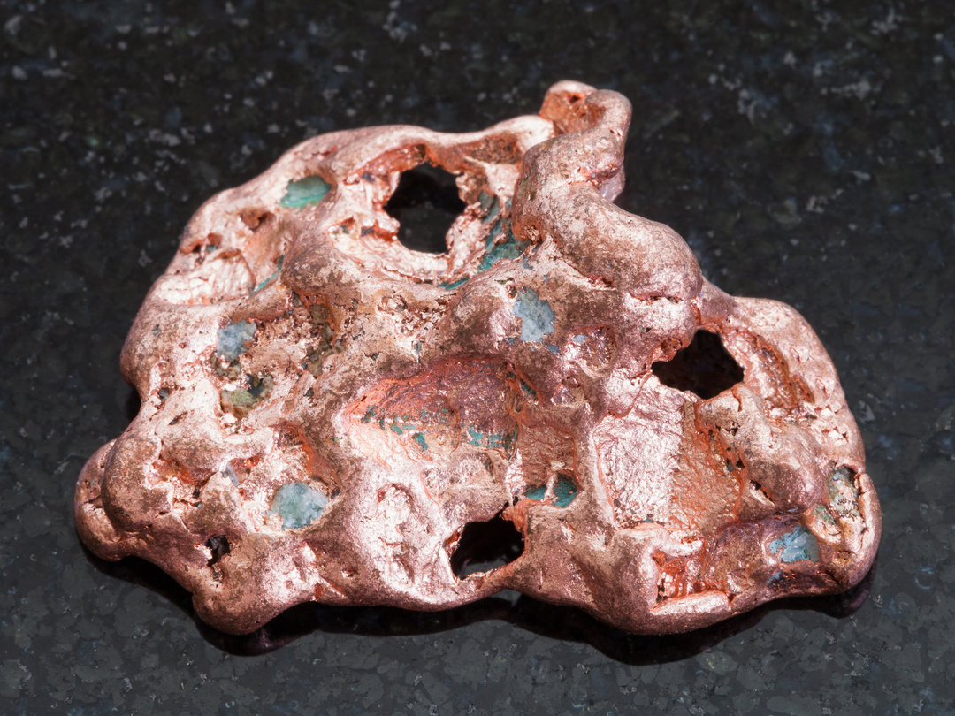



Green
Green paint was created using several different minerals, but the ancient Romans also created a special green pigment called verdigris by soaking copper plates in wine.
Notes:
The next colour we'll talk about is green. In antiquity green pigments were often made from different minerals. In Egypt it was common to use Malachite to create green pigment (which is toxic by the way). In ancient Rome, they developed a special green pigment called verdigris. Have you ever seen the Statue of Liberty? Did you know that the statue of liberty is actually made of copper? Over time, copper takes on a green colour, as it oxidizes (is exposed to oxygen) and a green film called patina forms over the copper. Here you can see a piece of copper with little pieces that have oxidized and then what a fully oxidized piece of copper might look like. The Romans used copper plates and soaked them in wine to speed up this process and create a pigment that would mimick this colour.

Slide 8
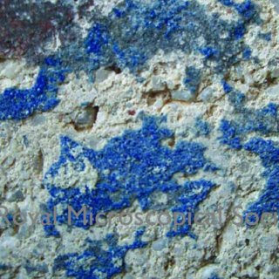







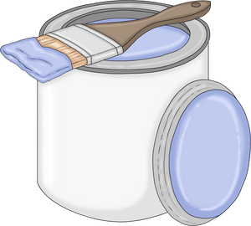
BLUE
Blue pigment was created using copper calcium silicate. Today, this colour is often called 'Egyptian Blue' and can still be purchased in a powder to paint with.
Notes:
Similar to how people would make green from minerals like malachite, blue pigments were also made of ground-up mineral - copper calcium silicate to be exact, like we see in this picture. This colour is called Egyptian Blue today since it is believed to have been first created in Egypt. It is also thought to be the first-ever synthetic pigment. The Romans called it caeruleum.

Slide 9
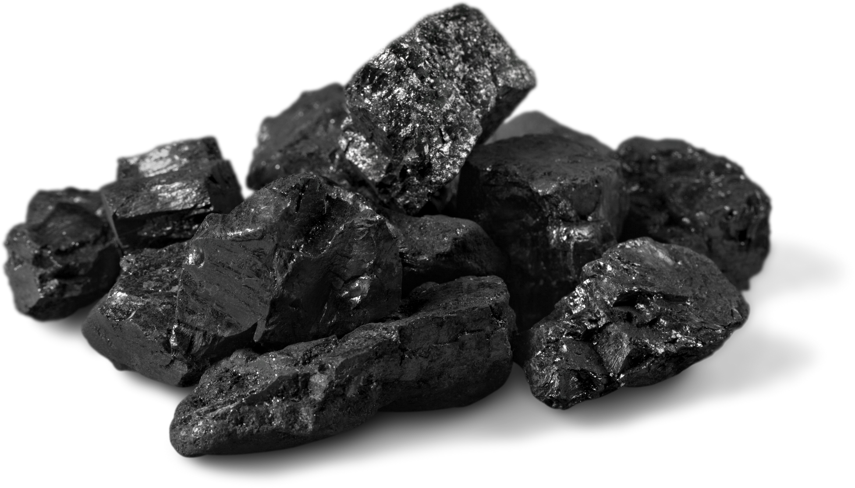
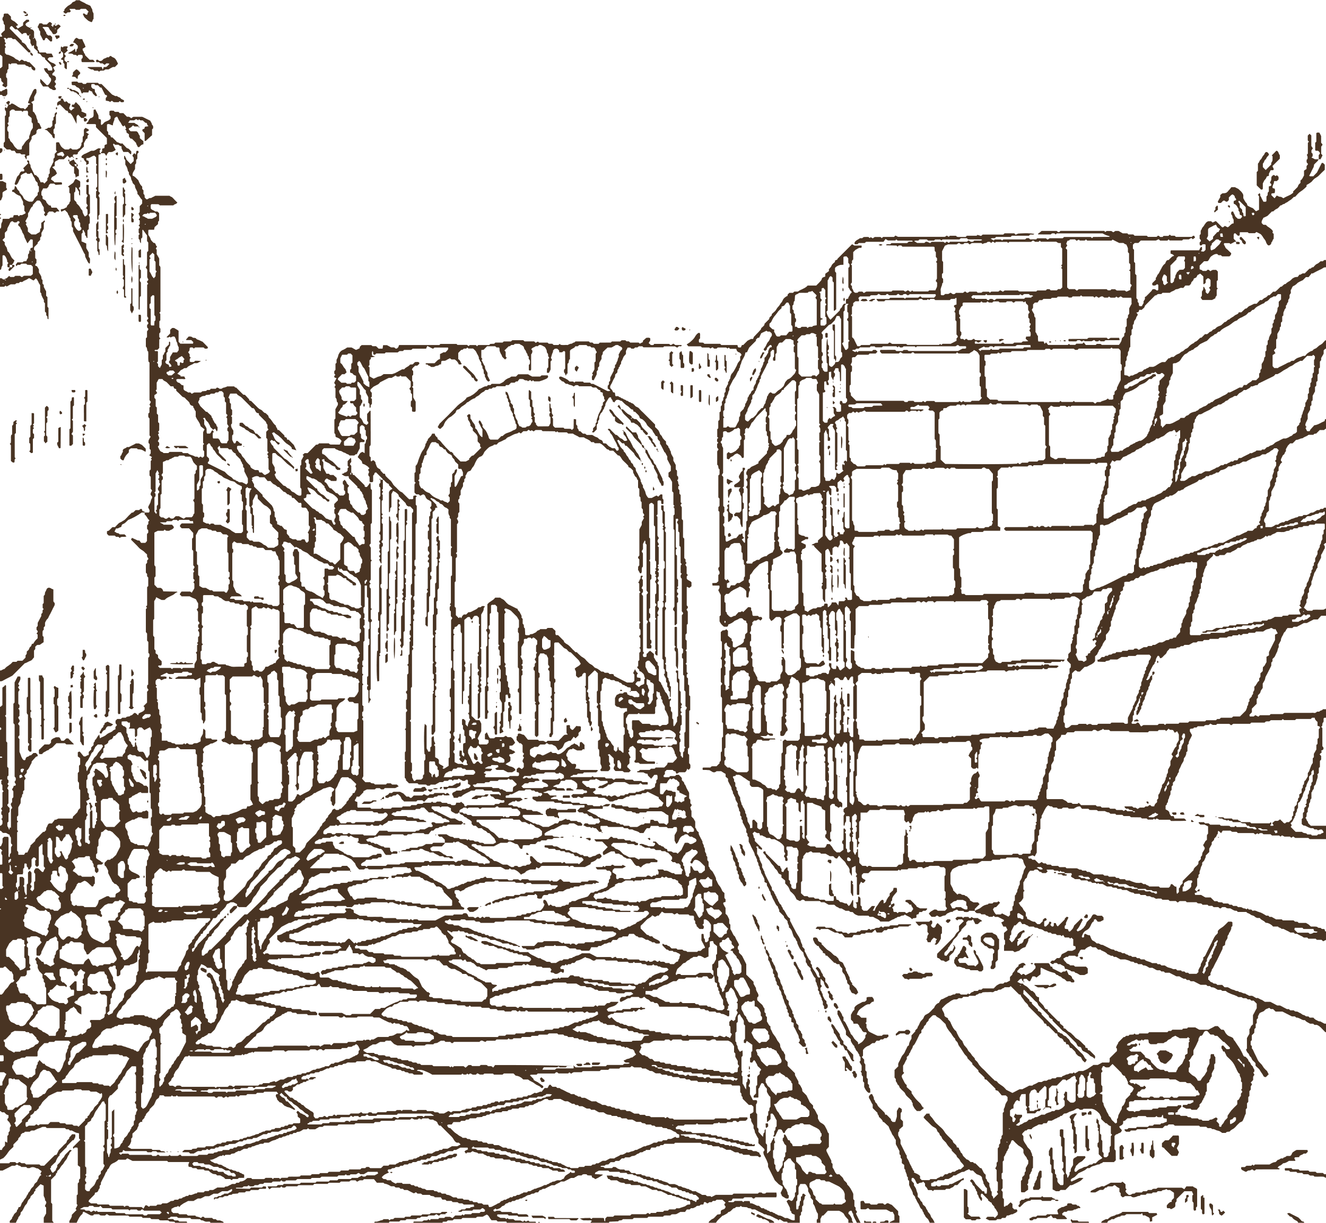

Black
Fine powder made of carbon and soot was used to create black paint.
Notes:
Finally, we have our black paint. This was made from finely ground carbon or soot. It was very easy to source since any time you burn wood, you'll have some of this left over. It is a very dark pigment and since it is so easy to acquire, it is used a lot in art today. Has anyone in here ever drawn with charcoal? That is very similar to what would have been used in making these paints. Before we get to look at some real frescoes, does anyone have any questions?

Slide 10


There were four main styles of frescoes found in Pompeii.
Let’s look at the different styles!
Notes:
In Pompeii, there were four main styles of fresco paintings, but we are going to focus on the second style of Pompeiian fresco which is the architectural style.

Slide 11
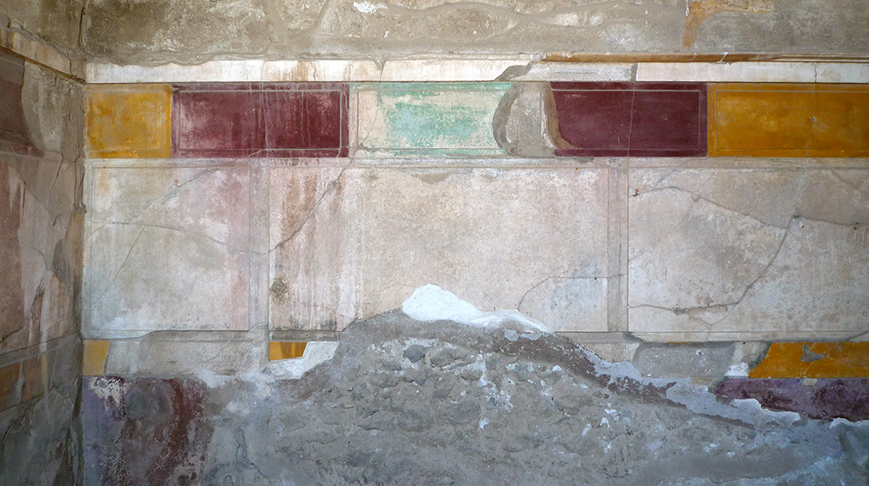

This fresco is in the first style, structural, incrustation or masonry style. It is characterized by colourful, faux-marble patches on the walls.
House of the Faun, Pompeii, built 2nd century, B.C.E. (photo: Steven Zucker, CC BY-NC-SA 2.0)

Slide 12
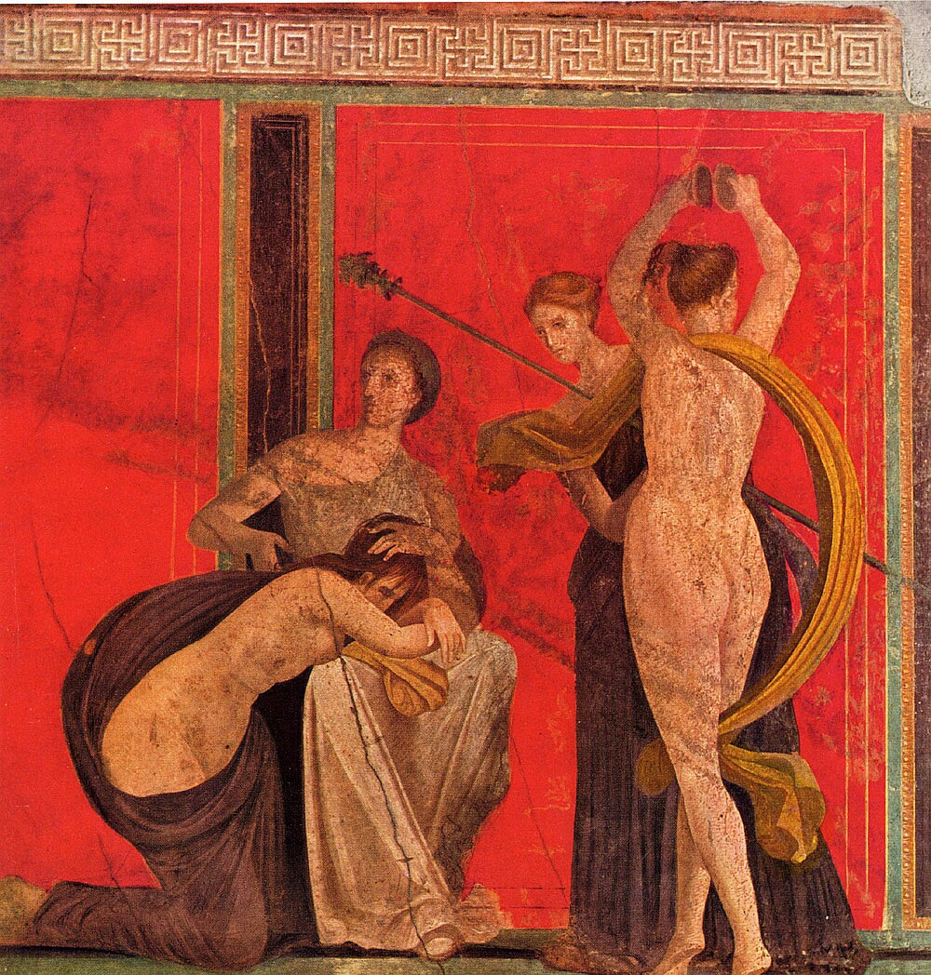


This fresco is in the second style, the architectural style, known for architectural features, illusions, and 3D elements.
The Villa of the Mysteries Fresco - Pompeii, Italy
From the Museum of Antiquities
Notes:
This is from the Villa of Livia just outside of Rome. Livia was the wife of the first emperor Augustus.

Slide 13
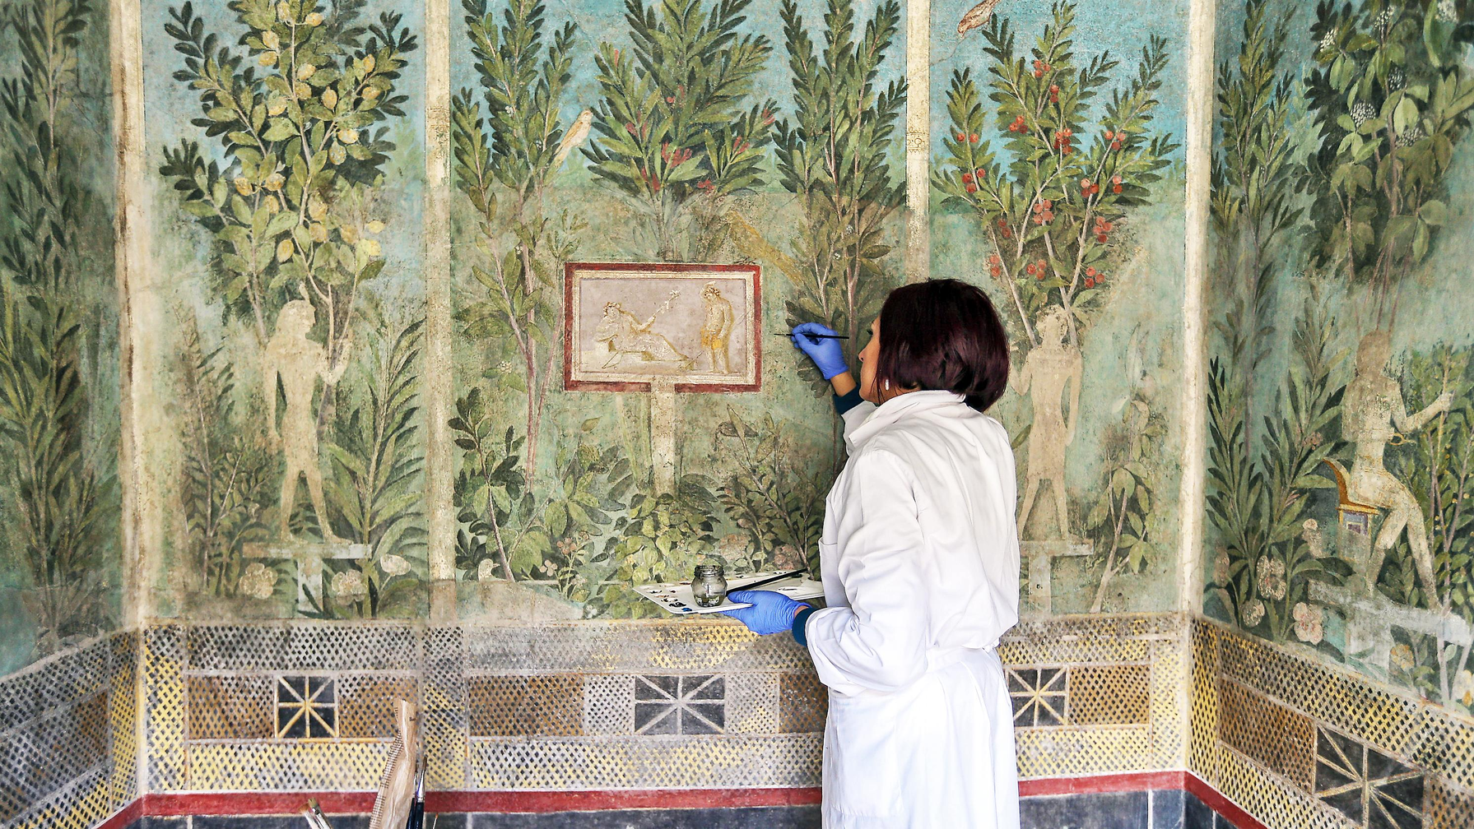
Another fresco in the architectural style from
The House of the Orchard - Pompeii, Italy
Notes:
This is from the House of the Orchard, a home that was preserved during the eruption of Mount Vesuvius and very recently restored in Pompeii. Look at the vibrant green leaves, the light blue sky and the red berries. All this detail and colour was preserved for almost 2000 years!

Slide 14
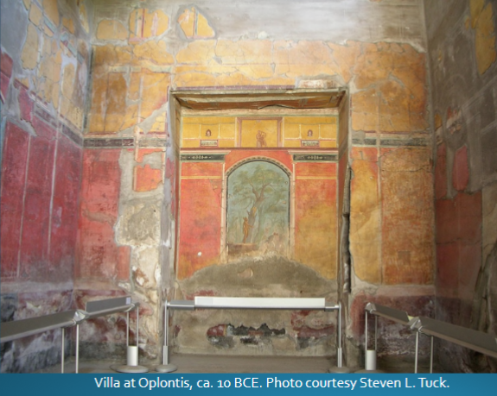
This fresco is in the third style, the ornamental style. This style still incorporated architectural elements, but fantastical, decadent ones that were not realistic for real-life buildings.

Slide 15
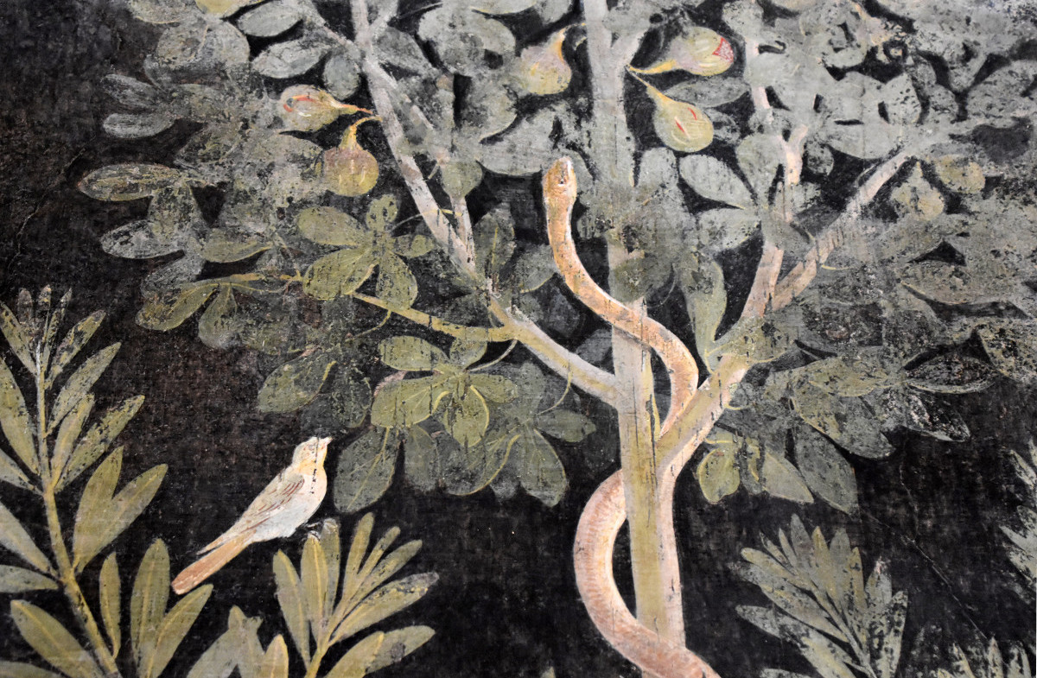
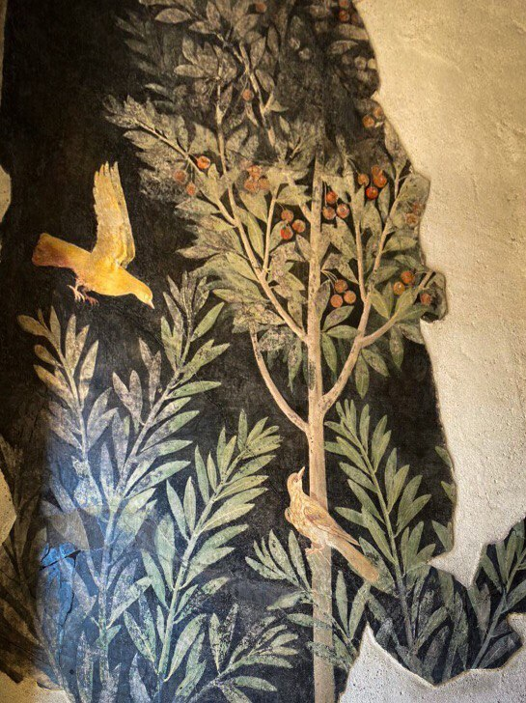


This fresco is in the fourth style, called the intricate style. These frescoes are busy and use the entire wall but are not as ornamented as the ornamental style.
La Casa degli Amanti or the House of the Lovers - Pompeii, Italy
Notes:
Finally, these are from another newly restored home in Pompeii, the House of the Lovers. These frescoes are actually from the fourth style of Pompeiian frieze, which is a combination of all three earlier styles. I really love the dark background, probably created with the charcoal paint we talked about. Garden themes were very common in fresco paintings, highlighting the beauty of nature. Did you know that the goddess Venus, or Aphrodite in Greece, was the goddess of the garden to the Romans?

Slide 16




Thank you for listening!

Slide 17

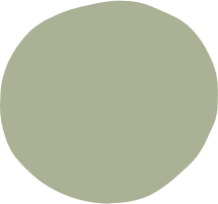


Sources
Clarke, John R. The Houses of Roman Italy, 100 B.C.-A.D. 250: Ritual, Space, and Decoration. Los Angeles: University of California Press, 1991.
Anderson, Maxwell L. “Pompeian Frescoes in The Metropolitan Museum of Art” The Metropolitan Museum of Art Bulletin, Met Publications, 45, no. 3 (Winter – 1987–1988).
"House of the Lovers" Pompeii Sites. Accessed May 26, 2022.
http://pompeiisites.org/en/archaeological-site/house-of-the-lovers/
Zucker, Steven and Beth Harris, "Painted Garden, Villa of Livia," in Smarthistory, December 6, 2015, accessed May 25, 2022, https://smarthistory.org/painted-garden-villa-of-livia/

Slide 18
Image Sources
Fiore, Julia." The Frescoes in Pompeii’s Lavish Villas Reveal the Fabulous Lives of Ancient Romans" in Artsy, August 28, 2018. Photo via Wikimedia Commons. Accessed May 25, 2022.
"Sample of iron(III) oxide" https://en.wikipedia.org/wiki/Iron(III)_oxide#/media/File:Iron(III)-oxide-sample.jpg
Kartashov, Pavel M. "Ferrihydrite" https://www.mindat.org/photo-155394.html
Pigments and painting techniques of Roman Artists - Scientific Figure on ResearchGate. https://www.researchgate.net/figure/Macro-photograph-of-lime-mortar-containing-crushed-marbleThe-blue-pigment-is-Egyptian_fig3_262896058 [accessed 25 May, 2022]

Slide 19
Image Sources
Cantile, Marco. "A restorer works on one of the frescoes in the restored..." Photograph. Getty Images, December 2019. https://www.thetimes.co.uk/article/pompeiis-painted-homes-open-frescoes-after-40-year-touch-up-cgrbd0hzq.
Scott, Jenni. "Villa of Livia: Rome’s very first First Lady." Wanted in Rome, May 2019. Accessed May 25, 2022. https://www.wantedinrome.com/news/villa-of-livia-romes-very-first-first-lady.html.
Cantile, Marco. "A detail of one of the frescoes in the restored Orchard..." Photograph. Getty Images, December 2019. https://www.cronachedellacampania.it/2019/12/pompei-retaurati-gli-affreschi-delle-stanze-da-letto-della-casa-del-frutteto/?refresh_ce.
Pompei: riapre dopo 40 anni la Casa degli Amanti.
https://grandenapoli.it/pompei-riapre-dopo-40-anni-la-casa-degli-amanti/

