Slide 1
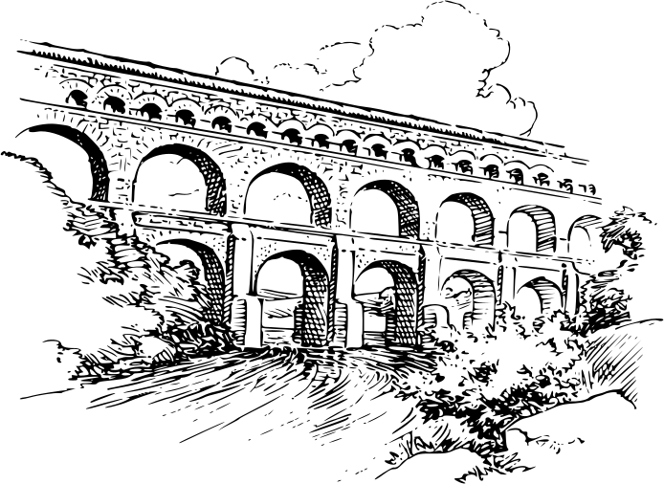
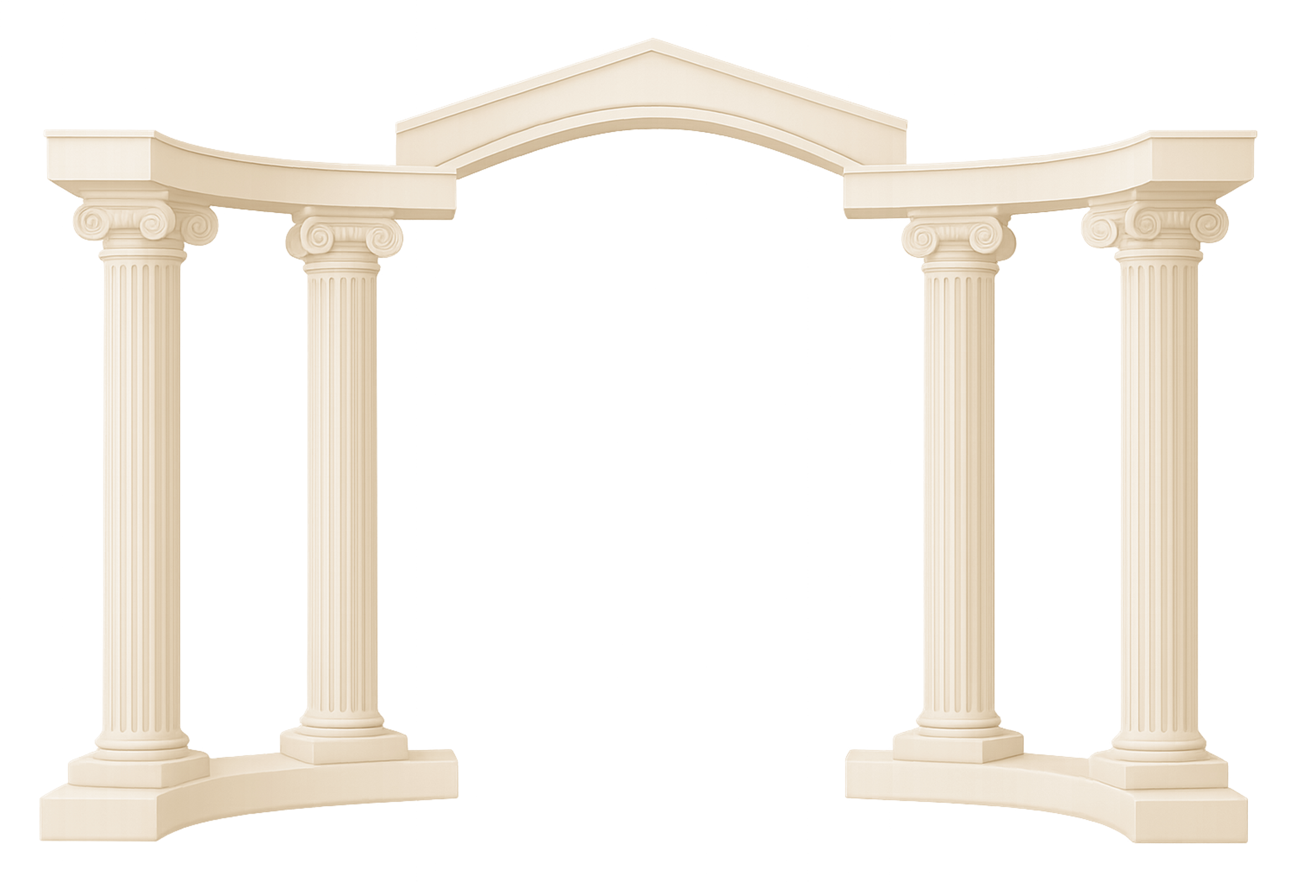

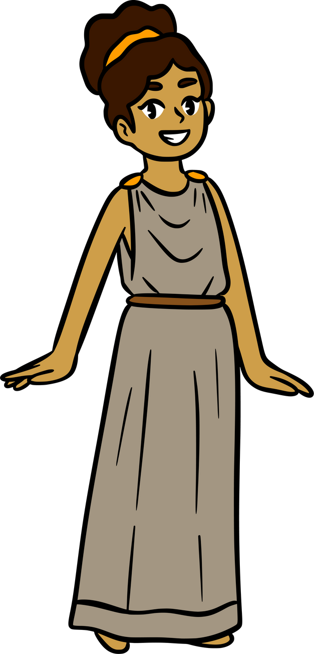

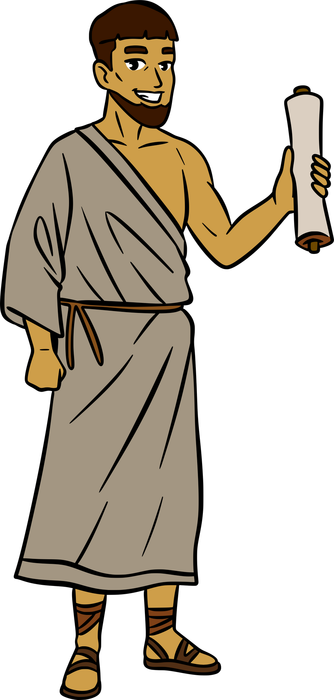

Bathing in Ancient Rome
Notes:
Today's lesson is on Bathing in Ancient Rome. Continue watching to learn about beautiful bathhouses and the importance of bathing in ancient Rome.

Slide 2
Communal Bathing
Bathing in ancient Rome was communal.
People would socialize and talk politics in the bathhouses.
Everyone bathed daily, the elite and the non-elite, including women, men and children.
Notes:
Bathing was a very important part of everyday life in ancient Rome. Bathing in ancient Rome was communal, meaning everyone bathed together. I know what you're thinking, people didn't all squish into a tub together; Roman bathhouses had multiple rooms and pools. Going to the bathhouse was for more than just bathing, as people went there to socialize, relax, exercise and learn.

Slide 3
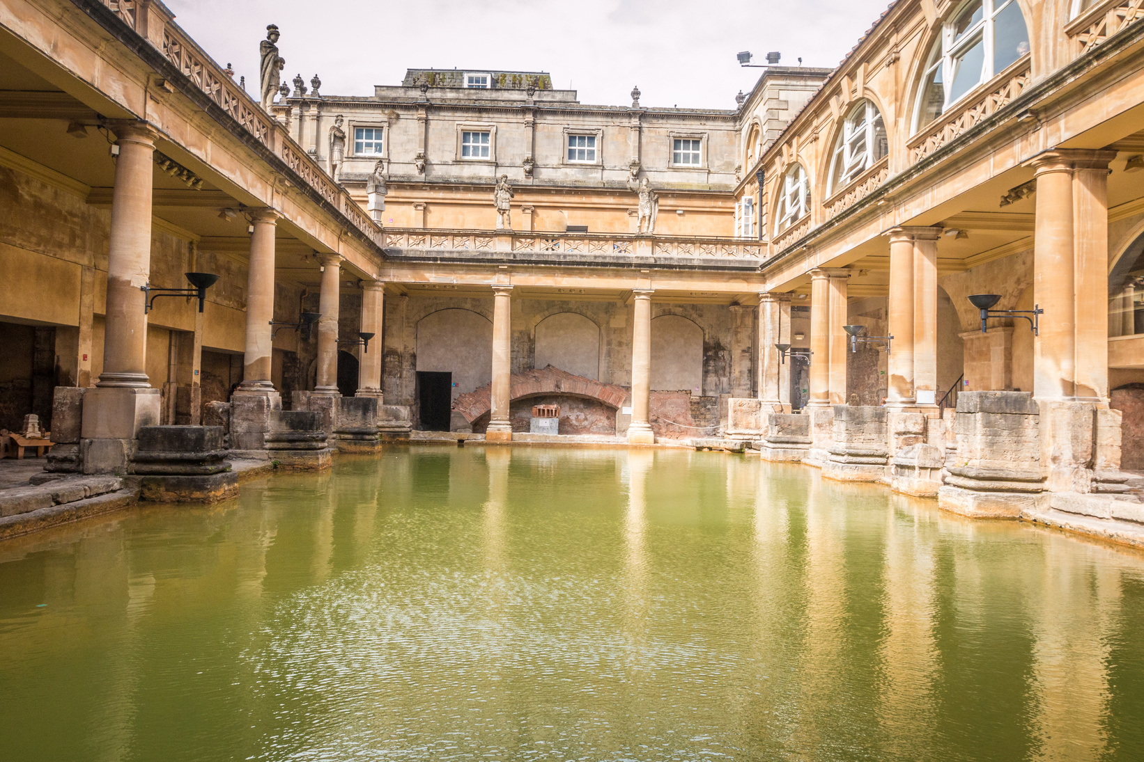
Bathhouses
Each city and town in the Roman Empire had a public bathhouse, called a thermae or balnae.
Bath houses were built by the elite of each town or city and some were built by the emperors.
Thermae is a Latin term used by the Romans to describe a large bathhouse, and balneum was used to describe a small bathhouse.
Roman baths in Bath, England.
Notes:
Each city within the empire had a bathhouse, called a thermae or balneum, for Roman citizens to use daily and thousands of people would pass through them every day. Bathing was not as simple as it is today, as the Romans had many steps to cleaning themselves that were as much about relaxing as they were about cleanliness.

Slide 4





Bathing Ritual
There were many different steps to bathing;
caldarium
(hot)
tepidarium
(warm)
fridgidarium
(cold)
caldarium
(hot)
Notes:
There were many different pools within the baths and there was a certain order for using them. You would begin with the caldarium, then go to the tepidarium, then the fridgidarium and then finally back to the caldarium. The Romans believed that this order of bathing would help keep them healthy and refreshed.

Slide 5
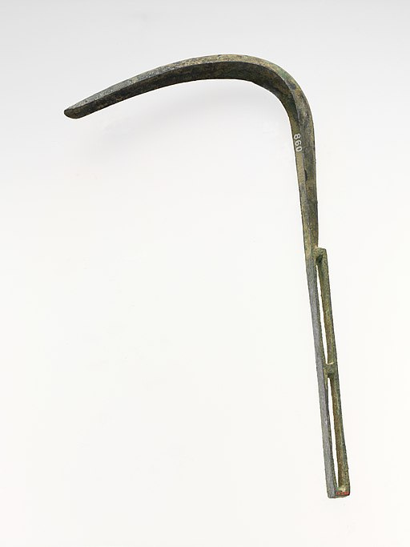
Bathhouses
A strigil was used to scrape away any dead skin or dirt.
Strigil.
Notes:
In addition to bathing in different temperatures, Romans received massages and strigling from the slaves of the bathhouse. Another aspect of wellness was getting a relaxing massage. The Romans wanted to be thoroughly clean, but instead of soap they were covered in olive oil and were scraped by a bronze tool called a strigil, to exfoliate their skin and ensure that they were squeaky clean.

Slide 6
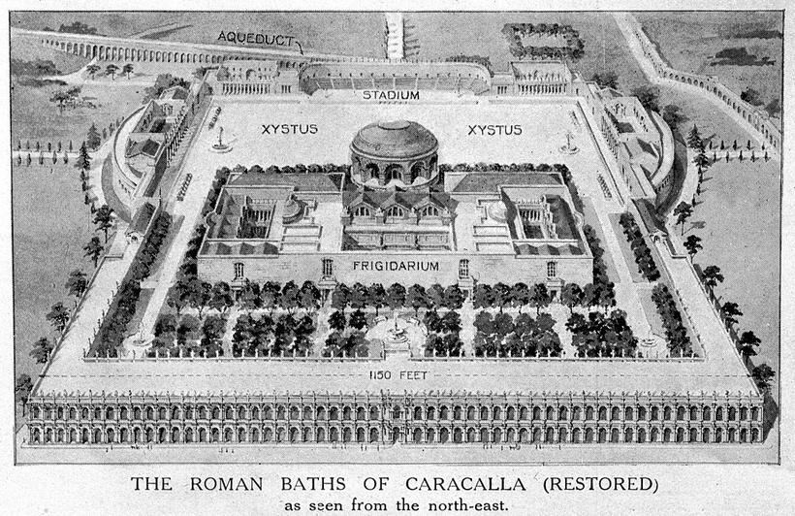
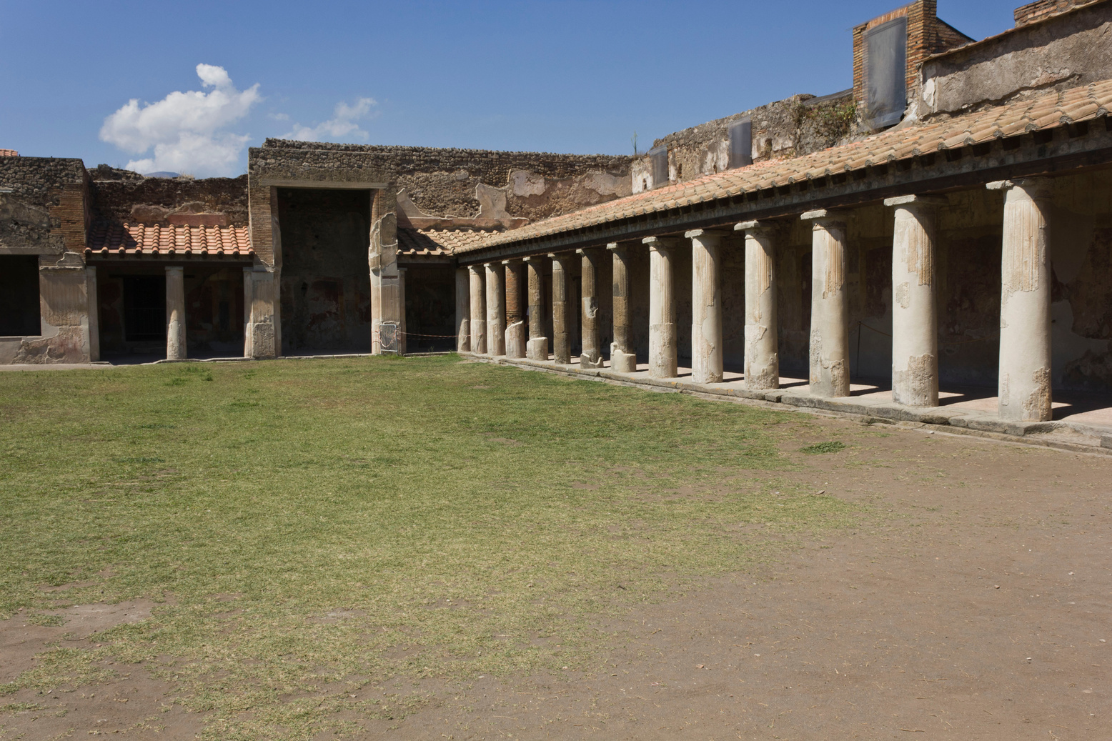
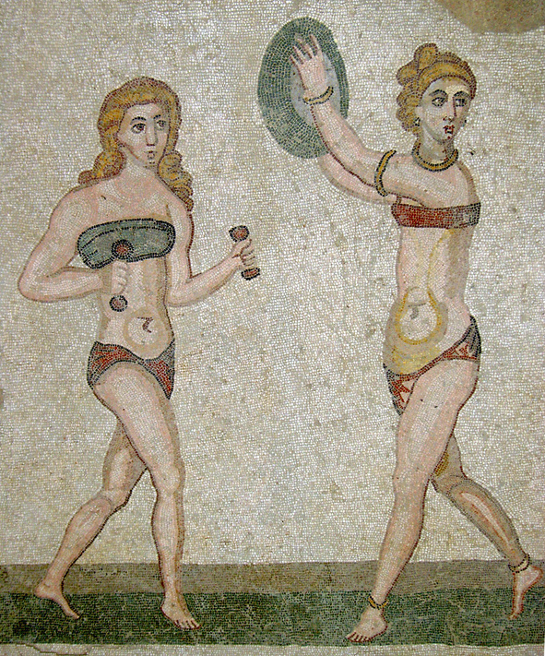

Bathhouses
Bath complexes were for more than just bathing, they were for exercising too.
The gymnasium of the Stabian baths, Pompeii.
The bath complex of Caracalla.
Roman women exercising.
Notes:
Bath complexes were a place for wellness. They had central courtyards with areas for exercising. Bath complexes like the impressive Baths of the emperor Caracalla had large courtyard gymnasiums, as seen in the image of the complex's reconstruction. Fun fact! Some bath complexes even had restaurants!

Slide 7
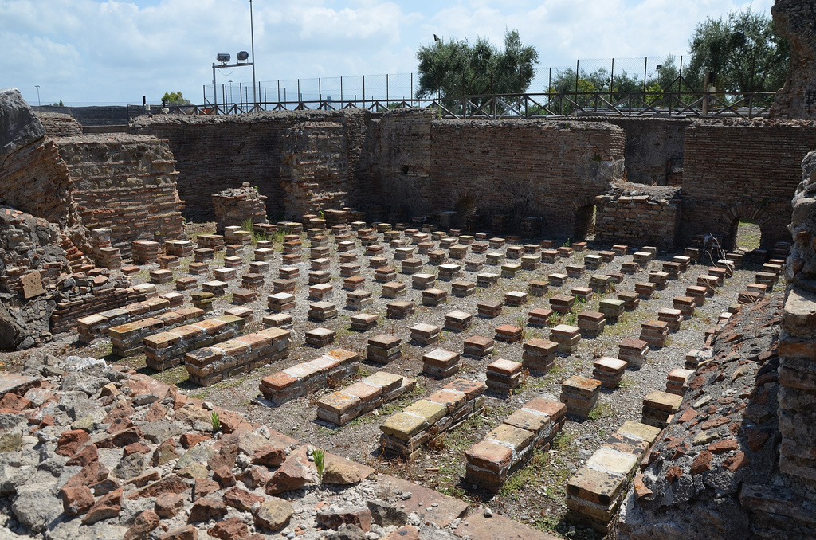
Indoor Heating
The hypocaust system of a bathhouse, Minturno, Italy.
The hypocaust system heated rooms like the tepidarium and the caldarium to keep them warm.
Warm air entered the space below the floors, heating the room above and exited through clay pipes that ran behind the walls.
Notes:
The most impressive element of Roman bathhouses was the heating system and indoor plumbing. The system used for heating the rooms of the complexes was called the hypocaust system. Heat entered space below the floor by a system of pipes. The heat was created by a wood-burning furnace. The hot air was then directed from the furnace to an open space below the floors, as you can see in the image to the left, although the floor no longer remains. The warm air then exited through clay pipes behind the walls of the room, which heated the room on the way out.

Slide 8
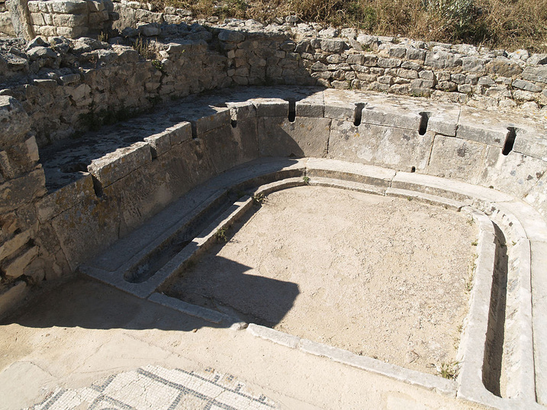
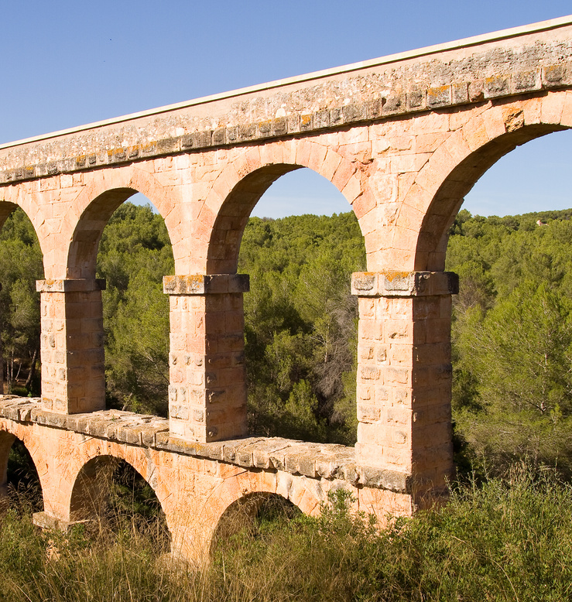
Indoor Plumbing
Aqueducts were attached to the bath complexes and fed water to the indoor plumbing system.
As the used water left the pools, it passed through the bathrooms and flushed out the toilets.
Aqueduct.
Roman toilets, Baths of the Cyclopes, Dougga.
What is an aqueduct?
An aqueduct is an above ground plumbing system that carried water into the city.
Notes:
Roman bathhouses had indoor plumbing too! The water used to fill the pools entered the bath complexes from an attached aqueduct. The water did not go to waste; as the water was drained from the pools it passed through the bathrooms and flushed out the toilets. What is an aqueduct? An aqueduct is one of many impressive feats of Roman engineering. It is an above ground plumbing system that carried water from a water source, like a lake, and carried into the city.

Slide 9
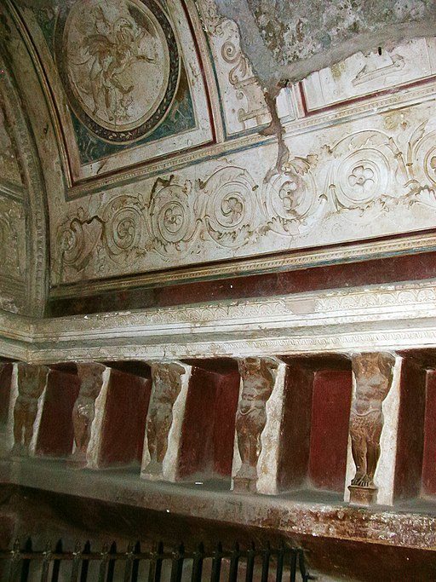
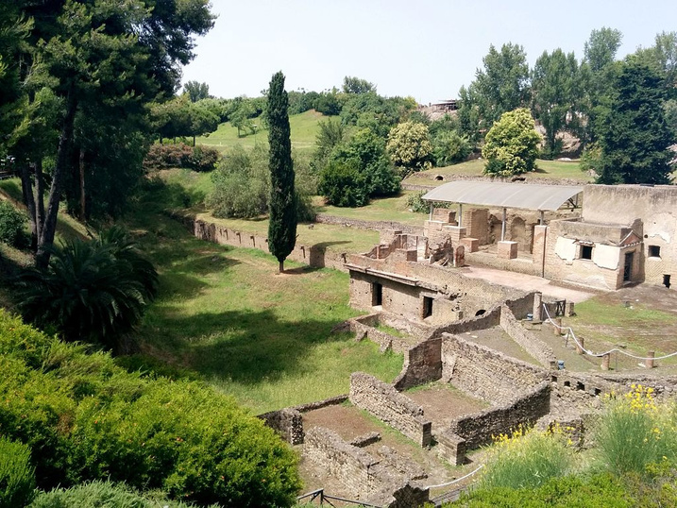
Bathhouse Art &Architecture
Not all bath complexes looked the same, as each had a different layout and design.
The inside and outside of the buildings were beautifully decorated.
Suburban baths, Pompeii.
Wall and ceiling of the tepidarium in the Forum Baths of Pompeii.
Notes:
The bath complexes were made of brick, and some were immensely grand, like the Baths of Caracalla, pictured to the left, which is now just a shell of what it once was. Not all bath complexes were the same, as each differed in layout and design. The inside and outsides of the buildings were beautifully decorated, as you can see in the image from within the tepidarium of the Forum Baths in Pompeii.

Slide 10
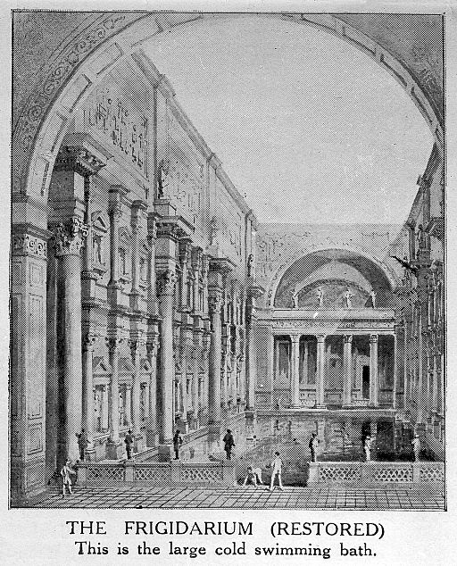
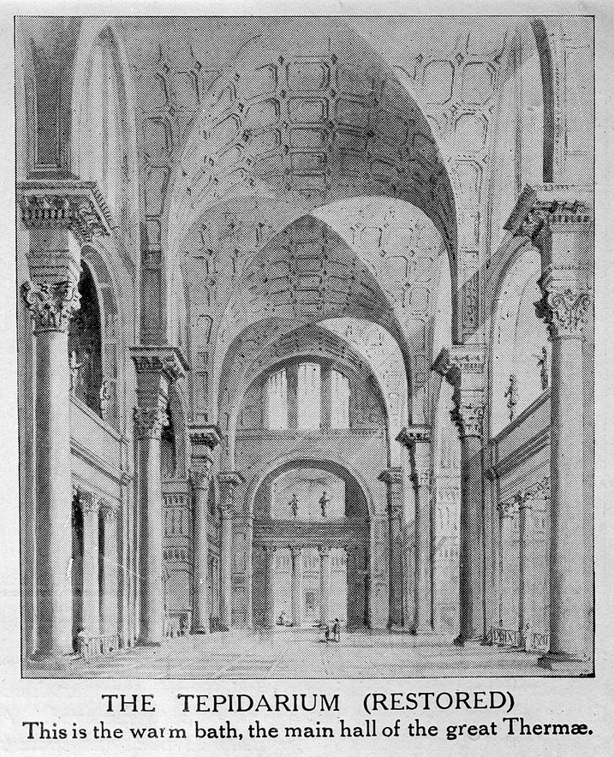
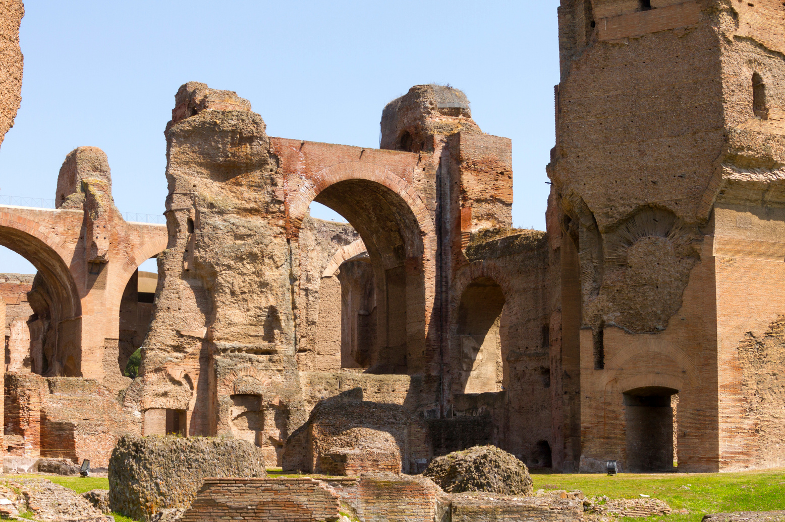
Bathhouse Art & Architecture
Reconstruction of the Baths of Caracalla.
Baths of Caracalla.
Notes:
Some bath complexes were immense and grand, like the baths of Emperor Caracalla. The baths of Caracalla had high ceilings with large archways, which would have been incredibly beautiful, luxurious and stunning.

Slide 11
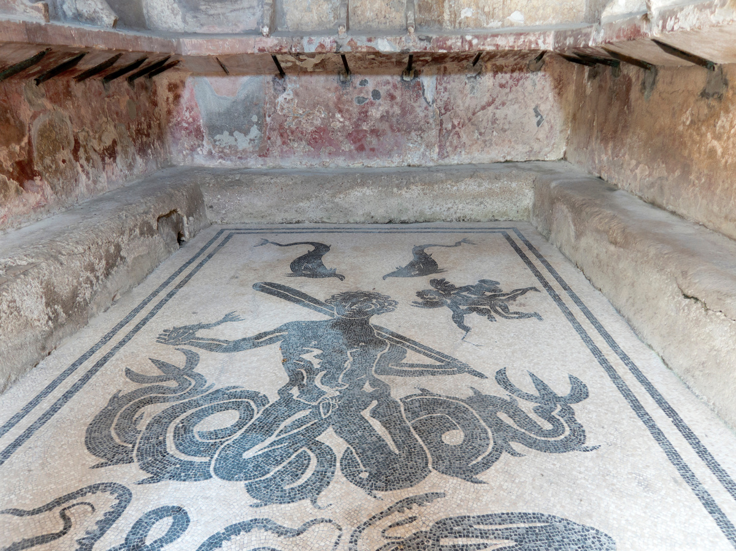
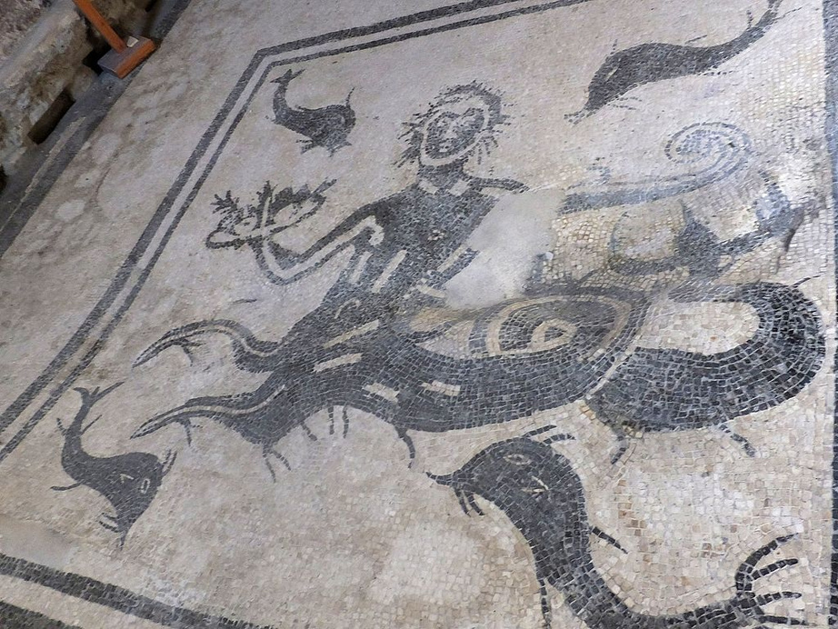
Bathhouse Art &Architecture
Mosaic, women's tepidarium, Herculaneum Central Baths.
Mosaic, men's tepidarium, Herculaneum Central Baths.
Notes:
Some bath complexes included areas for learning, which included libraries and art galleries. But, art could be found on the walls and floors throughout the complexes, like mosaics and frescoes. Animals, plants, mythical creatures and Roman gods could be found in the decorations throughout the baths.

Slide 12
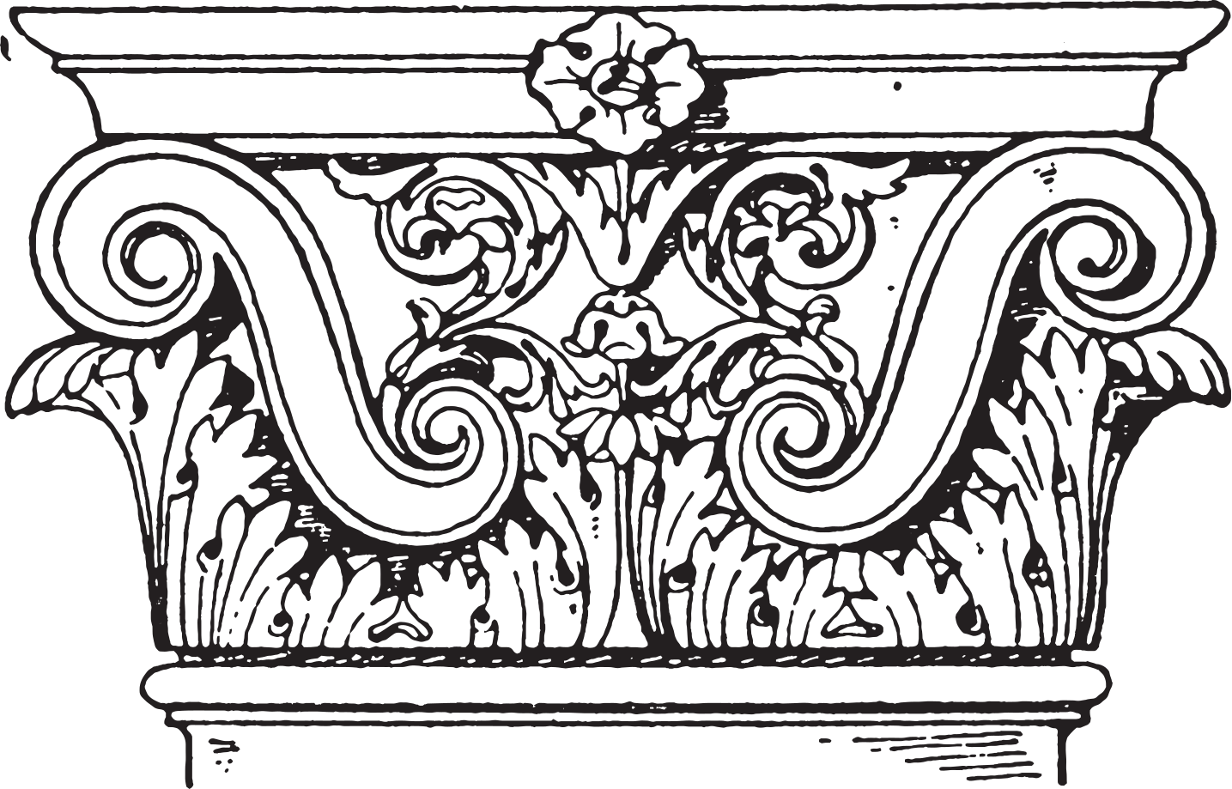
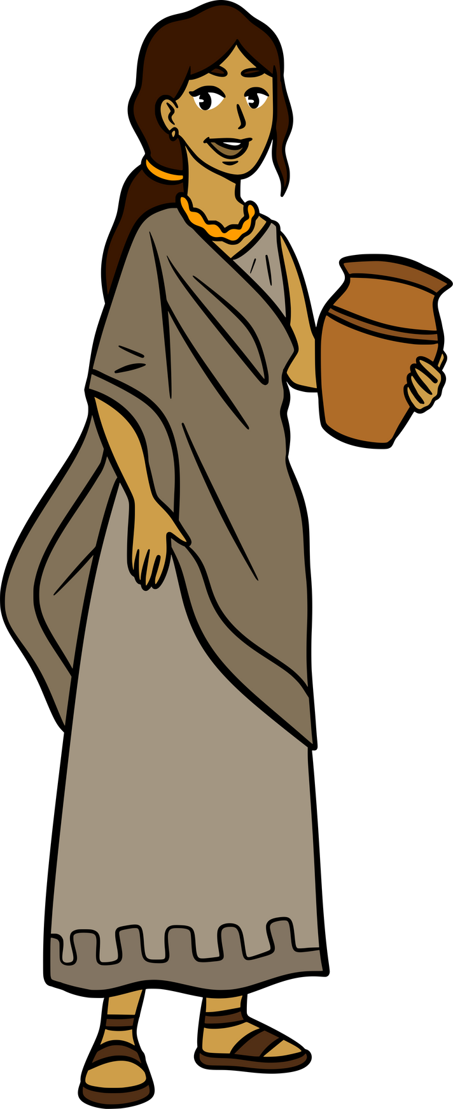

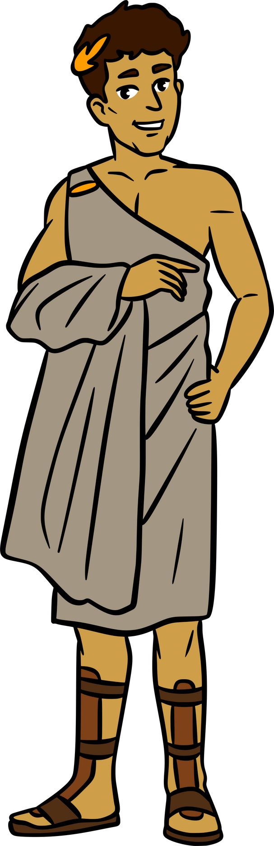
Don't Forget!
Daily bathing was very important in Roman society.
Bath complexes were centres for wellness.
Every city and town in the empire had a bathhouse, and they all differed in size, design and layout.
Notes:
Let's review what we've learned today! Don't forget these main points! The Romans visited the bathhouse every day, as cleanliness was important. Bath complexes were centres for wellness, as people went there to exercise, relax, socialize and learn. Every city and town in the empire had a bathhouse, and they all differed in size, design and layout. Some were very large and some were smaller.

Slide 13

Thank you!
Notes:
Thank you for watching! For more educational lessons and fun activities, visit Ancient Medieval Adventures Camp Online!

