Slide 1



The Theater of Dionysus :
The Ancient Greek Origins of Theatre

Slide 2
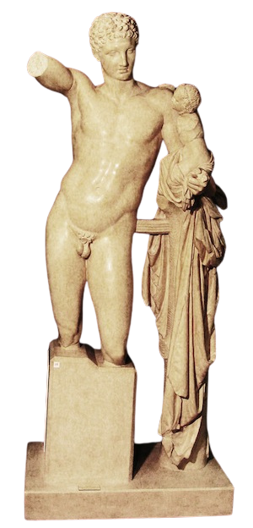
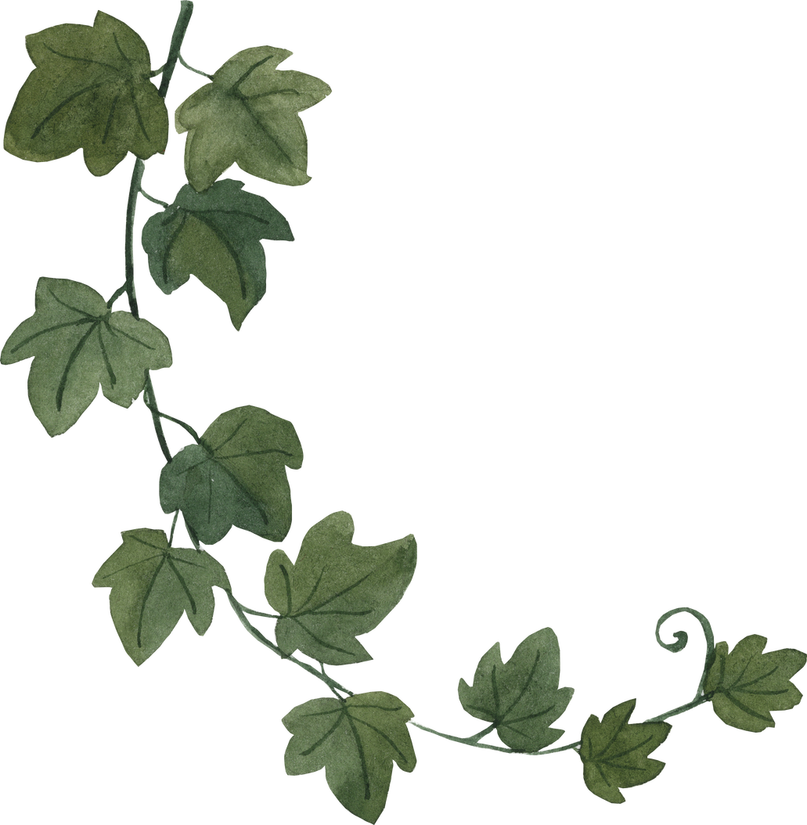
Dionysus
The Greek God of wine, theatre, ritual madness, fertility and ecstasy.
City Dionysia
The City Dionysia was a Greek festival established in the 6th century BCE that celebrated Dionysus. Theatrical performances and competitions were held at the festival to honour the god.
Hermes with the Infant Dionysus
Classical Greek, Replica.
Museum of Antiquities

Slide 3
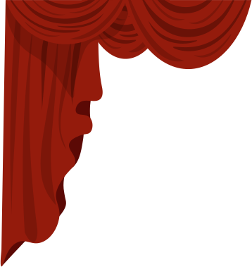
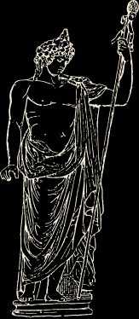
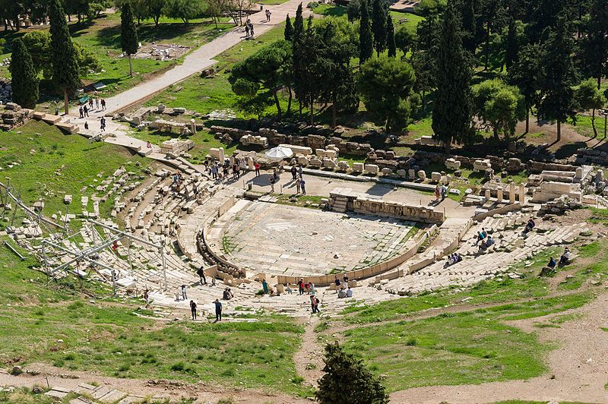
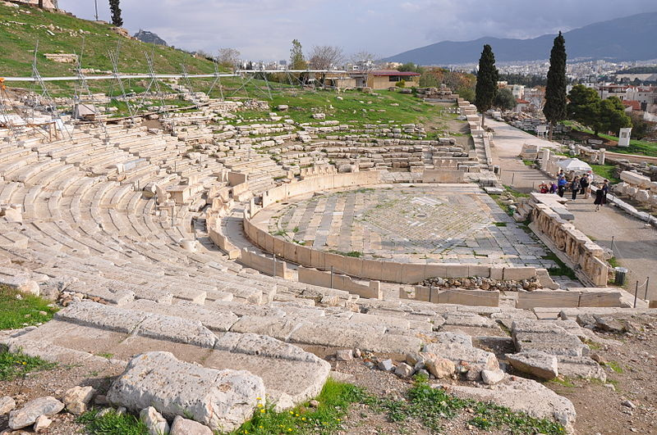
This theatre in Athens is considered the first example of a Greek theatre and the birthplace of Greek drama. The theatrical performances at the City Dionysia were performed here.
The Theatre of Dionysus

Slide 4
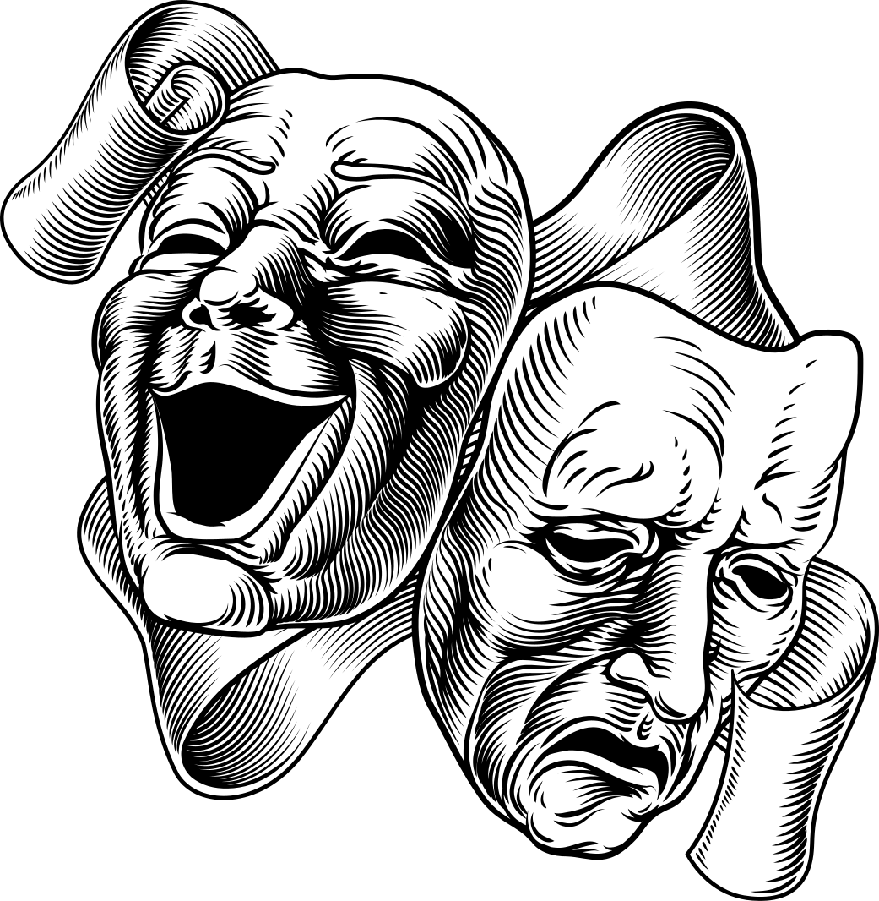

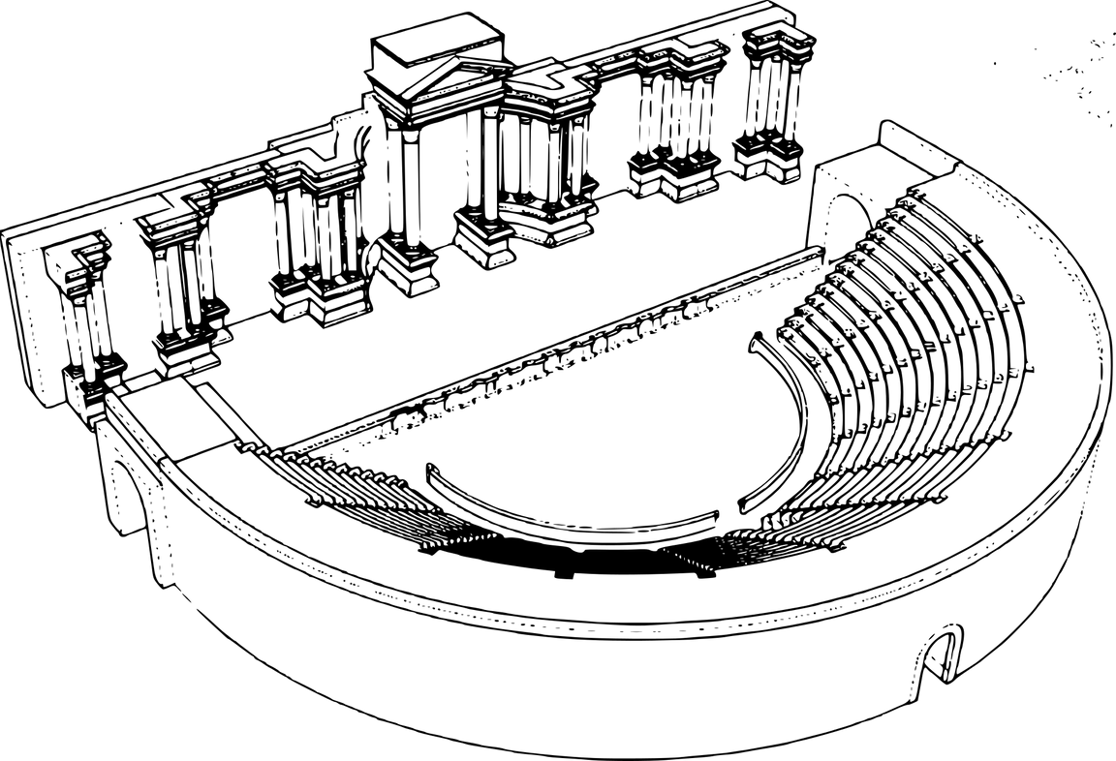


Greek Theatre Vocabulary
Skene
Parodoi
The word 'theatre' comes from the Greek word 'theatron' which literally means "place for seeing."
Orchestra
Parodoi
Cavea

Slide 5
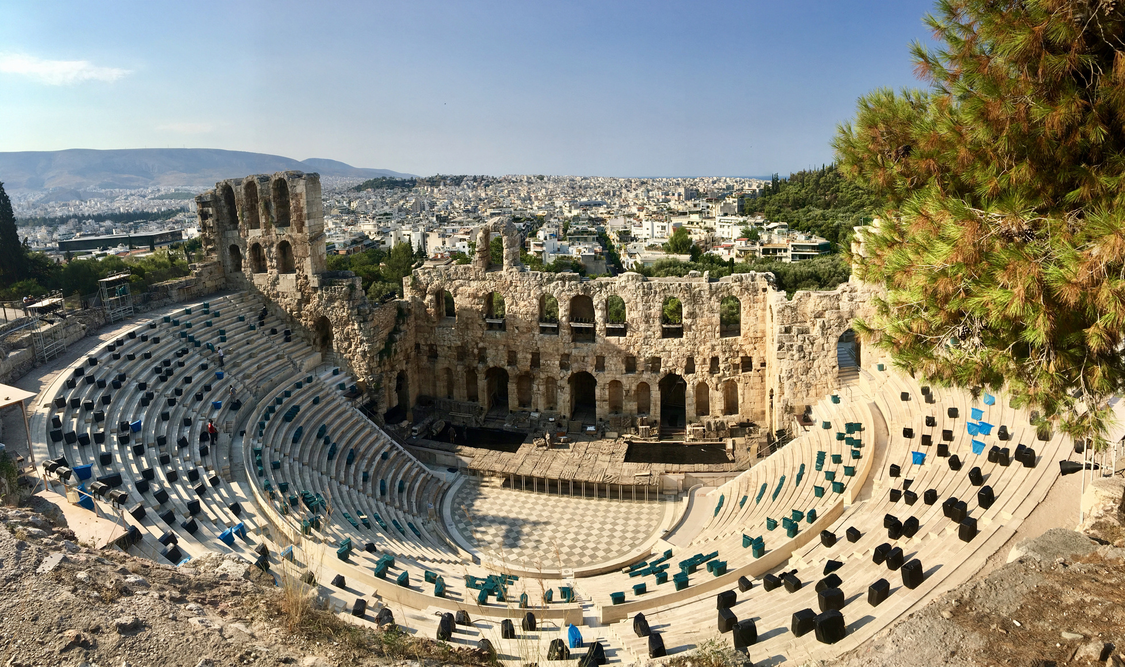
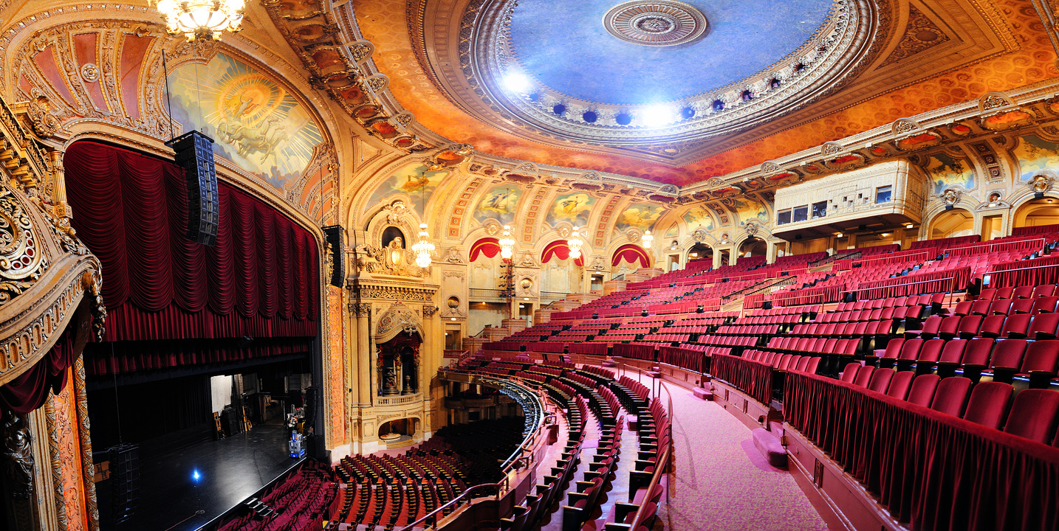

What are some similarities and differences that you can see between
ancient and modern theatres?

Slide 6


Tragedy, Comedy and Satyr : The 3 Genres of Ancient Greek Plays
Tragedies were, as the name suggests, tragic. They explored themes like death, loss, pride, abuse of power and the relationship between men and the gods.
Tragedy :
Comedies were funny, just like they are today. They were often satirical meaning they used irony and exaggeration to criticize people and things, often politics and current issues. Later comedies were more like sitcoms (think: Friends, The Office).
Comedy :
Satyr plays were performed during tragedies in between acts. They often made fun of the struggles of the characters in the tragedies and used more crude humour.
Satyr :

Slide 7

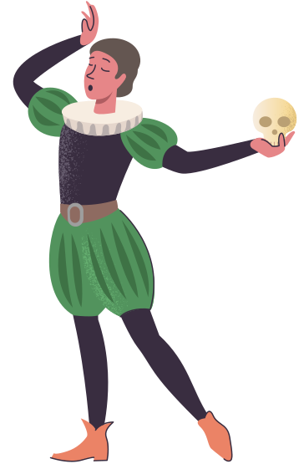
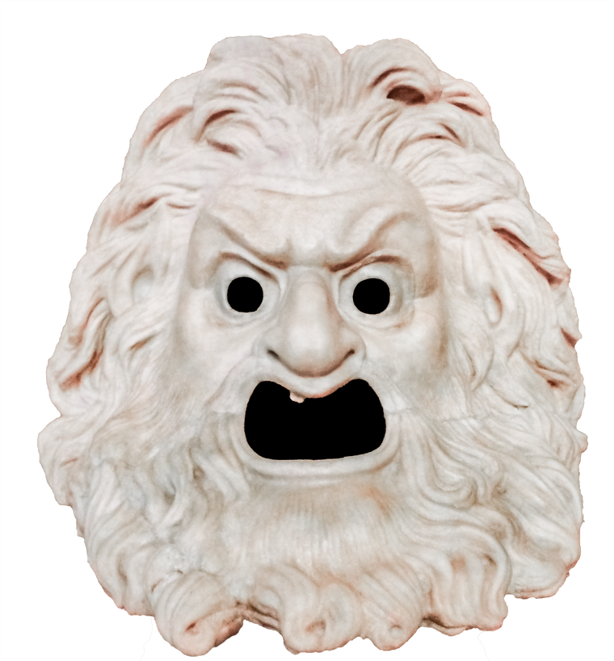
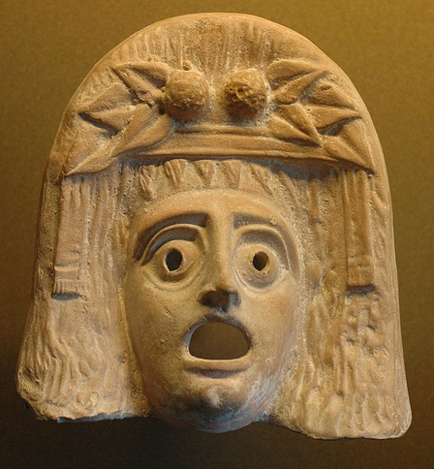
The Actors
A maximum of 3 actors were allowed on stage at a given time, meaning that actors often had to play more than one role.
The Masks
Masks were worn so that an actor could play more than one role.

Slide 8
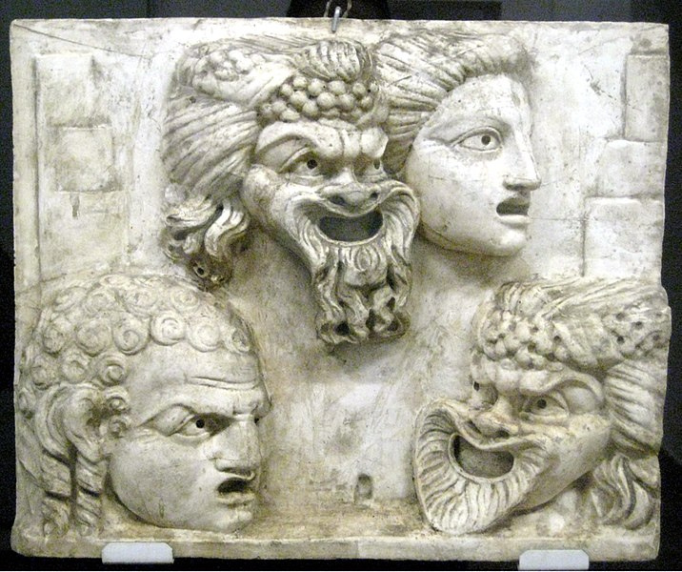
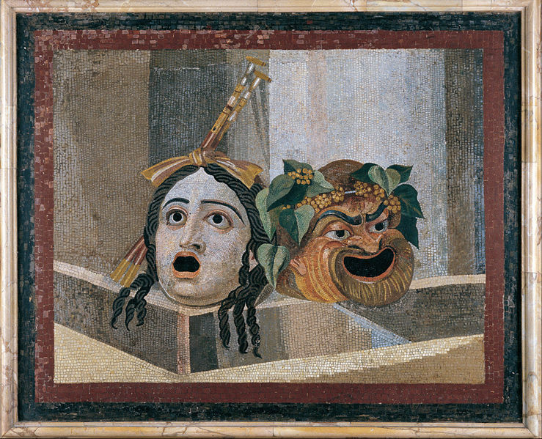
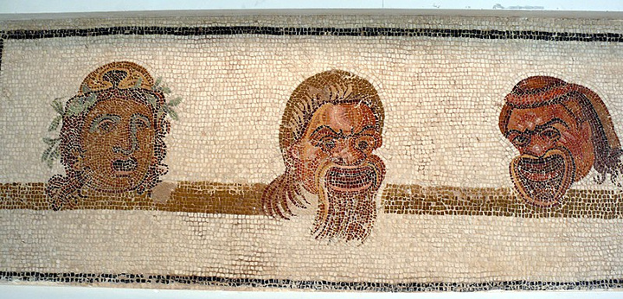
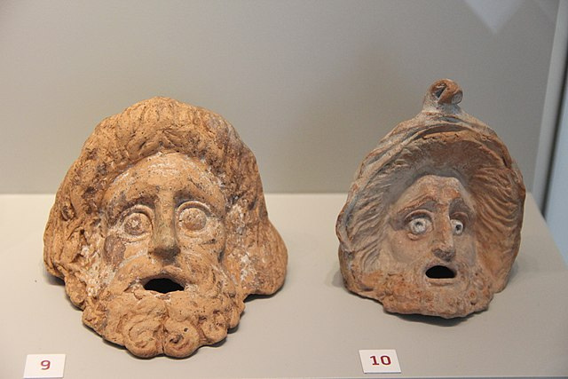
The masks were made of stiffened and painted linen and would sometimes have real animal or human hair on them!

Slide 9
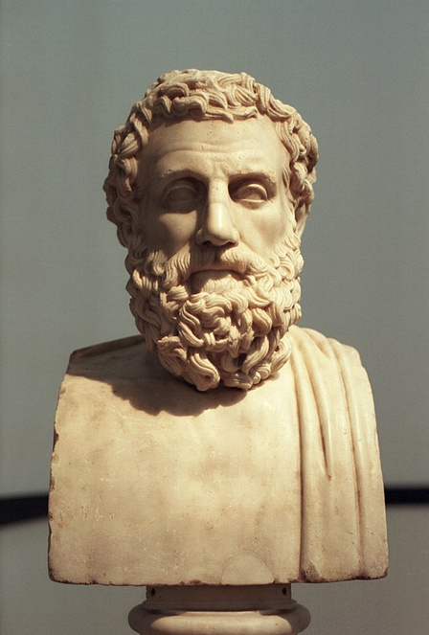
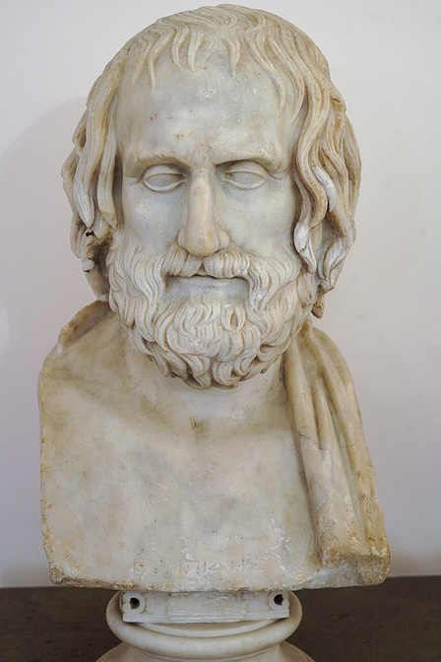
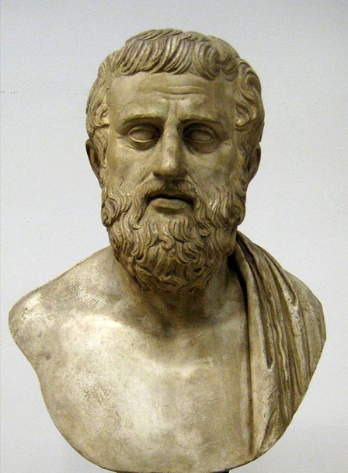
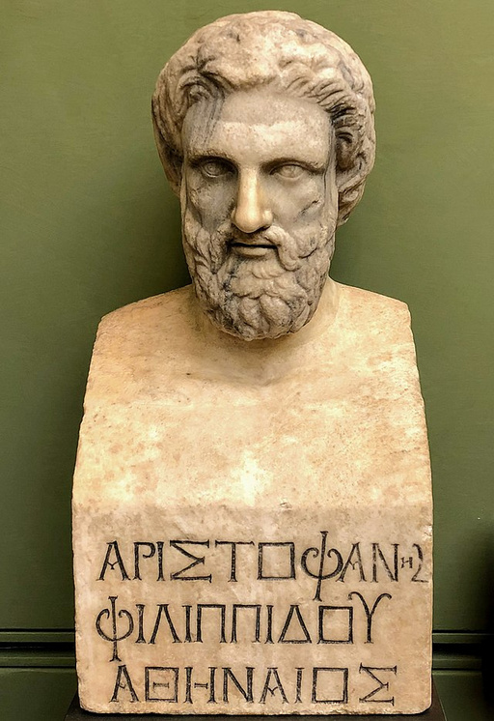
The Playwrights
Aeschylus
Euripides
525/524 -456 BCE
Tragedian
The father of tragedy.
480 - 406 BCE
Tragedian
Sophocles
Aristophanes
497/496 -
406/405 BCE
Tragedian
446 - 386 BCE
Comic playwright
The so-called master of comedy.

Slide 10
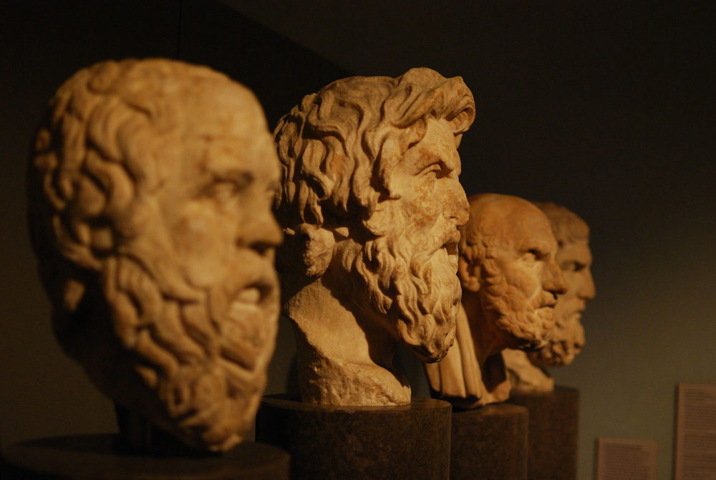
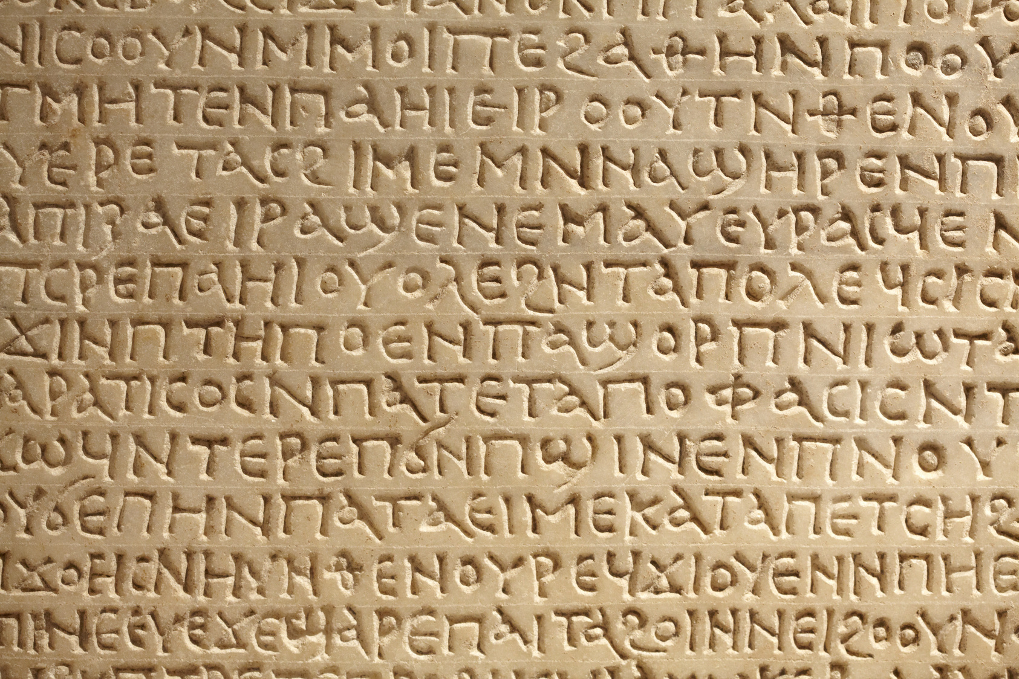
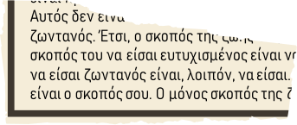
Aeschylus, Sophocles, and Euripides are the only 3 ancient Greek playwrights who have works that have survived in full.
All other plays that we know of, including Aristophanes’ famous comedies, are incomplete or fragmented.

Slide 11

Crash Course Video

Slide 12



How do you think ancient theatre might have influenced medieval or modern theatre, films, and television?

Slide 13
Bibliography
Giordano, Manuela. Out of Athens. Ritual Performances, Spaces, and the Emergence of
Tragedy. Berlin and Boston, 2014. 151-177
https://www.academia.edu/30606057/_Out_of_Athens_Ritual_Performances_Spaces_and_the_Emergence_of_Tragedy_in_G_Colesanti_M_Giordano_Submerged_Literature_in_Ancient_Greek_Culture_An_Introduction_Berlin_and_Boston_2014_151_177?email_work_card=view-paper
? Kassem, Asmaa. The Origins of Theatre in Ancient Greece and Beyond. Cambridge
University Press, 2007.
https://www.academia.edu/50756550/The_Origins_of_Theater_in_Ancient_Greece_and_Beyond?email_work_card=view-paper
Meineck, Peter. “The Embodied Space: Performance and Visual Cognition at the
Fifth Century Athenian Theatre.” New England Classical Journal. 39.1
(2012) 3-46. https://www.academia.edu/1490388/The_embodied_space_performance_and_visual_cognition_at_the_Theatre_of_Dionysos?email_work_card=view-paper
Papastamani-von Moock, Christina. “The Theatre of Dionysus as a Landmark for the Birth
of Theatre.” European Heritage Label. (2018) 1-5. https://www.academia.edu/40734564/The_Theatre_of_Dionysus_as_a_landmark_site_for_the_birth_of_theatre?email_work_card=view-paper
Vozani, Ariadni. The Architectural Correspondence of Space and Speech in Tragedy.
2003.
https://www.academia.edu/39389977/THE_ARCHITECTURAL_CORRESPONDENCE_OF_SPACE_AND_SPEECH_IN_TRAGEDY?email_work_card=view-paper
Wallace Pickard, Arthur. The Theatre of Dionysus in Athens. Oxford Clarendon Press. 1946.
https://www.academia.edu/44326516/The_Theatre_of_Dionysus_in_Athens_by_Arthur_Wallace_Pickard_Cambridge_1946_?email_work_card=view-paper

Slide 14
Image Sources
“Bacchus by Caravaggio” https://upload.wikimedia.org/wikipedia/commons/0/02/Bacchus_by_Caravaggio_1.jpg
“Dionysus Theater” https://upload.wikimedia.org/wikipedia/commons/2/2e/DionysiusTheater.jpg
“Theatre of Dionysus” By Farai Gandiya https://upload.wikimedia.org/wikipedia/commons/7/7a/Theatre_of_Dionysus_Panorama.jpg
“Ancient Times, Greek - Costumes of All Nations” https://upload.wikimedia.org/wikipedia/commons/7/70/Ancient_Times%2C_Greek._-_009_-_Costumes_of_All_Nations_%281882%29.JPG
“Ancient Greek Terracotta Mask” By Dorieo https://upload.wikimedia.org/wikipedia/commons/4/4f/Ancient_Greek_terracotta_mask_-_AGMA.jpg
“Dionysos mask Louvre” By Marie-Lan Nguyen https://upload.wikimedia.org/wikipedia/commons/4/44/Dionysos_mask_Louvre_Myr347.jpg
“Sophocles pushkin” By Shakko https://upload.wikimedia.org/wikipedia/commons/1/19/Sophocles_pushkin.jpg
“Euripide” https://upload.wikimedia.org/wikipedia/commons/6/67/Euripide.jpg
“Herma of Aeschylus” https://upload.wikimedia.org/wikipedia/commons/b/ba/Herma_of_Aeschylus%2C_Klas08.jpg
“Bust of Aristophanes” By Alexander Mayatsky https://upload.wikimedia.org/wikipedia/commons/0/08/Bust_of_Aristophanes.jpg
“Doppelseitiges Maskenrelief” By A, Ocram
https://upload.wikimedia.org/wikipedia/commons/0/0f/Doppelseitiges_Maskenrelief.JPG
“Masks Pushkin” By Shakko
https://upload.wikimedia.org/wikipedia/commons/0/09/Masks_pushkin.jpg
“Mosaic of the theatrical masks” https://upload.wikimedia.org/wikipedia/commons/3/3c/Mosaic_of_the_theatrical_masks_-_Google_Art_Project.jpg
“Sousse mosaic theatre masks” By Ad Meskens
https://upload.wikimedia.org/wikipedia/commons/6/66/Sousse_mosaic_theatre_masks.JPG
“Ancient Greece Terracotta Theater Figures” By Gary Todd
https://upload.wikimedia.org/wikipedia/commons/6/62/Ancient_Greece_Terracotta_Theater_Figures_%2828123059103%29.jpg
“Mousai Helikon Staatliche Antikensammlungen Schoen” https://upload.wikimedia.org/wikipedia/commons/6/63/Mousai_Helikon_Staatliche_Antikensammlungen_Schoen80_n1.jpg
“Aulos player Met” By Brygos Painter https://upload.wikimedia.org/wikipedia/commons/e/e4/Aulos_player_Met_24.97.28.jpg

