Slide 1
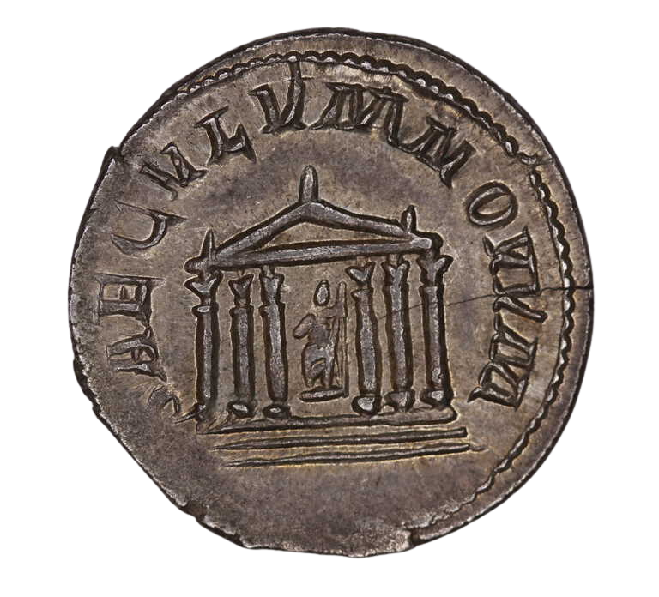
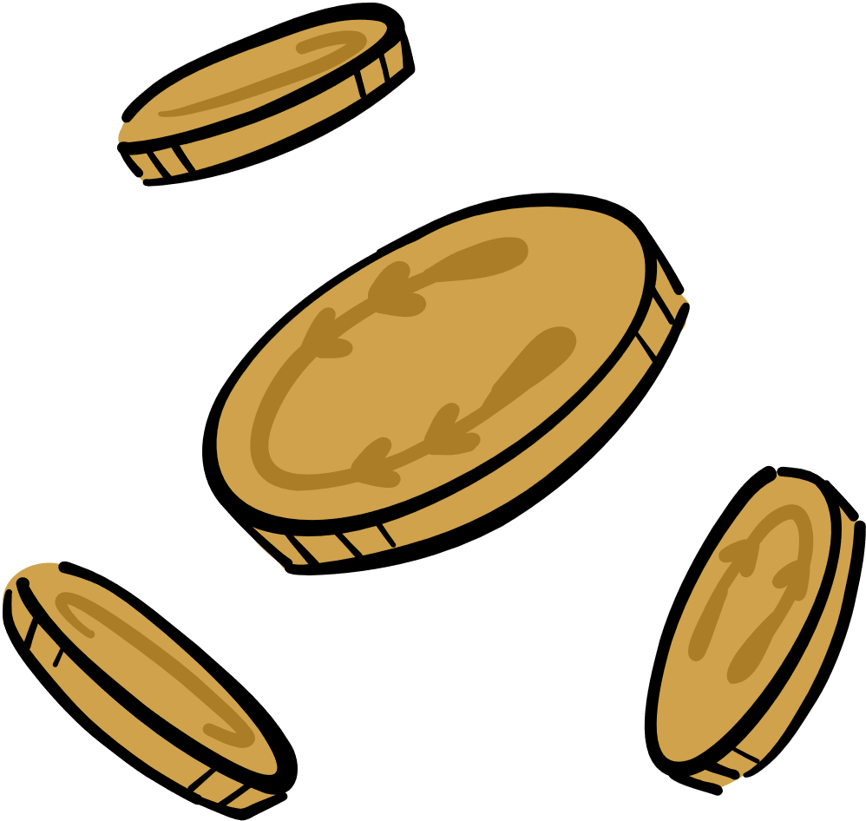
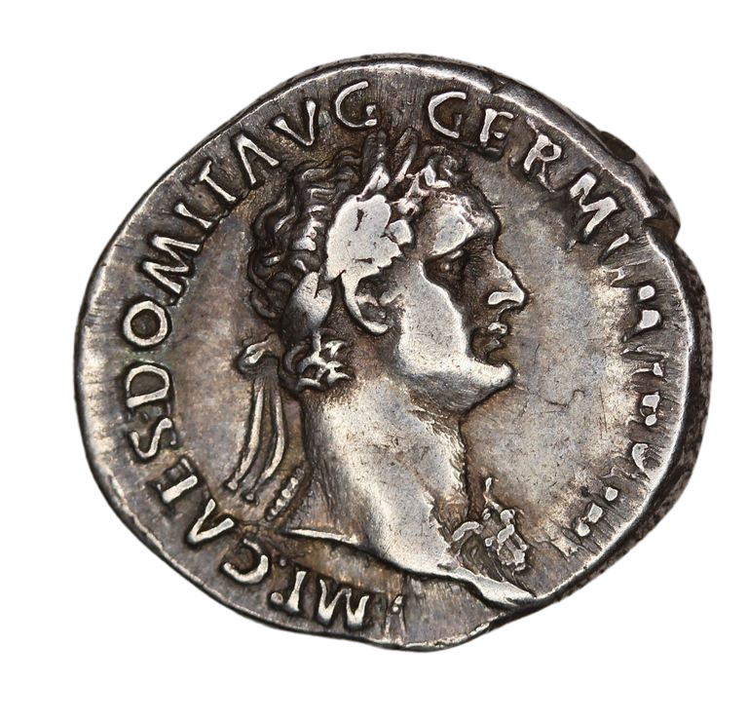
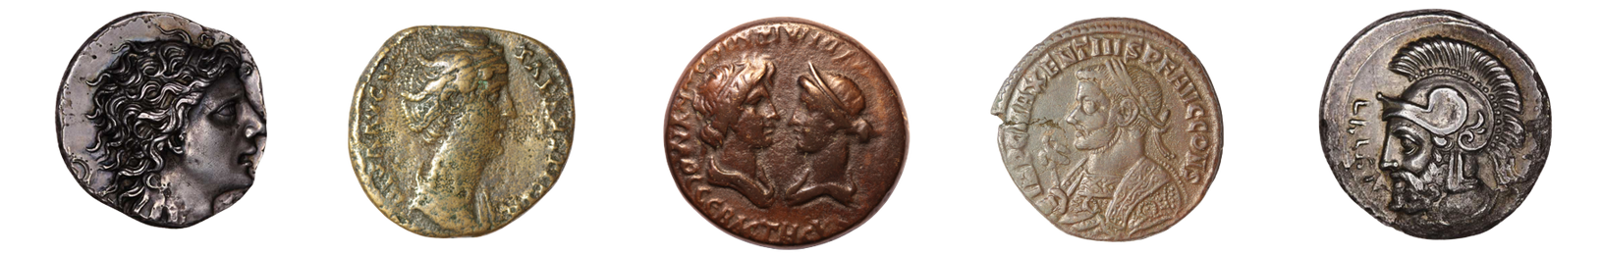
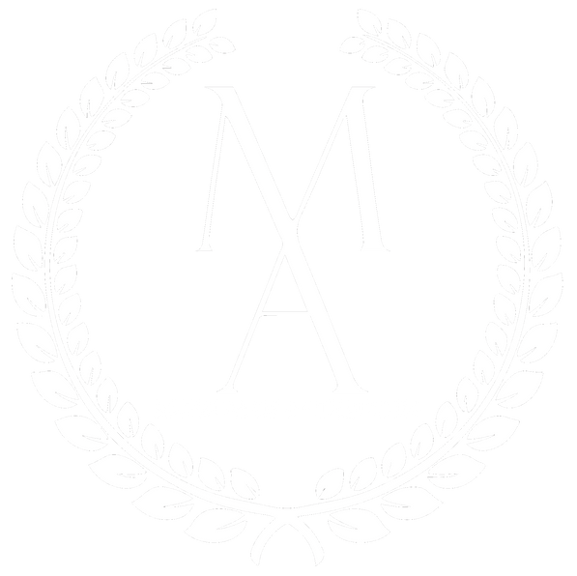

Introduction to Ancient Numismatics

Slide 2
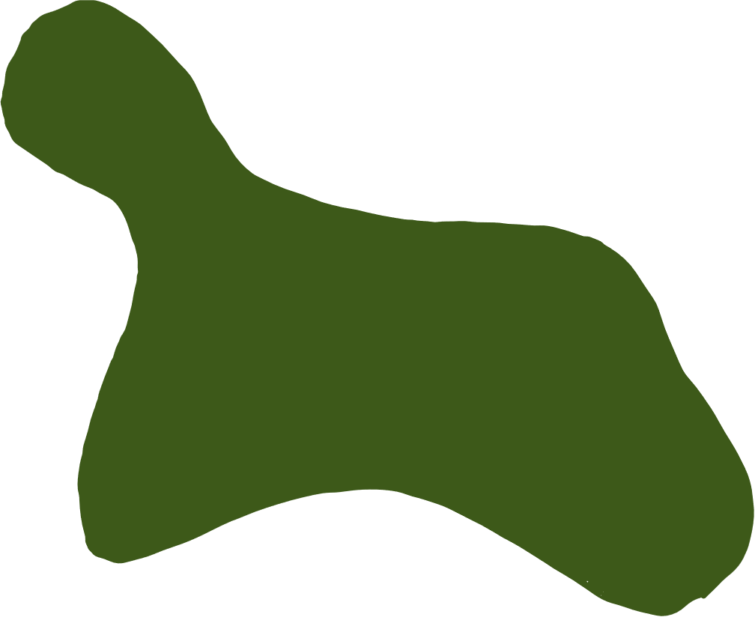
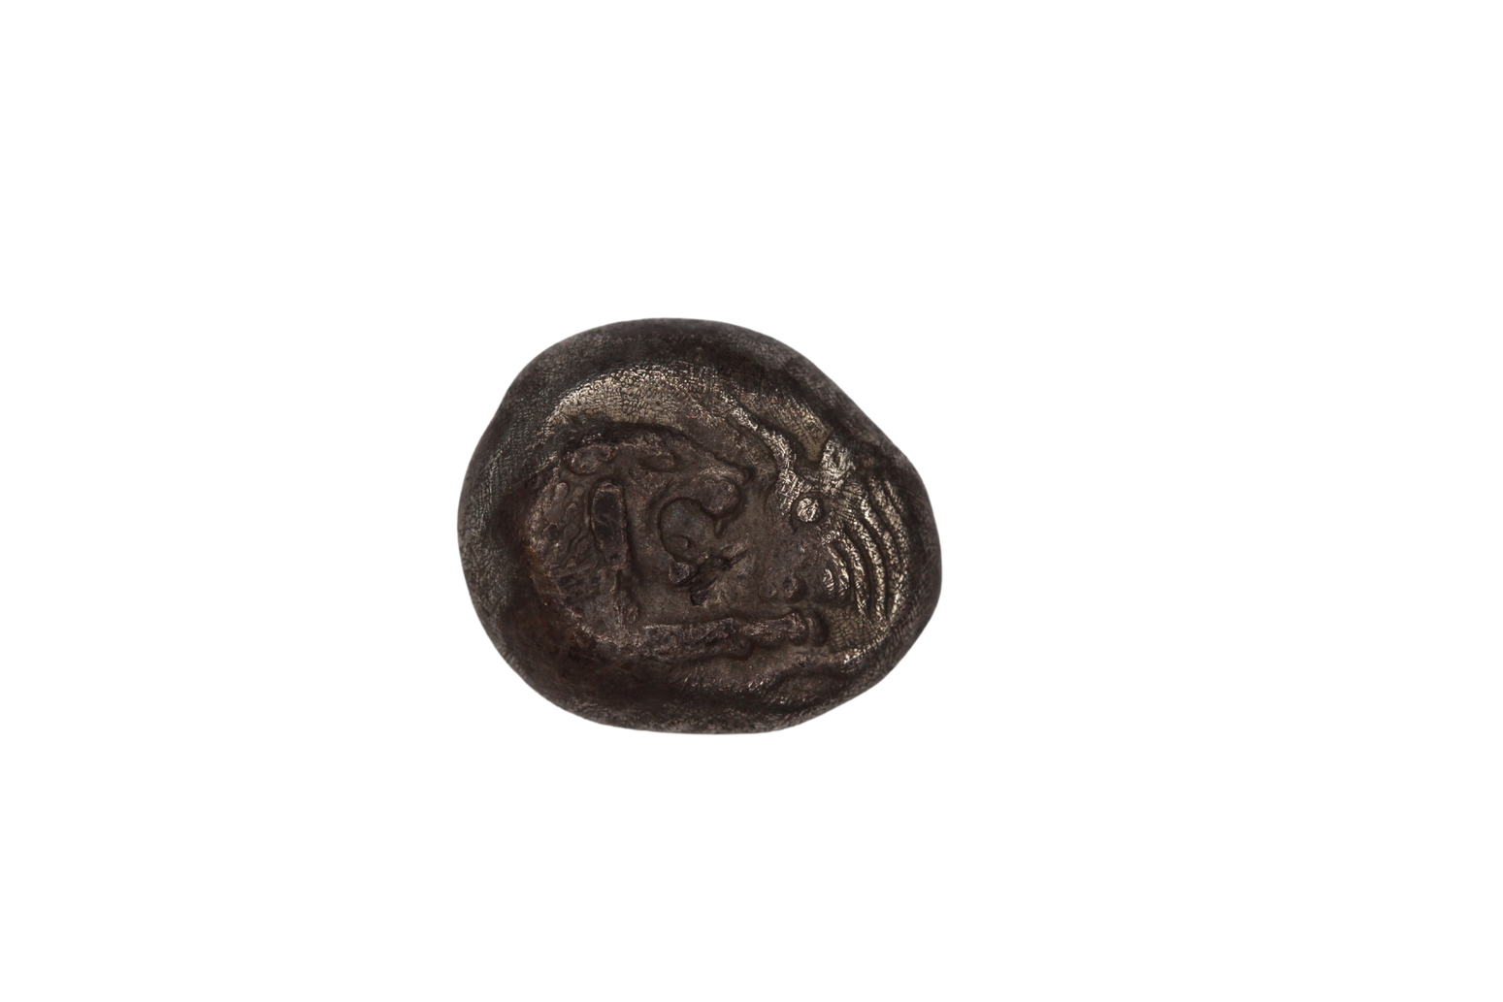
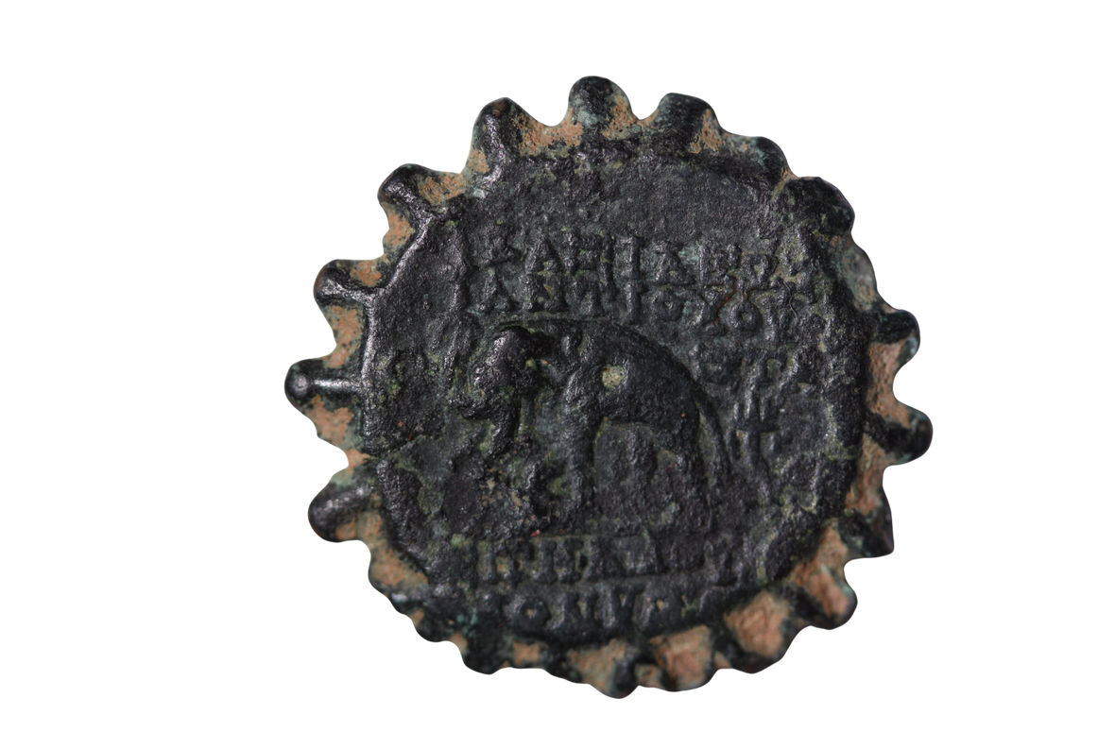
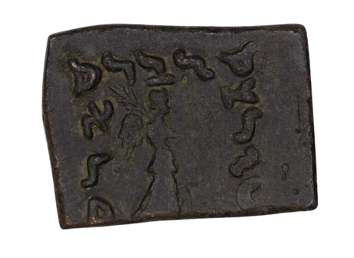
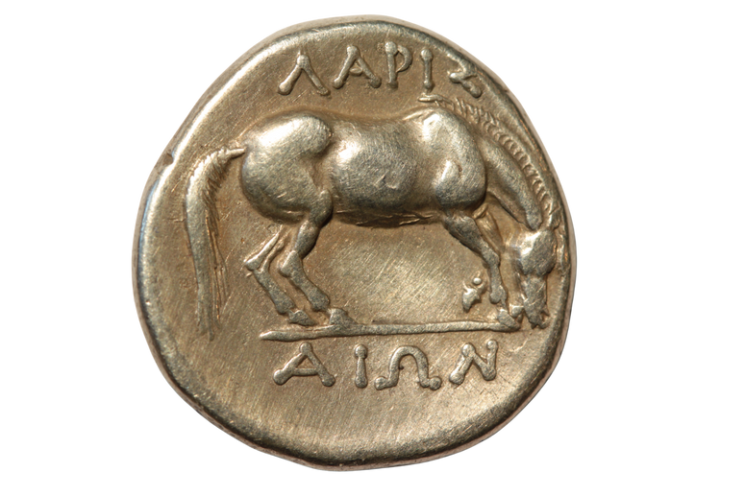
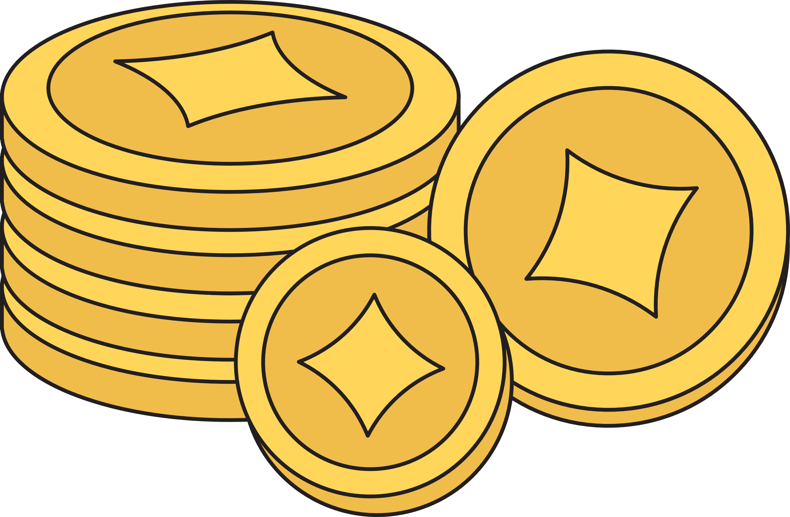

What is a coin?​
"A piece of metal (or, rarely, of some other material) certified through its marks to be of a definite exchange value or issued by a governmental authority to be used as money."
-American Numismatic Society
Notes:
So what is a coin? Discuss:
-definition on slide
-coins can appear in all shapes and forms
-some of the earliest forms of currency were not in the shape of coins as we know them today (see shapes on slide)
-coins could be issued by emperors/kings, officials, or even private citizens called moneyers

Slide 3
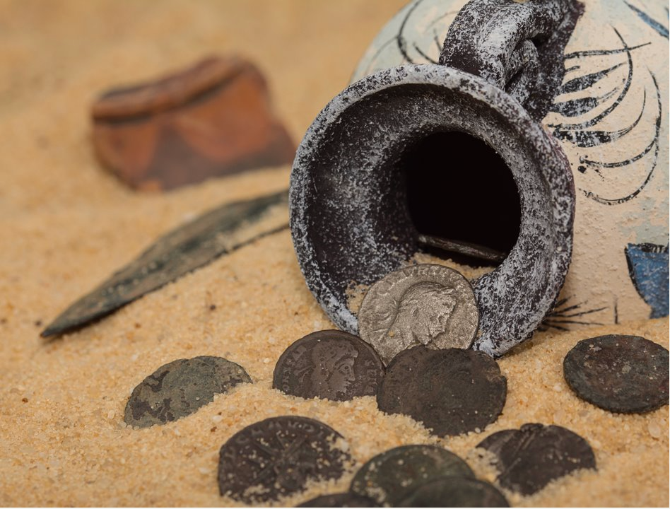

Numismatics​
The study of coins, medals, and banknotes, especially from an archaeological or historical perspective.​
Notes:
Numismatics is the study of coins, medals, and banknotes, especially from an archaeological or historical perspective.
Coins can be useful in many ways:
They can help with dating archaeological digs by layers
The images on the coins can help us understand art history
The designs can help us understand the political messaging & symbols used at the time.
They can also help us understand mythology since myths are sometimes shown on coins.

Slide 4
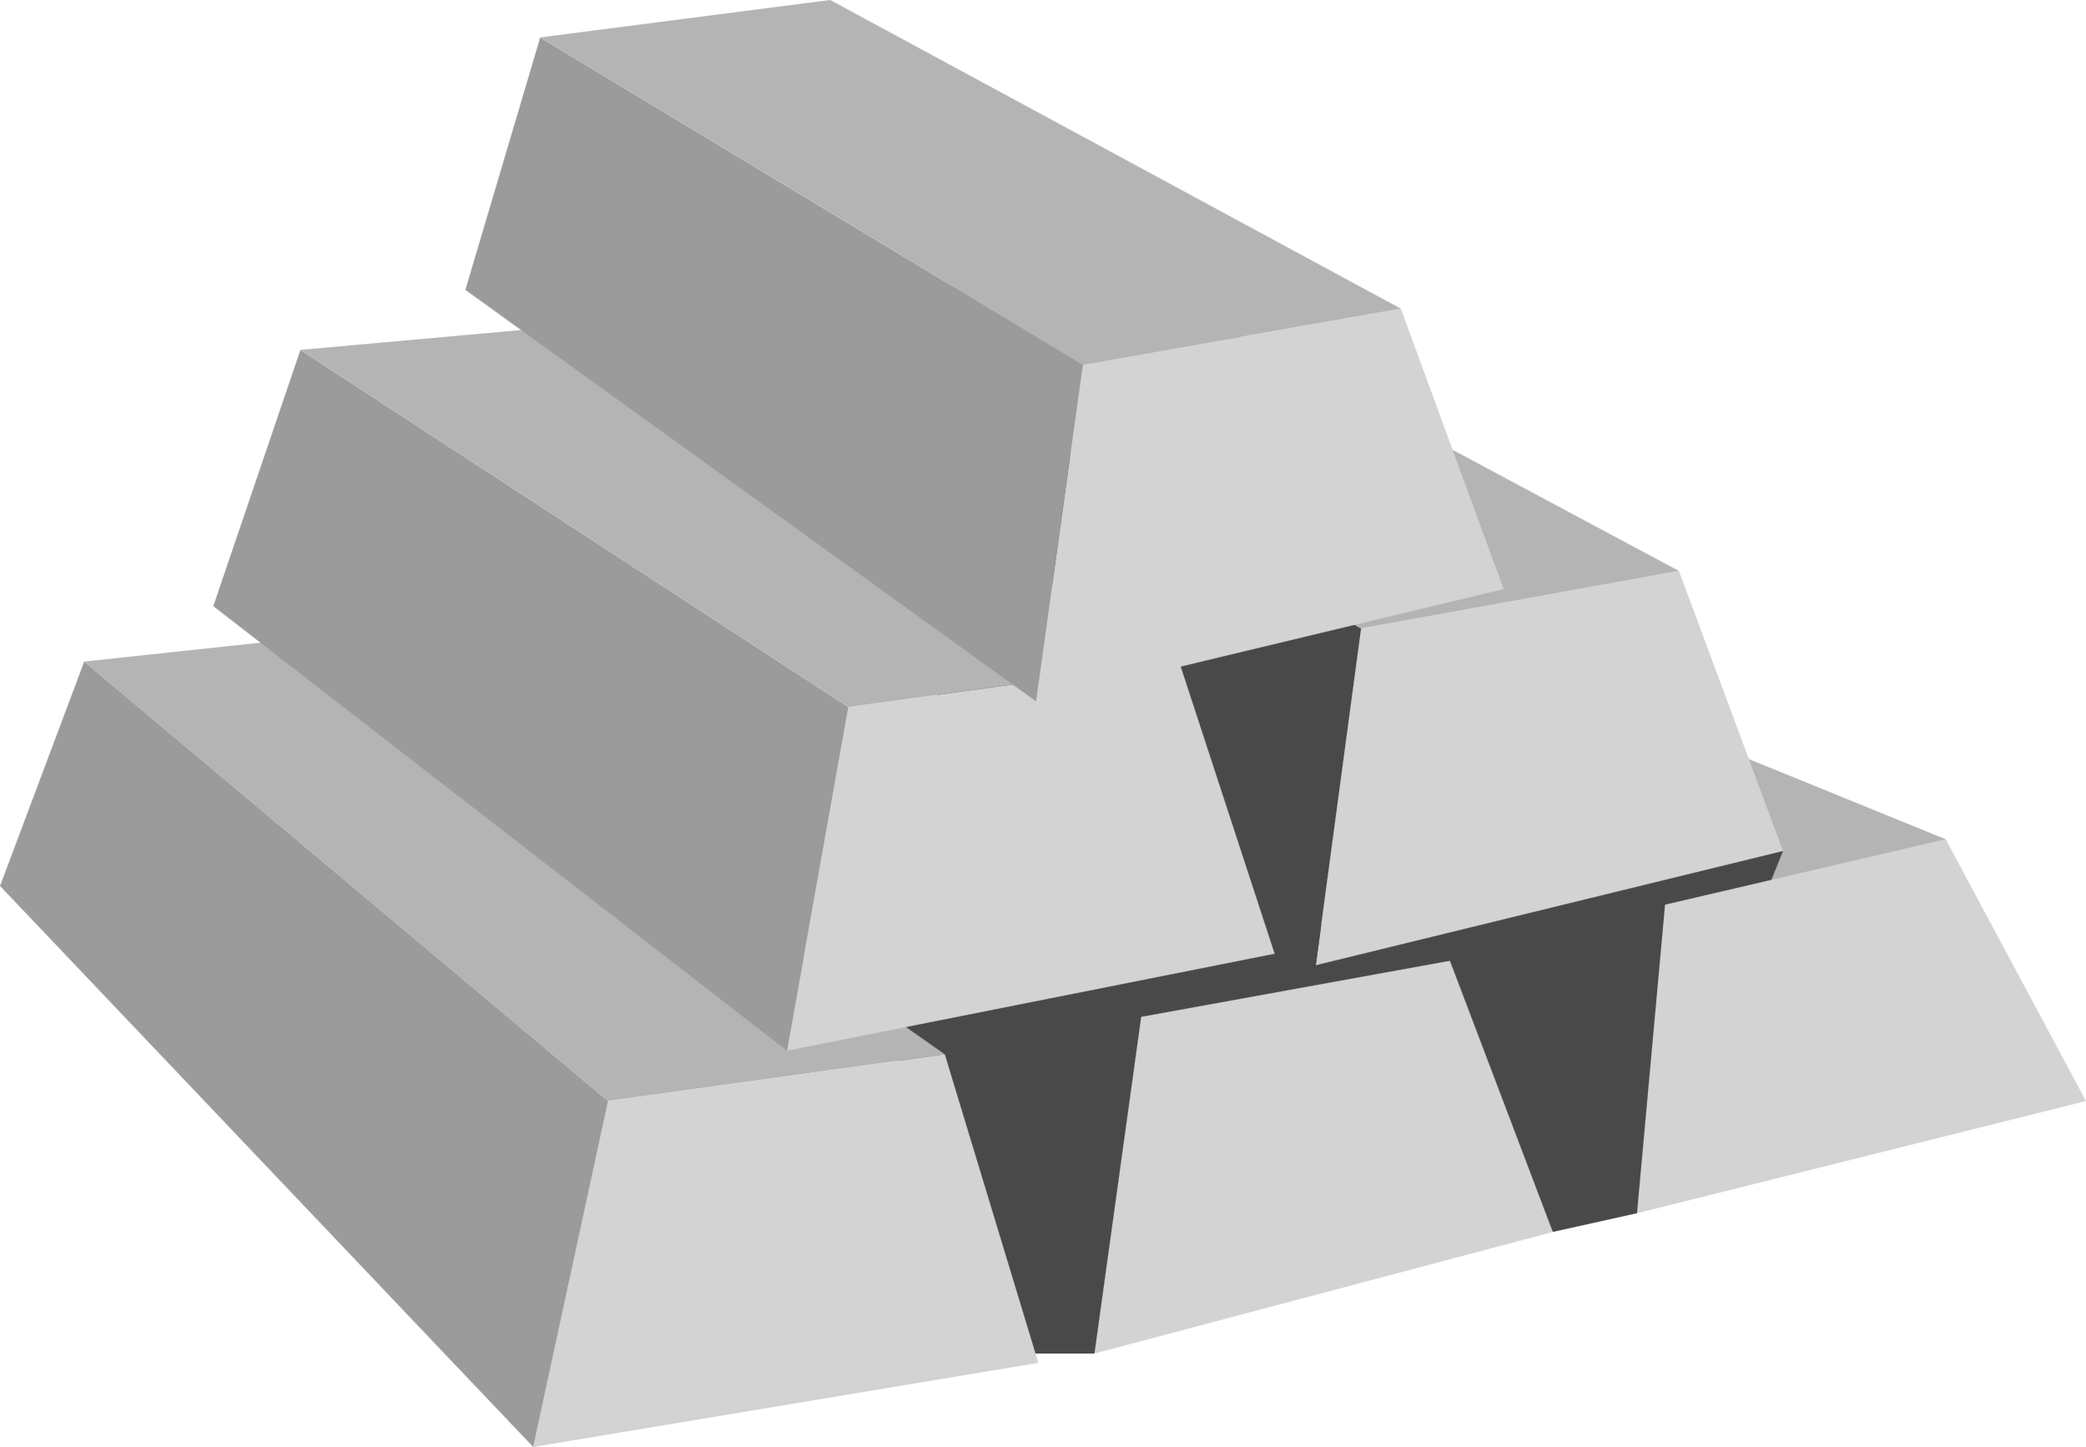
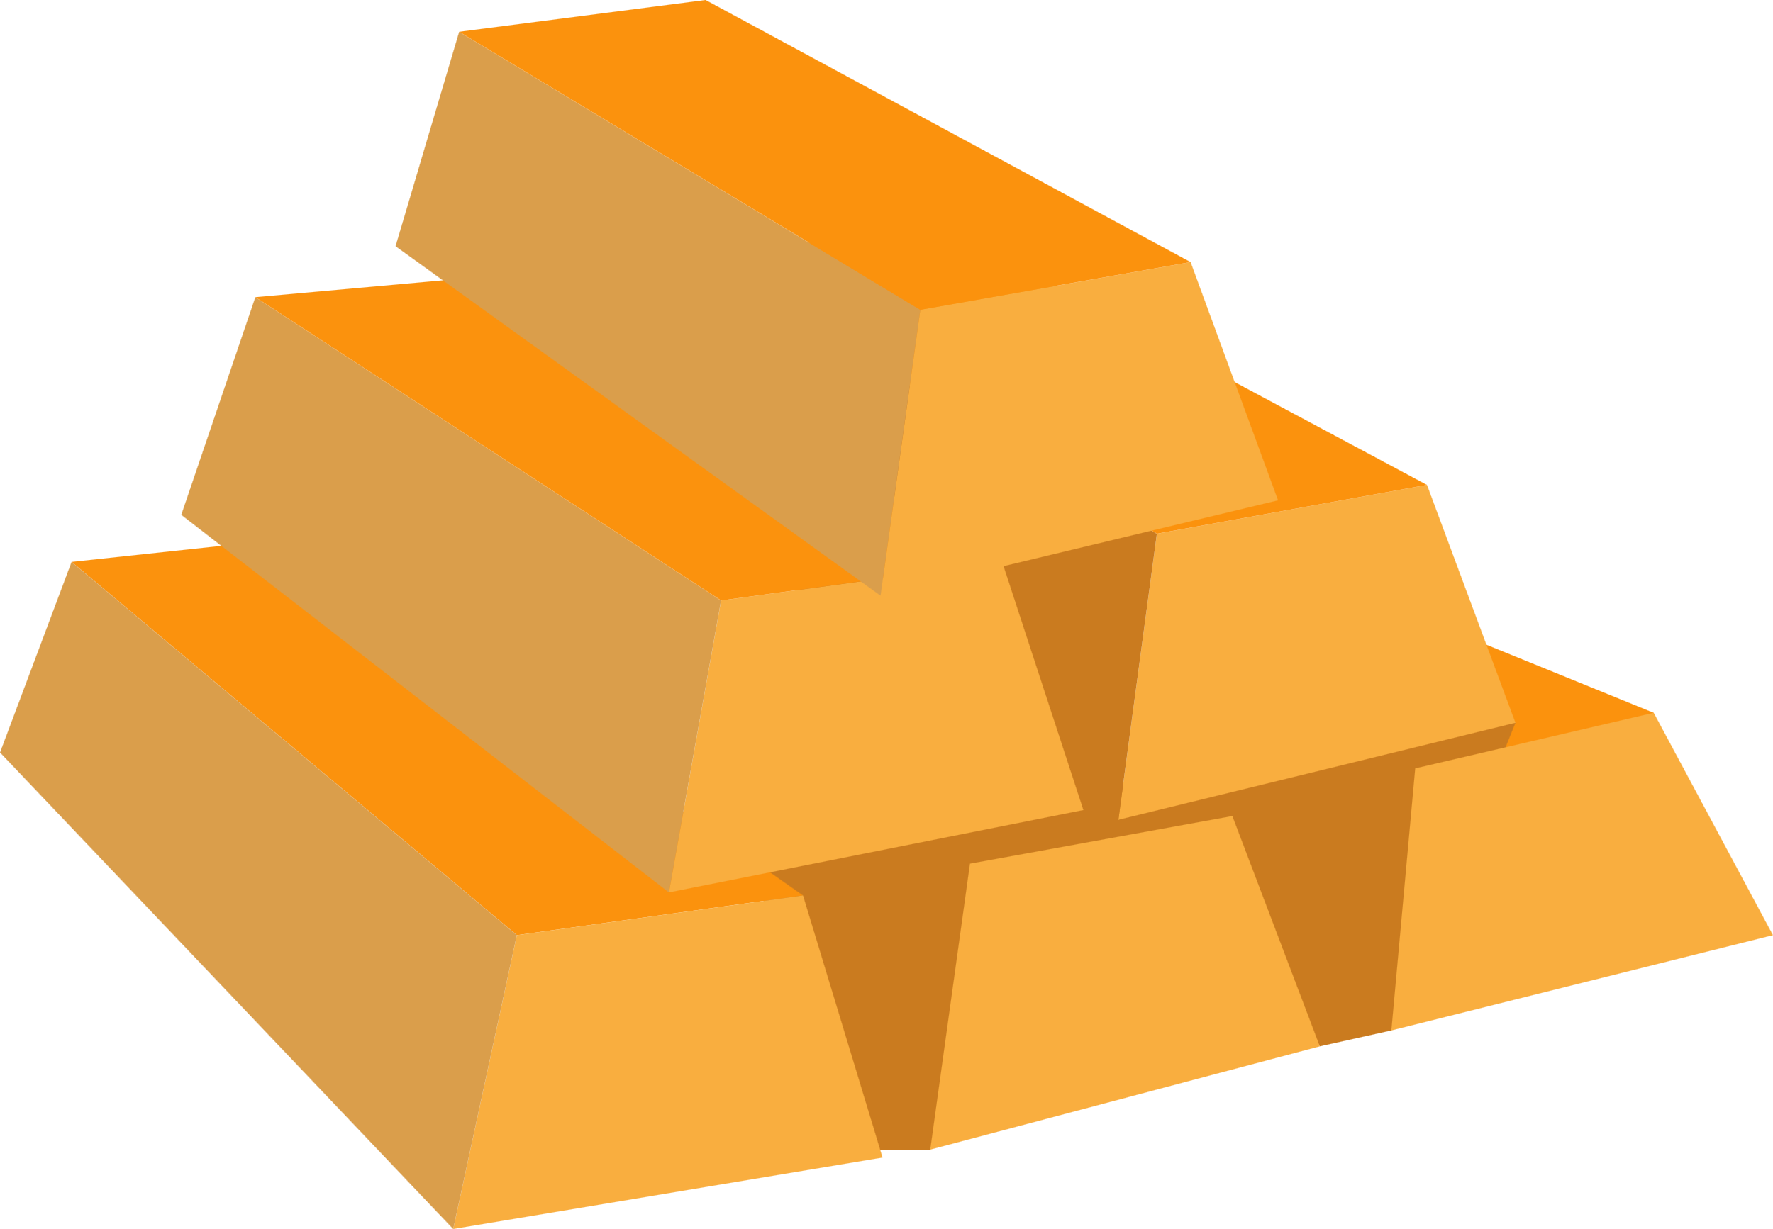
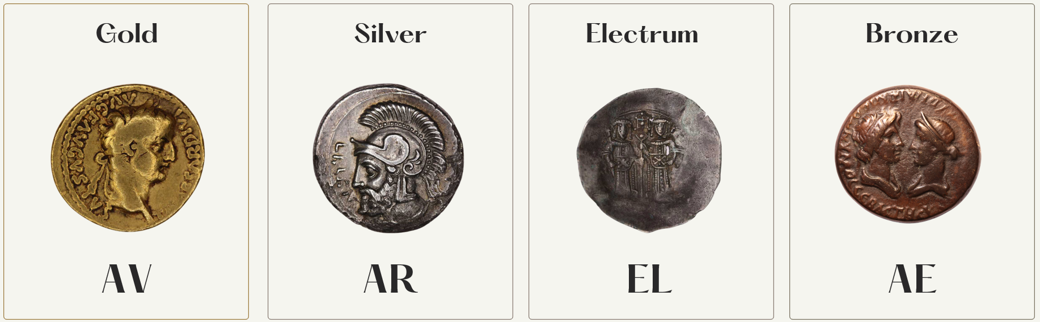
Metals
Notes:
Coins could be made out of many different materials. Numismatists (people who study coins) use these abbreviations to refer to common materials. (Hint: some of these come from the names of elements on the periodic table!) AV or AU is gold (aurum in Latin), AR is silver (argentum in latin), EL is short for electrum - an alloy of gold and silver, and AE is bronze (aes in latin) - bronze is an alloy of copper and tin!
AES pronounced - ICE

Slide 5
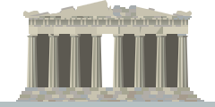
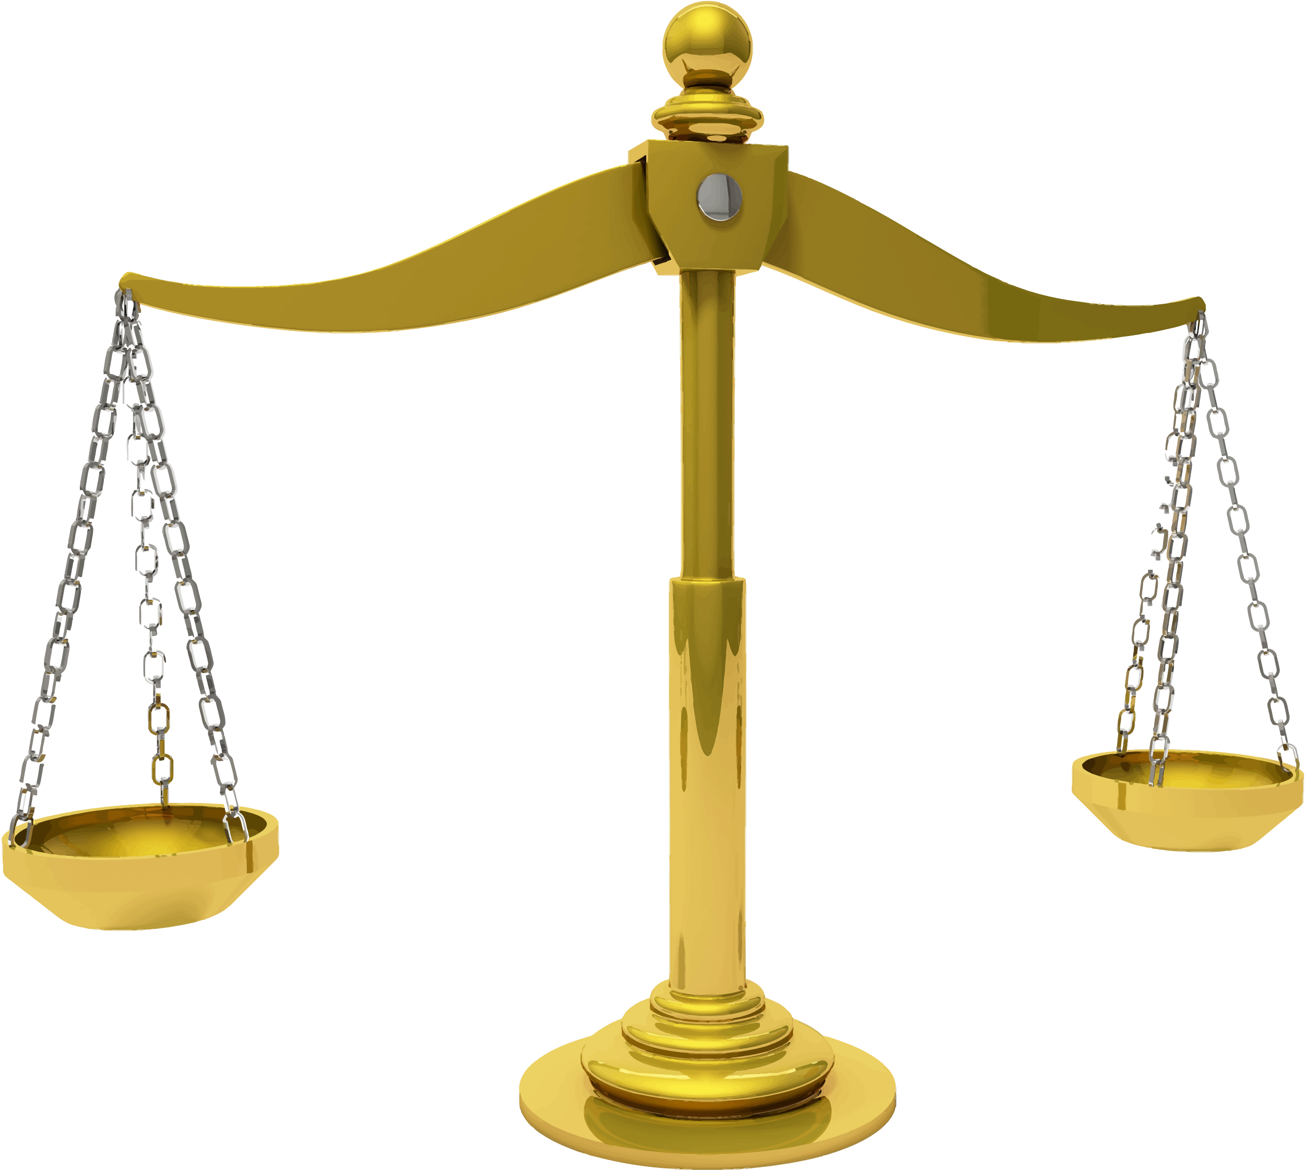
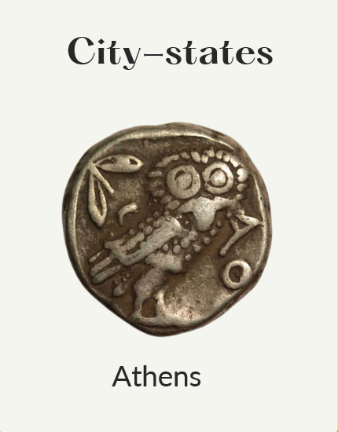
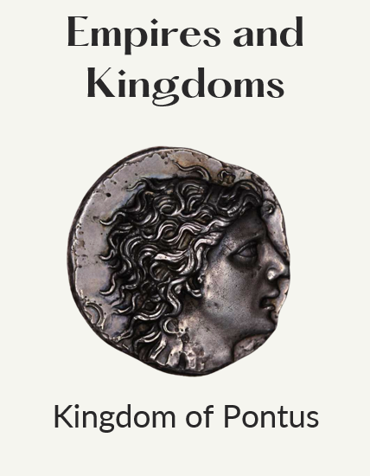
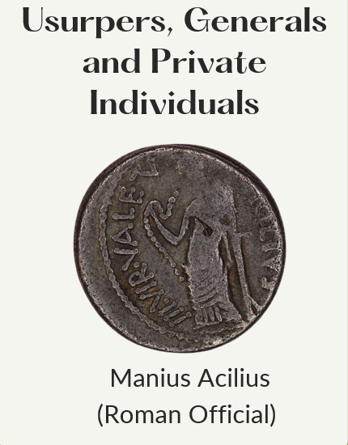
Issuing Authority
Different people and institutions could mint coins​
Notes:
Here are some examples of coins minted by different people or institutions. The owl coin from Athens was minted by the city-state of Athens. The middle coin is a coin of Mithradates VI, an ancient Greek King, and it was minted by the Kingdom of Pontus, his kingdom. The coin on the left was minted by a private citizen in ancient Rome named Manius Acilius. He was a general and a politician (a statesman) in ancient Rome.

Slide 6
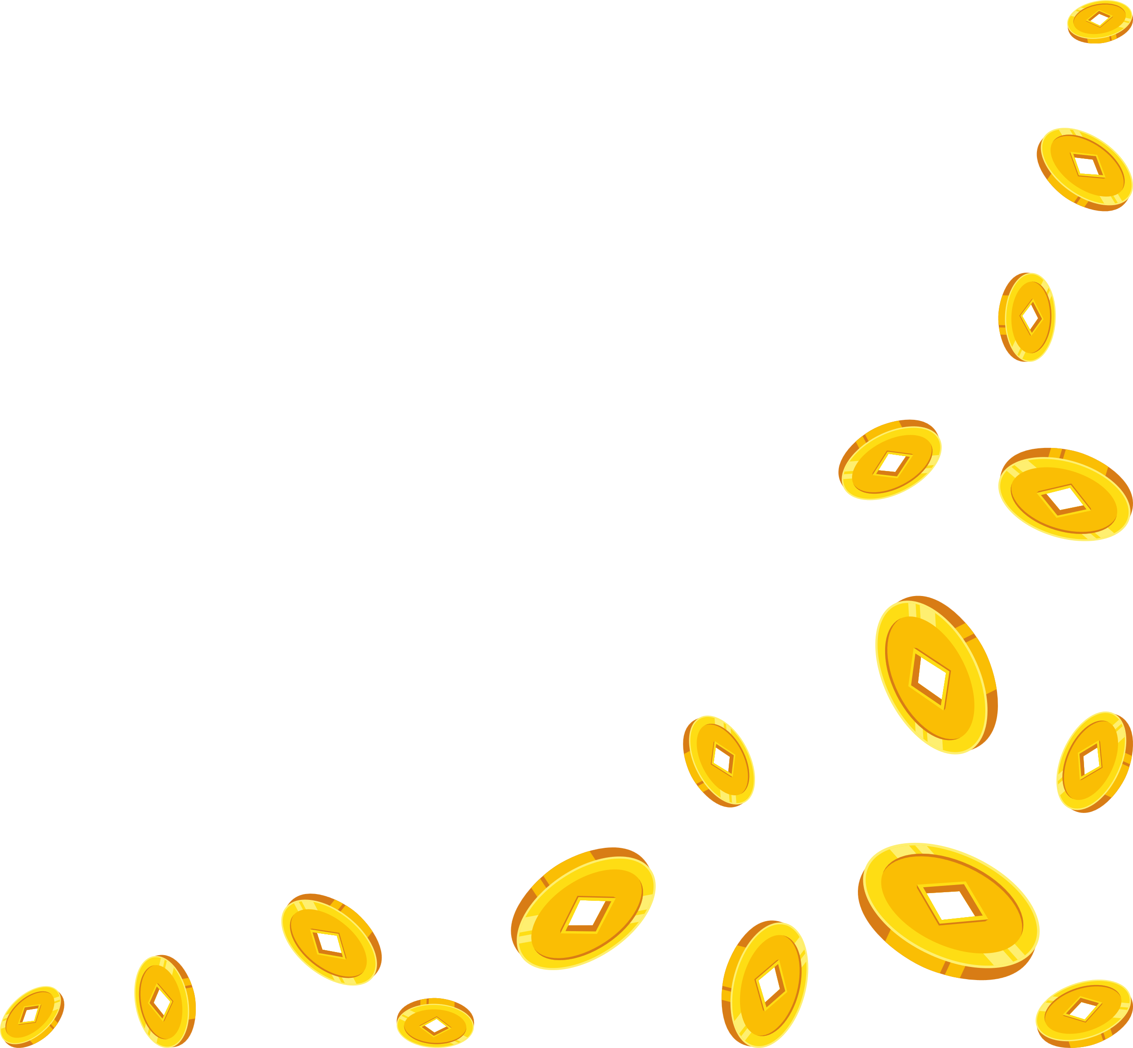
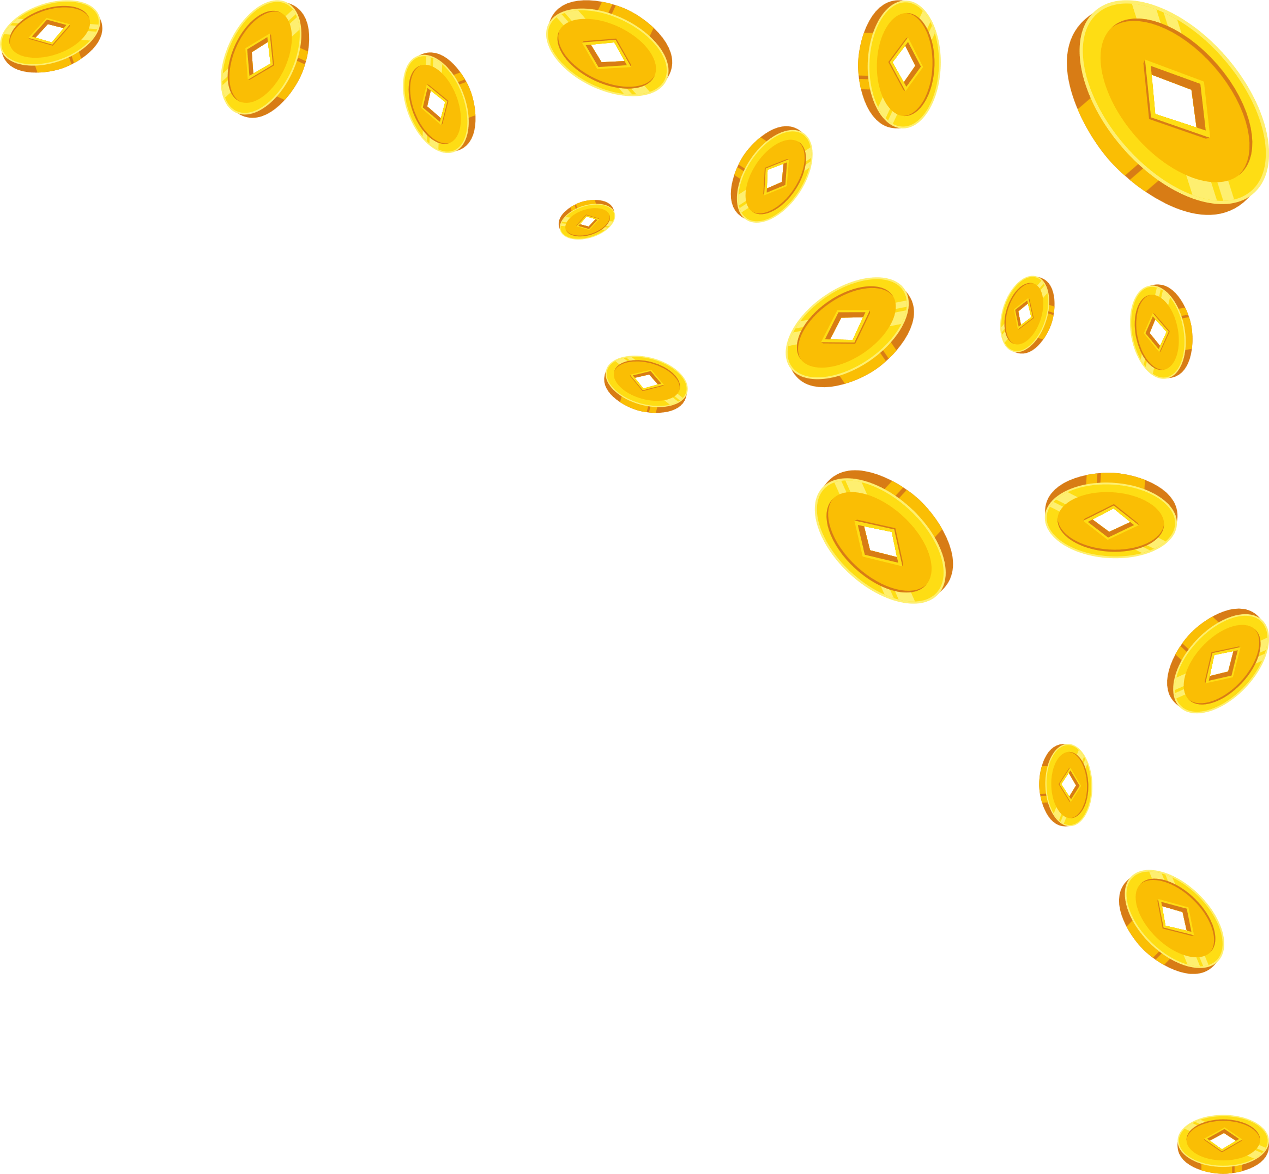

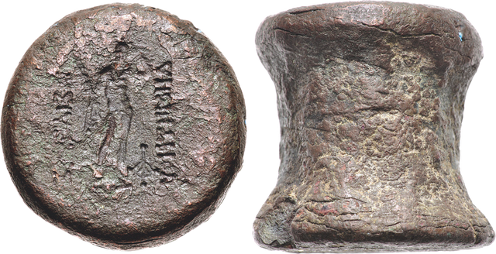
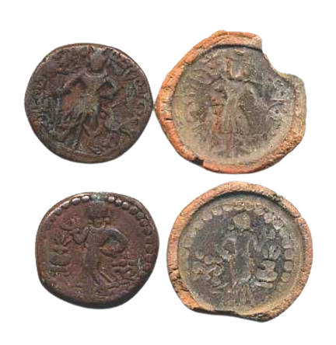


How were coins made?
Coin die from mint of ​Demetrius I of Bactria, 200-185 BCE​
Hammer
Reverse die
Blank/flan
Yaudheya clay coin molds, c. 3rd-4th centuries CE ​
Obverse die
Anvil
Notes:
Coins could be made one of two ways. One was with two dies and a hammer.
The bottom die, called the obverse die, was set in an anvil. then, a blank piece of metal called a blank or a flan was placed on top. The top die called the reverse die was placed on top and then it was hammered onto the blank. The pictures carved into the dies would create a picture on the coin!
There were also cast coins using two moulds together, a technique used in some early Roman coinage and sometimes used to make forgeries. Hot metal was poured into a mould that had the design on the inside and once the metal cooled, it was opened up to reveal the coin!

Slide 7
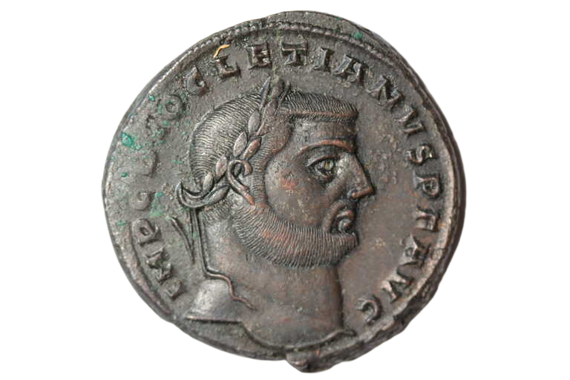
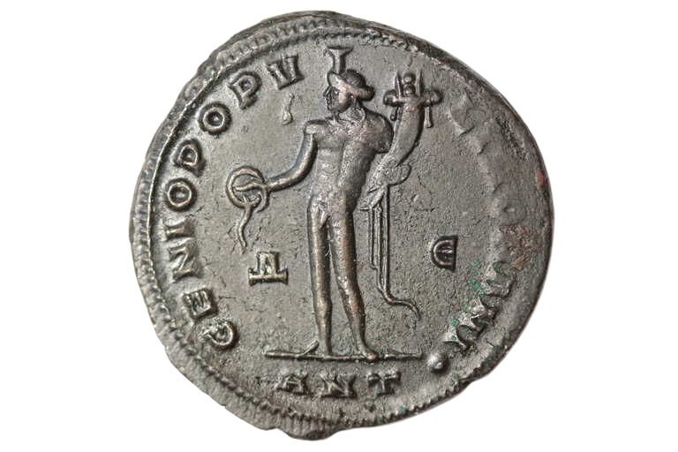
Reading a Coin
Material
Obverse
Reverse
Legend
Type
Type
Attributes
Field
Exergue
Mint Marks
Notes:
Here are all the different parts on a coin.
What we would call the 'head' of the coin is called the obverse. it often has a portrait on it. What we would call the 'tail' is called the reverse. While both sides can be very detailed, the image on the reverse often changes the most.
The legend is any writing on the coin. This coin has the name of the emperor on it "DIOCLETIAN"
The exergue is the main field below the figure. The letters here (ANT) stand for the city of Antioch, where this was made.
The Attributes are clues or symbols that let us know who the figure(s) is/are. This figure is holding a cornucopia and a patera, a dish for offerings. This lets us know the figure is a genius, a divine being sort of like a guardian angel.
The field is the open space around the main figure.
Mint marks also show us where the coin was minted.

Slide 8
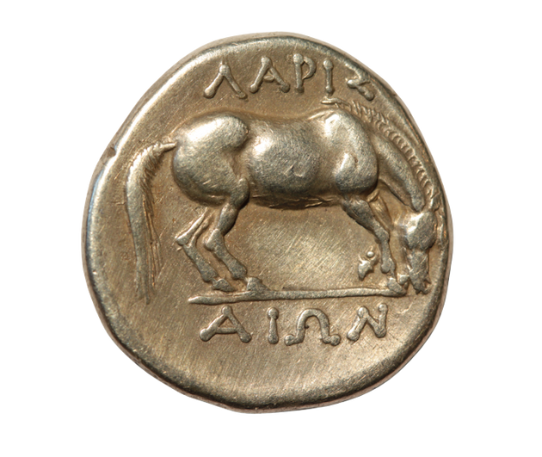
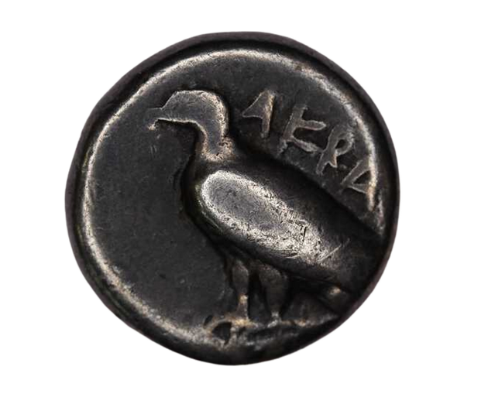
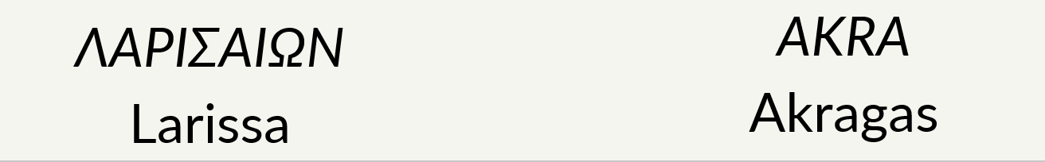
Reading A Coin
Ethnic: the name of a tribe, city-state or territory that issued the coin ​
Notes:
Some coins also have what's called an ethnic. The ethnic is commonly seen on the coins of Greek city-states. It means "belonging to" [city]
The coin on the left reads Larissaion - belonging to Larissa.

Slide 9
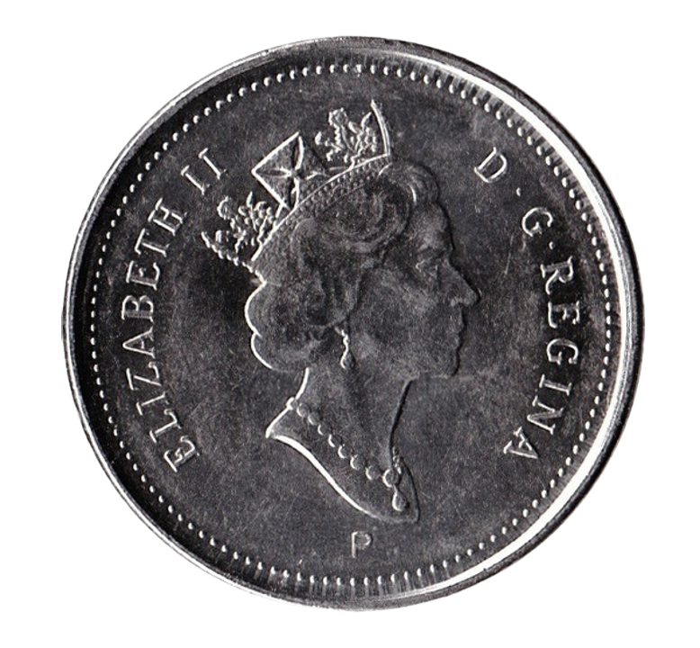
Inscriptions
Inscriptions: ​
define an image on a coin​
imply a relationship​
abbreviated
D G REGINA =
?​
AVG =
Augustus​
Dei Gratia Regina = ​
By the Grace of God, Queen​
Notes:
Inscriptions on coins help us to figure out what the image on the coin is. They're often abbreviated. A common example on Roman coins is AVG or Augustus. This coin is a canadian coin. The back says D G REGINA
short for Dei Gratia Regina. It means By the Grace of God, Queen. Do you know who this woman is?

Slide 10
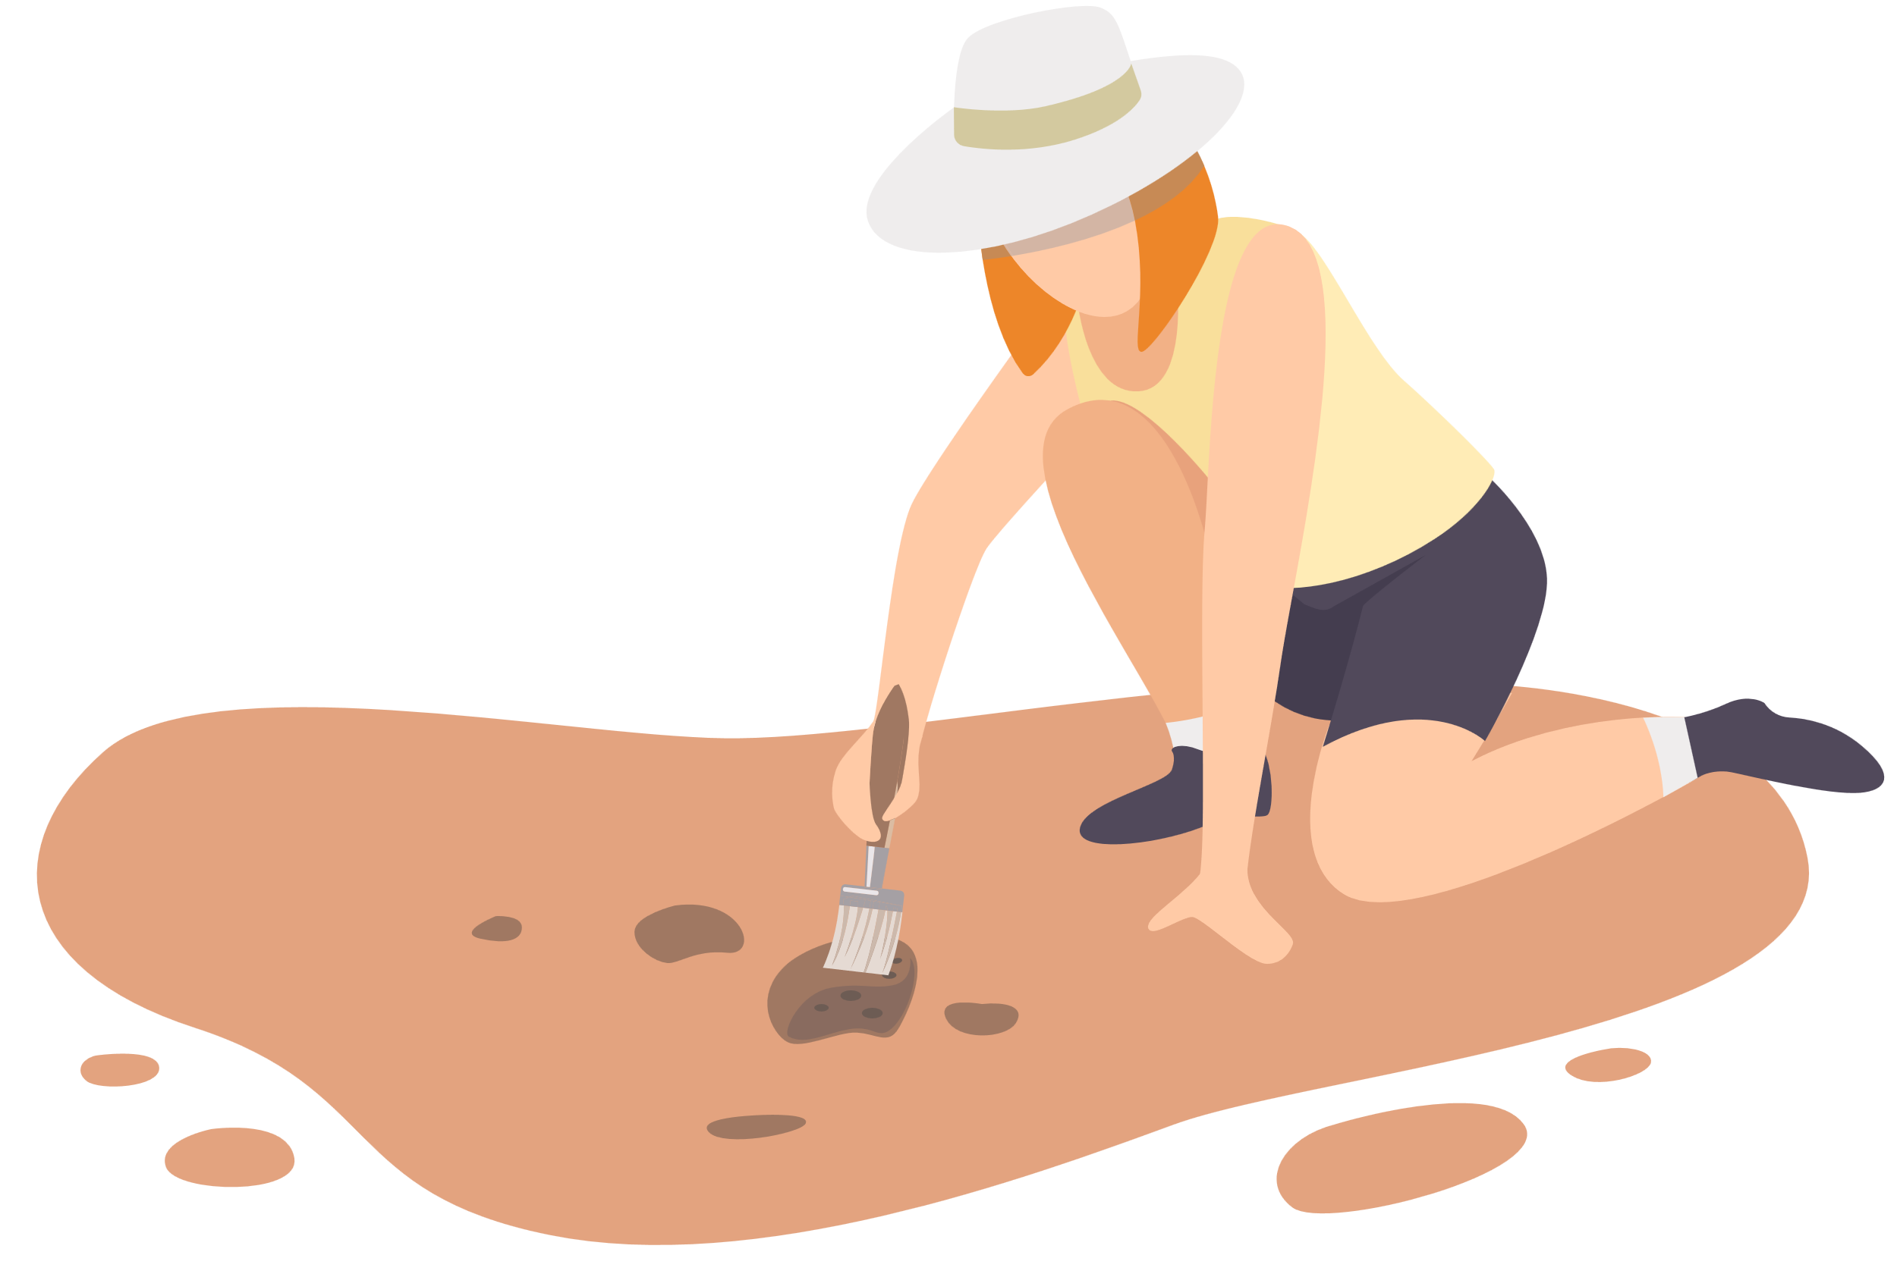

What Coins Tell Us
Archaeological Information:​
Dates​
Levels of Occupation​
Economic & trade activity​
Antoninianus​
238 CE = 42% silver​
268 CE = 2.5% silver​
Notes:
Coins tells us important information, despite being so small. For example, different coins are made at different times. Our coins today have dates on them, but numismatists can tell how old ancient coins are based on the pictures and the designs on them. When archaeologists are doing digs at old sites, the coins can tell them exactly how old each layer is as they dig deeper and deeper. The amount of coins they find can also tell them how many people lived in the area, and how much trade was happening there.
If the economy isn't doing well, there may be less precious metals in the coins too. For example, the Roman coin called the Antoninianus was made of 42% silver in 238 CE. only 30 years later, it was made of 2.5% silver. Does anyone want to guess why? It's because in those 30 years, there was an economic crisis in Rome and they couldn't afford all the silver they needed for the coins!

Slide 11
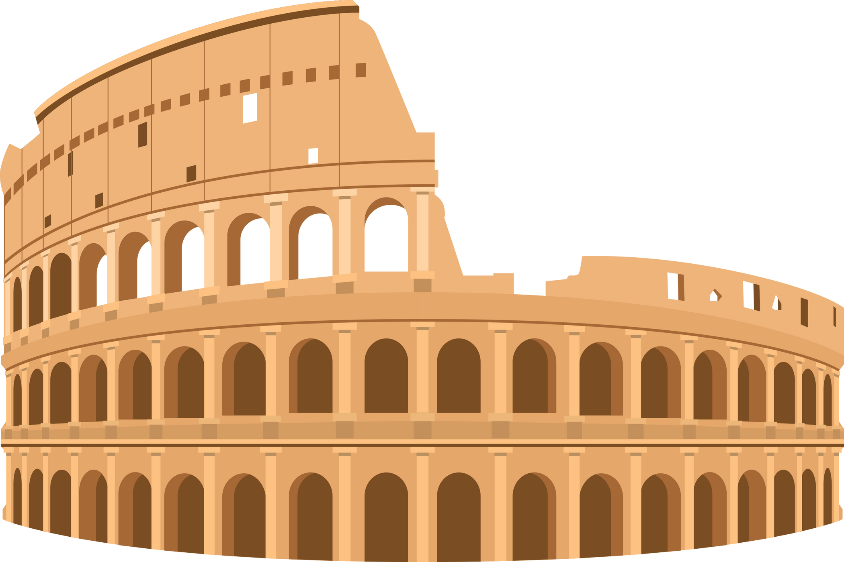
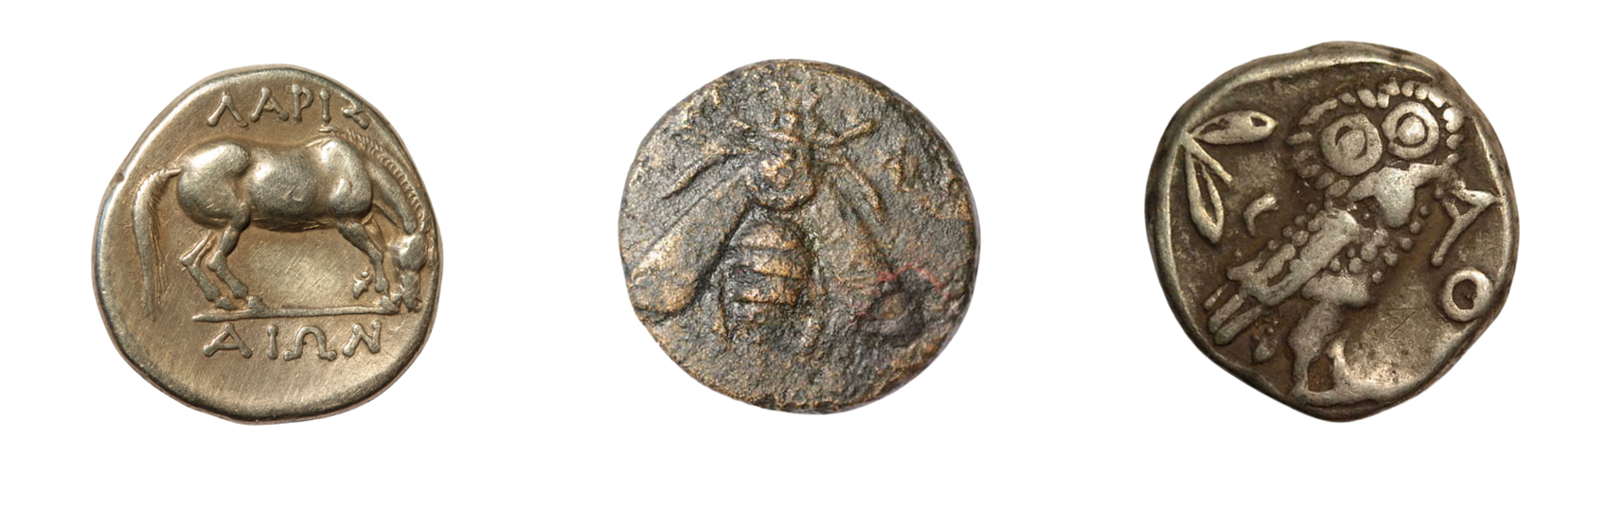
What Coins Tell Us
Imagery​
Powerful people or institutions​
Prominent deities​
Symbolism​
Larissa
Ephesus
Athens
Notes:
The images on coins can tell us about important people, gods and symbols. These three coins are from Greek city states and the images tell us something unique about each one.
The coin from Larissa on the left has a horse on it. Larissa was famous for it's incredible horses!
The coin with the Bee on it is from Ephesus, a city that worshiped the Greek goddess Artemis. We know that the Bee was very closely connected to Artemis because of coins like this, but only in Ephesus - and we don't know why. It's a bit of a mystery to historians even today!
The coin on the right is from Athens and shows an owl on it. The Owl is the animal of Athena, and Athena was the patron goddess of Athens!

Slide 12
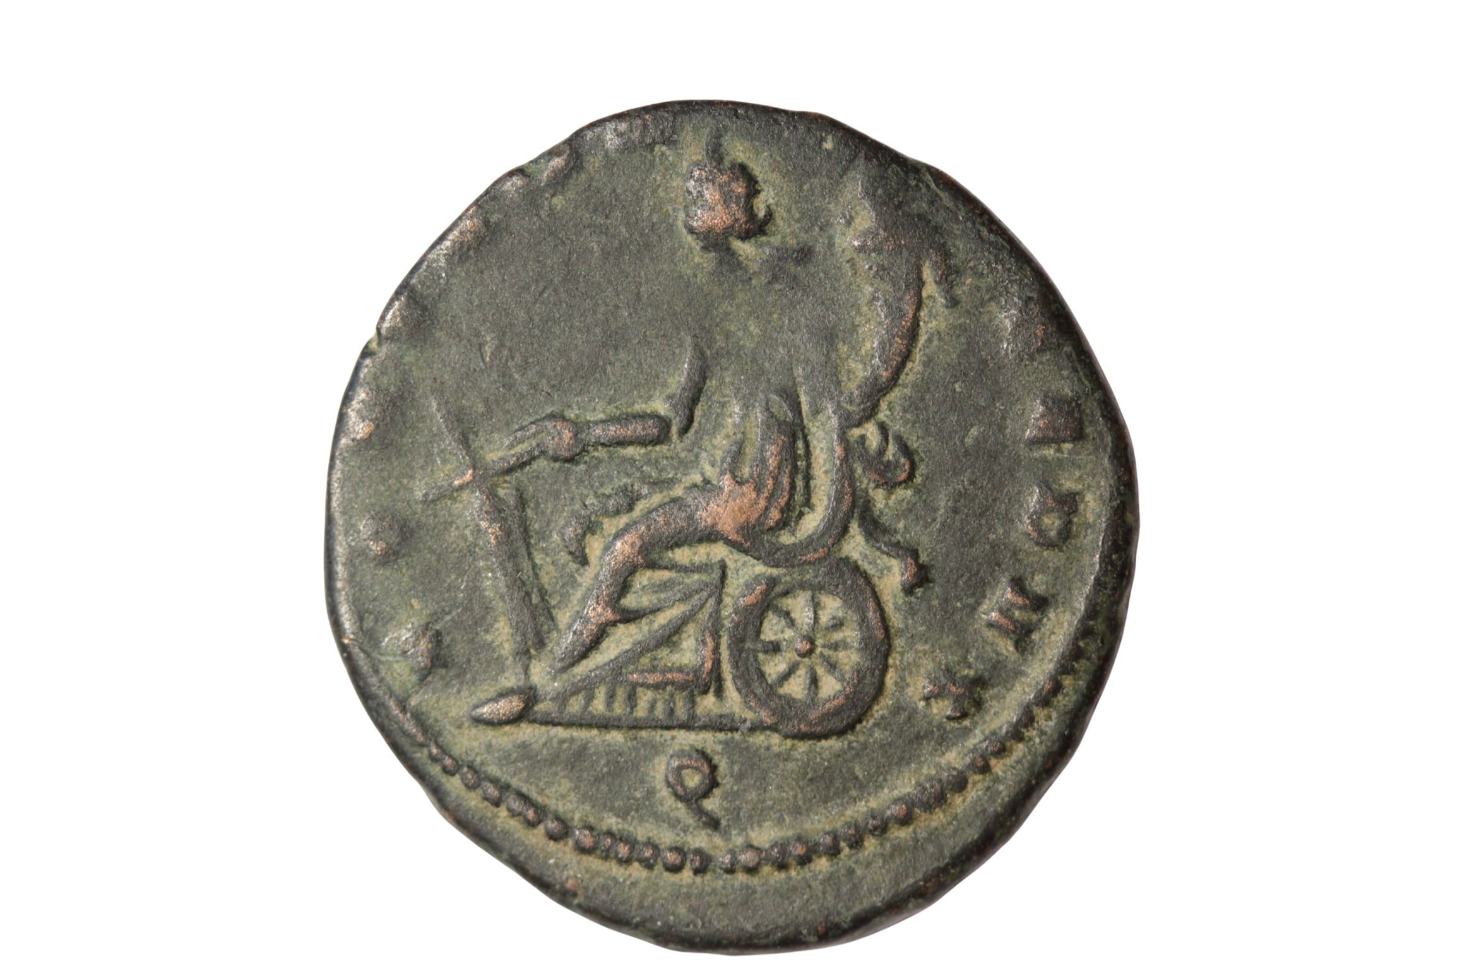
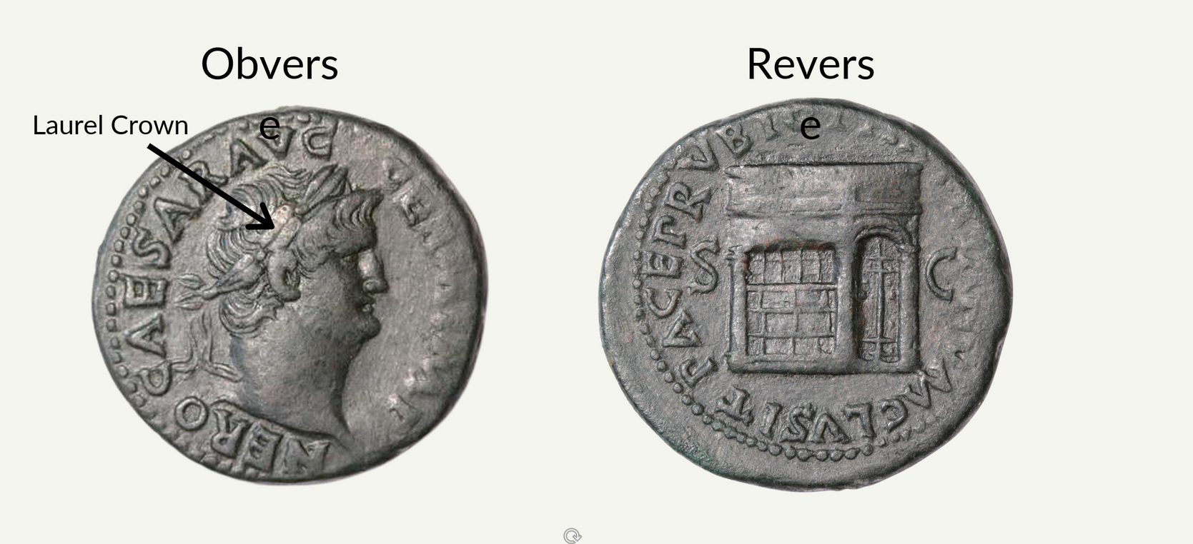
What Coins Can Tell Us:
An Ancient Example
PACE P R VBIQ [PARTA IANV]M CLVSIT; SC
With the Peace of the People of Rome Everywhere, He Closed (the Temple) of Janus; By Decree of the Senate​
Notes:
Coins could also commemorate events, events that we might not have known about if we didn't study coins.
This coin commemorates when the Roman emperor Nero closed the doors to the temple of Janus
The Inscription translates to: With the Peace of the People of Rome Everywhere, He Closed (the Temple) of Janus; By Decree of the Senate.
-Since closing doors to temple was very rare, this event is commemorated on coinage as part of Nero's messaging campaign. Basically, it was a way for him to spread the news about this grand event since coins were in the hands of many people across the whole empire!

Slide 13



Questions to Consider
Why would Nero want to proclaim universal peace? ​
How would the coin be received by the Roman people?​
What message is this coin trying to send?​
Notes:
*possible answers*
1) Lots of people see them, new ones can be made frequently, lots of them are made, we see/use them everyday, even poorer people might have seen them, before phones/internet it was a way to spread a message far very quickly
2) common symbols, good quality image, use myths and stories people are familiar with, positive messaging and framing
3) good news, political change, victory at war, the state is stable and has money

Slide 14
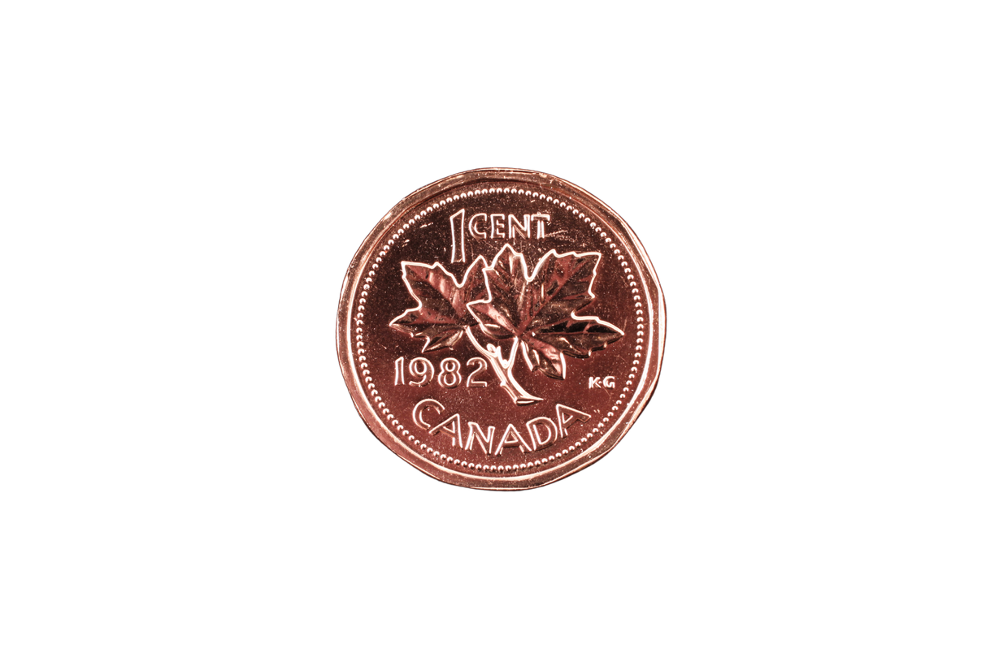
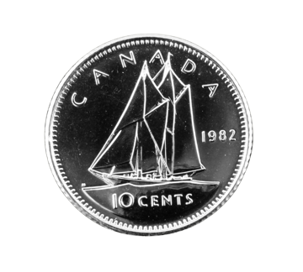
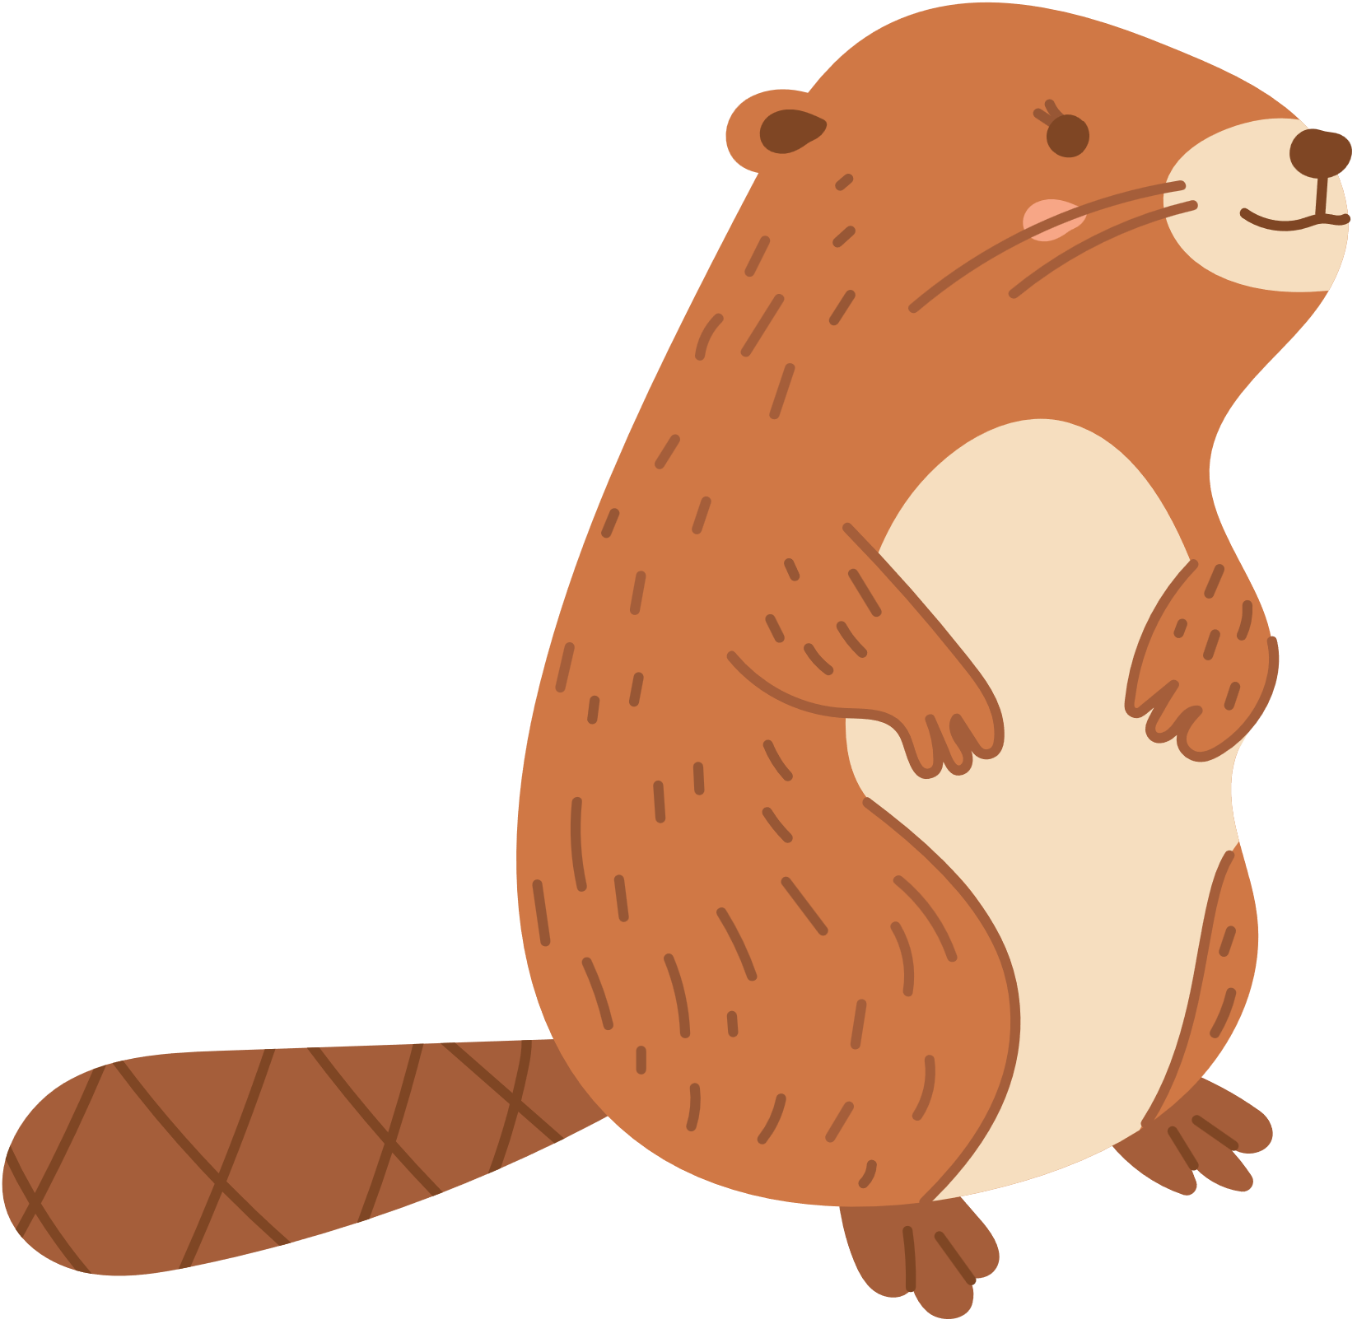
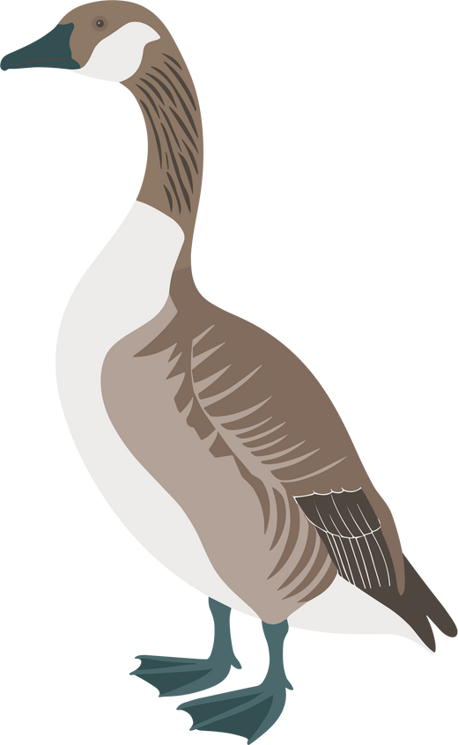
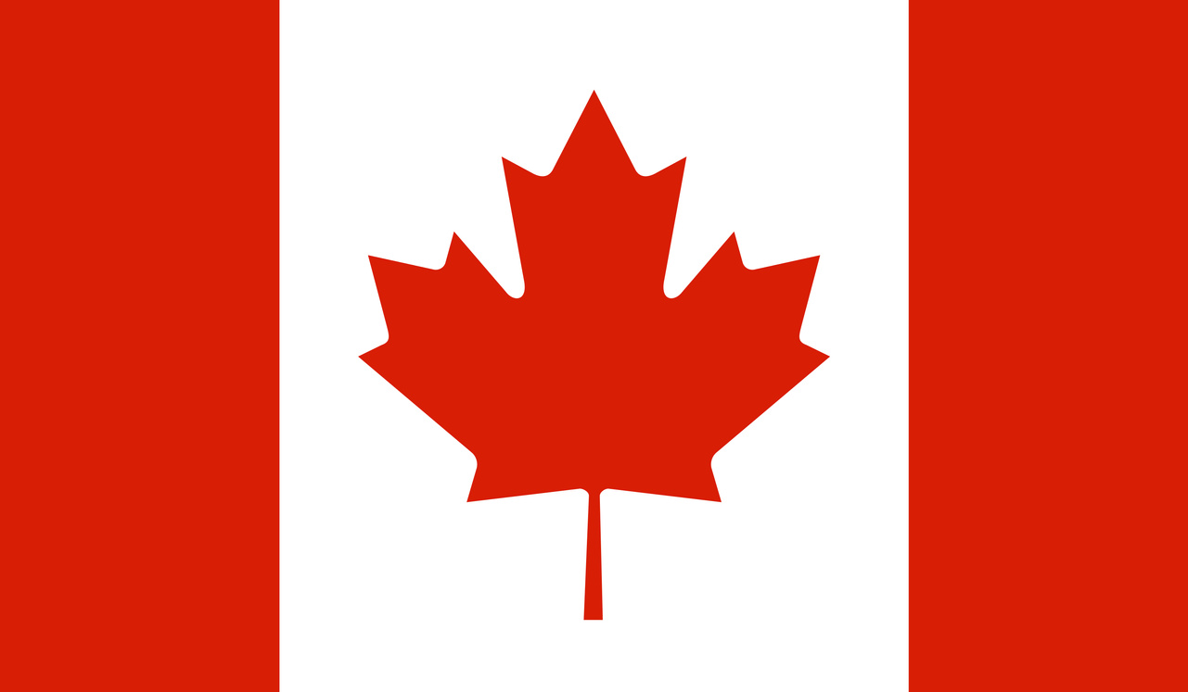
What Coins Tell Us:
Canadian Coins
What do our coin designs say about us?​
Animals and nature​
Maple leaves
Notes:
Talk about images on canadian coins or other coins the kids are familiar with. You can also talk about bills!

Slide 15
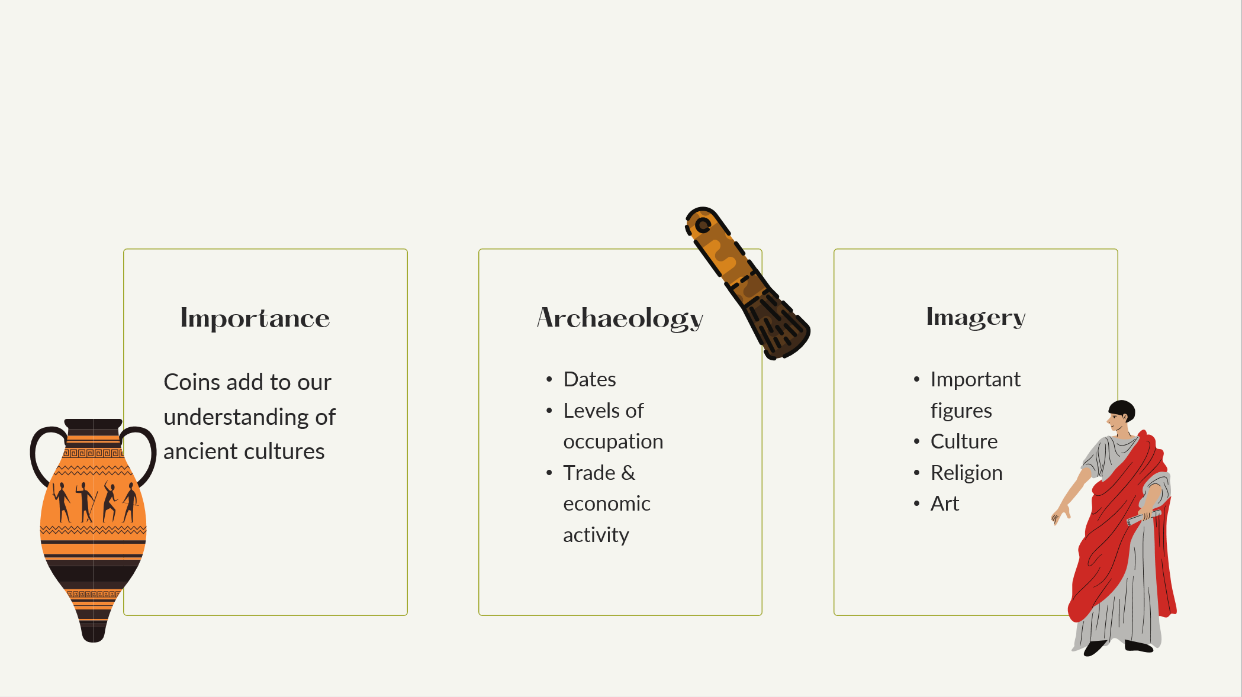
Summary

Slide 16
Sources
Indo-Greek Yaudheyas coins and moulds. Scott Semans World Coins (CoinCoin.com), CC BY 3.0. Wikimedia Commons.
https://commons.wikimedia.org/wiki/File:Indo-Greek_Yaudheyas_coins_and_moulds_01.jpg.​
By Awmcphee - Own work, CC0 1.0. https://commons.wikimedia.org/wiki/File:Canada_$0.05_2003.jpg.​
All other coin images are property of the Museum of Antiquities.​
Bland, Roger. “From Gordian III to the Gallic Empire (AD 238-274)”. In The Oxford Handbook of Greek and Roman Coinage, ed. William E. Metcalf. Oxford: Oxford
University Press, 2012.​
Estiot, Sylviane. “The Later Third Century”. In The Oxford Handbook of Greek and Roman Coinage, ed. William E. Metcalf. Oxford: Oxford University Press, 2012.​
Howgego, Christopher. Ancient History from Coins. New York: Routledge, 1995.​
Barney, Robert K. & Heine, Michael H. (2015). The emblem of one united body …one great sporting Maple Leaf’: The Olympic Games and Canada's quest for
self-identity. Sport in Society, 18(7):816-834, DOI: 10.1080/17430437.2014.990688​

