Slide 1


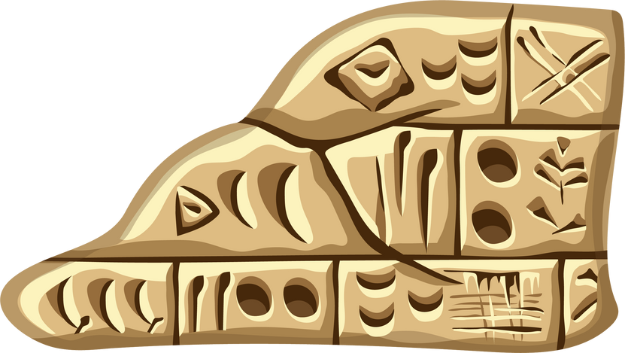


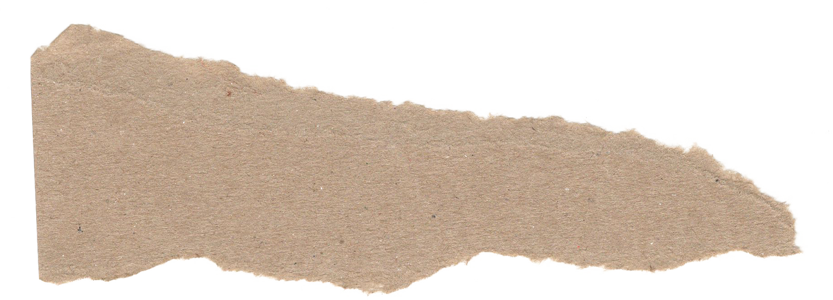
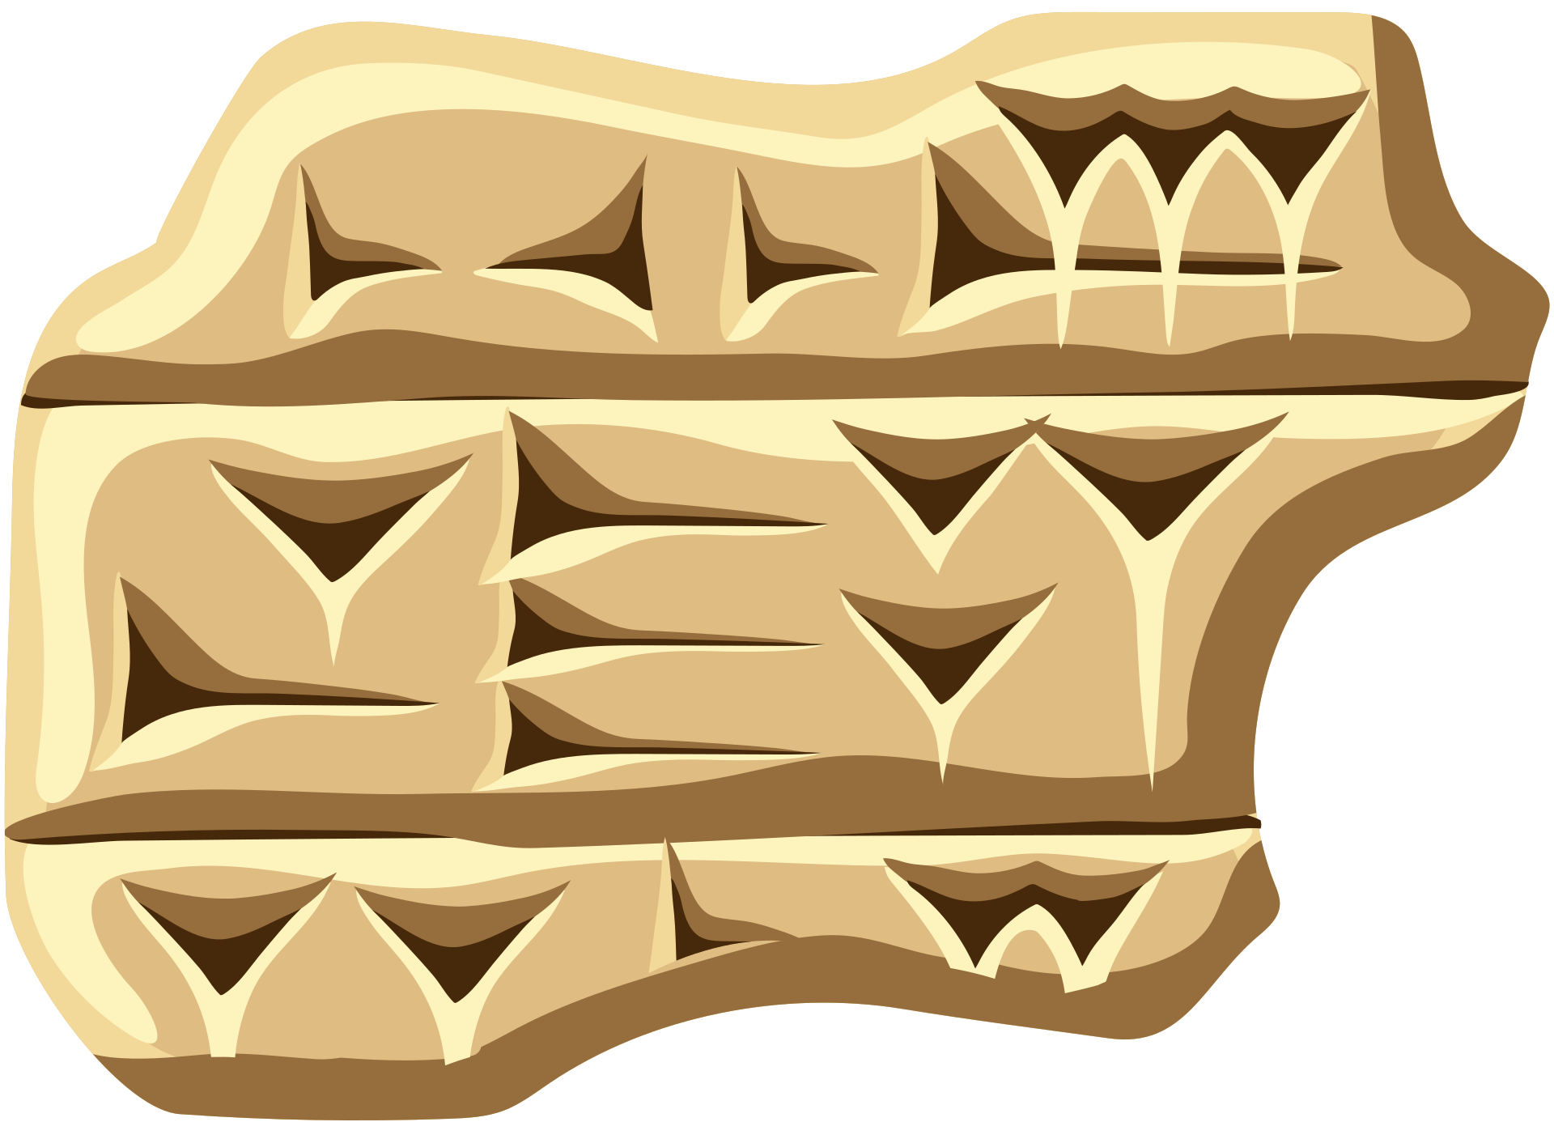


cuneiform

Slide 2



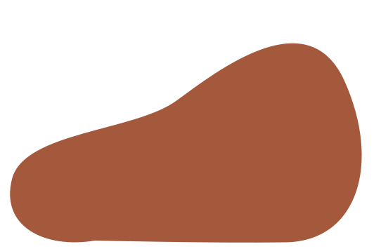
Modern
Cuneiform
What we'll learn
Where and When it was found
What is
Cuneiform?
The Civilization
Uses of Cunieform

Slide 3



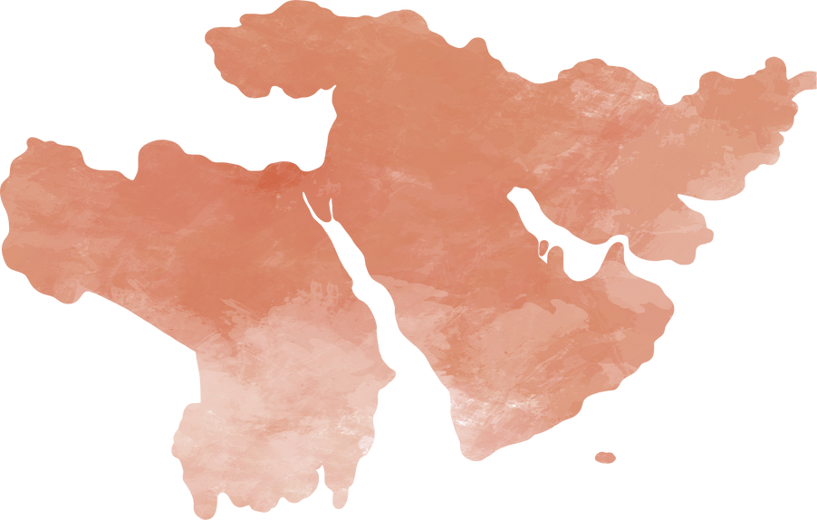

Where & When
• Mesopotamia, or modern Iraq, Iran, and Syria.
• 3000 BCE, or 5000 years ago.

Slide 4

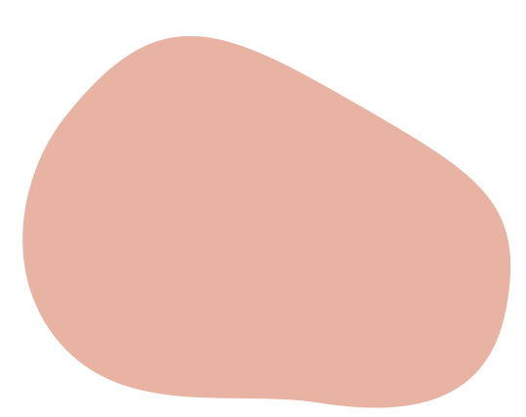


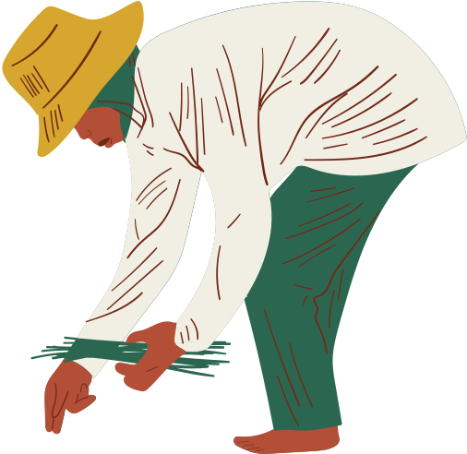
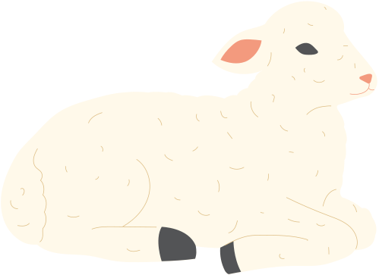
The cradle of civilization
•Mesopotamia was home to many of the world's firsts:
•agriculture
•irrigation systems
•cities
•writing

Slide 5



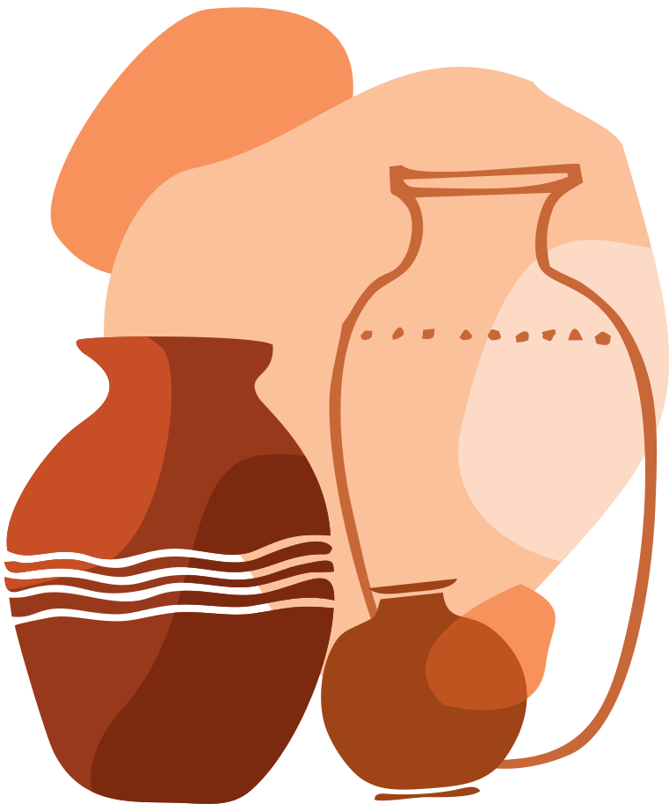




The cradle of civilization
Increased agricultural production meant that some people could do things besides farm.
This led to a need for a new way to record transactions and sale records.

Slide 6






Earliest writing
Inscriptions by city administrators and merchants.
the allocation, storage, and trade of goods.
Found around the city of Uruk.
CUNEIFORM
Means "wedge-shaped," referring to the stylus used to leave impressions in the clay.

Slide 7


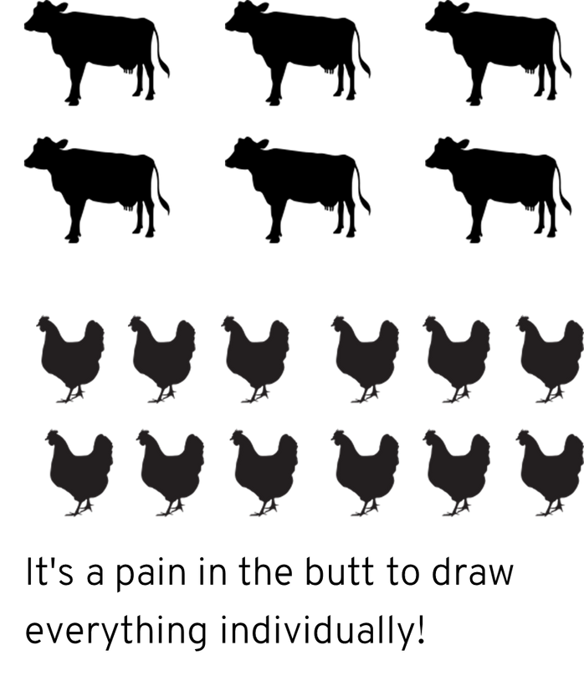
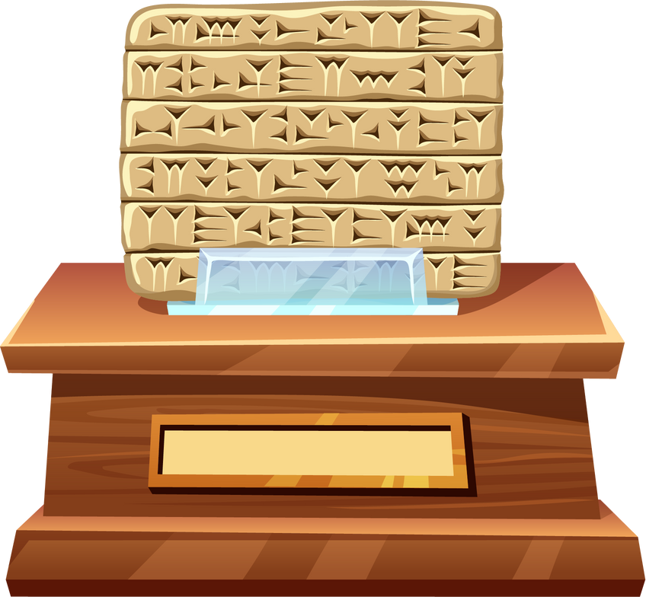
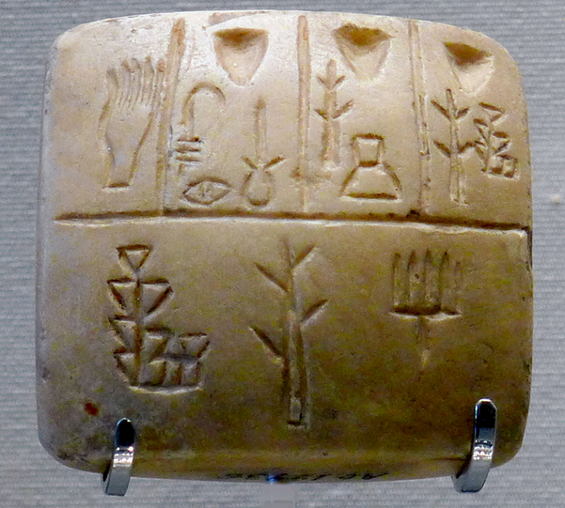
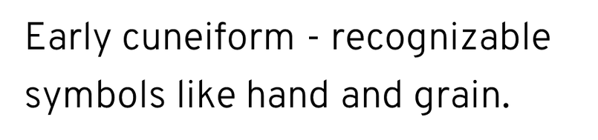
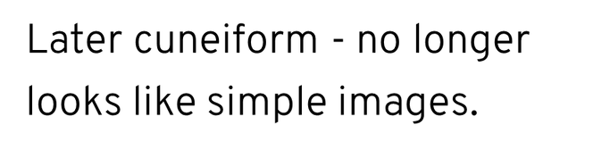
THE EARLIEST WRITING

Slide 8






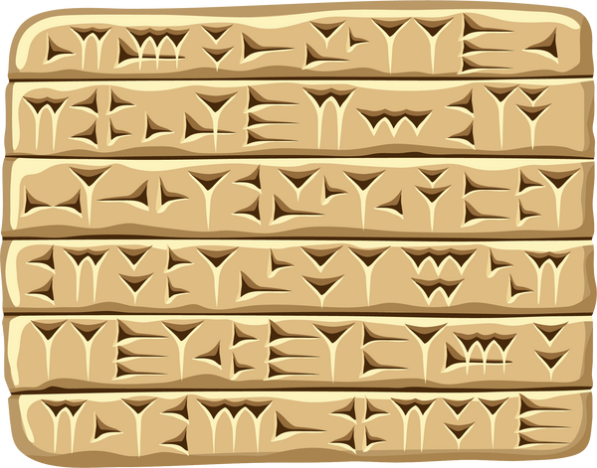
CUNEIFORM AND LANGUAGES
Cuneiform was first used to write the spoken language of Sumerian, but there were other spoken languages in Mesopotamia that adopted cuneiform for writing, including:
•Akkadian
•Hurrian
•Hittite
Old Persian

Slide 9
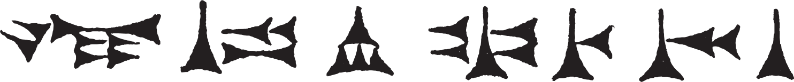
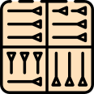

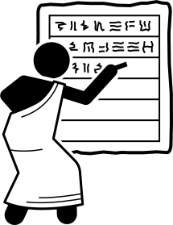

CUNEIFORM GROWS
•Cuneiform's use expanded to literature and poetry.
•Many small fragments of cuneiform have been found.
•Some huge libraries have been discovered with whole texts like:
⚬The Epic of Gilgamesh
⚬The Enuma Elis
⚬Historical records

Slide 10

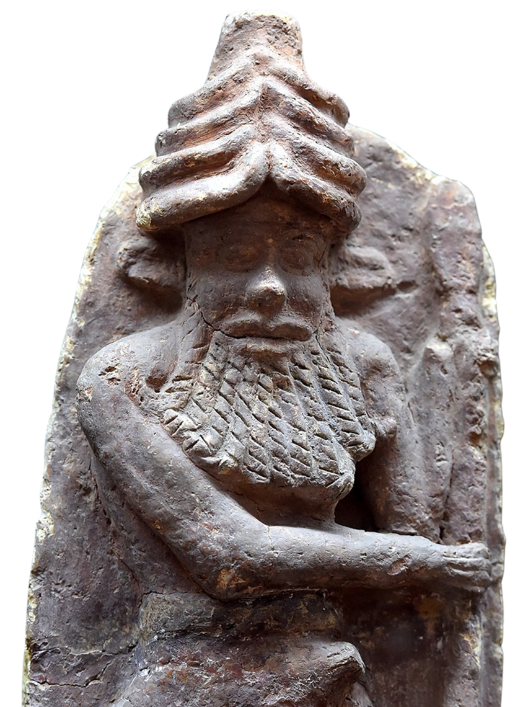
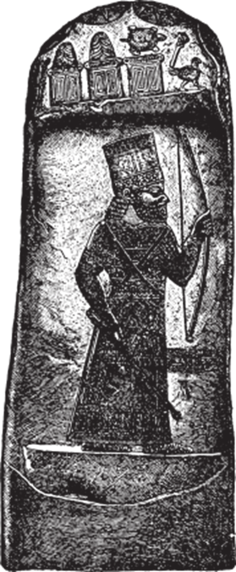

The Epic of Gilgamesh
Cuneiform & Literature
The Enuma Elish
Some of the earliest known human texts were written in Cuneiform!

Slide 11
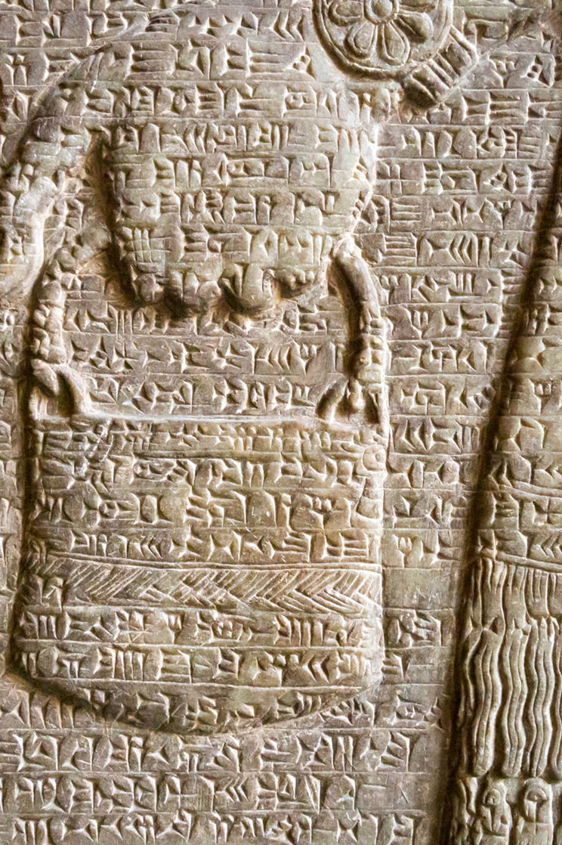
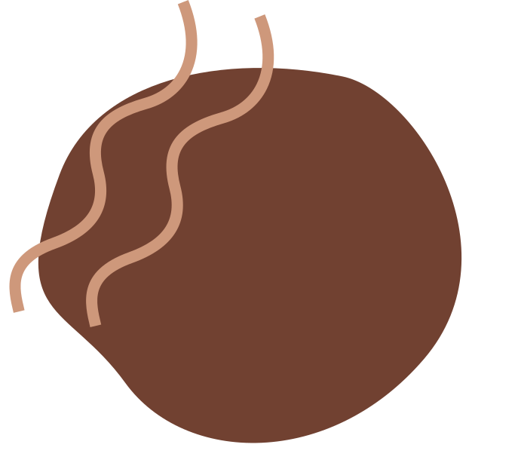

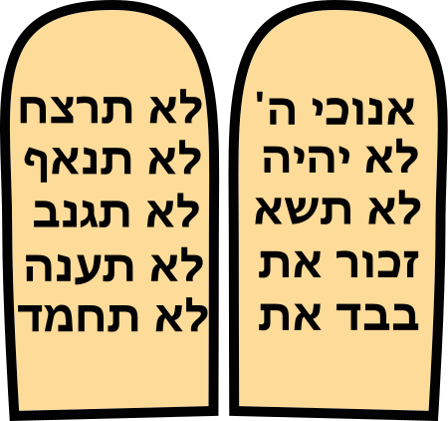
cuneiform today
•Cuneiform was used for over three thousand years until 75 CE.
•Assyriologists study cuneiform tablets and translate them from the many languages of ancient Mesopotamia .

Slide 12
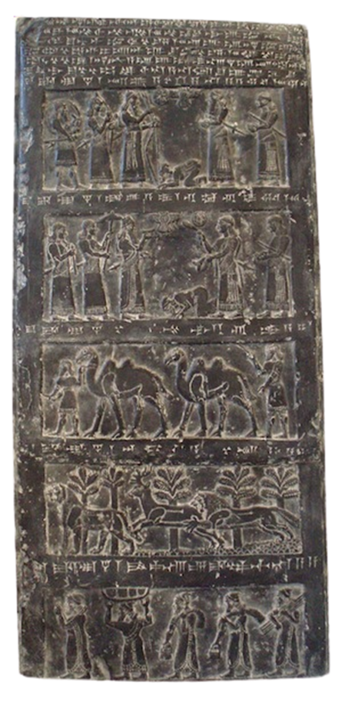
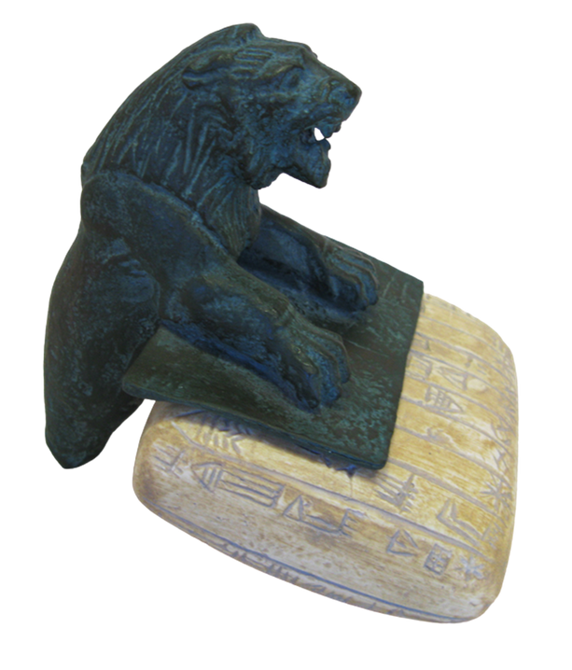
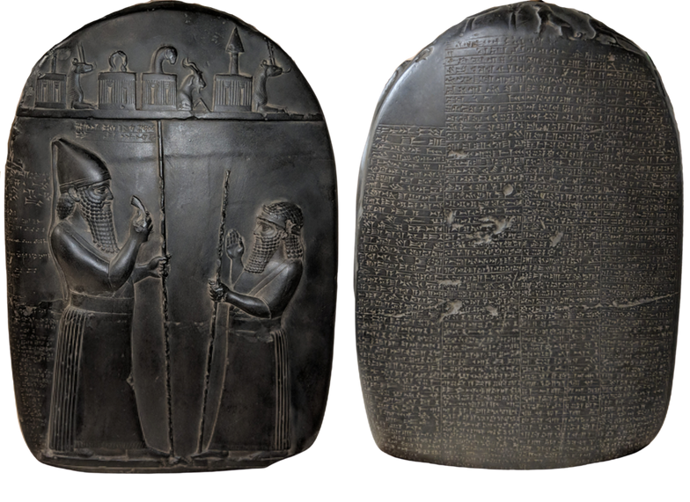
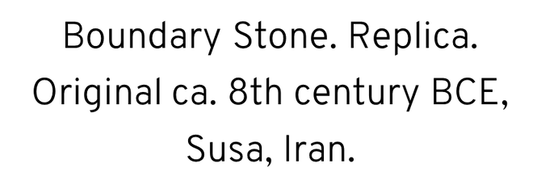
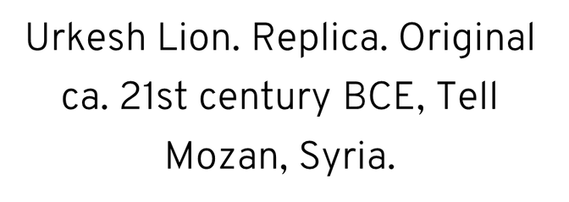
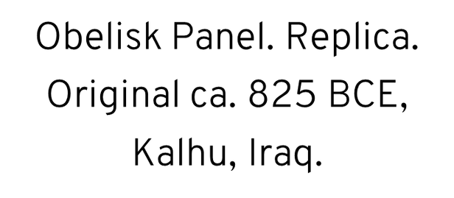
cuneiform at the mOa

Slide 13
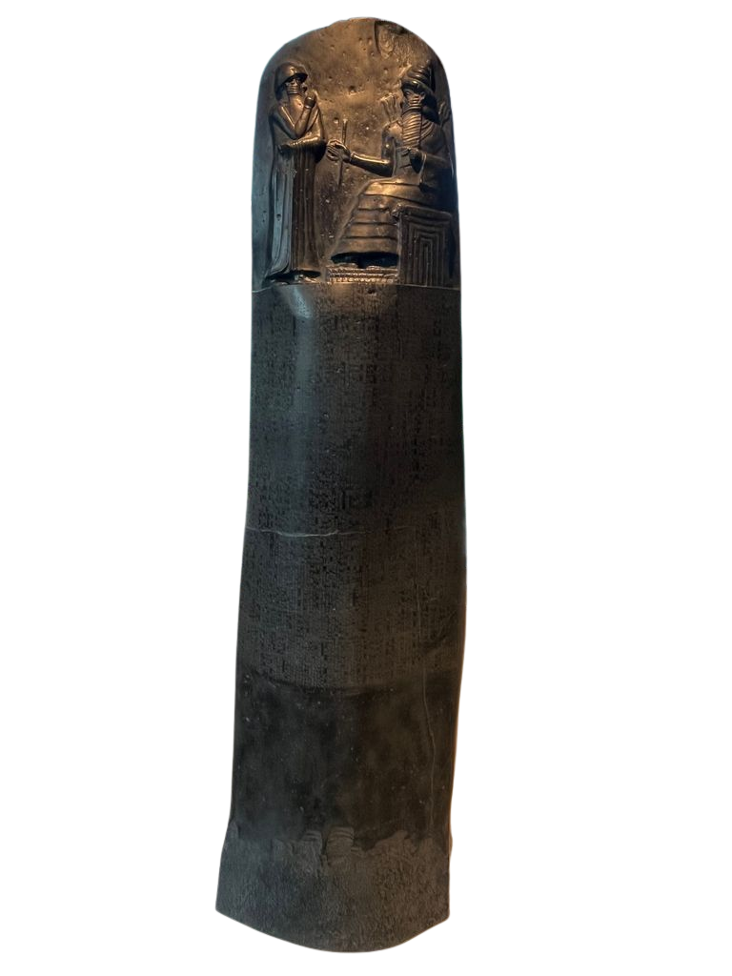
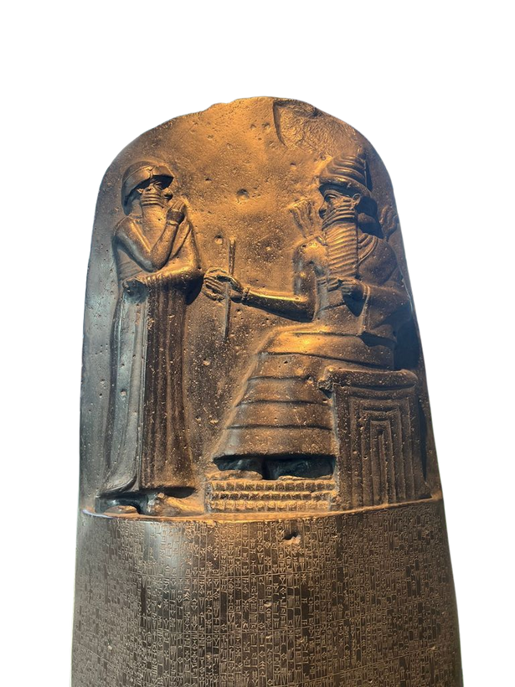
cuneiform at the mOa
Code of Hammurabi. Replica. Original ca. 18th century BCE, Susa, Iran
This artifact is over 7 feet tall!

Slide 14



CUNEIFORM IN ACTION
Notes:
https://www.youtube.com/watch?v=zjDFBb4IDqk

Slide 15


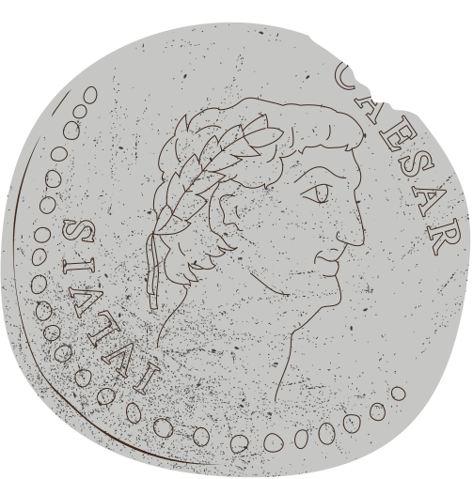
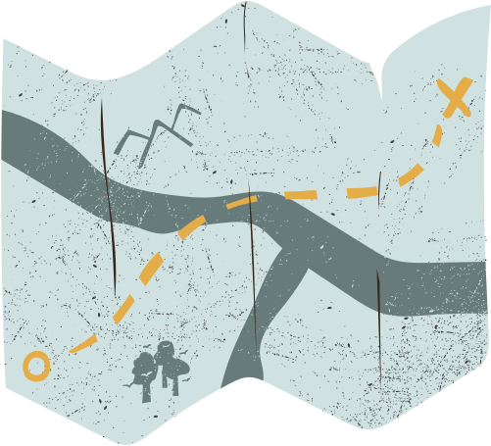

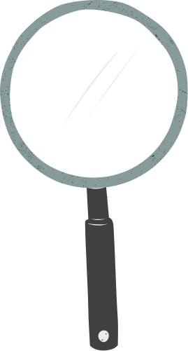
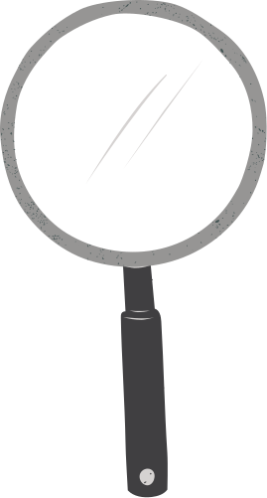
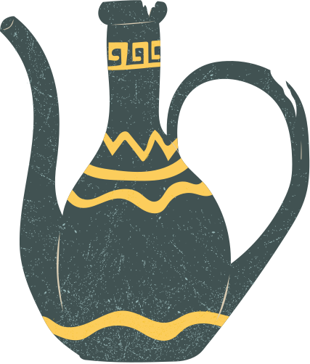
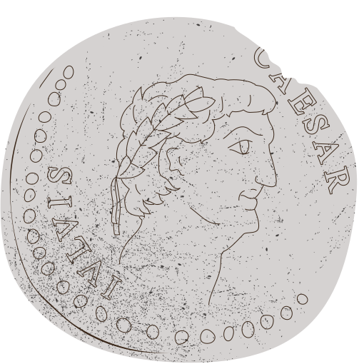


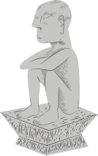
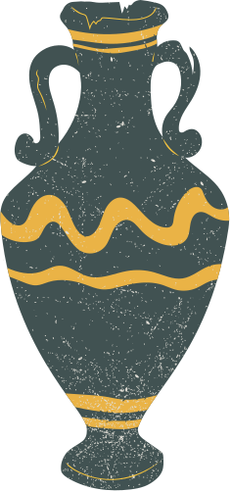
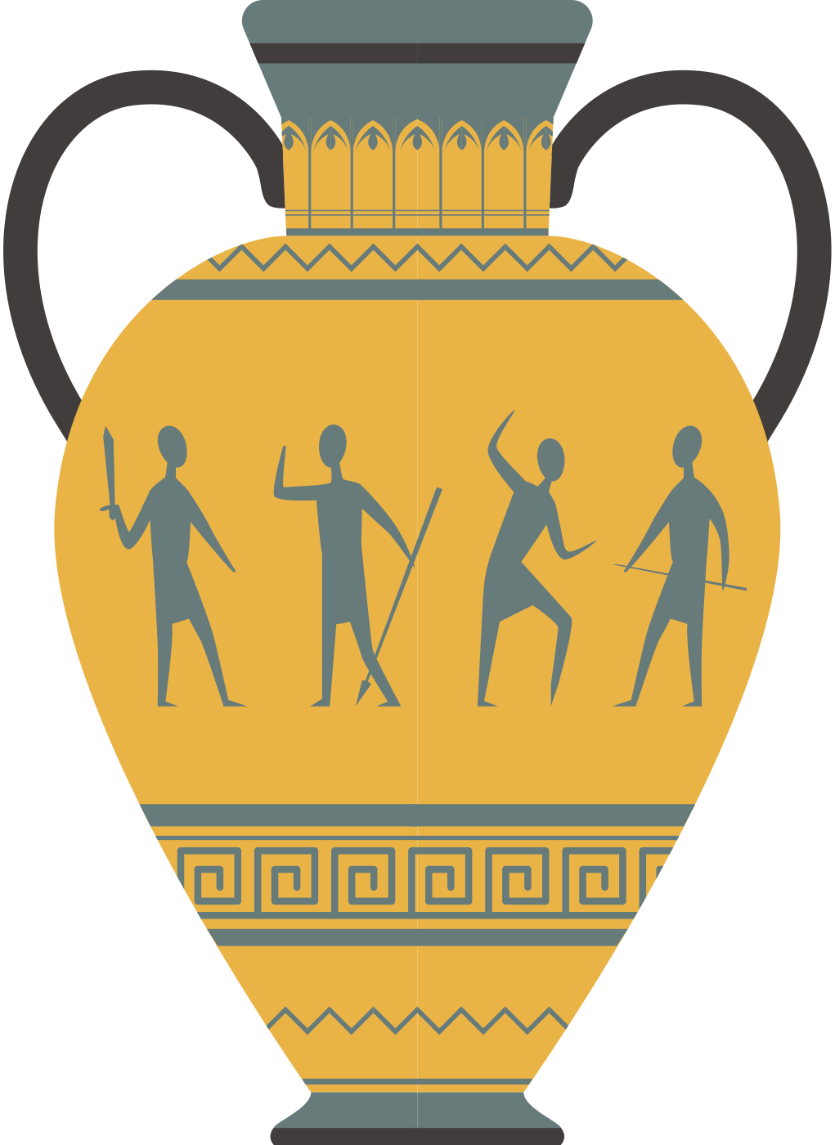
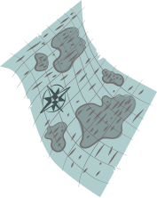


Thank you for listening
ANY QUESTIONS?

Slide 16

BIBLIOGRAPHY
Finkel, Irving, and Jonathan Taylor. Cuneiform. London: The British Museum Press, 2015.
Glassner, Jean-Jacques. The Invention of Cuneiform: Writing in Sumer. Translated and edited by Zainab Bahrani and Marc Van de Mieroop. Baltimore: Johns Hopkins University Press, 2003.
Radner, Karen, and Eleanor Robson, eds. The Oxford Handbook of Cuneiform Culture. Oxford: Oxford University Press, 2011.
Van de Mieroop, Marc. Cuneiform Texts and the Writing of History. London: Routledge, 1999.
Walker, C.B.F. Cuneiform. Berkeley: University of California Press, 1987.

Slide 17
BIBLIOGRAPHY
Middle_East_topographic_map-blank.svg: Sémhur (talk)derivative work: Zunkir, CC BY-SA 3.0, https://commons.wikimedia.org/wiki/File:Uruk_expansion.svg
LessayCatus at French Wikipedia, CC BY-SA 2.5, https://commons.wikimedia.org/wiki/File:Calame-1.jpg
Louvre Museum, CC BY 3.0, https://commons.wikimedia.org/wiki/File:P1150884_Louvre_Uruk_III_tablette_%C3%A9criture_pr%C3%A9cun%C3%A9iforme_AO19936_rwk.jpg
Louvre Museum, Public domain, https://commons.wikimedia.org/wiki/File:Sales_contract_Shuruppak_Louvre_AO3766.jpg
Gary Todd, CC0, https://commons.wikimedia.org/wiki/File:Library_of_Ashurbanipal.jpg
Louvre Museum, Public domain, https://commons.wikimedia.org/wiki/File:Hero_lion_Dur-Sharrukin_Louvre_AO19862.jpg
Osama Shukir Muhammed Amin FRCP(Glasg), CC BY-SA 4.0 https://commons.wikimedia.org/wiki/File:Enkidu,_Gilgamesh%27s_friend._From_Ur,_Iraq,_2027-1763_BCE._Iraq_Museum.jpg

