Slide 1
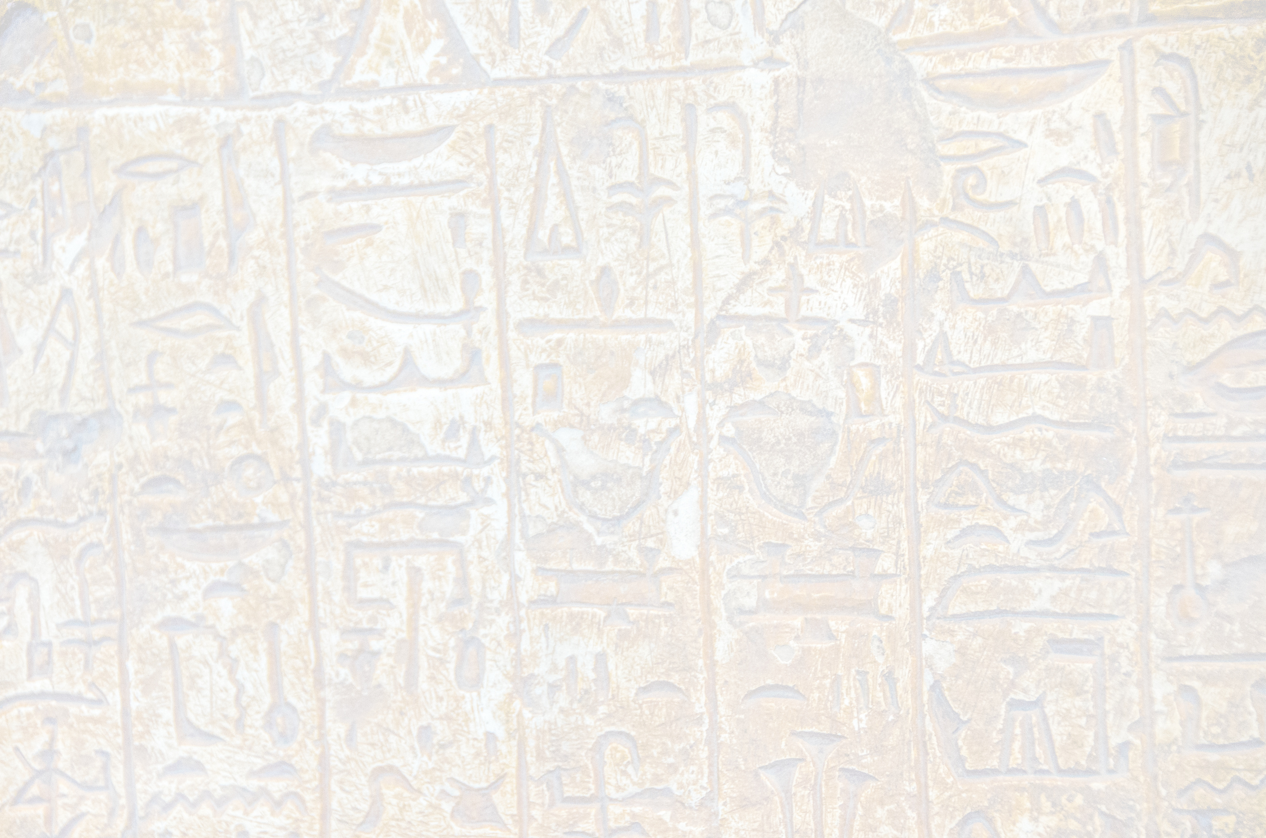
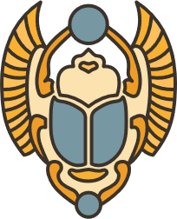
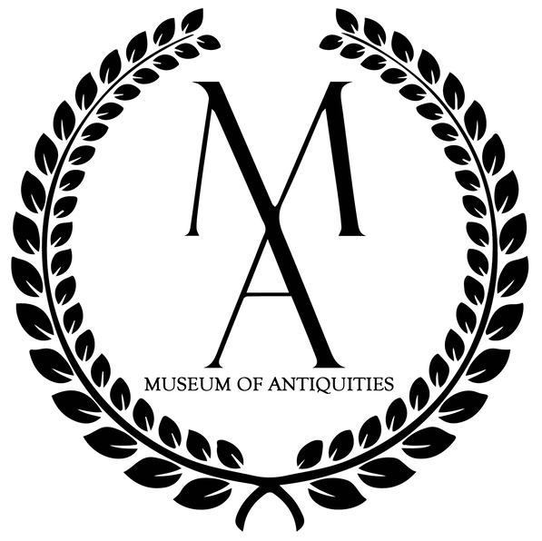
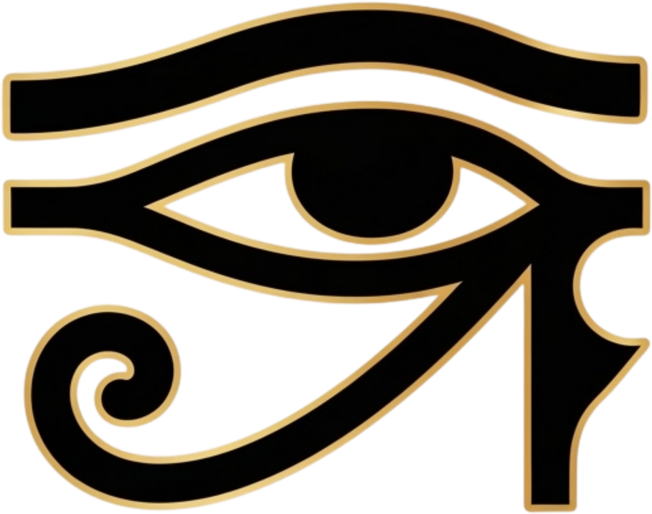
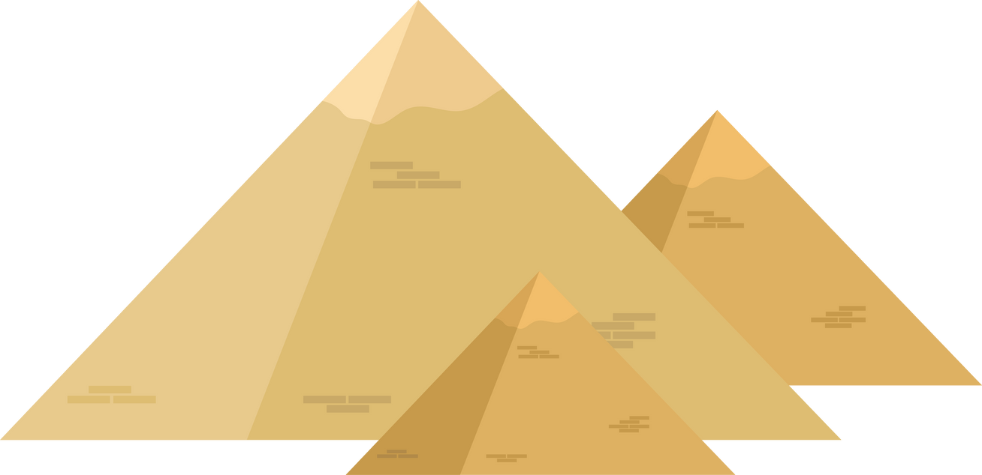
Egyptian Amulets

Slide 2
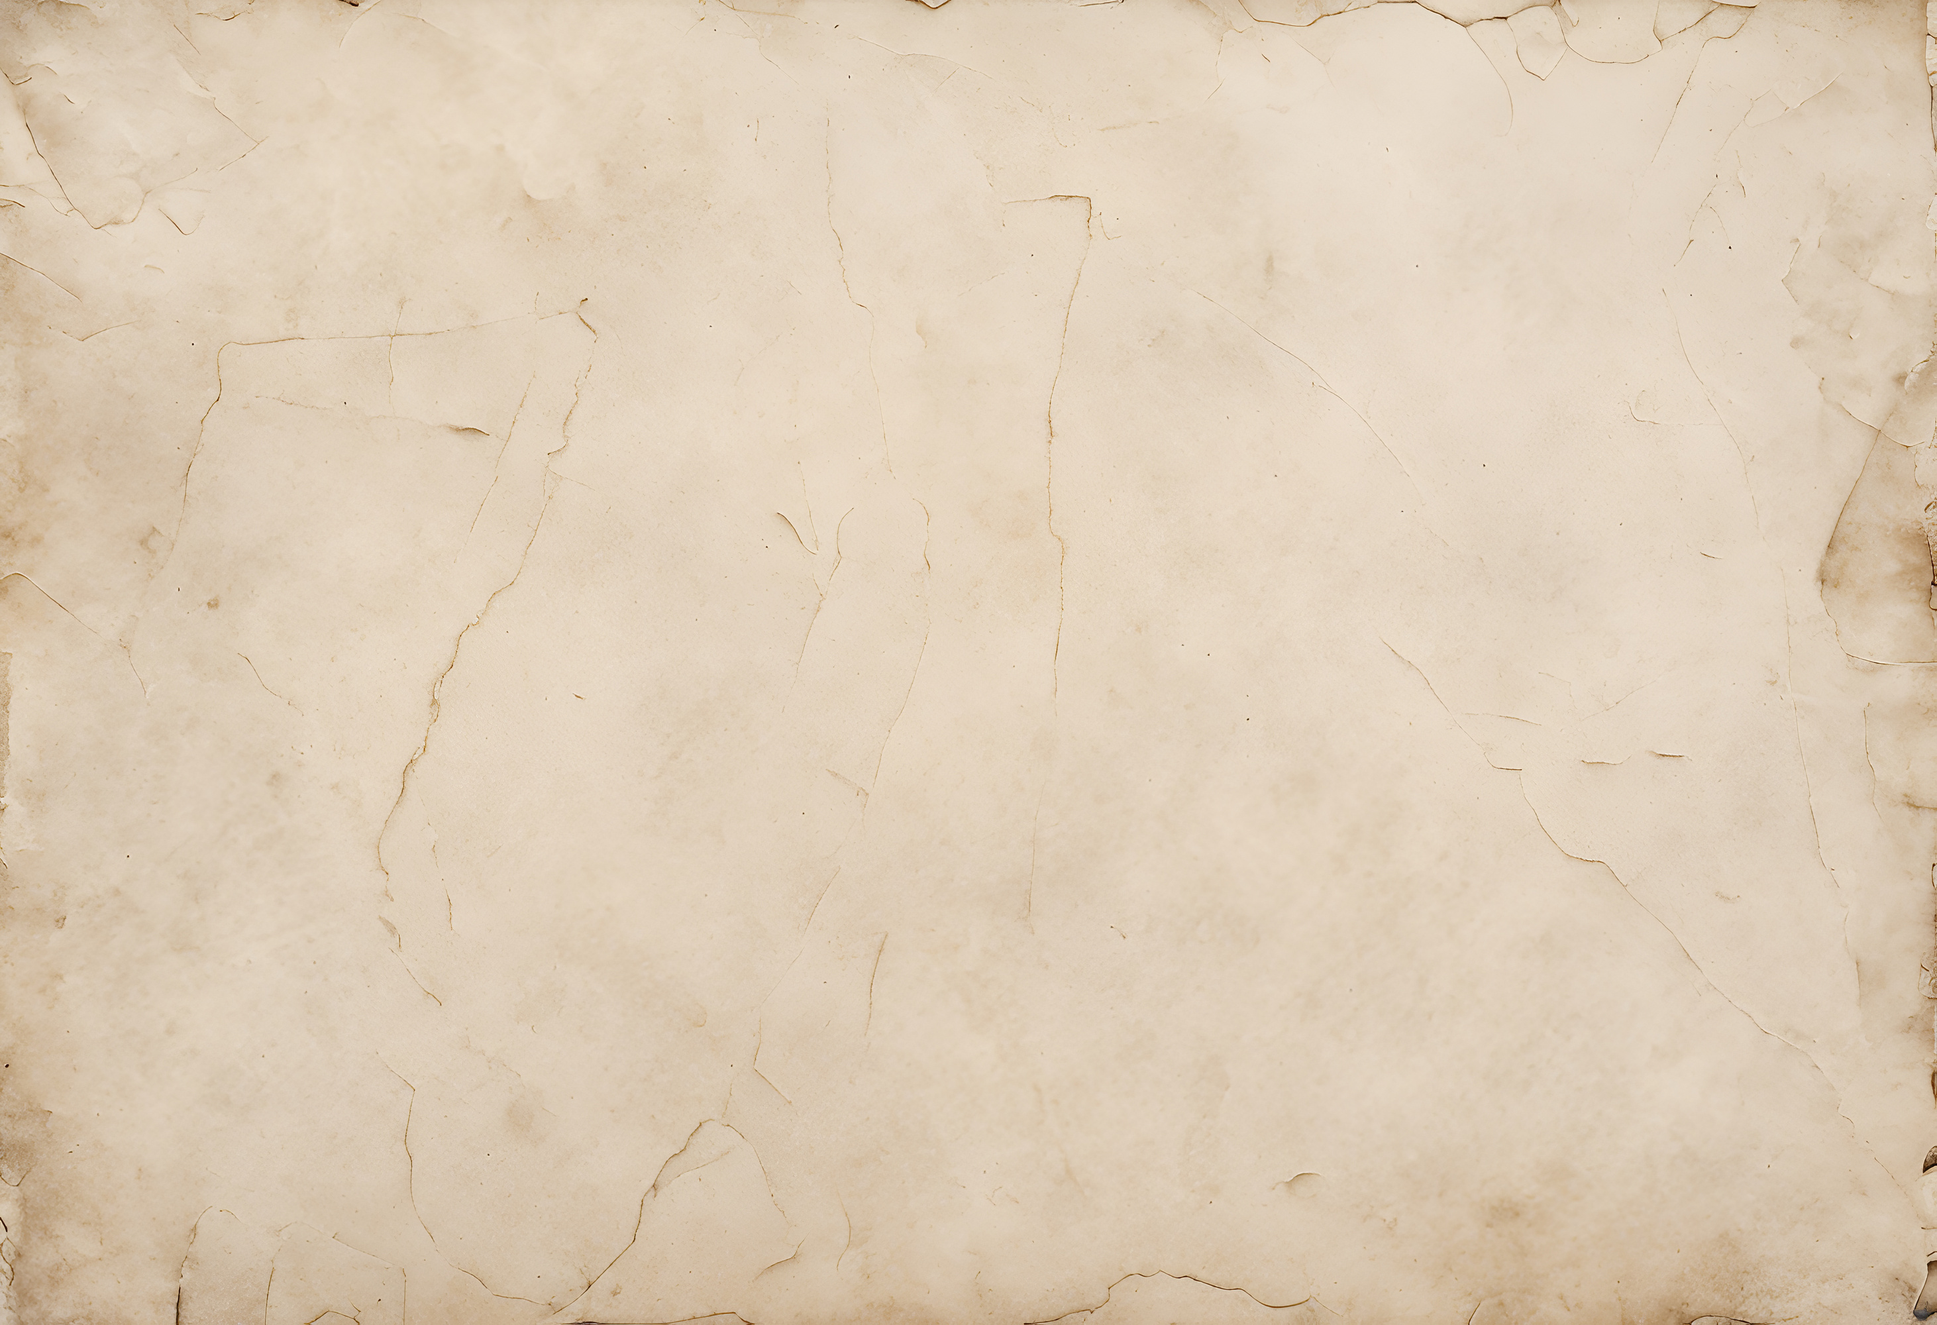
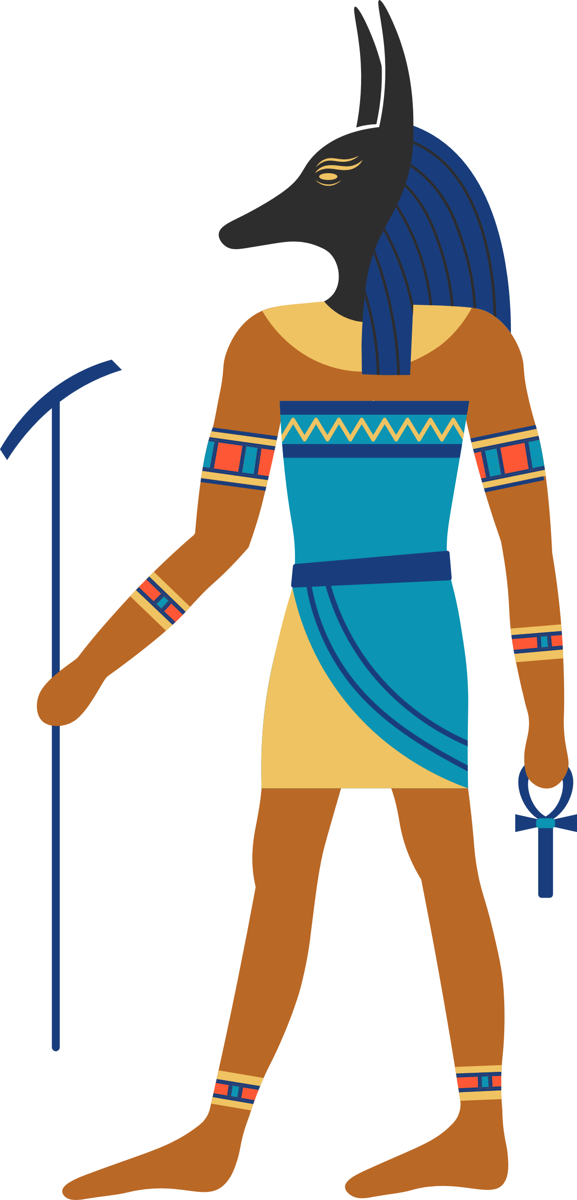
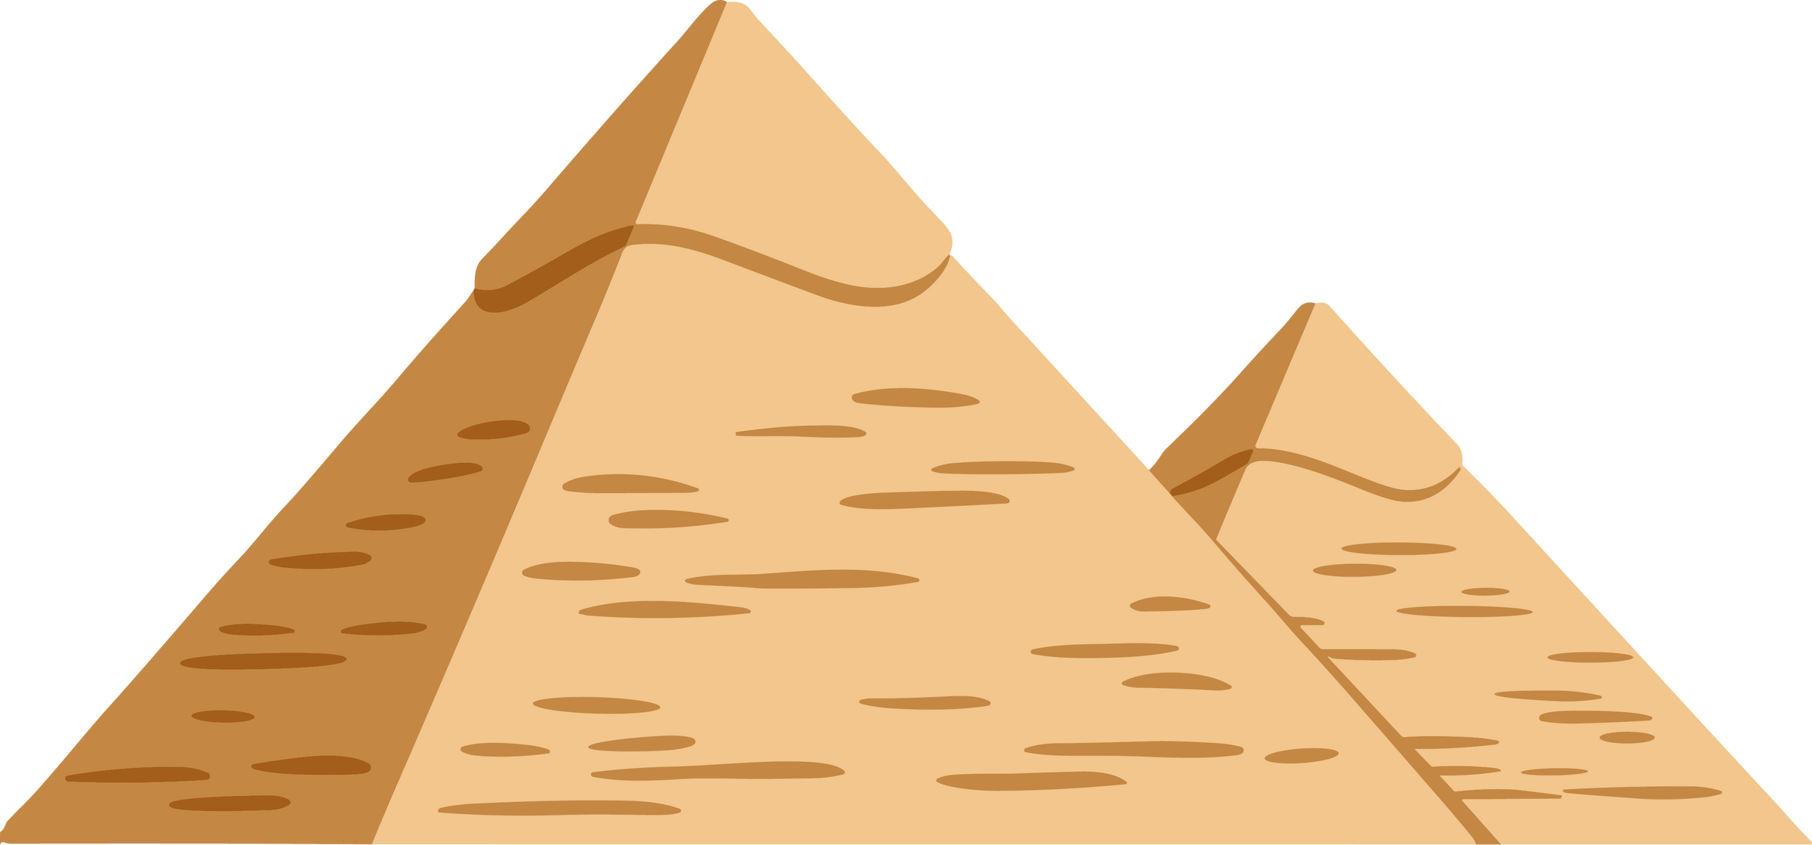
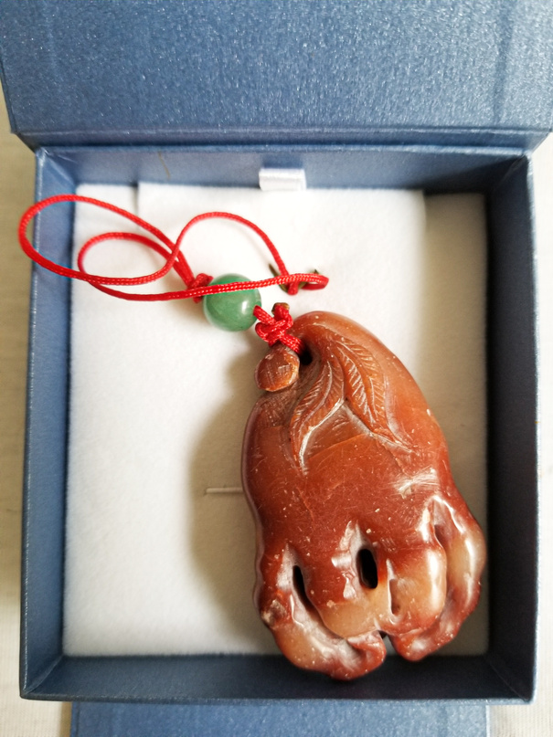
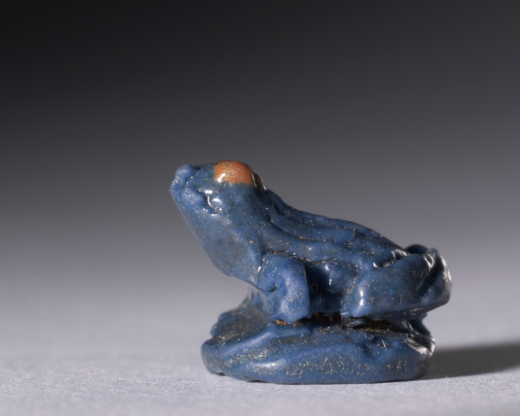
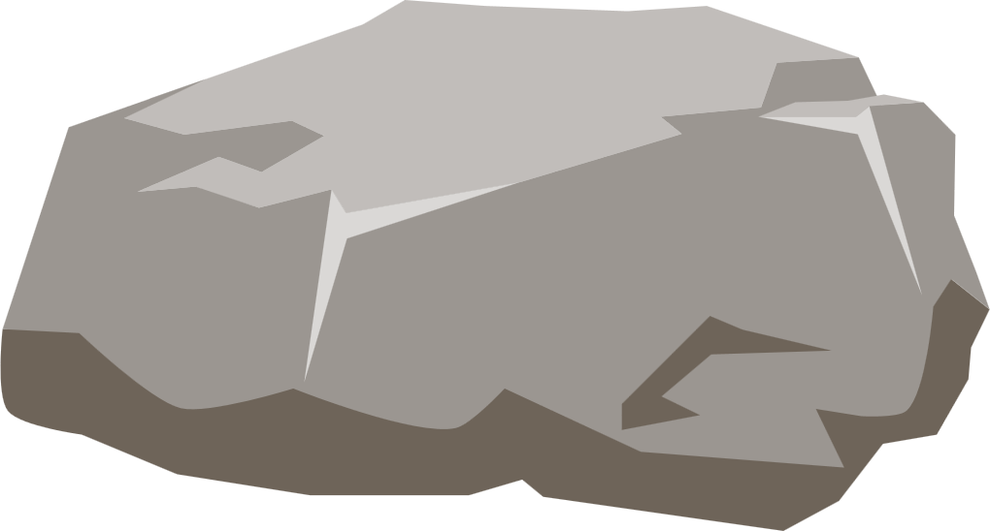
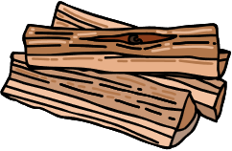
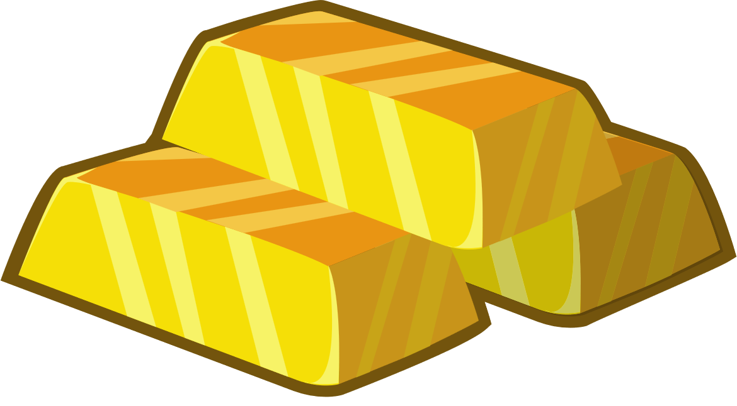
What are Amulets?
Amulets are objects that are known to give the wearer some kind of magical benefit like protection, good luck, or strength.
They could be made of materials such as:
Stone
Wood
Precious Metals

Slide 3
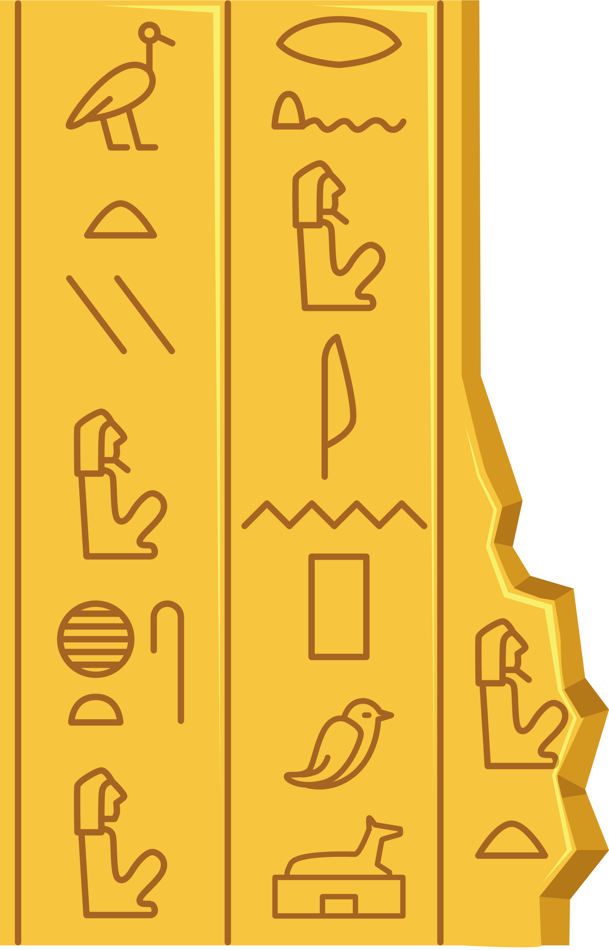

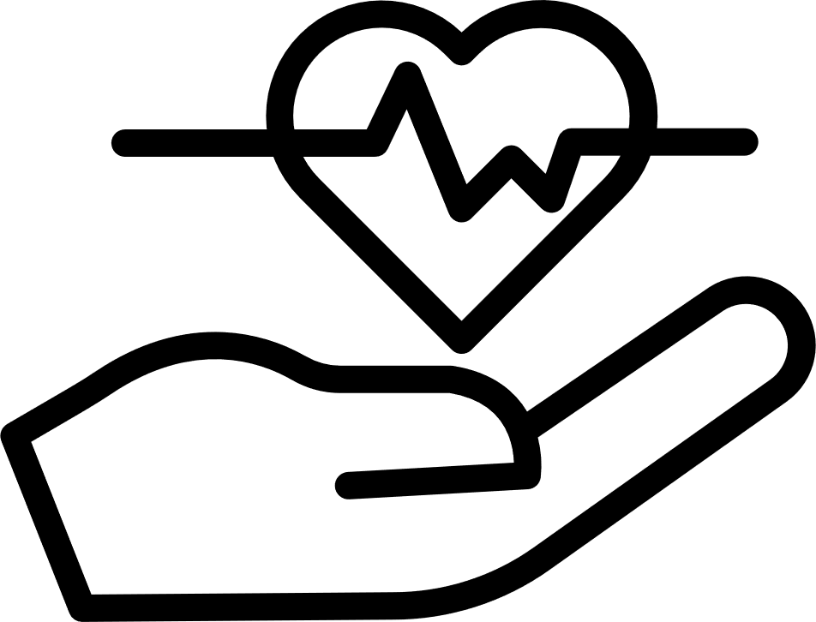

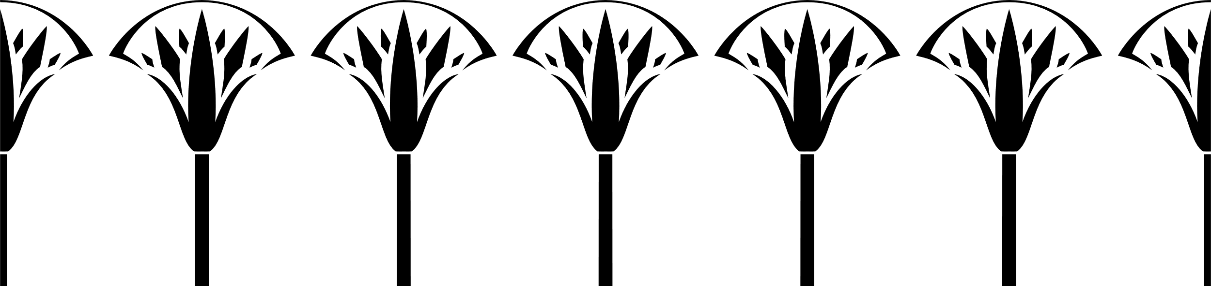
What Were Amulets Used For?
Amulets had many uses, but most fit into three main categories:
Protection from Evil
Long Life
Strength and Power

Slide 4
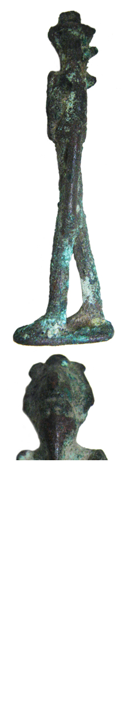
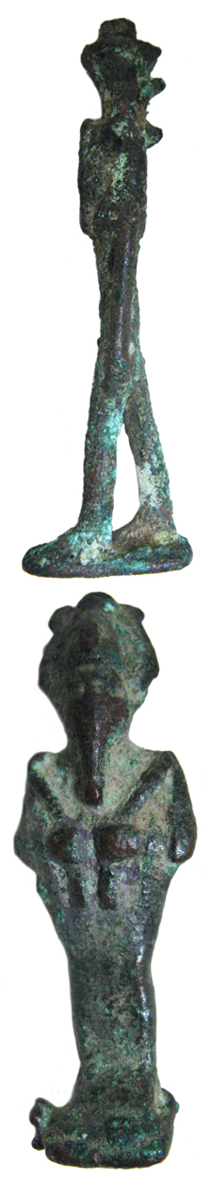
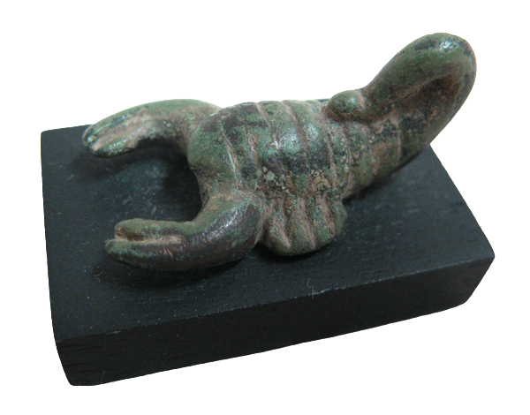
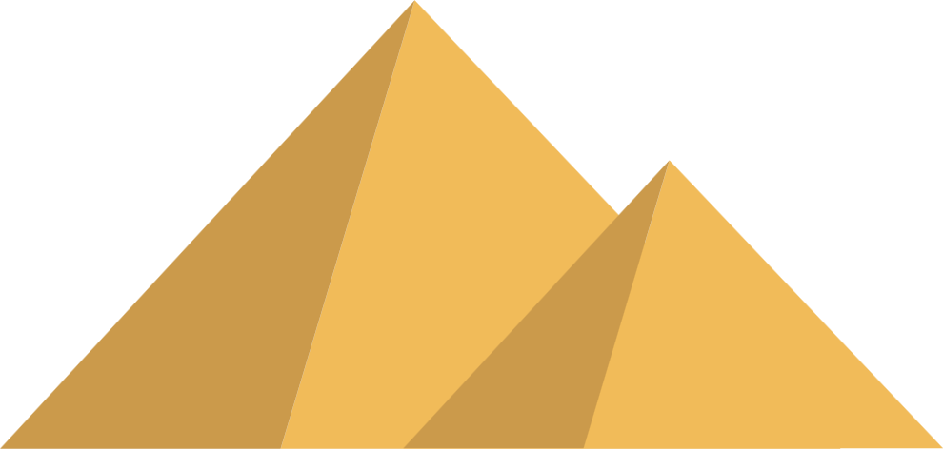
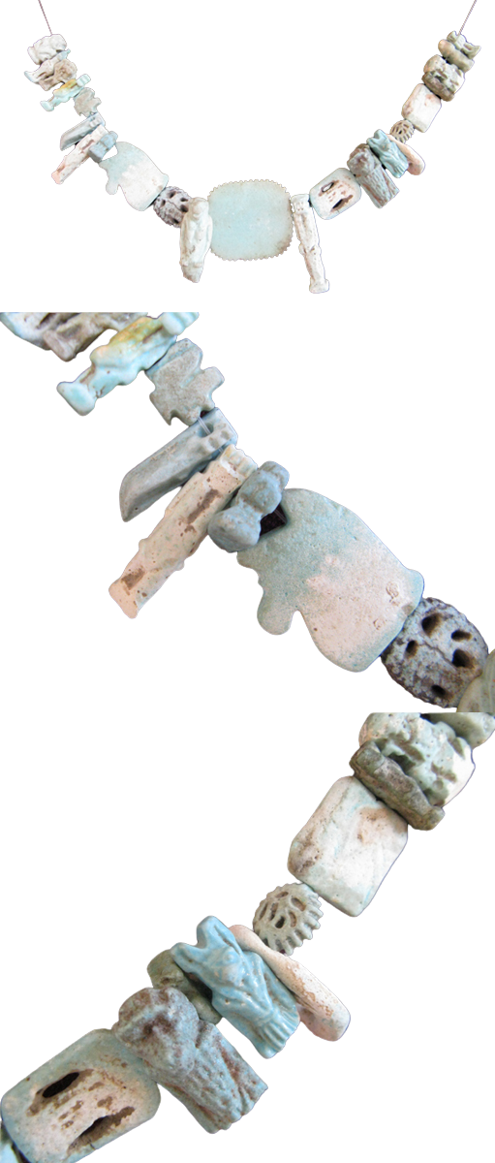
Bronze Amulets
Faience Amulets
Scorpion Amulet
Used for good luck and a safe journey to the afterlife
Used for protection and to represent the goddess Serket
94 amulets with many different uses
If you want to learn more about these amulets check out the "Collections" section on our website!
Notes:
Here at the Museum of Antiquities, we have some very cool Egyptian amulets...

Slide 5
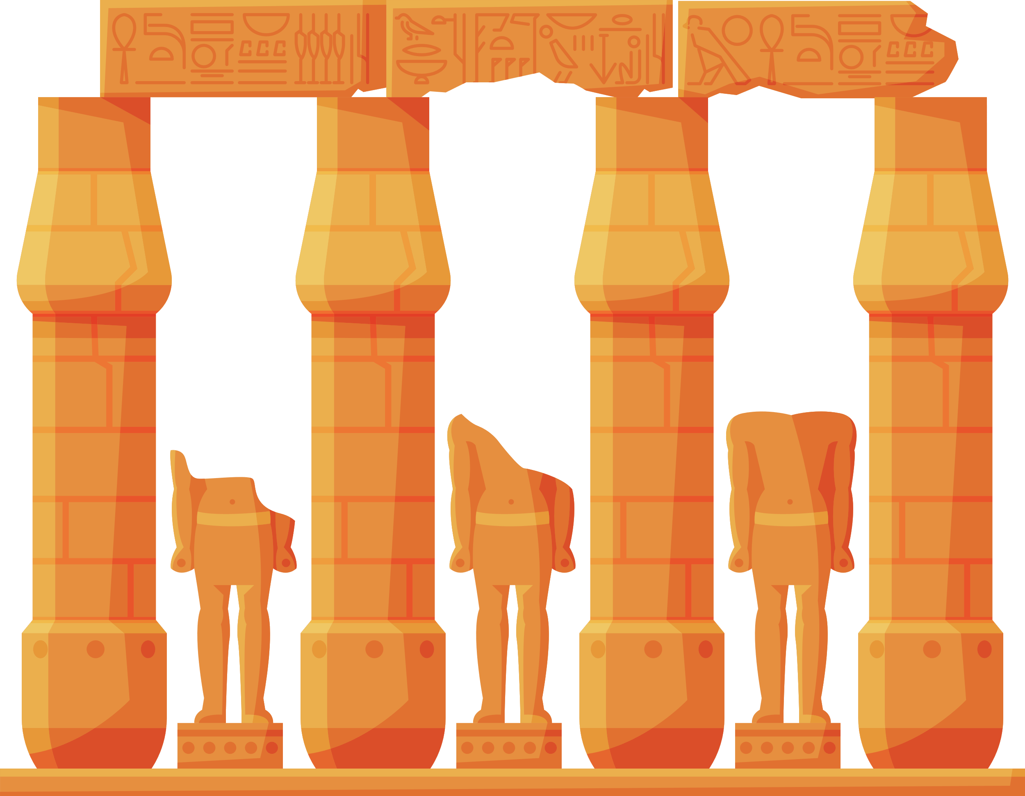
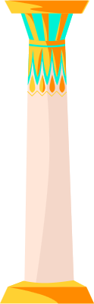
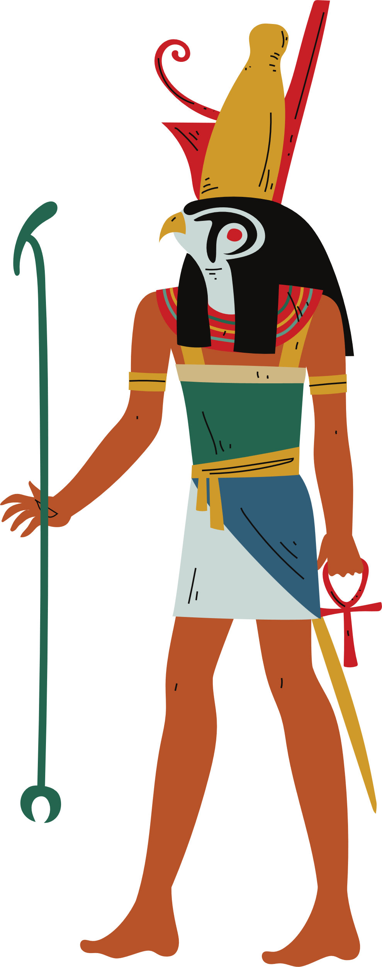
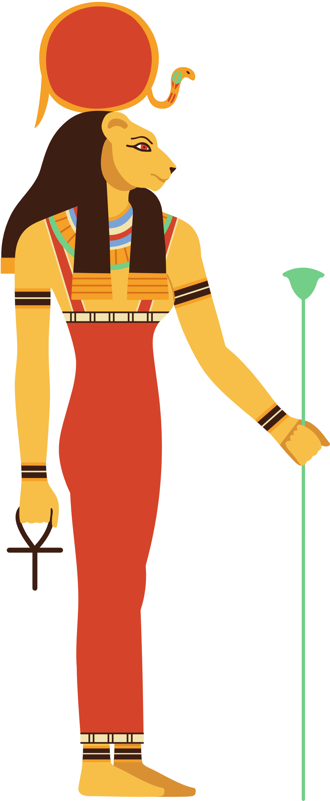
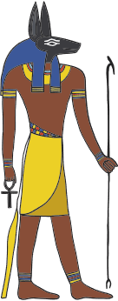
Egyptian Gods As Animals
Horus, the god of the sun, was depicted as a falcon.
Anubis, the god of funerary practices, was depicted as a jackal.
Sekhmet, the goddess of war, was depicted as a lion.
Notes:
Horus - Falcon
Anubis - Canine/Dog
Sekhmet - Lioness
Many Egyptian gods were associated with animals and had animal forms. When shown on amulets, these animals were thought to bring the protection or power of the gods to their wearers.

Slide 6

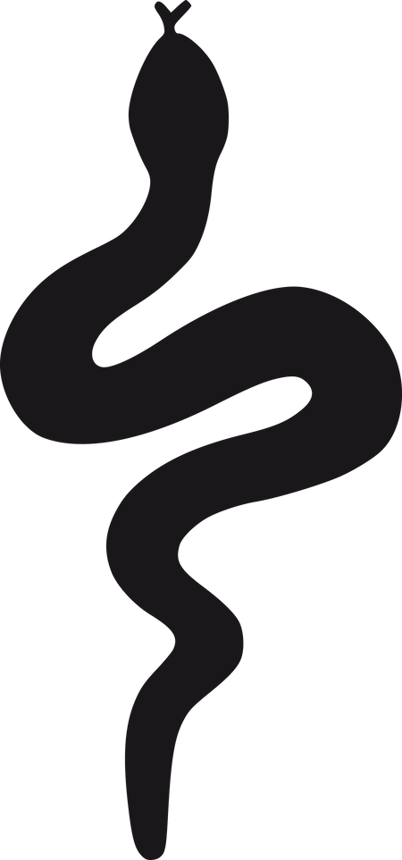
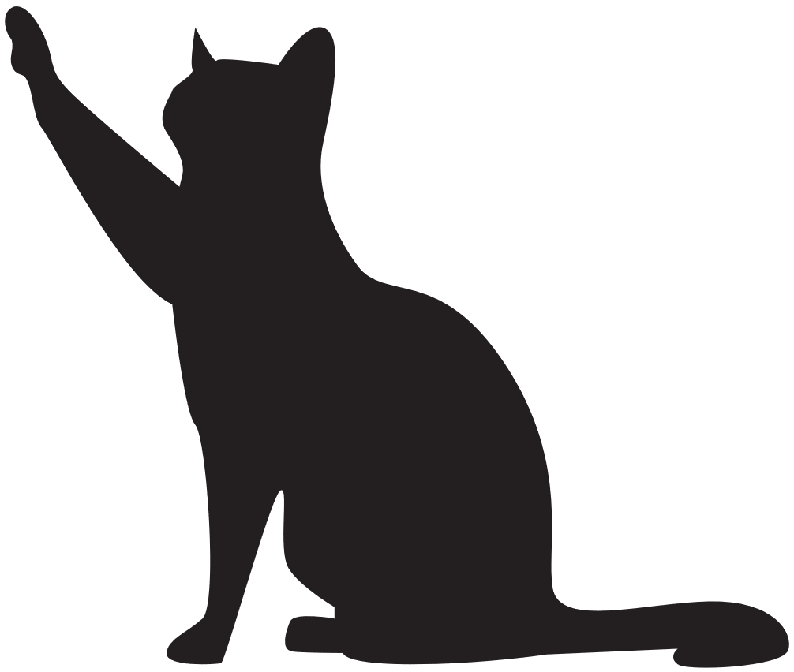
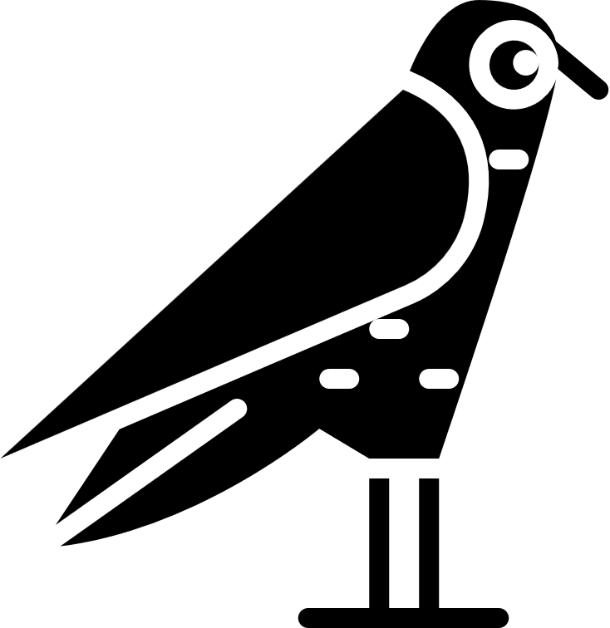
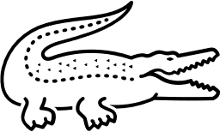
Question Time!
If you were an Egyptian god and you had to choose an animal to represent you, which one would it be and why?
Notes:
Prompt the kids to share which animal they would pick.

Slide 7
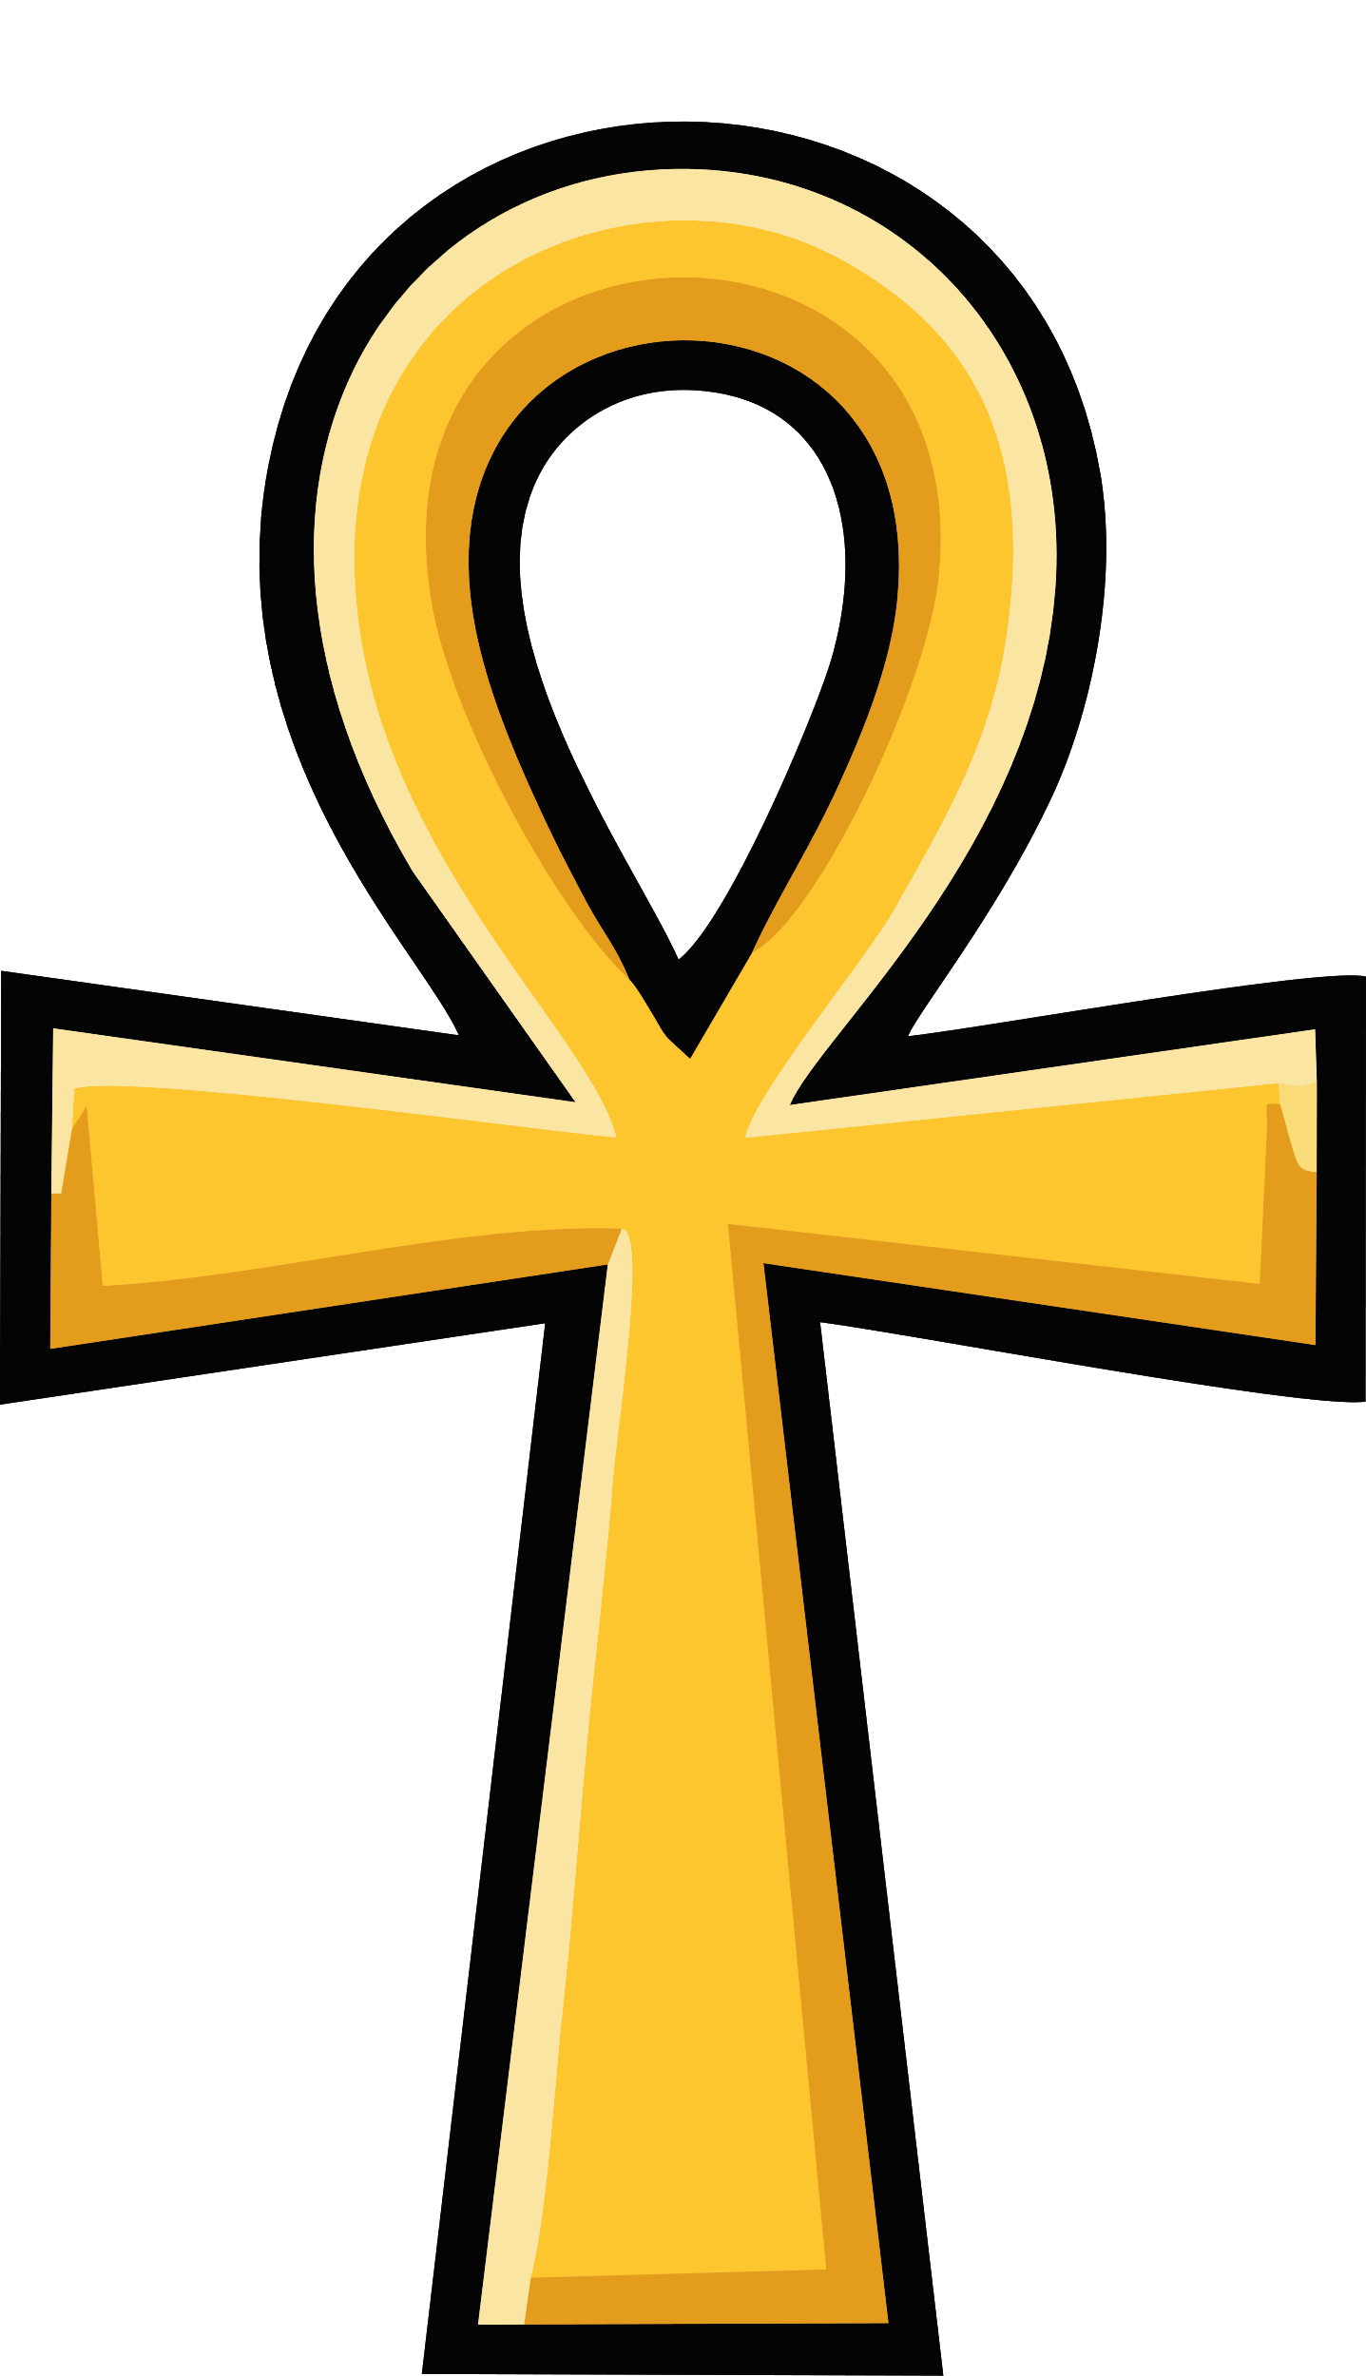
The Ankh
Notes:
Now we are going to talk about Egyptian symbols!
The Ankh is known as the key of life, represented as a cross with a loop at the top. Sometimes it is ornamented with decorative flourishes but usually comes as shown on the screen. It is one of the oldest symbols of ancient Egypt, representing life and the journey ahead to the afterlife.

Slide 8
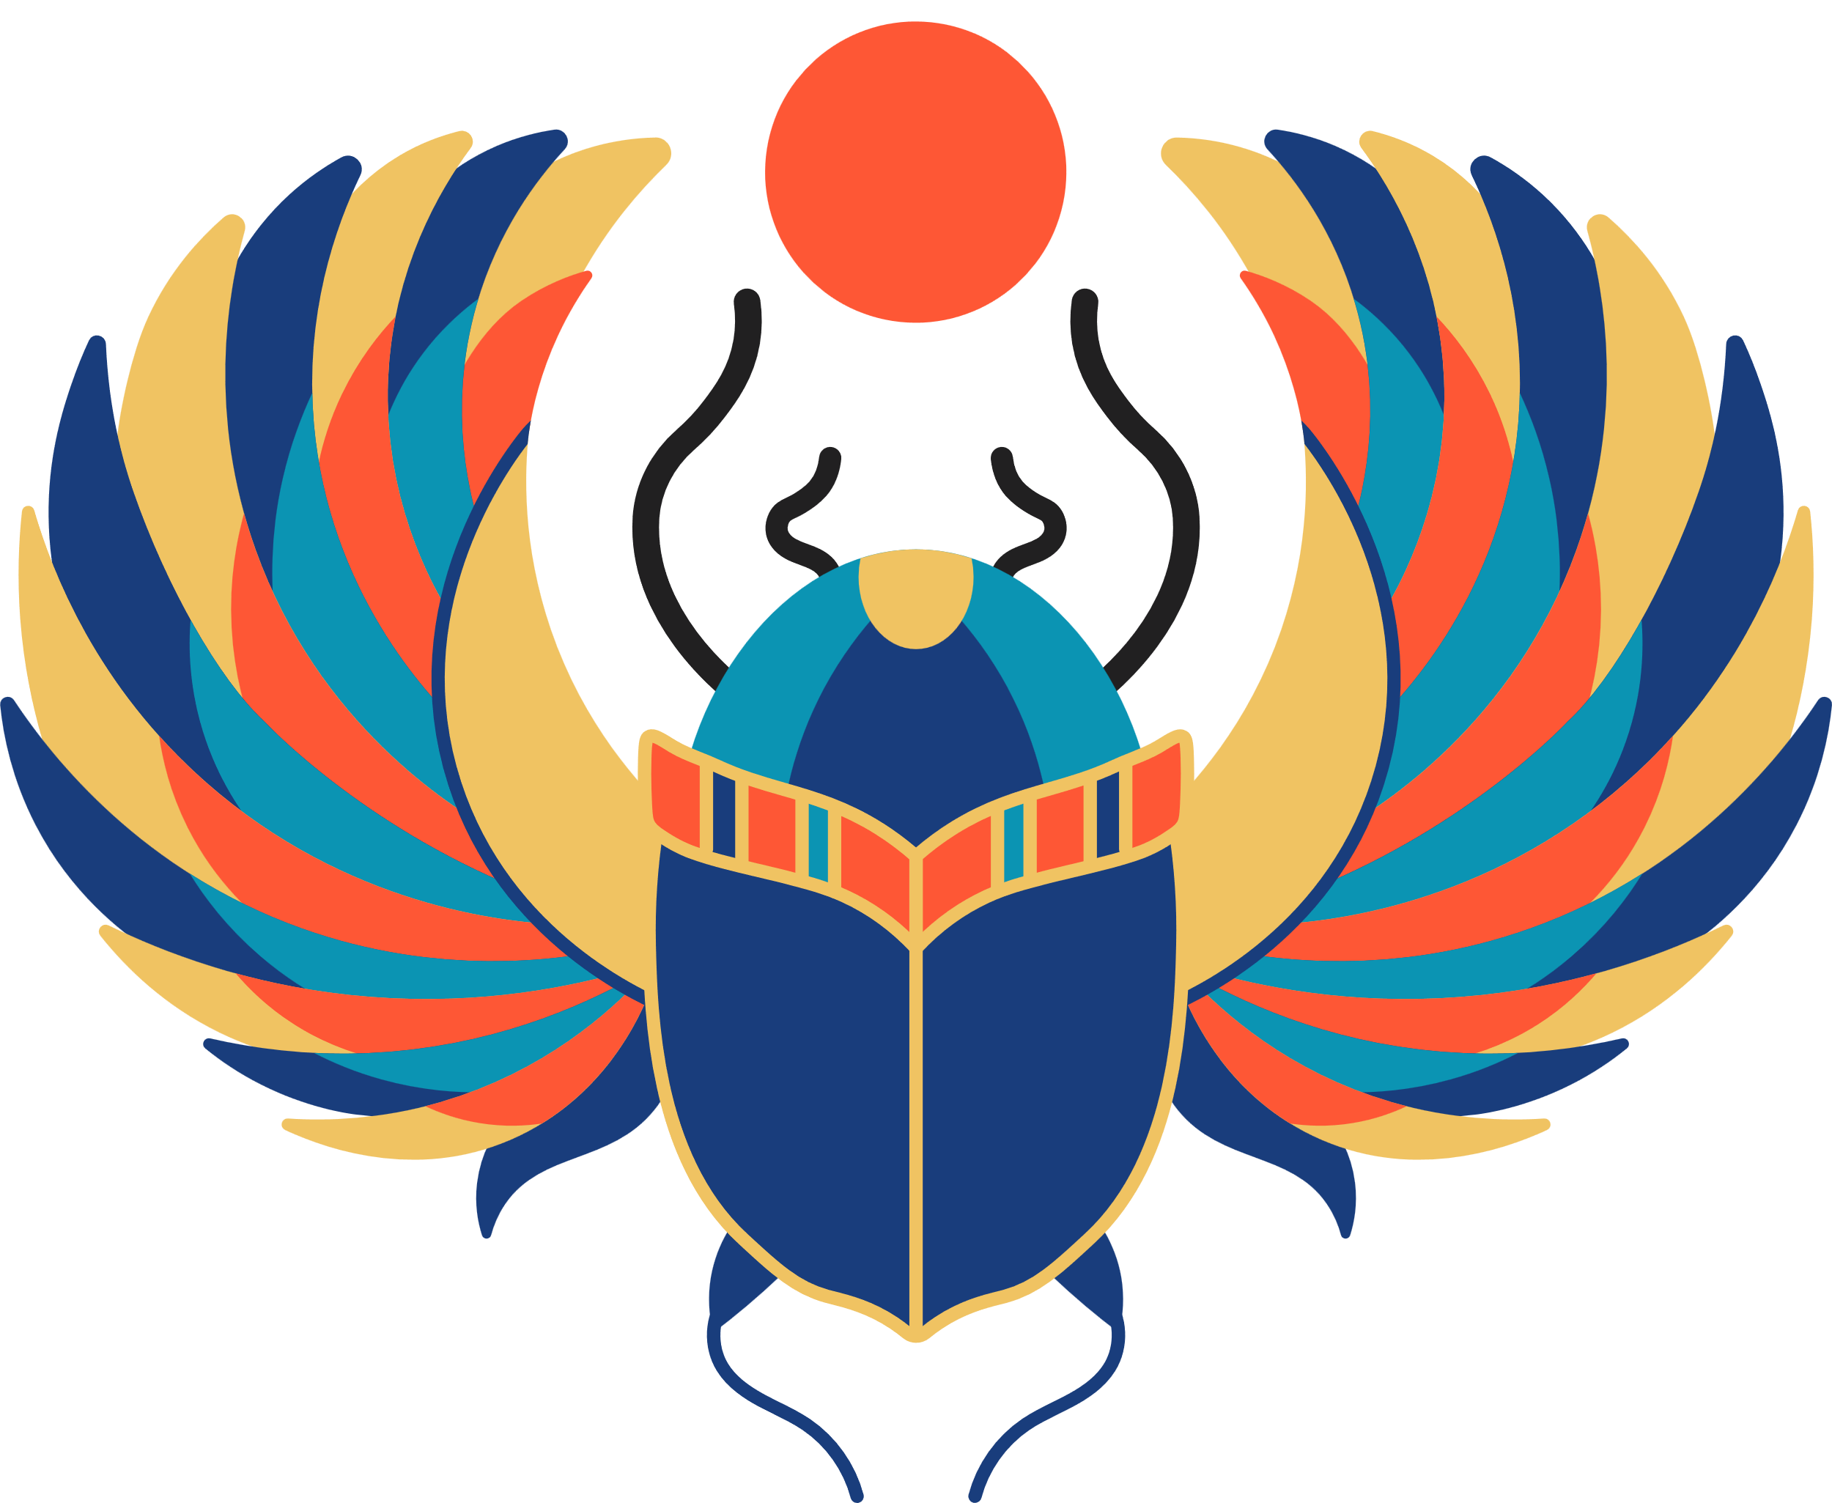
The Scarab
Notes:
The scarab is a type of dung-eating beetle, the Ancient Egyptians associated the scarab with the god of creation, who would roll the sun across the sky each day. It was worn for strength.

Slide 9
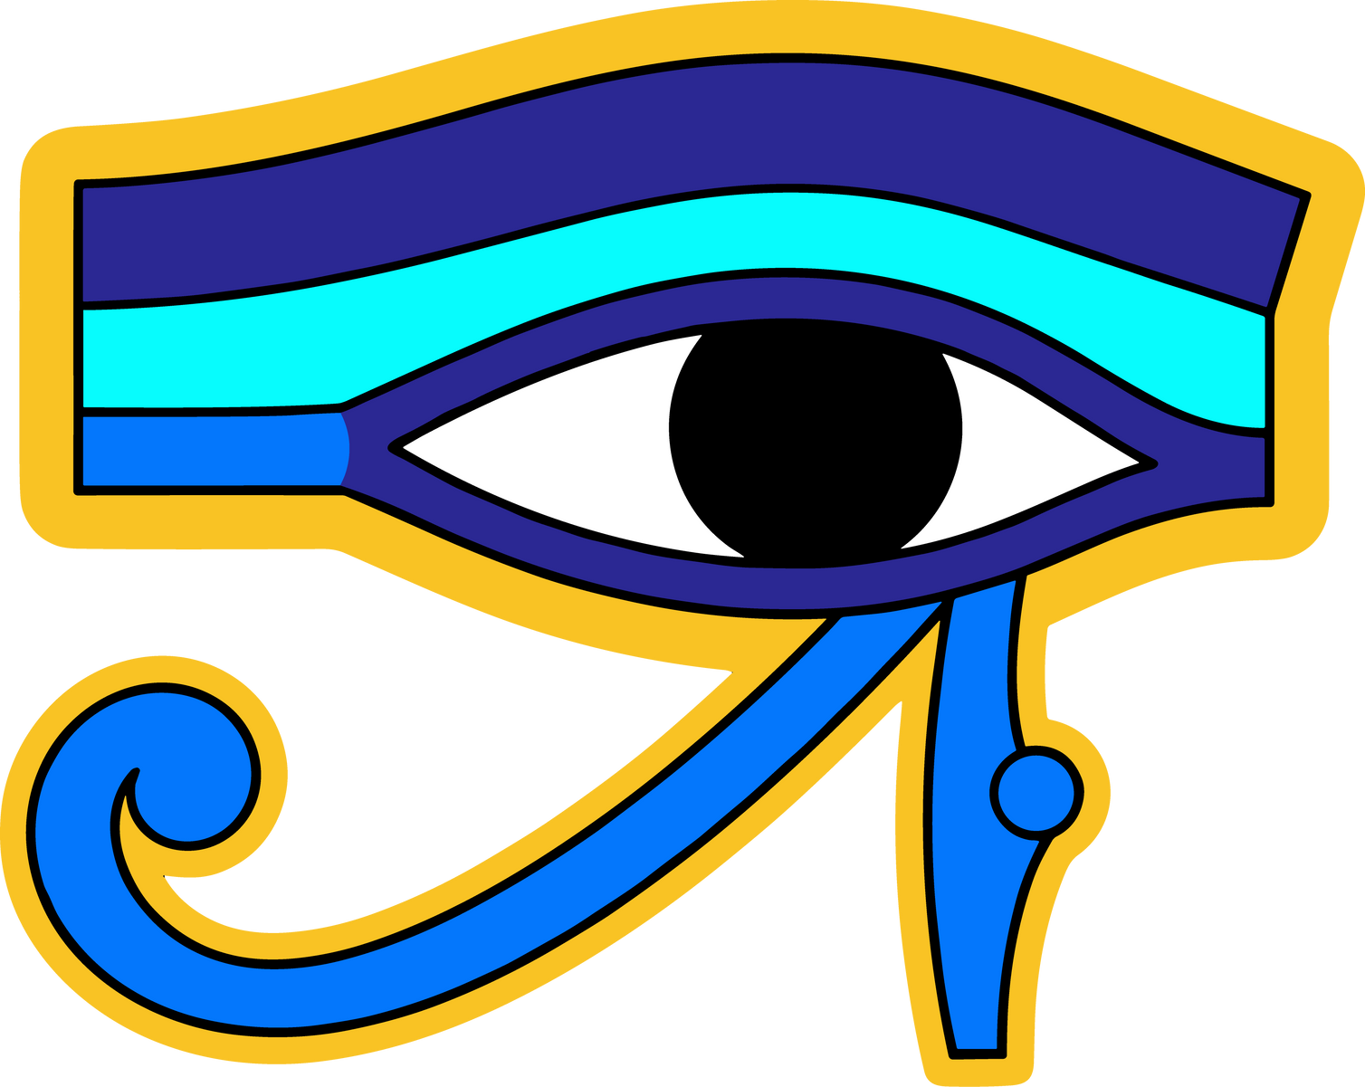
The Udjat
Notes:
The udjat, which means “eye,” was worn for good health, safety, happiness, and general well-being. Two udjats could be used to represent the sun and the moon.

Slide 10
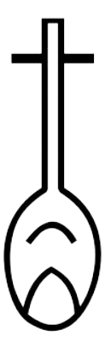
The Nefer
Notes:
The Nefer was made to look like an ancient lute or a heart and windpipe. The word “nefer” means “good,” so those who wore the Nefer would likely wear it for happiness, good luck, and joy.

Slide 11
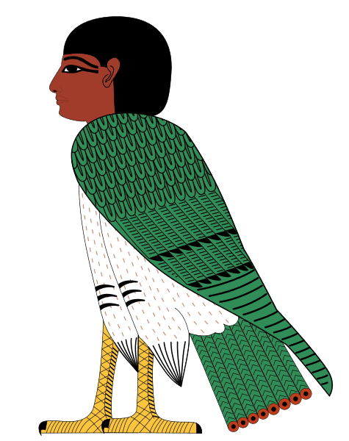
The Ba
Notes:
The ba symbol shows a hawk with a man’s head, which could be a person’s soul. It was worn for strength, and is meant to have a connection to the sky god Horus.

Slide 12
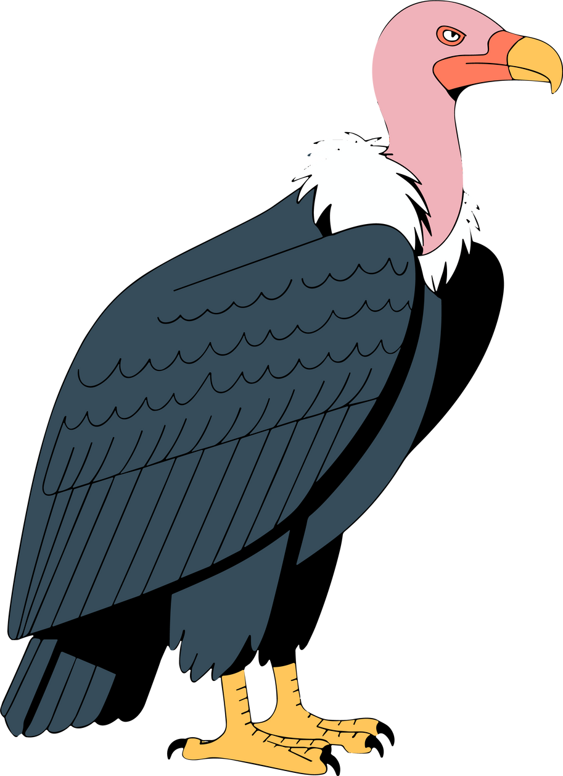
The Vulture
Notes:
The vulture is likely meant to represent the goddess Isis, it was meant to give the wearer strength and fierceness.

Slide 13
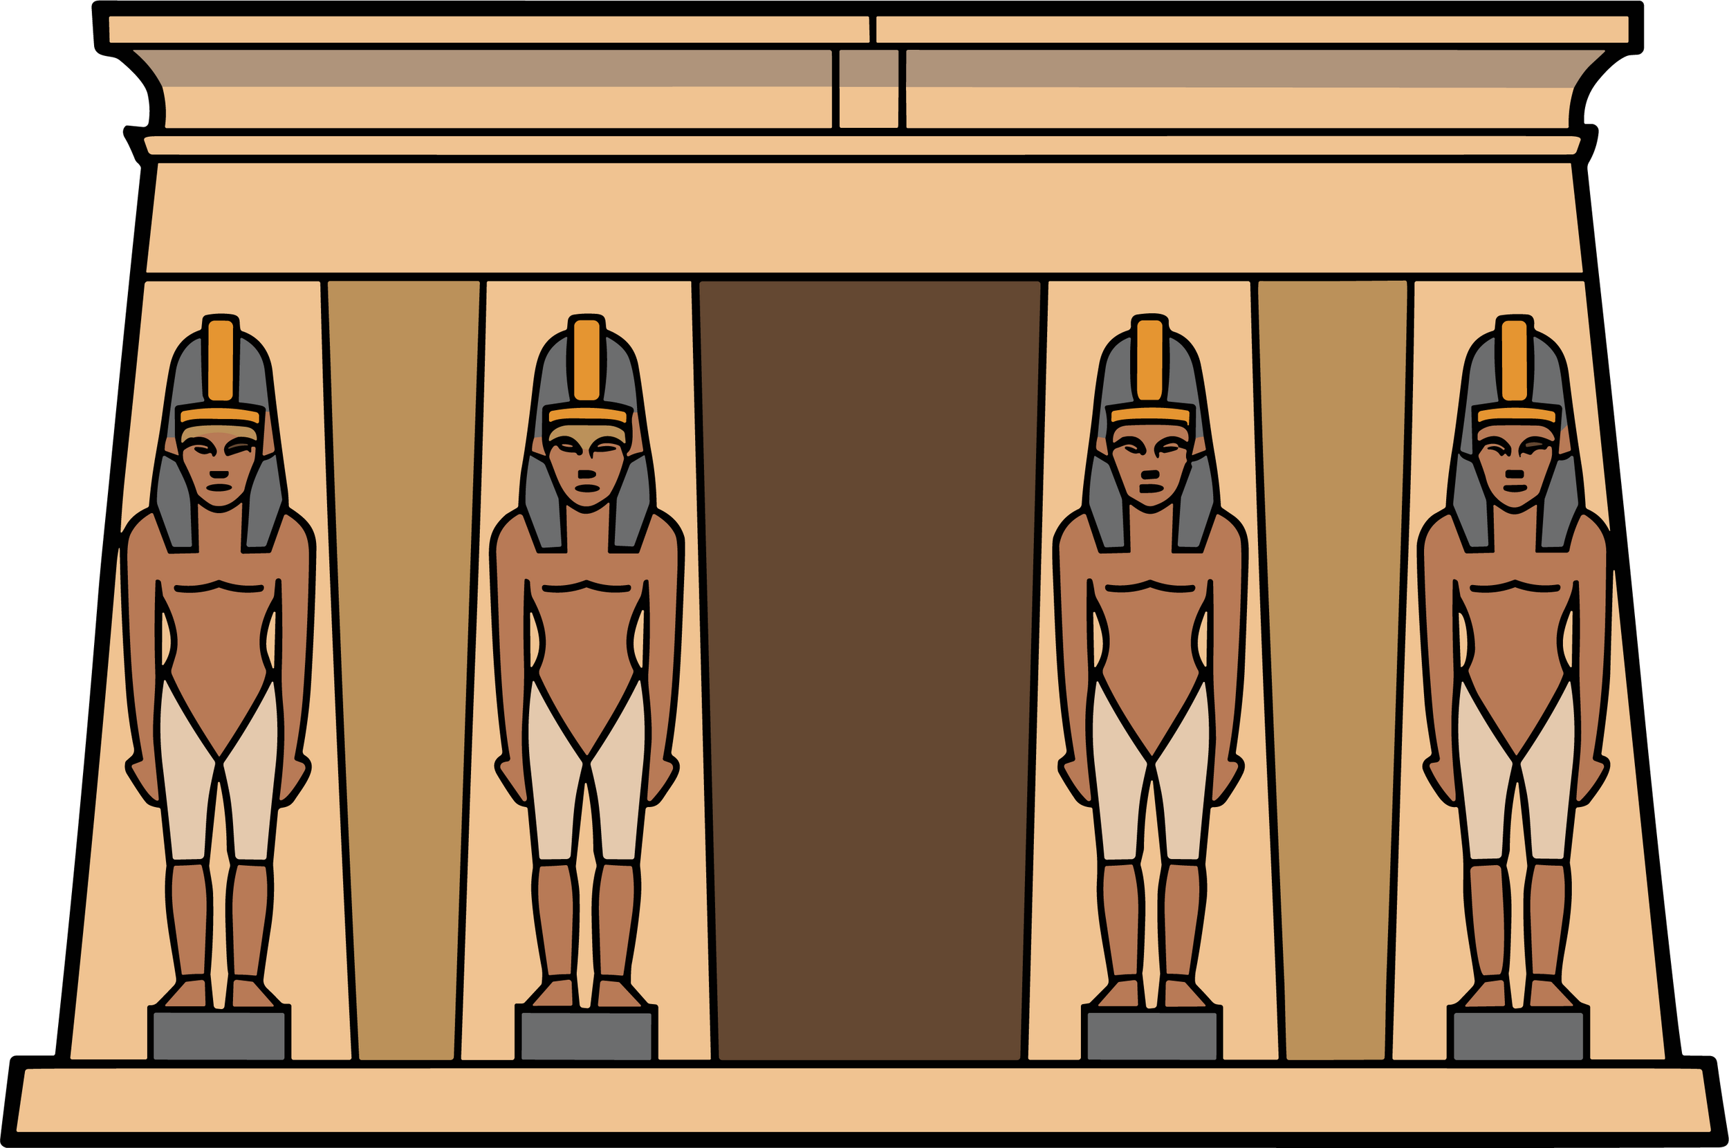
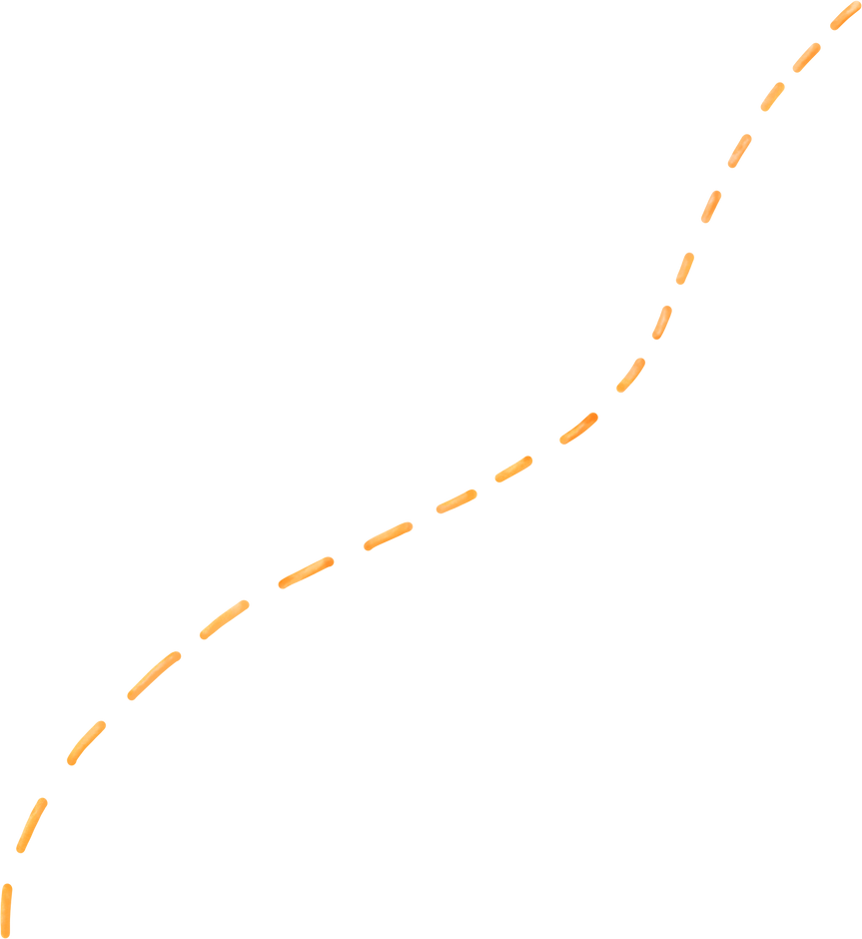
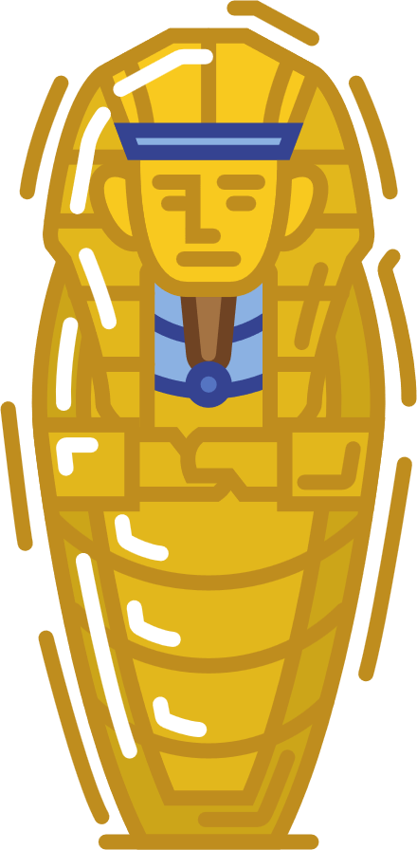


Amulets and the Afterlife
Ancient Egyptians believed that sometimes a soul would have trouble passing from our world into the afterlife, and it needed a little help.
Notes:
The Ancient Egyptian afterlife could be a scary place with many challenges, and amulets could help protect you, give you strength, and remind you of things that your soul might have forgotten.

Slide 14

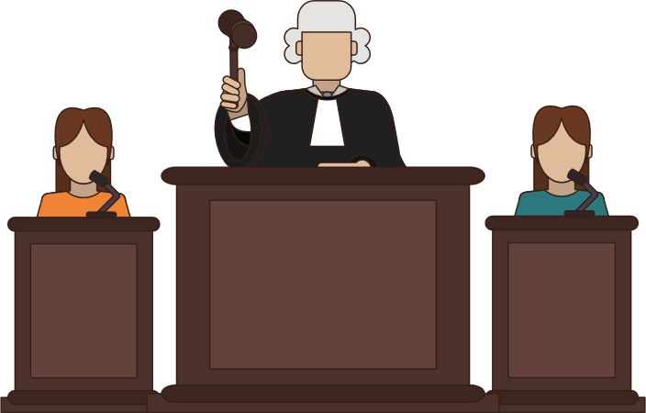
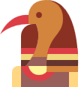
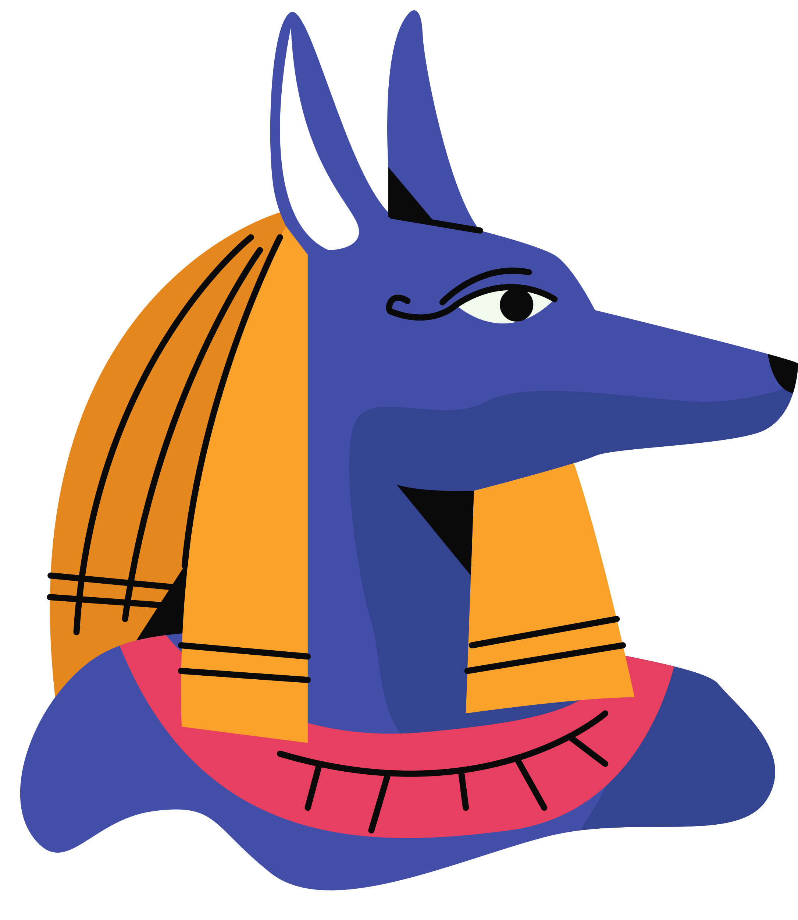
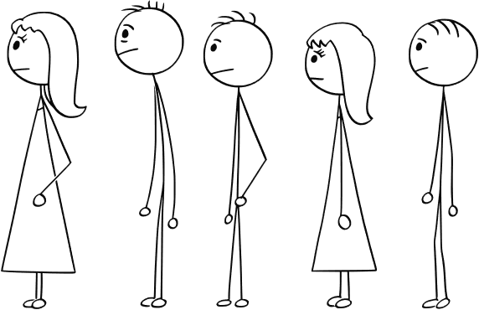
The Hall of Truth
"I have not told lies!"
"I have not stolen!"
"I have not made anyone cry!"
Notes:
The first place a soul would have to go once entering the afterlife is the Hall of Truth. The soul would have to stand in front of the gods Osiris, Thoth, Anubis, and forty-two other judges and tell them if they had been a good person or not.

Slide 15
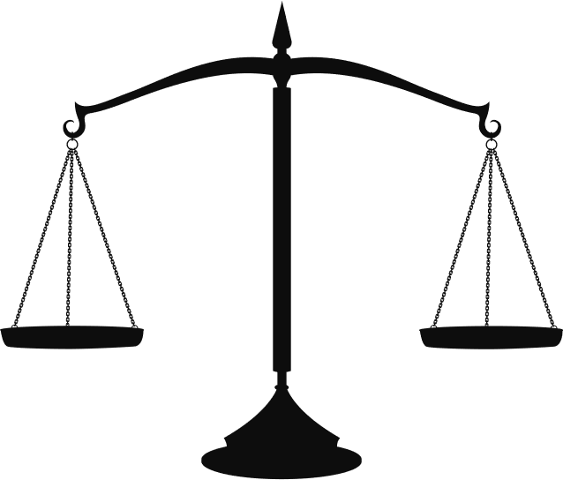


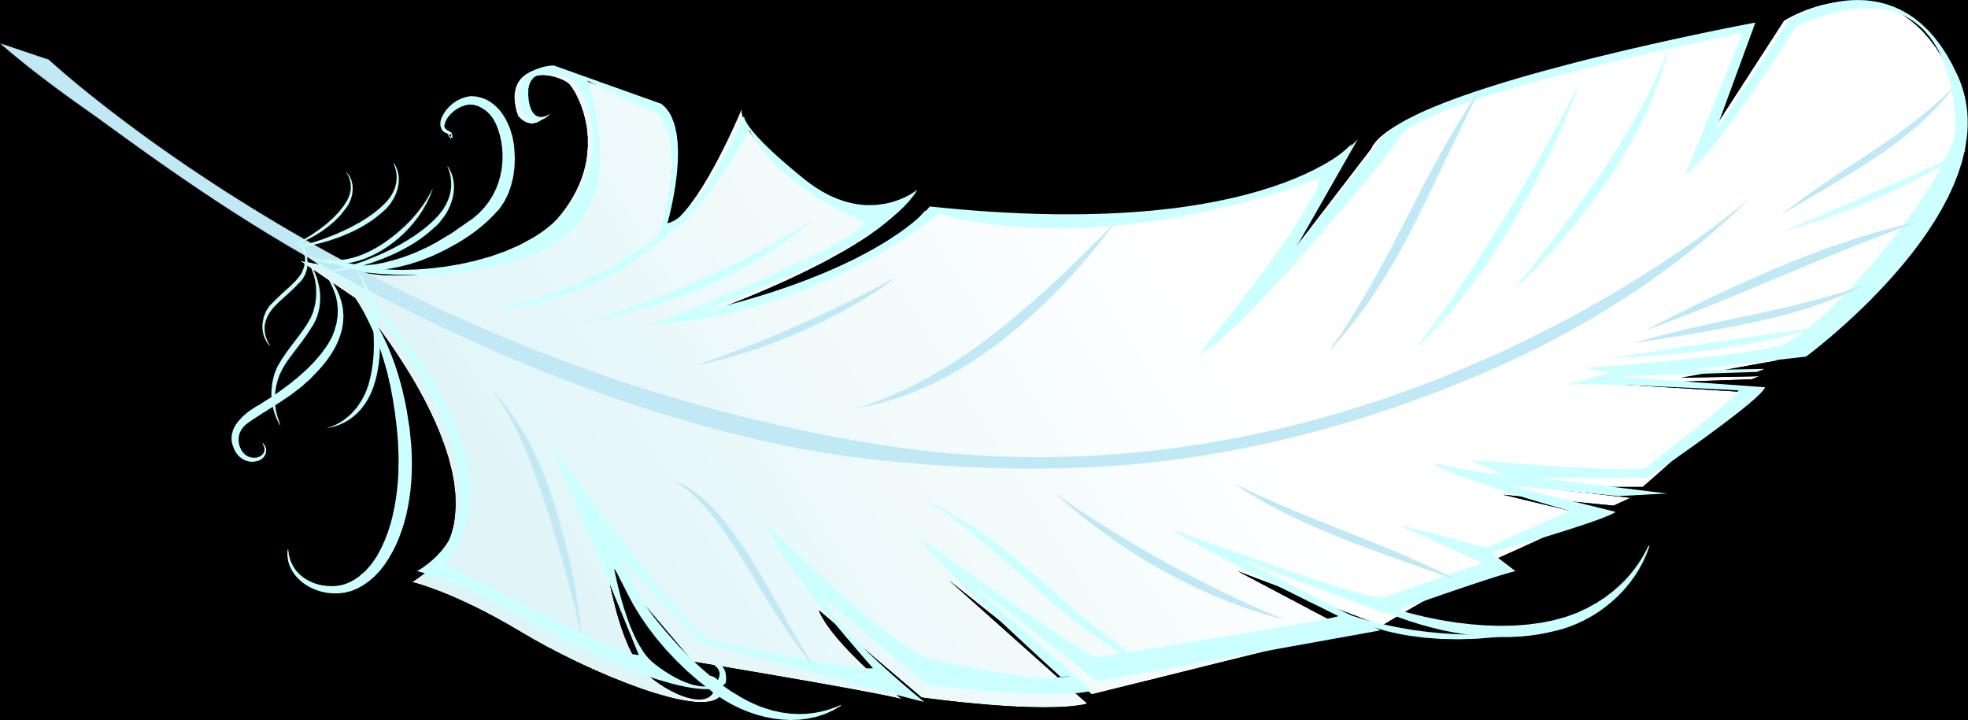
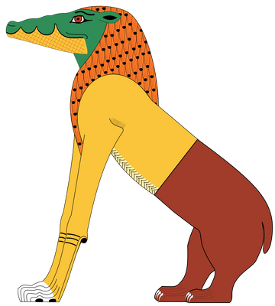
The Hall of Truth
But if it was heavier, the heart would be thrown onto the ground and eaten by Ammit, a fearsome beast.
If the heart weighed the same as the feather, the soul could continue on to the next challenge.
Notes:
If the deceased could get passed the judges by showing that they had not committed any sins, their heart would be weighed against the goddess of truth, Maat, represented as an ostrich feather.

Slide 16

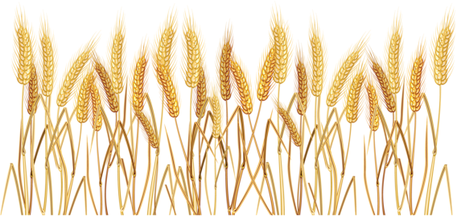
Field of Reeds
Notes:
After the soul moved on from their tribunal, they would travel through the underworld, undertaking many challenges before finally arriving at the Field of Reeds. Here, the soul would get to rest and enjoy paradise.

Slide 17
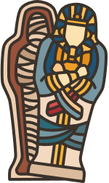
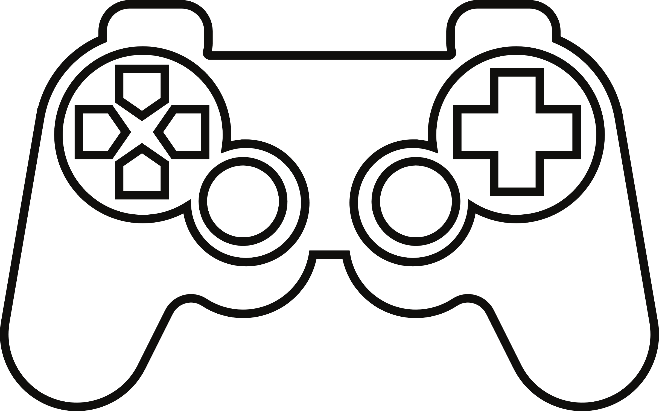
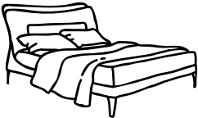






Question Time!
What would your Field of Reeds look like?
Notes:
Prompt the kids to describe what their ideal afterlife would look like.
EX. Minecraft, sleeping in, eating your favourite food, etc...

Slide 18
Works Cited
Budge, E. A. Wallis. Amulets and Superstitions. London: Oxford University Press, 1930.
Janák, Jiří. “Journey to the Resurrection. Chapter 105 of the Book of the Dead in the New Kingdom.” Studien Zur Altägyptischen Kultur 31 (2003): 193–210. http://www.jstor.org/stable/25152890.
The MET. “Snake-head Amulet.” Accessed March 2, 2023 https://www.metmuseum.org/art/collection/search/548214
Mueller, Dieter. “An Early Egyptian Guide to the Hereafter.” The Journal of Egyptian Archaeology 58 (1972): 99–125. https://doi.org/10.2307/3856241.
O’Neill, Cian. “Cramming for the Afterlife.” Fortnight, no. 475 (2011): 18–19. http://www.jstor.org/stable/41963384.
All images courtesy of Canva or the Museum of Antiquities.

