Slide 1
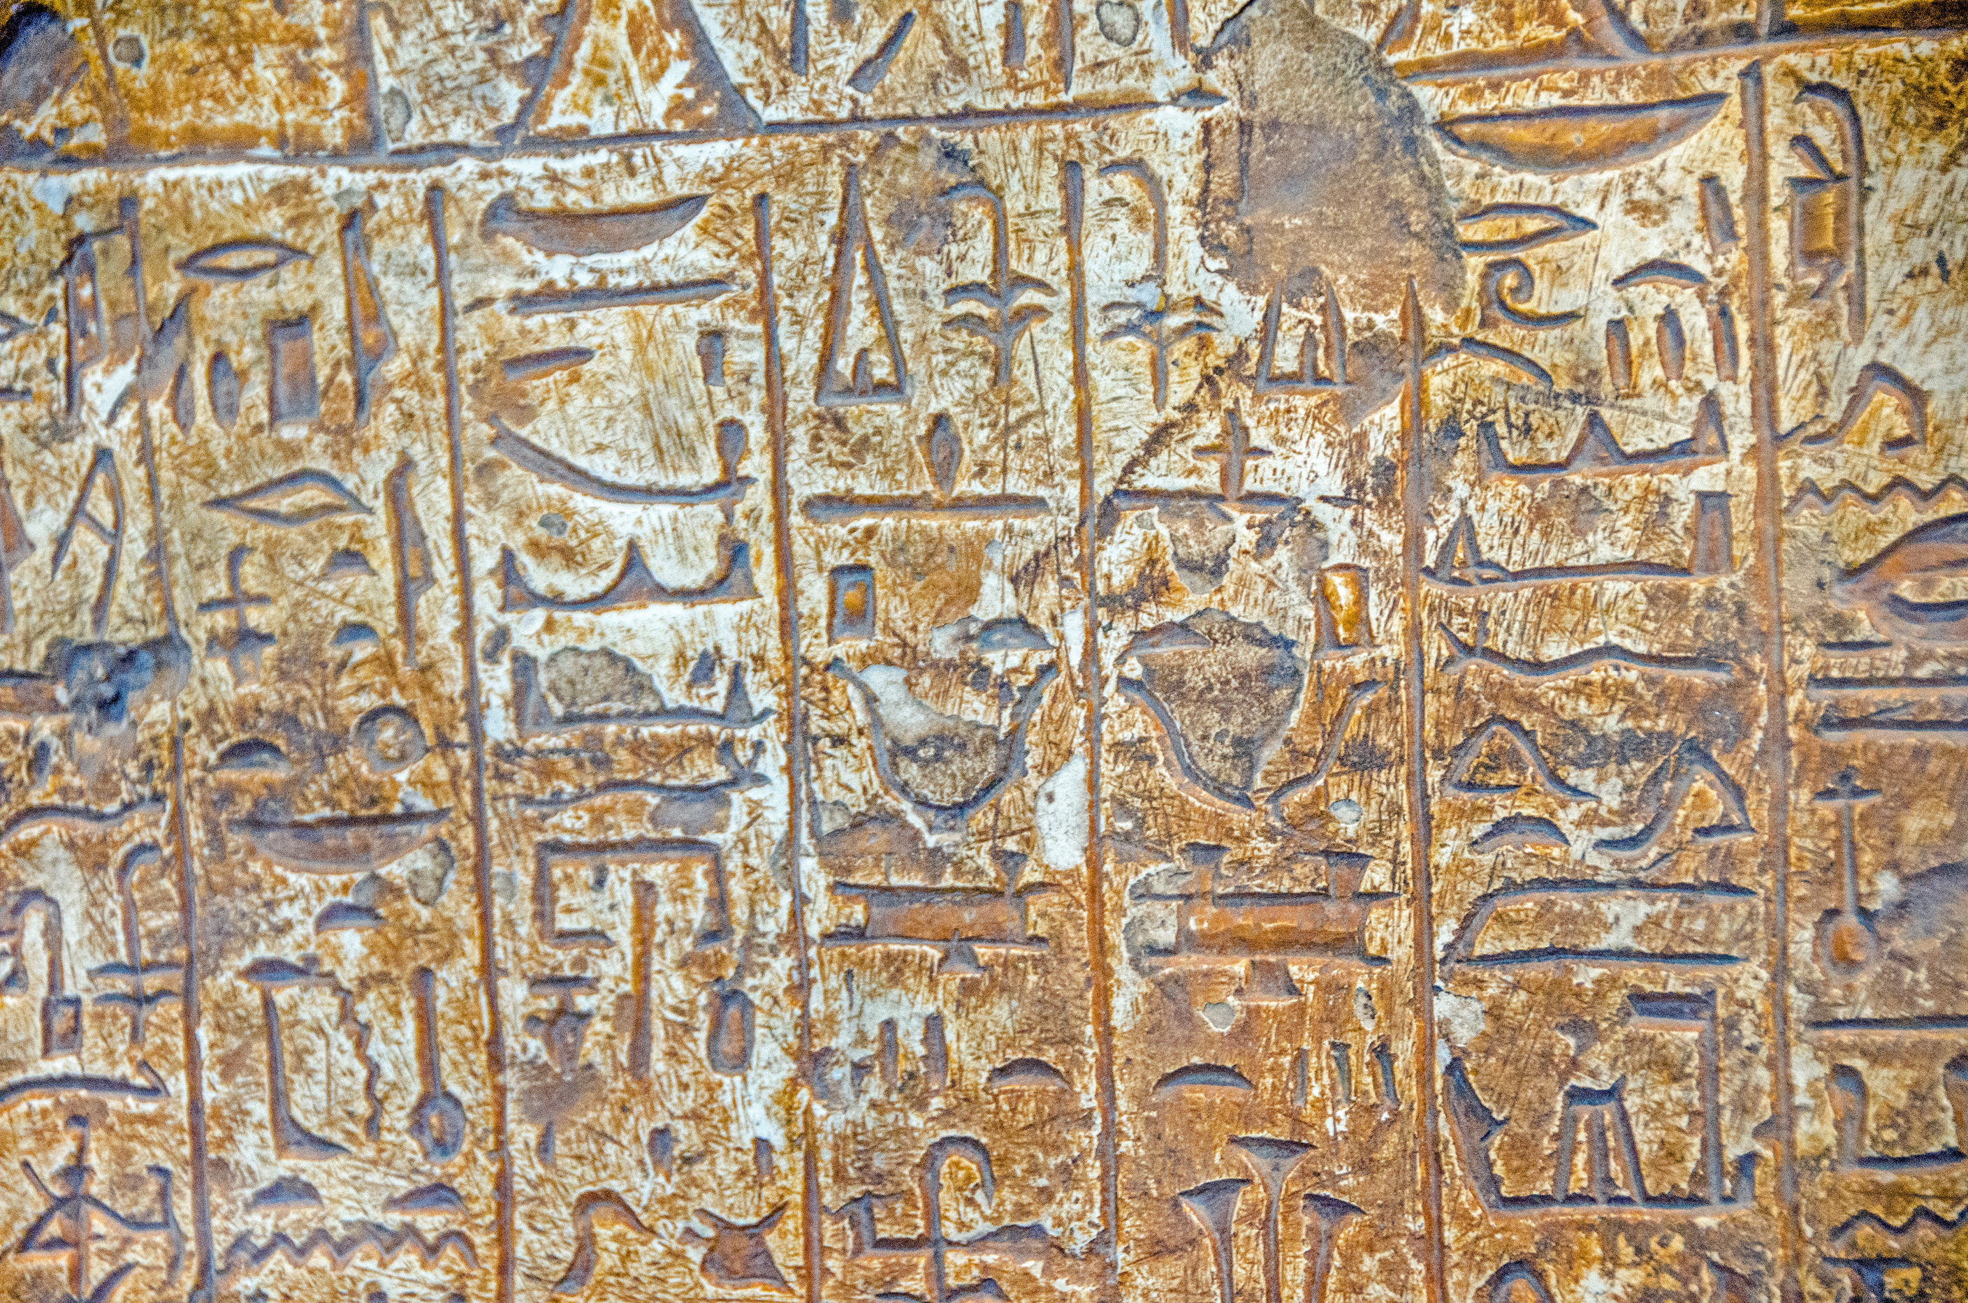
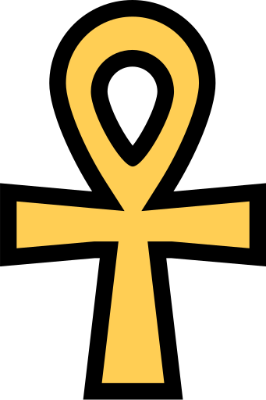
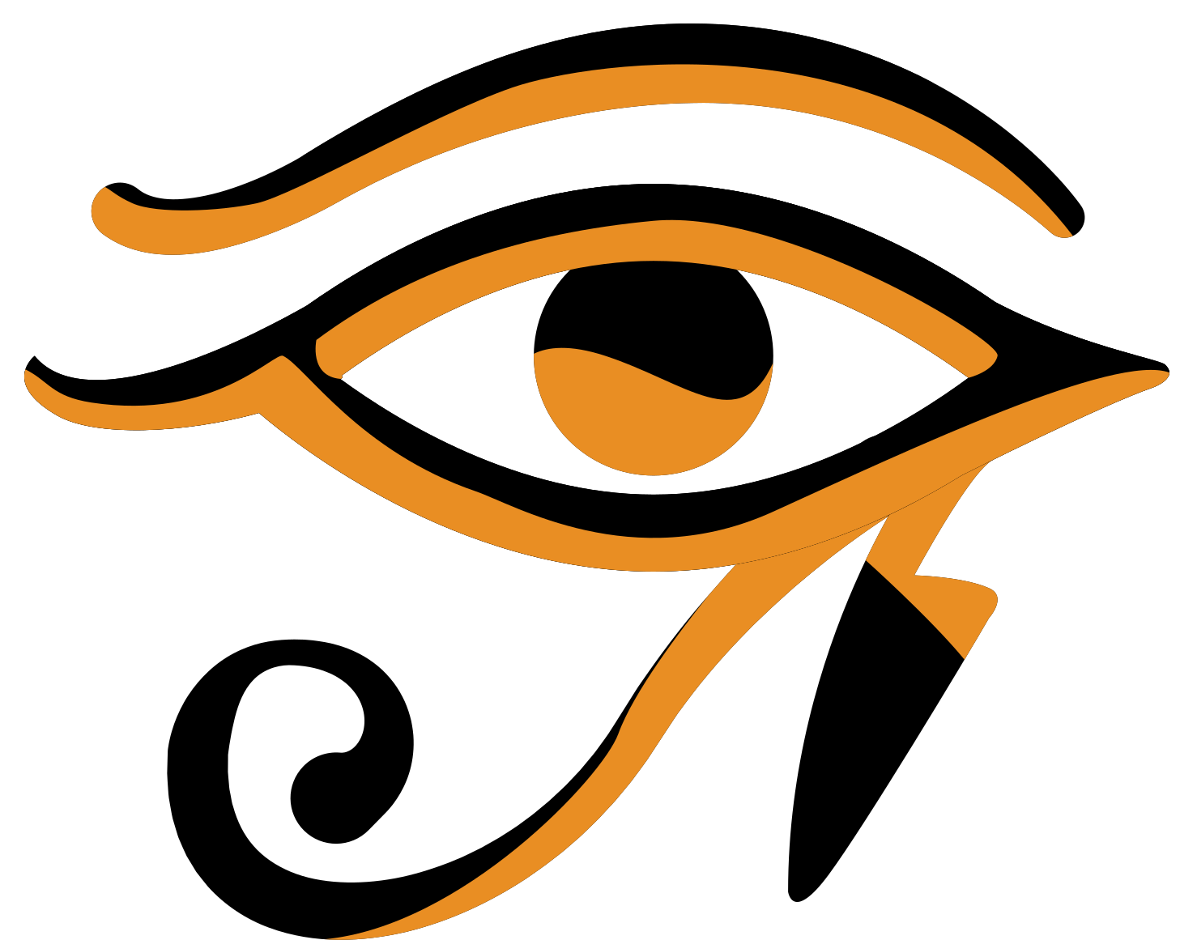
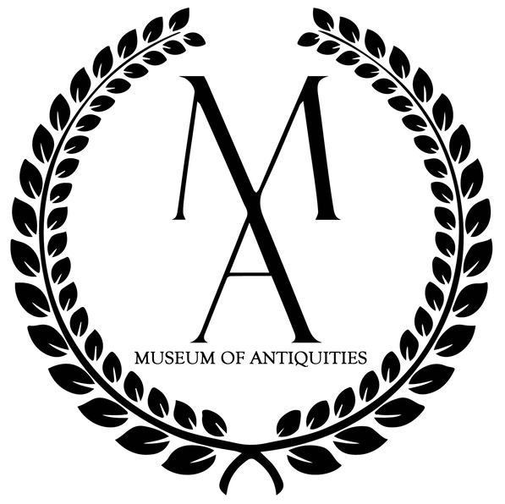
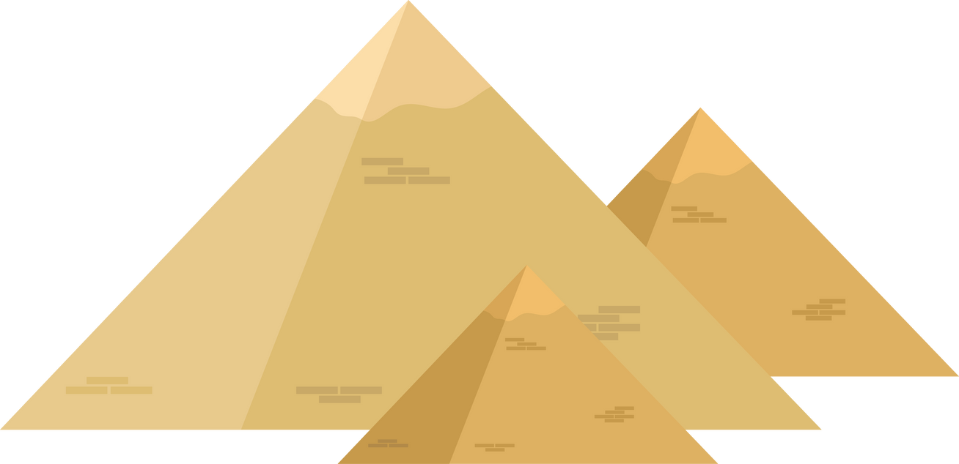
Egyptian Amulets

Slide 2
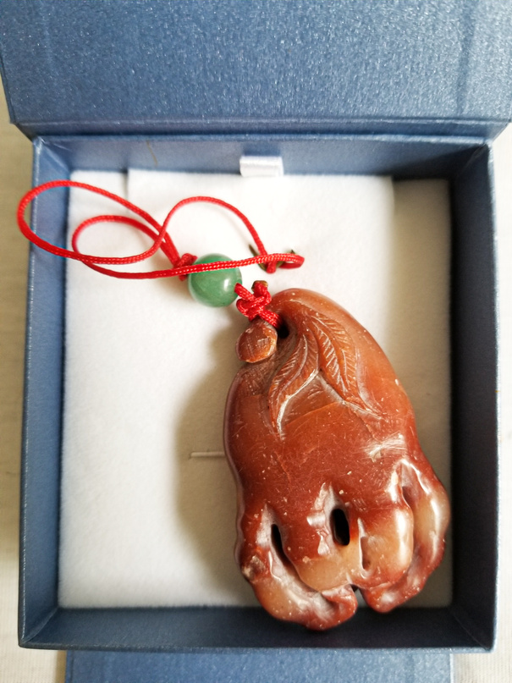
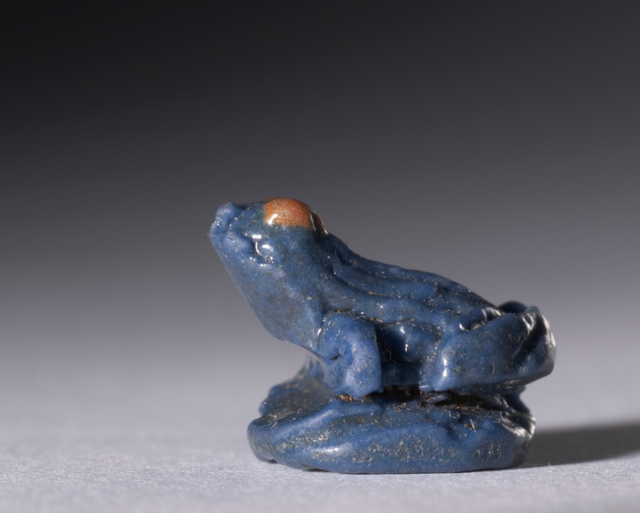
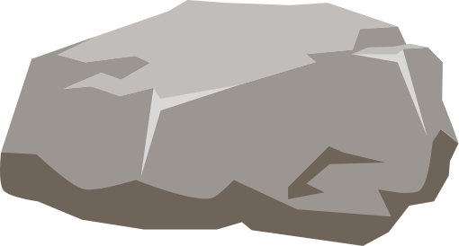
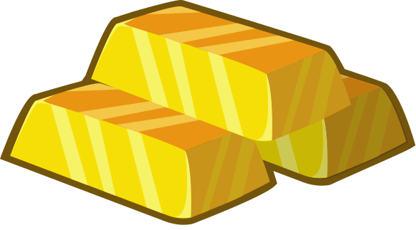

What are Amulets?
Amulets are objects that are known to give the wearer some kind of magical benefit like protection, good luck, or strength.
They could be made of materials such as:
Stone
Precious Metals
Wood

Slide 3



What Were Amulets Used For?
Amulets had many uses, but most fit into three main categories:
Protection from Evil
Long Life
Strength and Power

Slide 4
Serpent's Head Amulet
Used for protection against snakebites

Slide 5
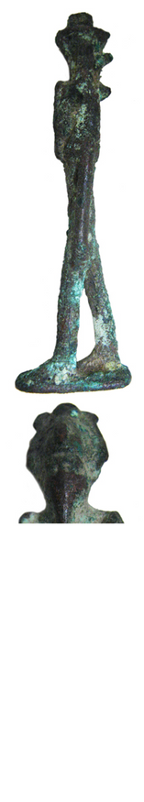
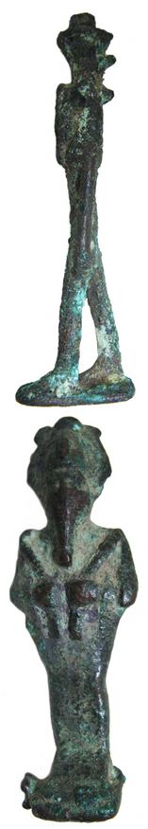
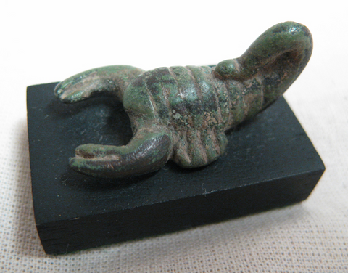
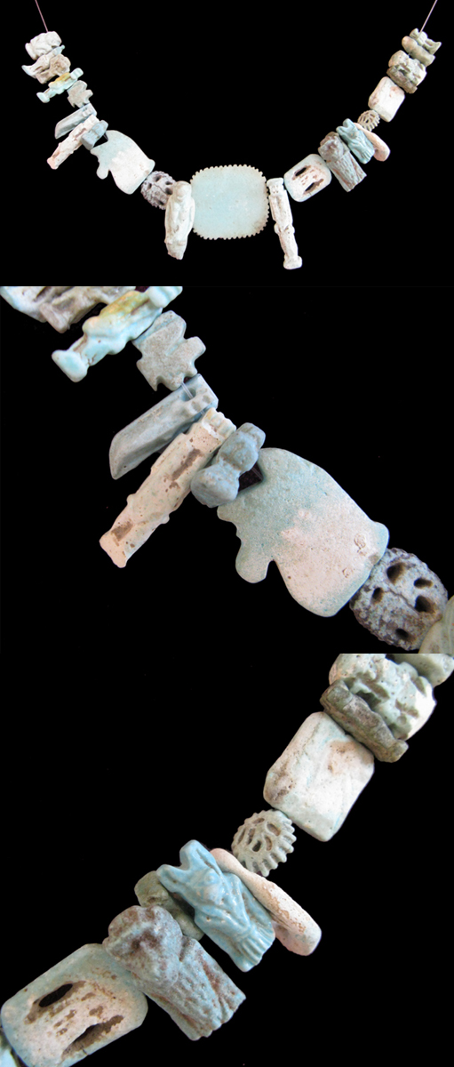
Amulets at The Museum of Antiquities
Here at the Museum of Antiquities, we have some very cool Egyptian amulets...
Bronze Amulets
Faience Amulets
Scorpion Amulet
Used for good luck and a safe journey to the afterlife
94 amulets with many different uses
Used for protection and to represent the goddess Serket
If you want to learn more about these amulets check out the "Collections" section on our website!

Slide 6
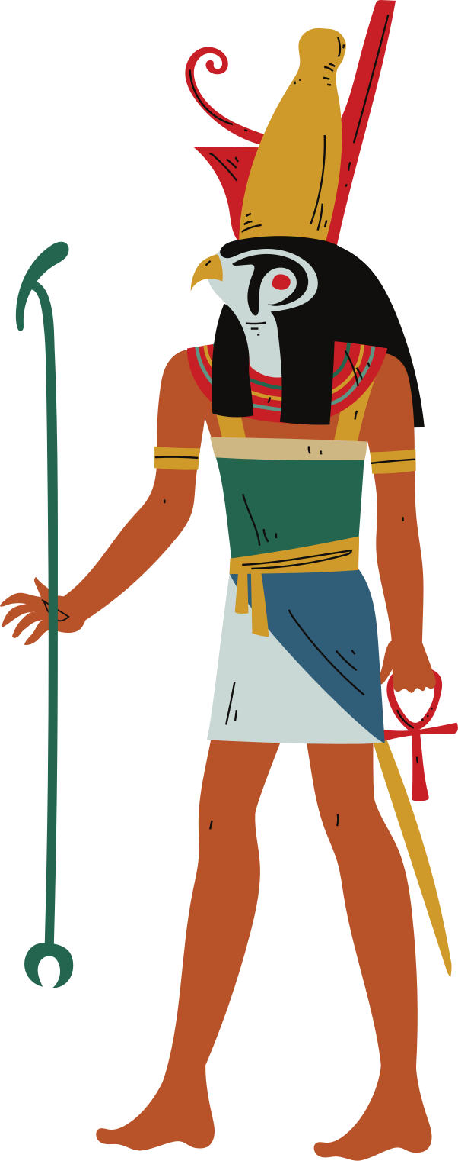

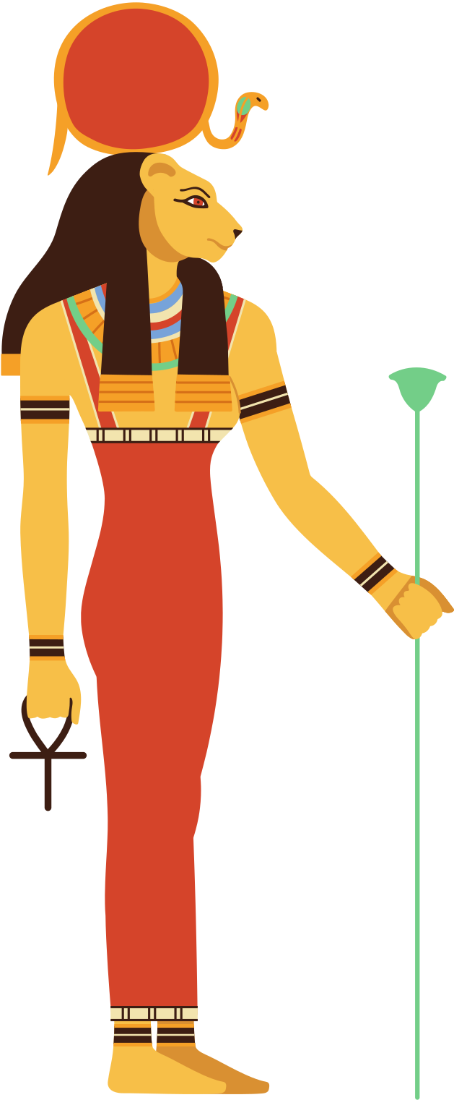
Egyptian Gods As Animals
Many Egyptian gods were associated with animals and had animal forms. When shown on amulets, these animals were thought to bring the protection or power of the gods to their wearers.
Anubis, the god of funerary practices, was depicted as a jackal.
Horus, the god of the sun, was depicted as a falcon.
Sekhmet, the goddess of war, was depicted as a lion.
Notes:
Horus - Falcon
Anubis - Canine/Dog
Sekhmet - Lioness

Slide 7

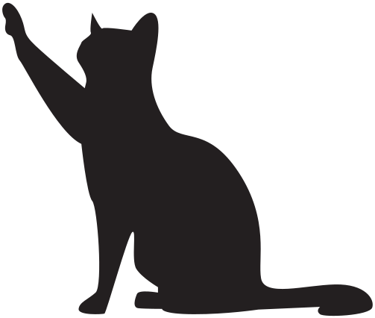
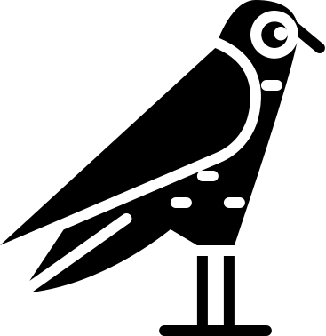

Question Time!
If you were an Egyptian god and you had to choose an animal to represent you, which one would it be and why?

Slide 8
Egyptian Symbols
The Ankh
The ankh is the oldest amulet symbol used by the Ancient Egyptians, but what the picture represents is uncertain. The word “ankh” means life, or “everlasting life”

Slide 9
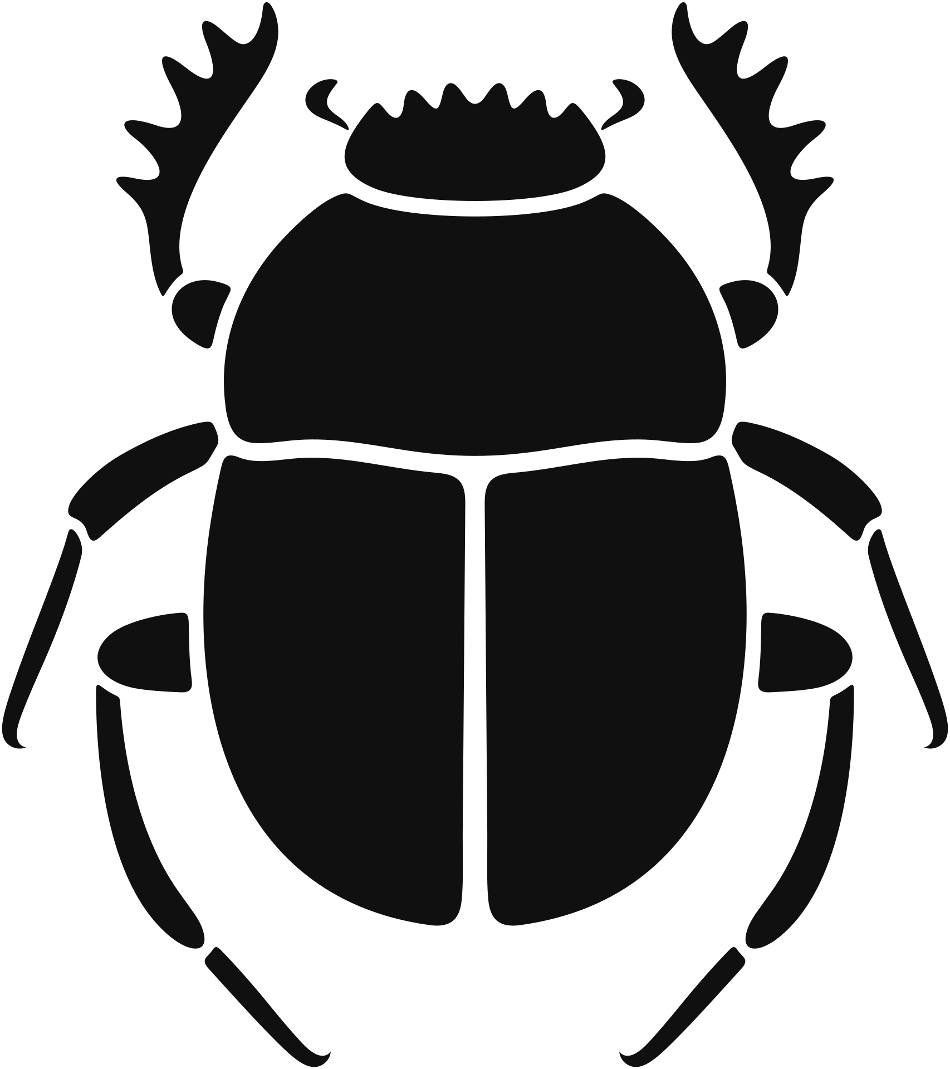
Egyptian Symbols
The Scarab
The scarab is a type of dung-eating beetle, the Ancient Egyptians associated the scarab with the god of creation, who would roll the sun across the sky each day. It was worn for strength.

Slide 10
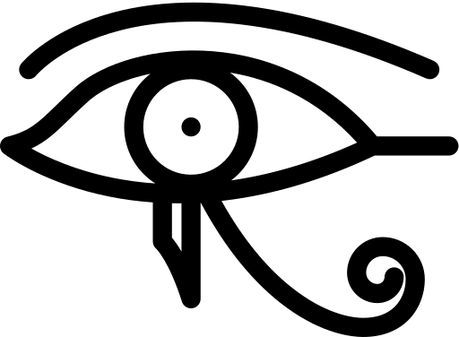
Egyptian Symbols
The Udjat
The udjat, which means “eye,” was worn for good health, safety, happiness, and general well-being. Two udjats could be used to represent the sun and the moon.

Slide 11
Egyptian Symbols
The Nefer
The Nefer was made to look like an ancient lute or a heart and windpipe. The word “nefer” means “good,” so those who wore the Nefer would likely wear it for happiness, good luck, and joy.

Slide 12

Egyptian Symbols
The Ba
The ba symbol shows a hawk with a man’s head, which could be a person’s soul. It was worn for strength, and is meant to have a connection to the sky god Horus.

Slide 13

Egyptian Symbols
The Vulture
The vulture is likely meant to represent the goddess Isis, it was meant to give the wearer strength and fierceness.

Slide 14
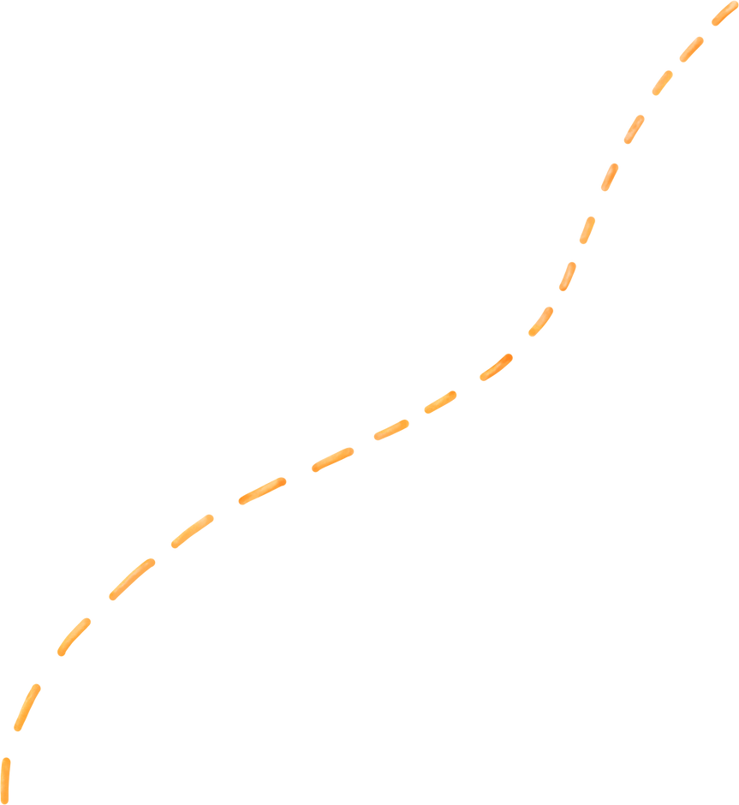
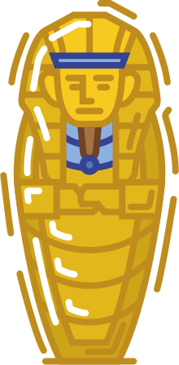


Amulets and The Afterlife
Ancient Egyptians believed that sometimes a soul would have trouble passing from our world into the afterlife, and it needed a little help.
The Ancient Egyptian afterlife could be a scary place with many challenges, and amulets could help protect you, give you strength, and remind you of things that your soul might have forgotten.

Slide 15

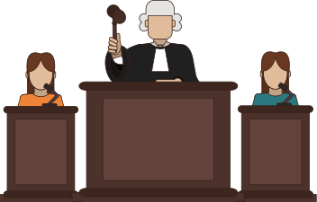

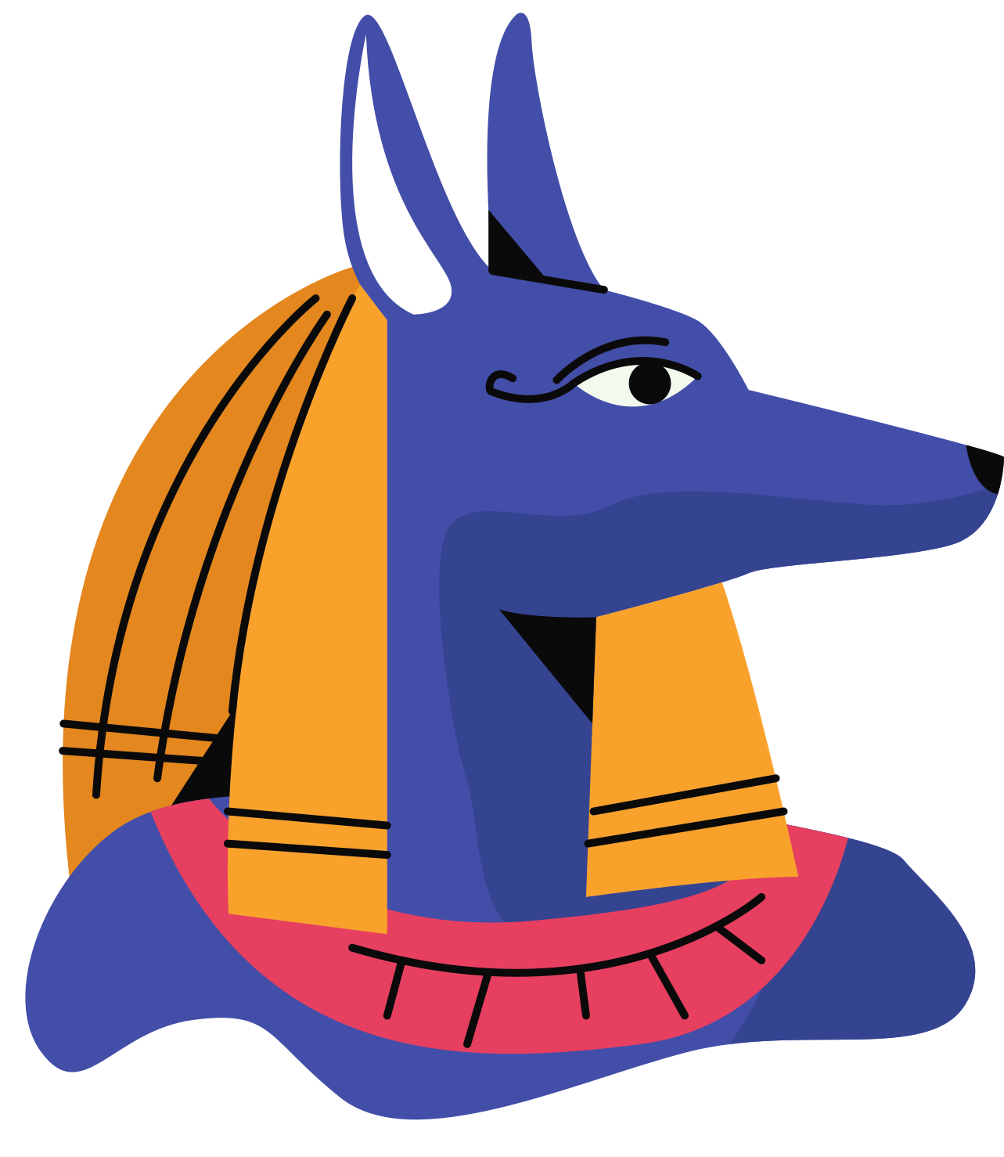
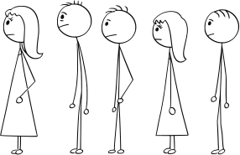
The Hall of Truth
The first place a soul would have to go once entering the afterlife is the Hall of Truth. The soul would have to stand in front of the gods Osiris, Thoth, Anubis, and forty-two other judges and tell them if they had been a good person or not.
"I have not told lies!"
"I have not stolen!"
"I have not made anyone cry!"

Slide 16
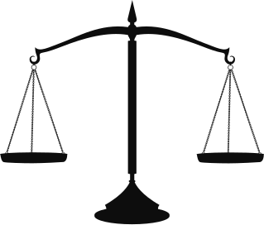


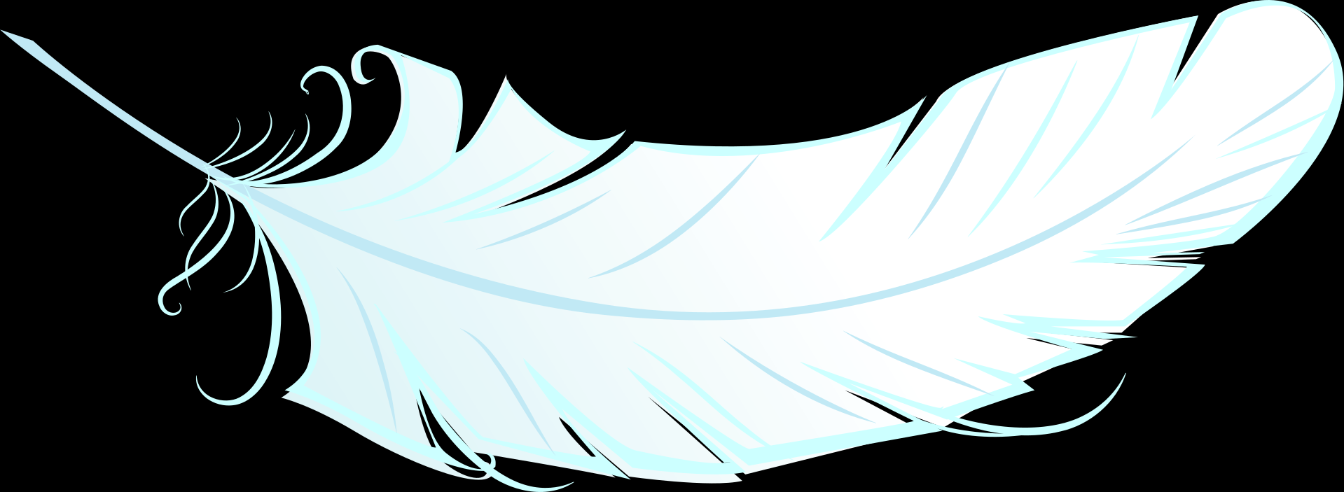
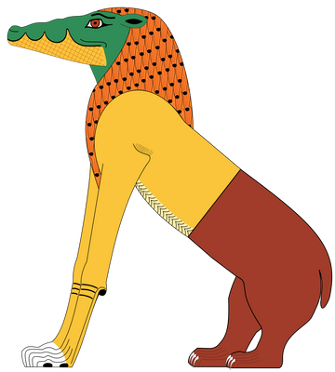
The Hall of Truth
If the deceased could get passed the judges by showing that they had not committed any sins, their heart would be weighed against the goddess of truth, Maat, represented as an ostrich feather.
But if it was heavier, the heart would be thrown onto the ground and eaten by Ammit, a fearsome beast.
If the heart weighed the same as the feather, the soul could continue on to the next challenge.

Slide 17

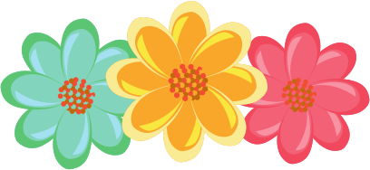

The Field Of Reeds
After the soul moved on from their tribunal, they would travel through the underworld, undertaking many challenges before finally arriving at the Field of Reeds. Here, the soul would get to rest and enjoy paradise.

Slide 18
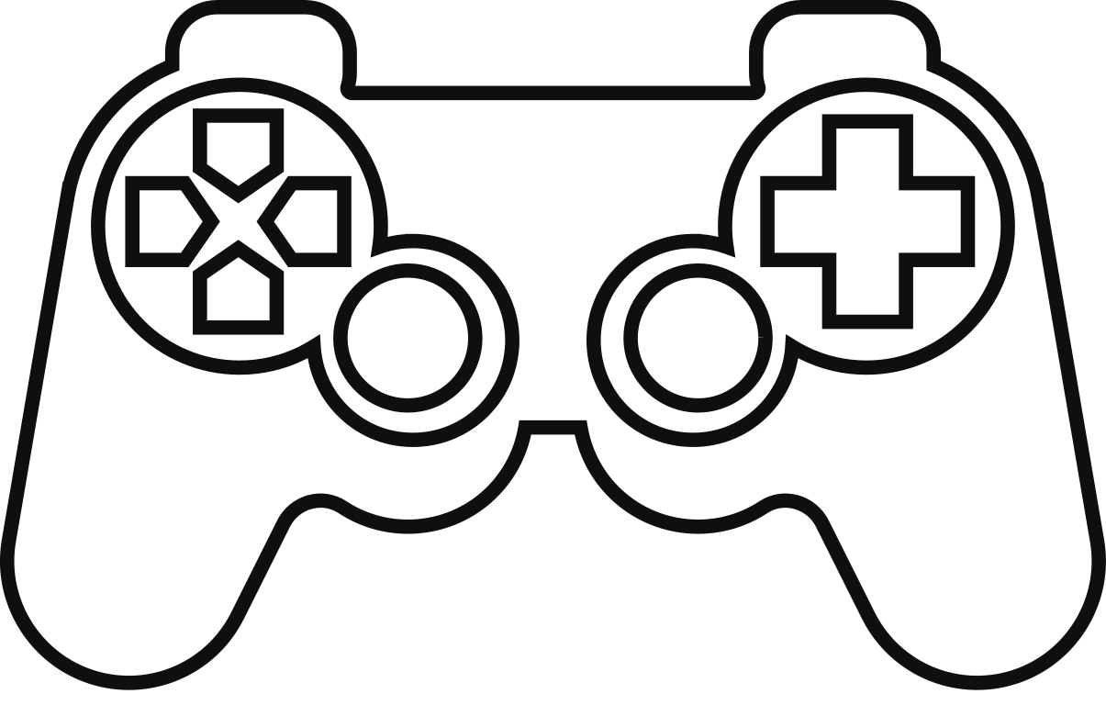

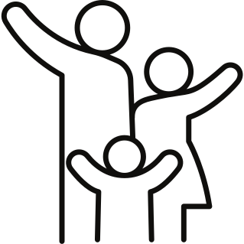



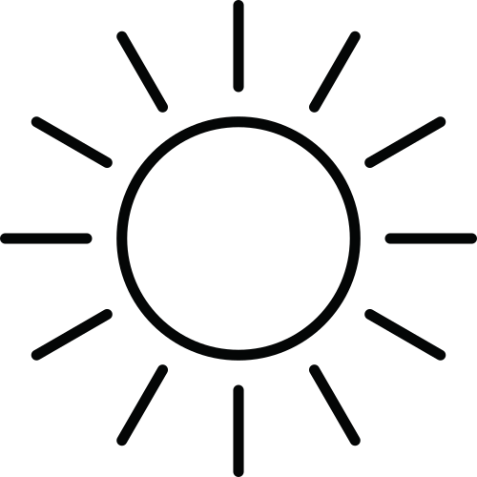
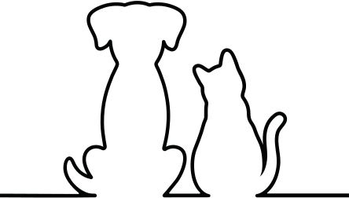
Question Time!
What would paradise look like to you?

Slide 19
Works Cited
Budge, E. A. Wallis. Amulets and Superstitions. London: Oxford University Press, 1930.
Janák, Jiří. “Journey to the Resurrection. Chapter 105 of the Book of the Dead in the New Kingdom.” Studien Zur Altägyptischen Kultur 31 (2003): 193–210. http://www.jstor.org/stable/25152890.
The MET. “Snake-head Amulet.” Accessed March 2, 2023 https://www.metmuseum.org/art/collection/search/548214
Mueller, Dieter. “An Early Egyptian Guide to the Hereafter.” The Journal of Egyptian Archaeology 58 (1972): 99–125. https://doi.org/10.2307/3856241.
O’Neill, Cian. “Cramming for the Afterlife.” Fortnight, no. 475 (2011): 18–19. http://www.jstor.org/stable/41963384.
All images courtesy of Canva or the Museum of Antiquities.

