Slide 1



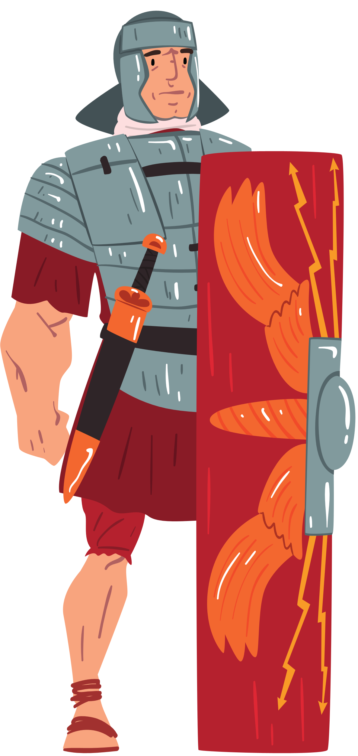
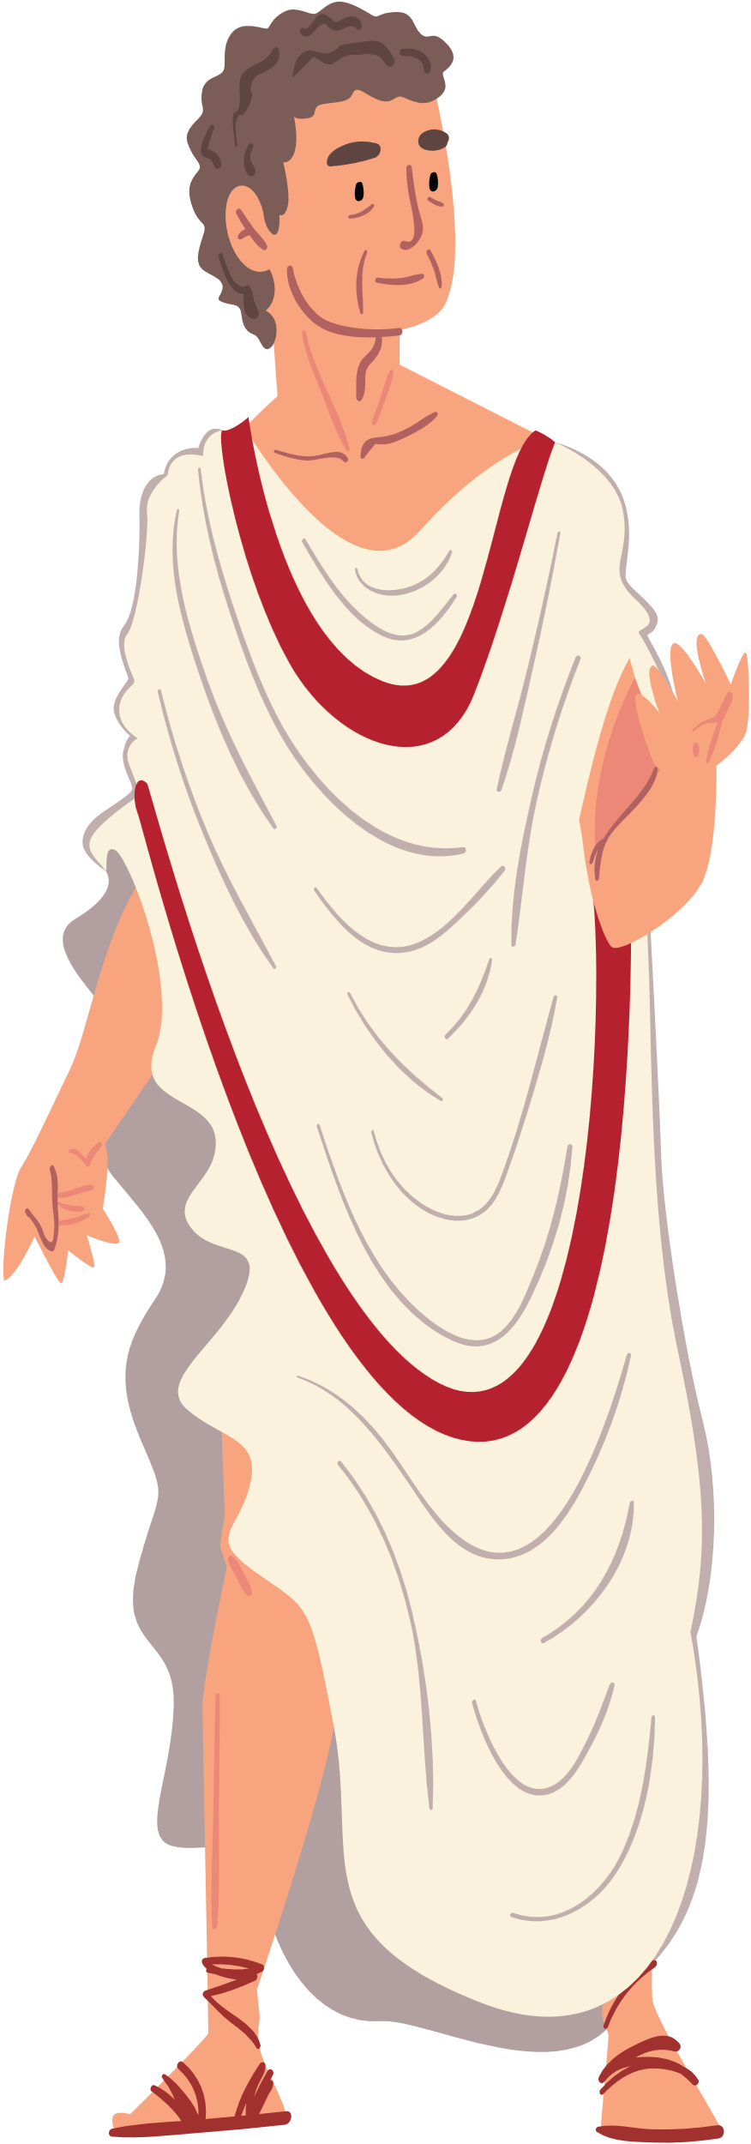

Roman Mythology

Slide 2
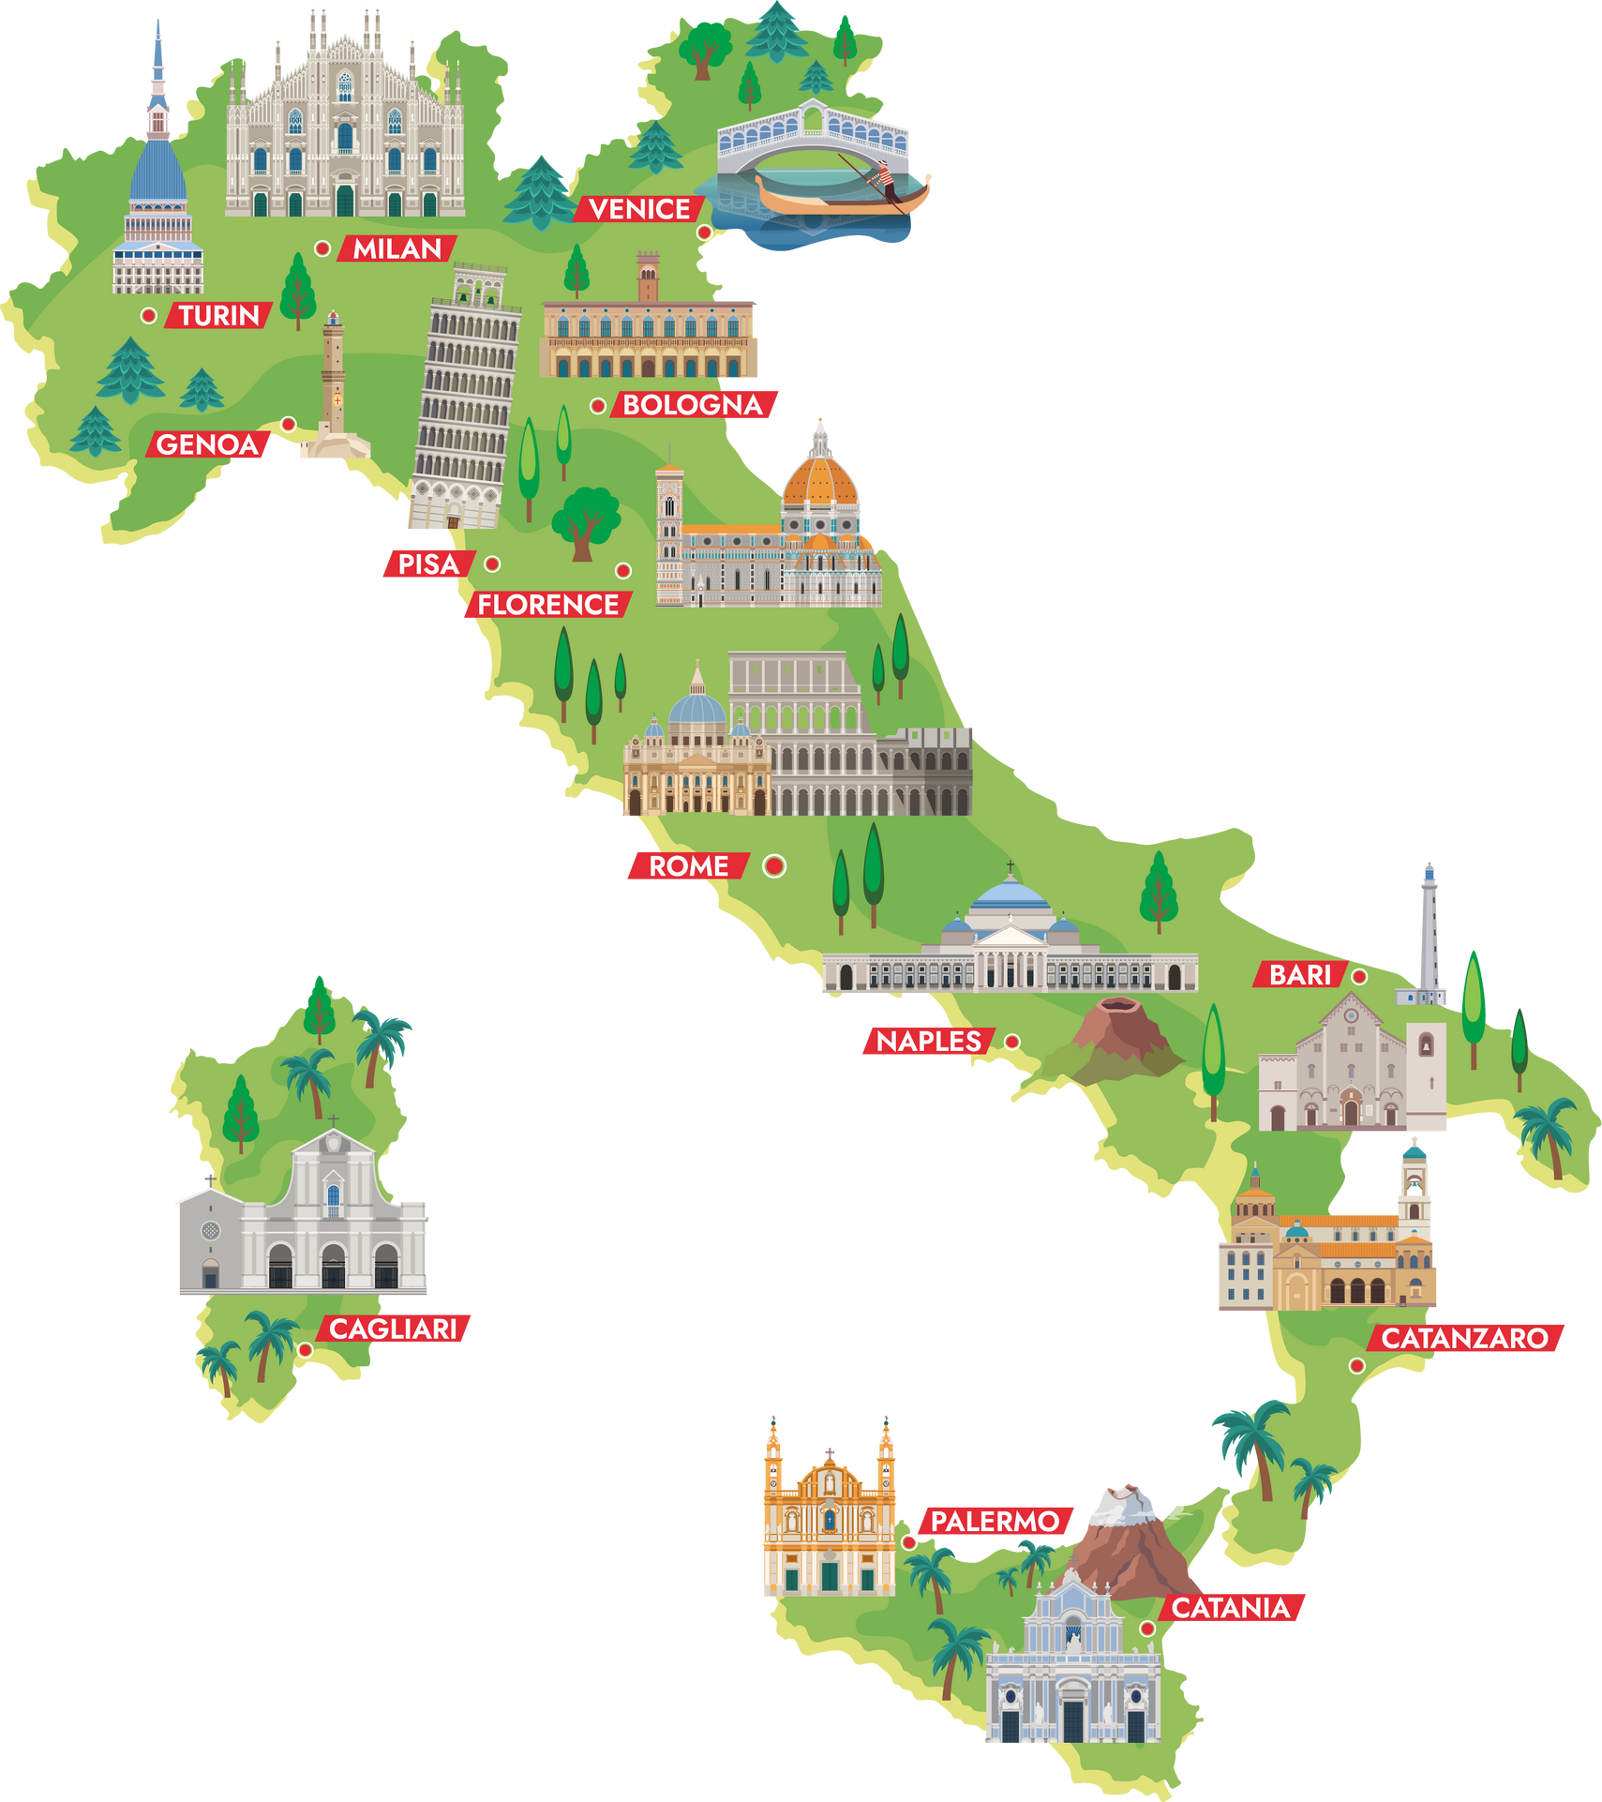
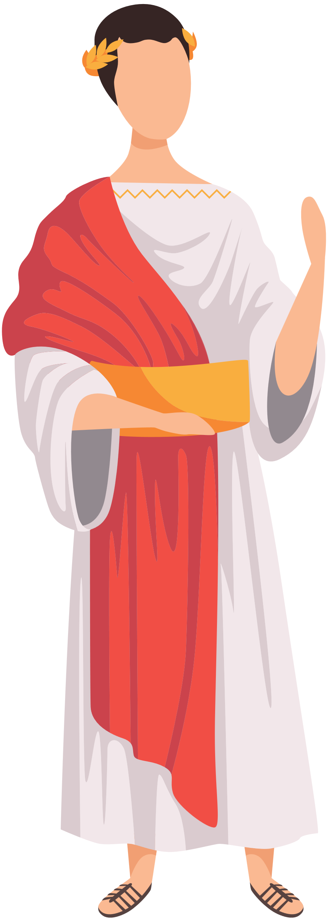

Where is Rome?
Notes:
The city of Rome is in the middle of the Italian peninsula, very close to the ocean. Why do you think it might be important for a city to be close to the ocean?
Well, being near the water had many benefits. Rivers and streams allowed people easy access to the water, and the ocean allowed for fishing, trade, and travel!

Slide 3

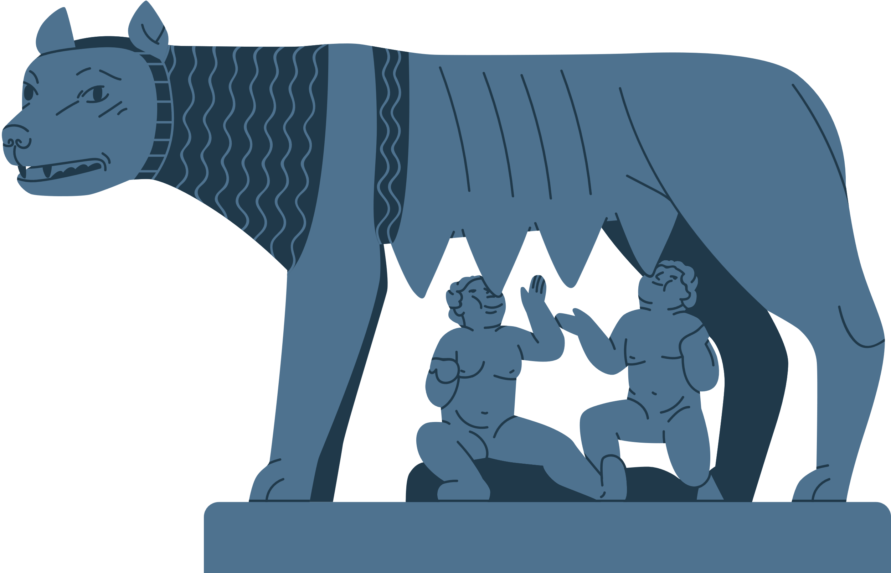
The Beginning of Rome
She-wolf
Romulus and Remus were twin sons of Mars. Their mother, Rhea Silvia, was the daughter of a famous king. After giving birth to the twins, Rhea’s uncle ordered that the twins be killed, so Rhea Silvia set them afloat on the Tiber River.
Thankfully, the twins survived and were nursed by a she-wolf on the site of what is now called Rome.
Eventually, the twins decided to build a city of their own: Rome. Unfortunately, they got into a fight over where they would build the city, but Romulus won by killing his brother. The city is named “Rome” after him.
Romulus and Remus
Notes:
The story of the city of Rome is a very famous myth.
Romulus and Remus were twin sons of Mars. Their mother, Rhea Silvia, was the daughter of a famous king. After giving birth to the twins, Rhea’s uncle ordered that the twins be killed, so Rhea Silvia set them afloat on the Tiber River.
Thankfully, the twins survived and were nursed by a she-wolf on the site of what is now called Rome.
Eventually, the twins decided to build a city of their own: Rome. Unfortunately, they got into a fight over where they would build the city, but Romulus won by killing his brother. The city is named “Rome” after him.

Slide 4

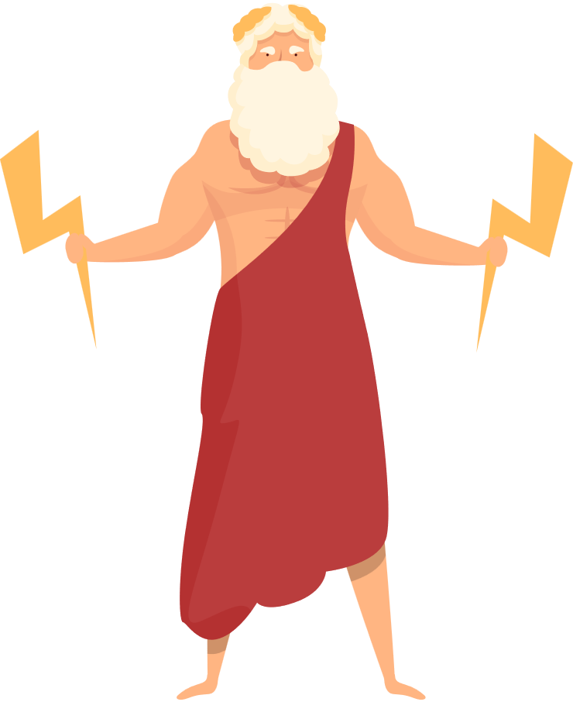
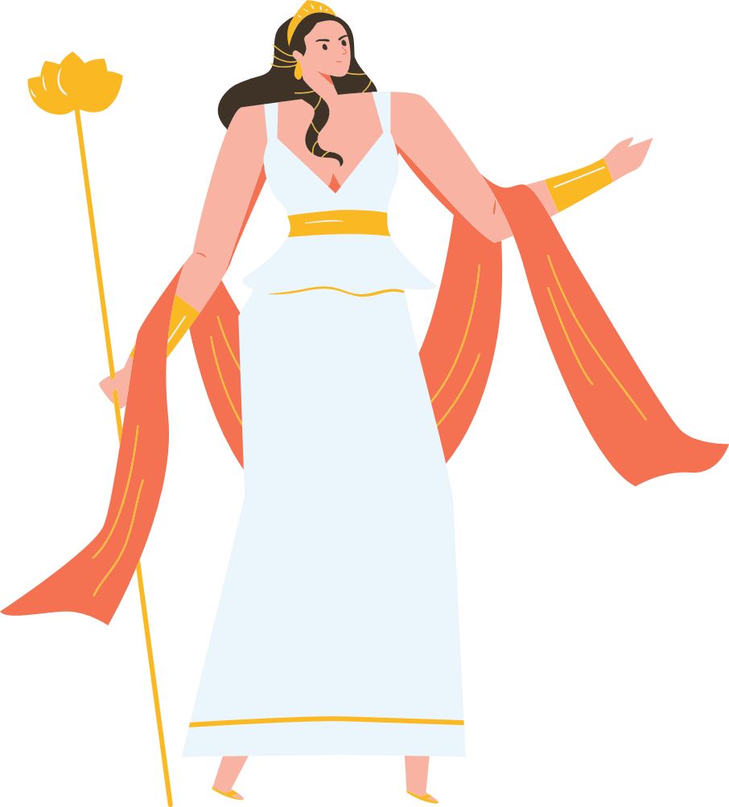

The Roman Gods
Juno
Jupiter
Notes:
The Roman Gods are very similar to the Greek gods, but have different names and sometimes slightly different powers.
First are Jupiter and Juno.
Jupiter is the King of the Gods, and god of thunder and lightning.
Juno is the Wife of Jupiter; goddess of women and fertility.

Slide 5
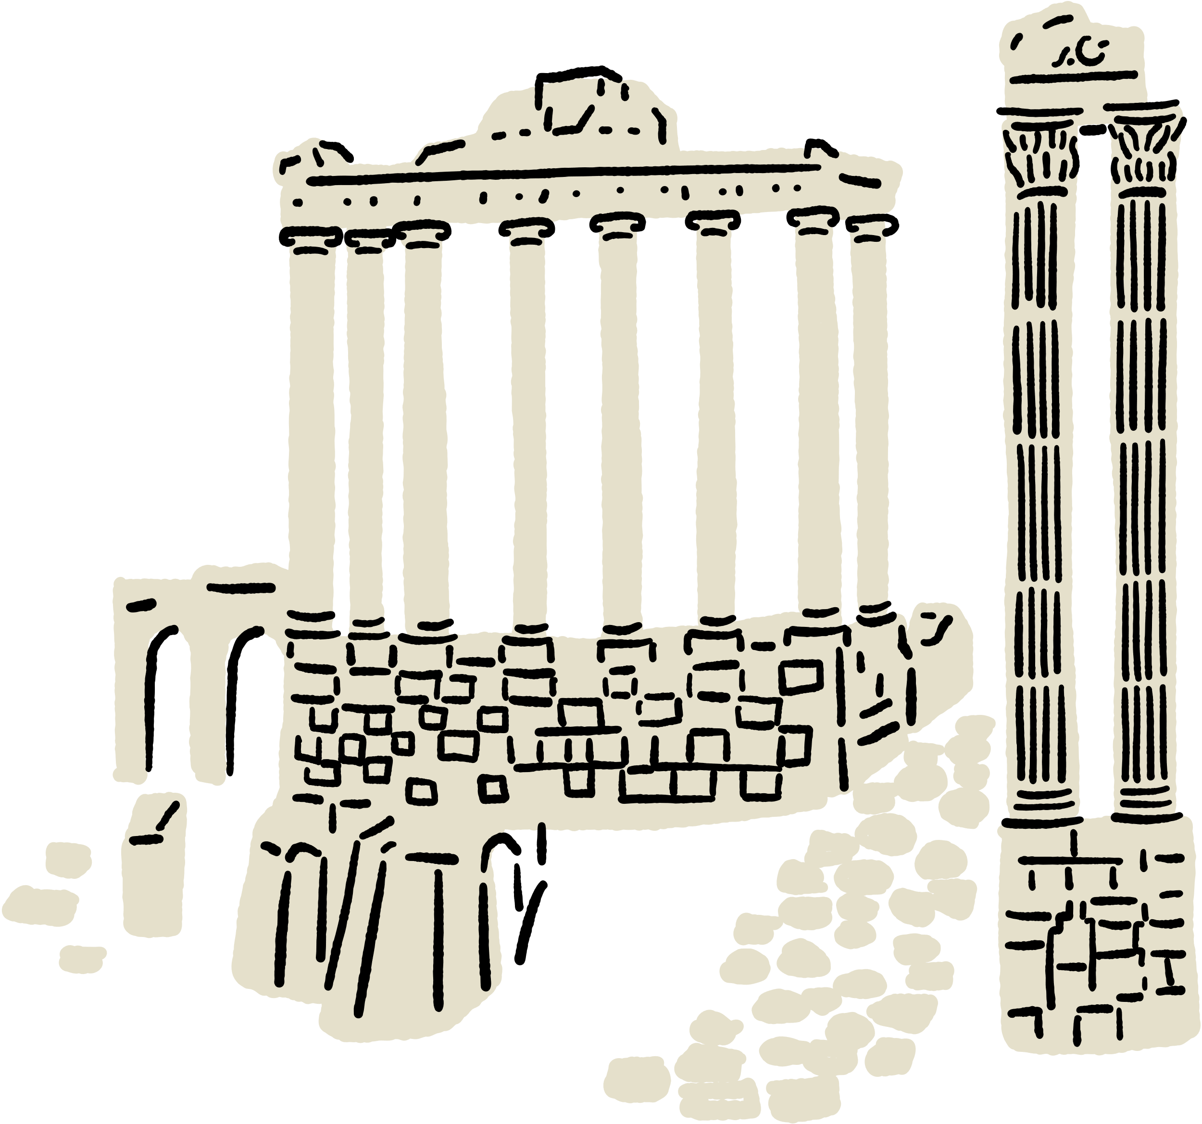
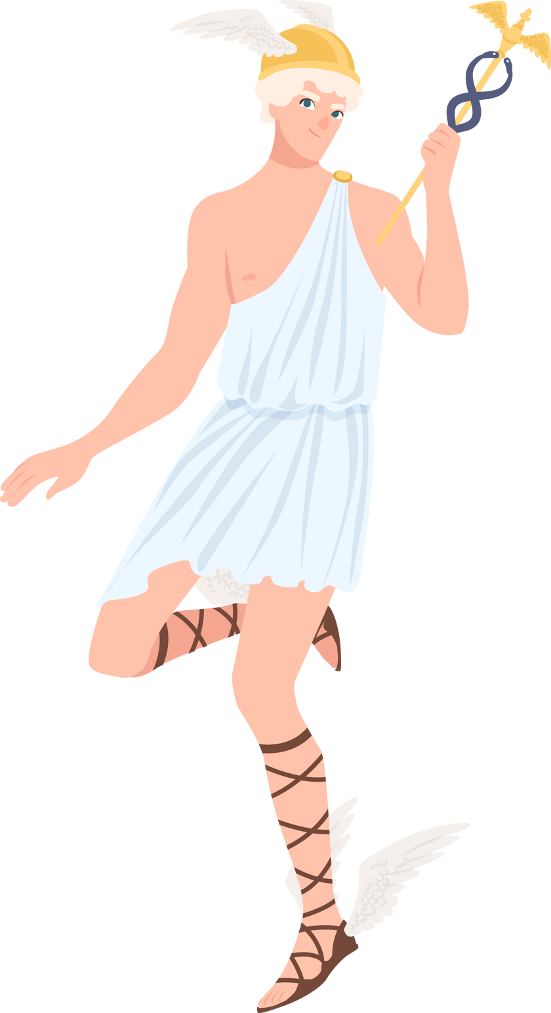
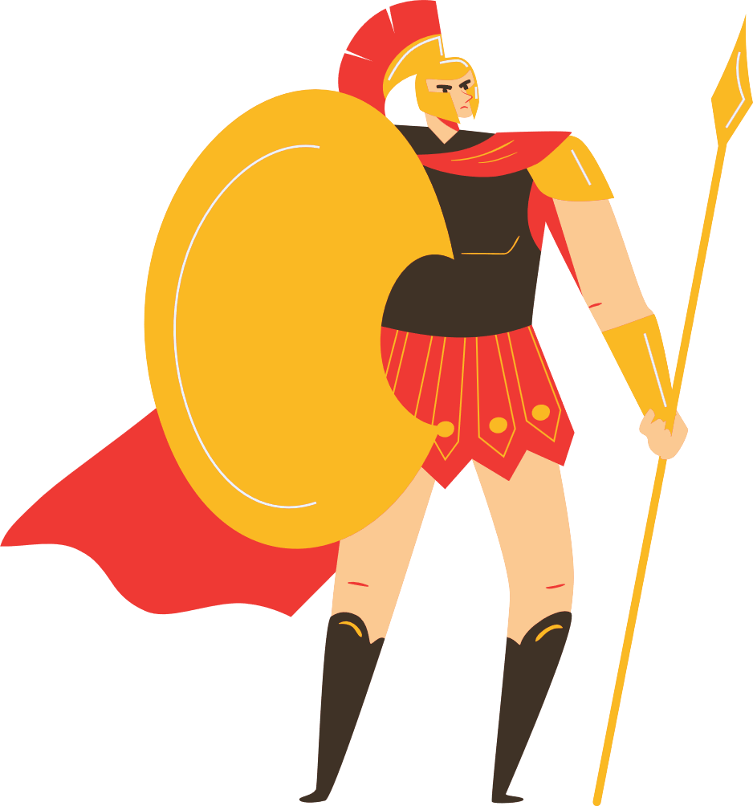

The Roman Gods
Mars
Mercury
Notes:
Mars is the son of Jupiter and Juno, the god of war.
Mercury is the god of travelers and tradesmen.

Slide 6

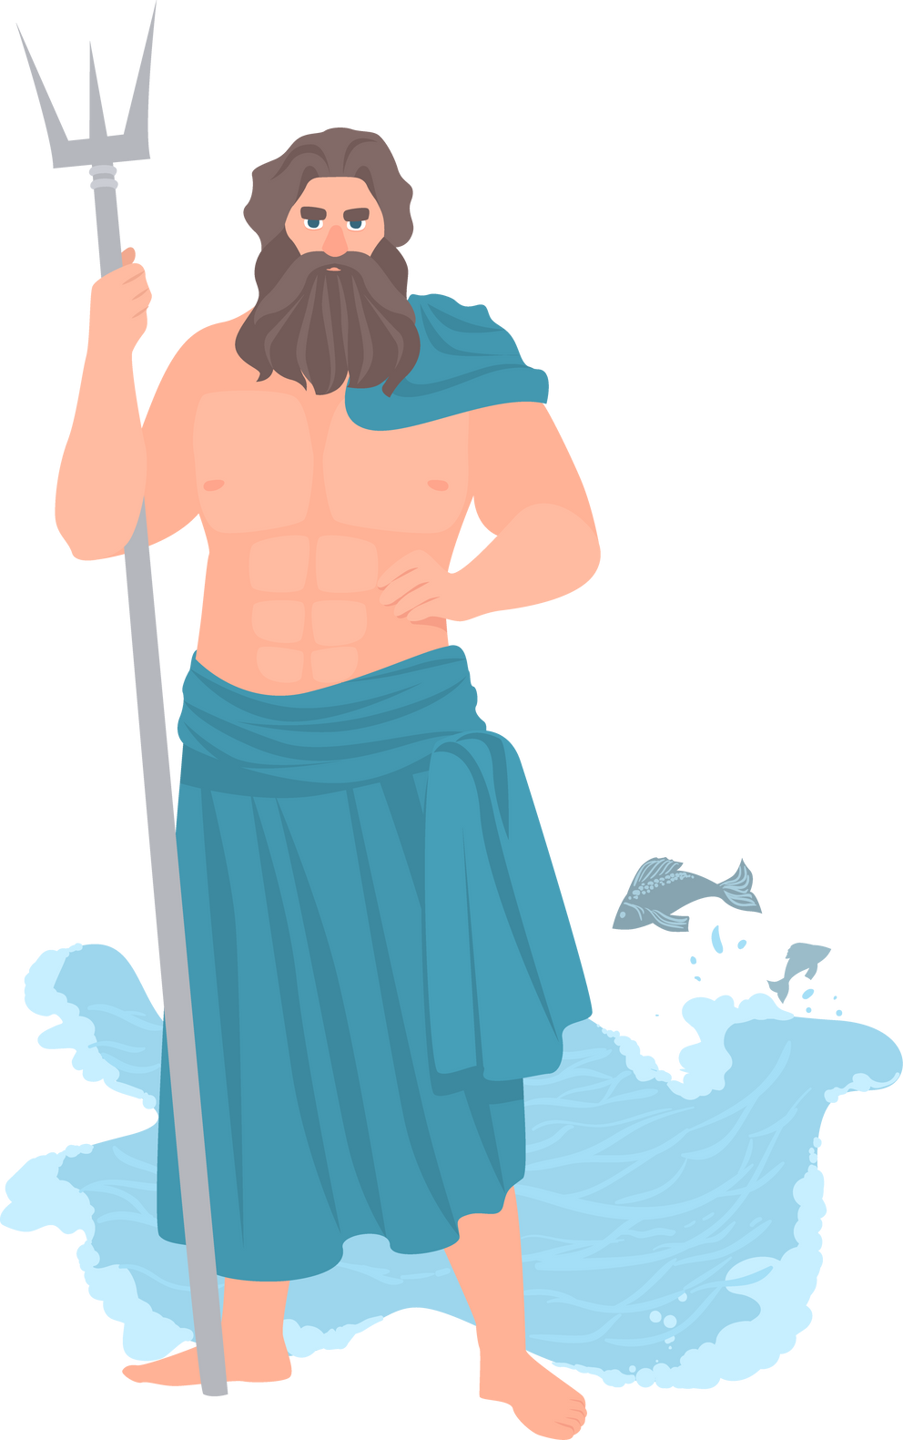
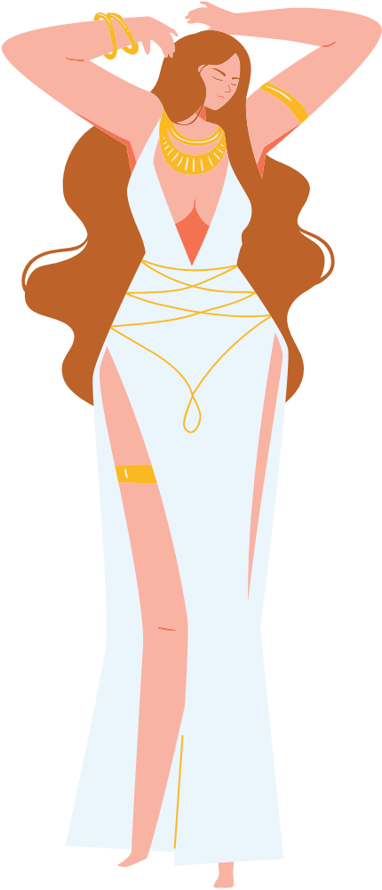

The Roman Gods
Neptune
Venus
Notes:
Neptune is Jupiter's brother and the god of the sea.
Venus is the goddess of love and female beauty. Venus was very important to the Romans, alongside Mars, as her son Aeneid travelled to the area surrounding Rome to establish a population there.

Slide 7
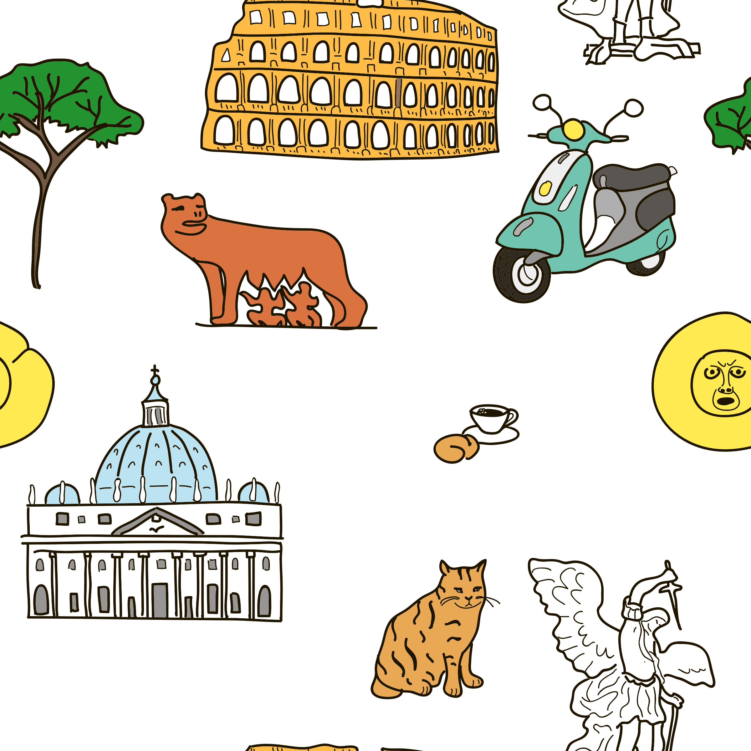
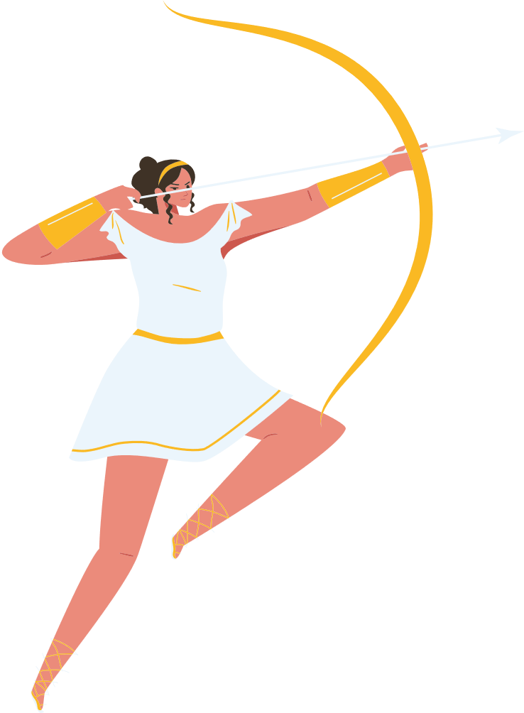
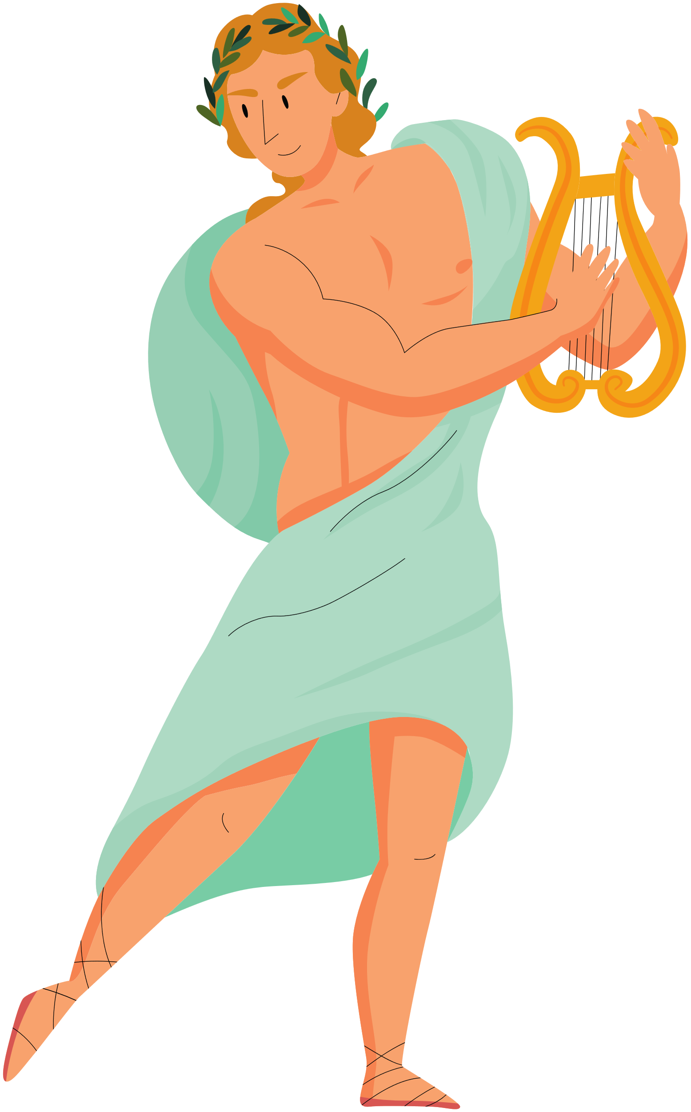

The Roman Gods
Apollo
Diana
Notes:
Apollo is the god of music, archery, male beauty, healing and poetry.
Diana is his twin sister, the goddess of hunting, archery and animals.

Slide 8
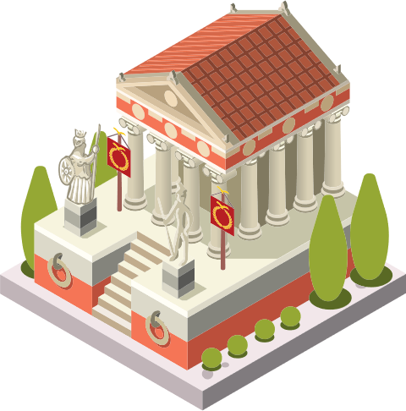
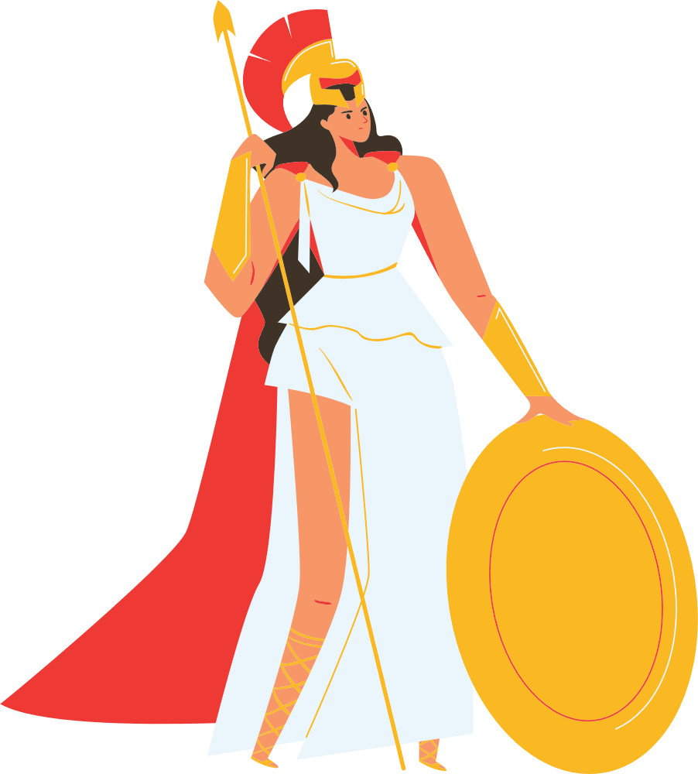
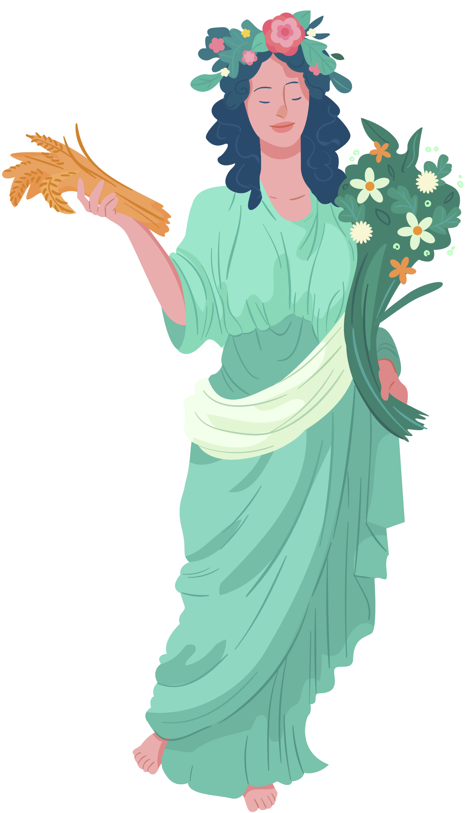

The Roman Gods
Minerva
Ceres
Notes:
Minerva is the goddess of wisdom and learning.
Ceres is the goddess of agriculture.

Slide 9
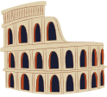

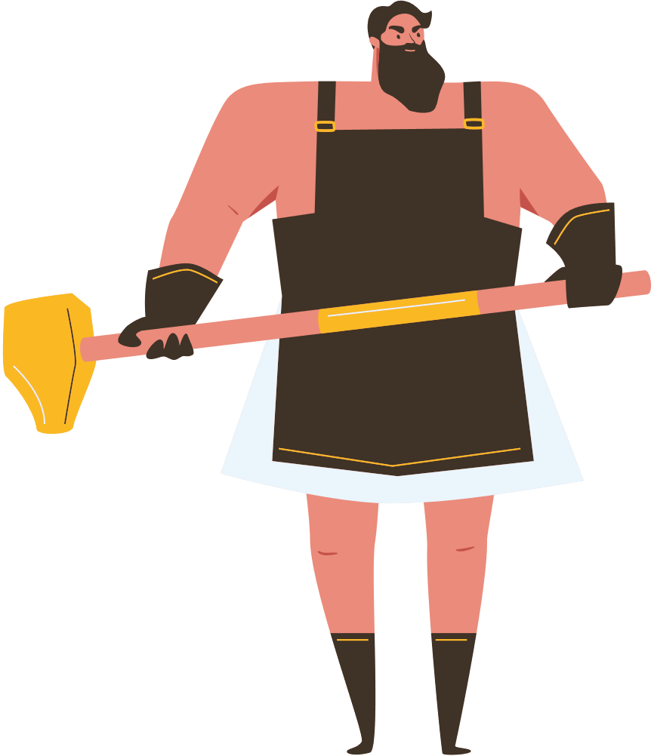
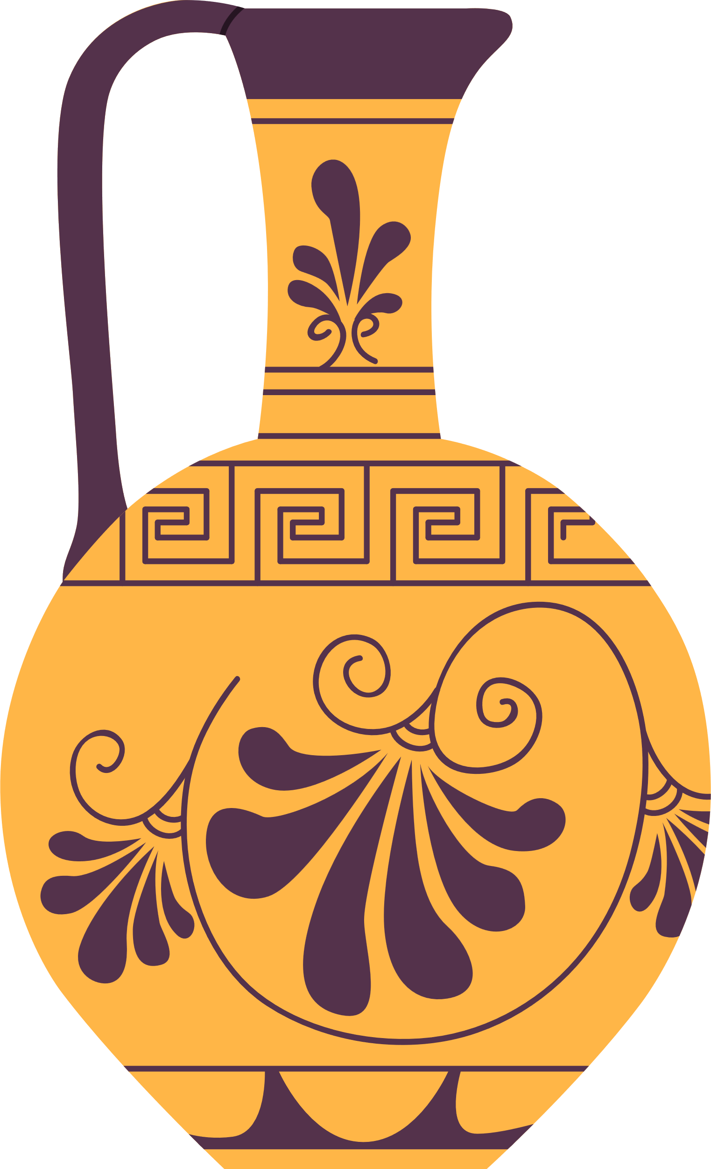
The Roman Gods
Vulcan
Vesta
Notes:
Vulcan was the god of blacksmiths.
Vest was Jupiter's sister, the goddess of the hearth and the home.

Slide 10
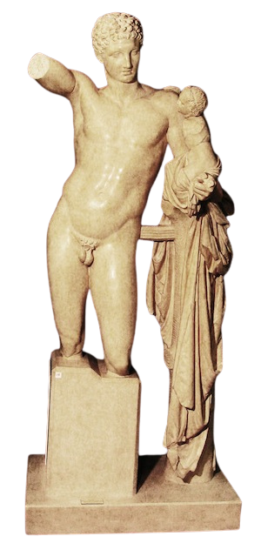
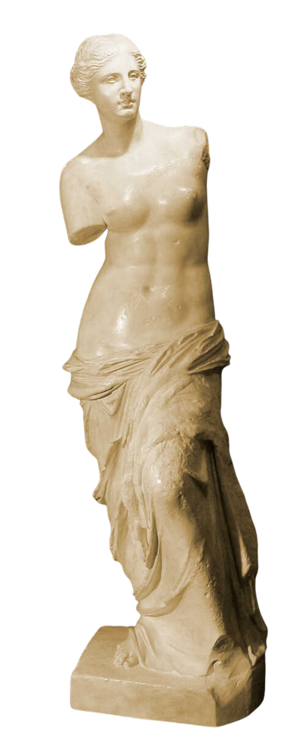


In the Museum
Hermes (Mercury) and the Infant Dionysus (Bacchus)
c. 343 BCE
Aphrodite of Melos a.k.a. Venus de Milo
2nd century BCE
Notes:
We have statues of some of these famous gods in the Museum.

Slide 11
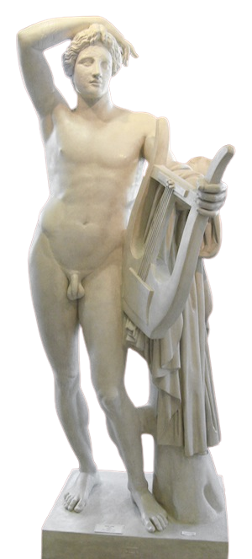
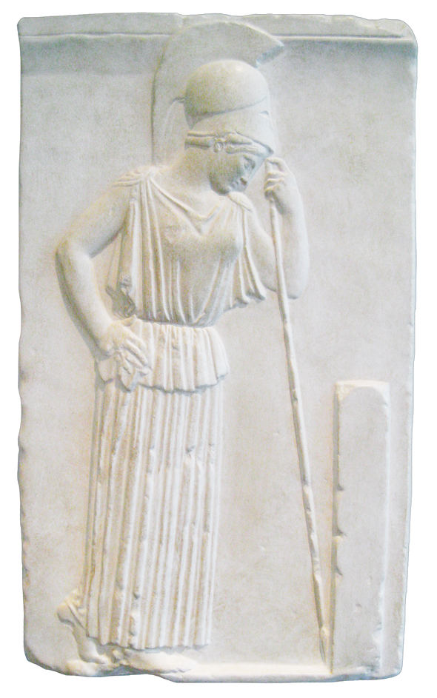
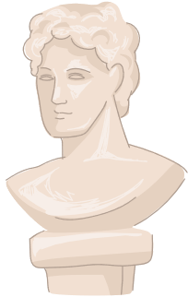

In the Museum
Apollo Lykeios
c. 370 - 360 BCE
Pensive Athena (Minerva)
c. 460 BCE

Slide 12
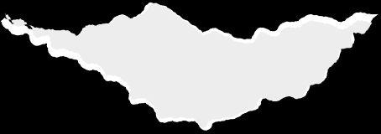
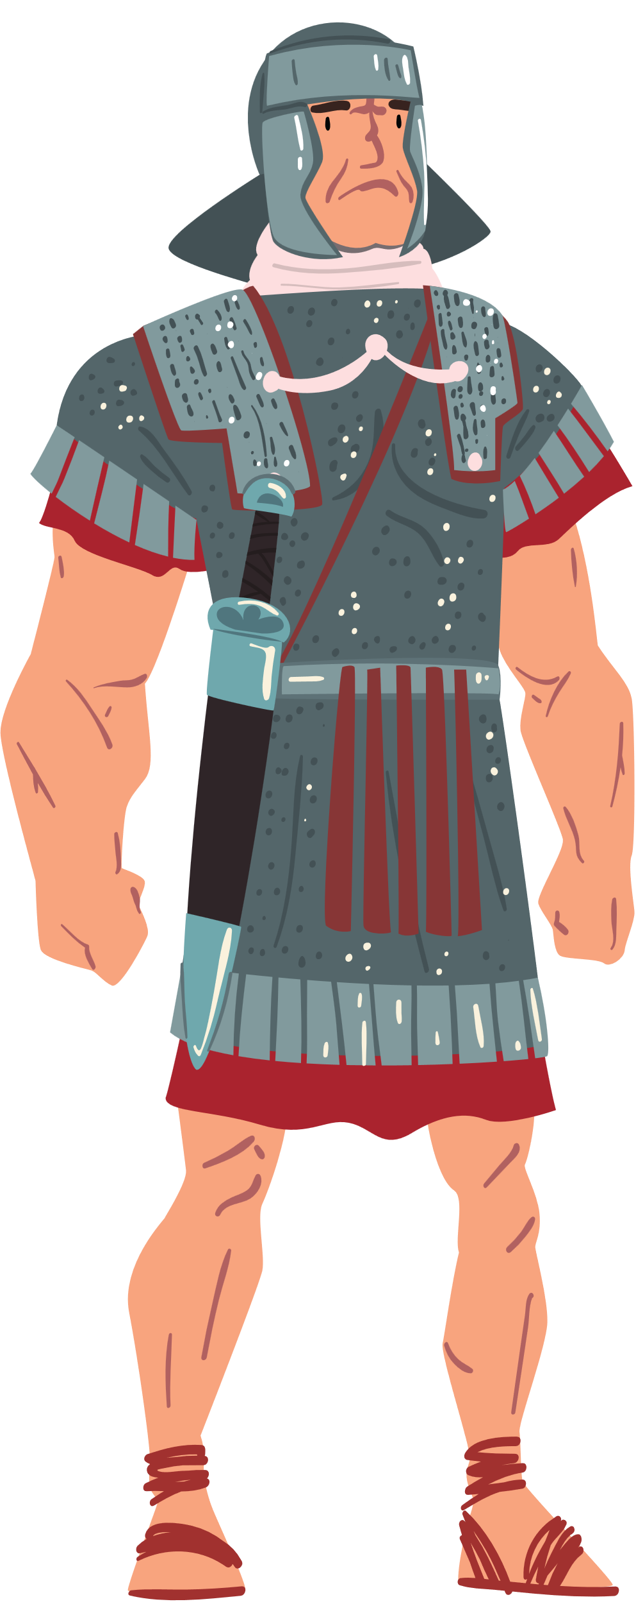
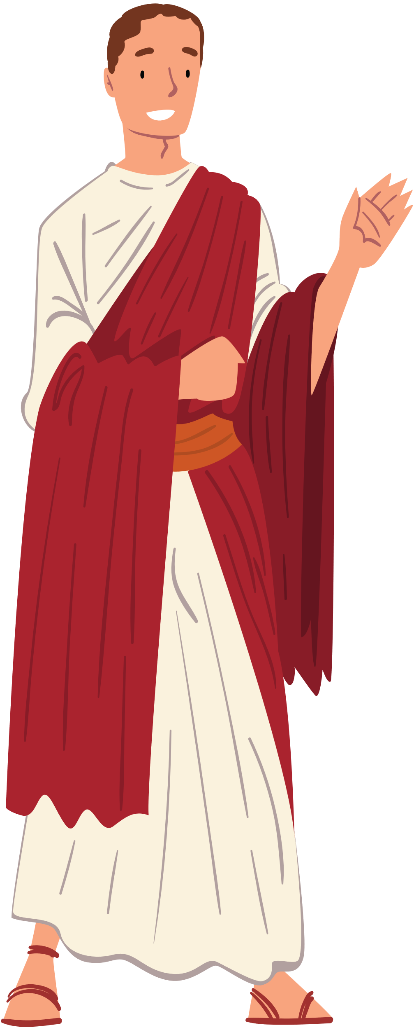
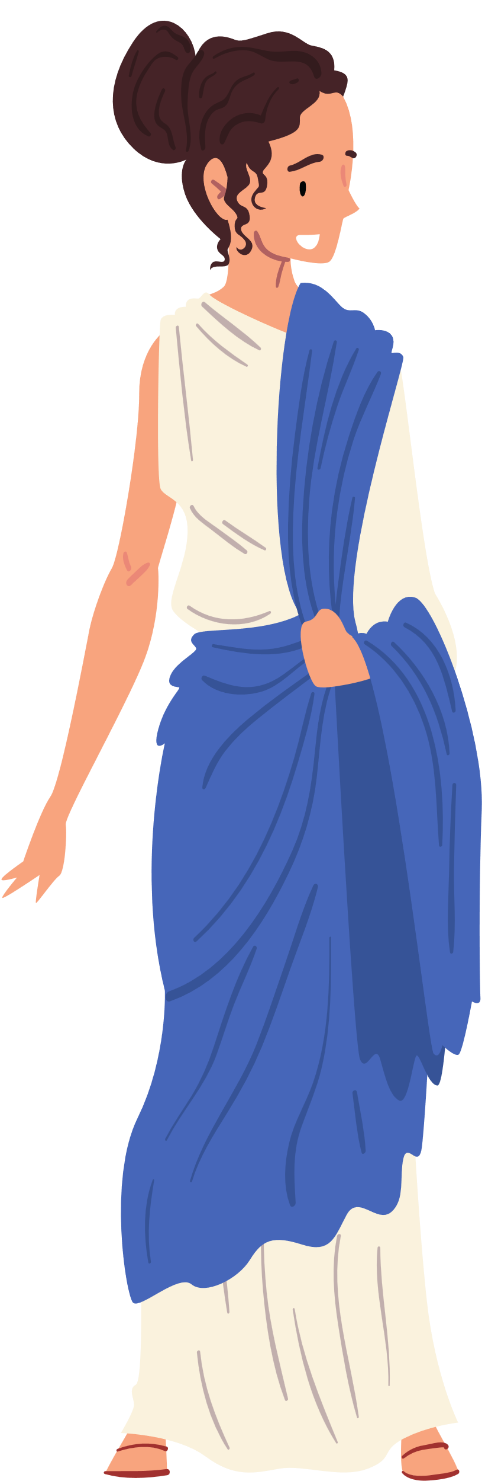
ACTIVITY TIME
Choose one of these myths to research:
Cupid and Psyche
Jupiter and Io
Echo and Narsissus
or choose one of these figures:
Janus (a god)
Augustus (the first Roman emperor)
Aeneas (a mythological soldier)
Then, write a short version of the myth or a short biography of the figure in your own words to share with the class!
Notes:
*This activity is best suited for small groups. We recommend students either
A) Split up into 6 groups to research the same topics,
or
B) Split into groups of 5-6 where each student researches their subject individually and they take turns sharing and discussing within their group.

Slide 13
Sources
Beard, Mary. SPQR : A History of Ancient Rome. London: Profile Books, 2015.
Cameron, Alan. 2004. Greek Mythography in the Roman World. Oxford: Oxford University Press, 2004.
Daly, Kathleen N. Greek and Roman mythology A to Z : a young reader's companion. of Mythology A-Z. New York: Facts On File, 1992.
Fox, Matthew. "The Myth of Rome" In A Companion to Greek Mythology. Blackwell Companions to the Ancient World. Literature and Culture.Edited by Ken Dowden and Niall Livingstone. Chichester; Malden, MA: Wiley-Blackwell, 2011.

