Slide 1
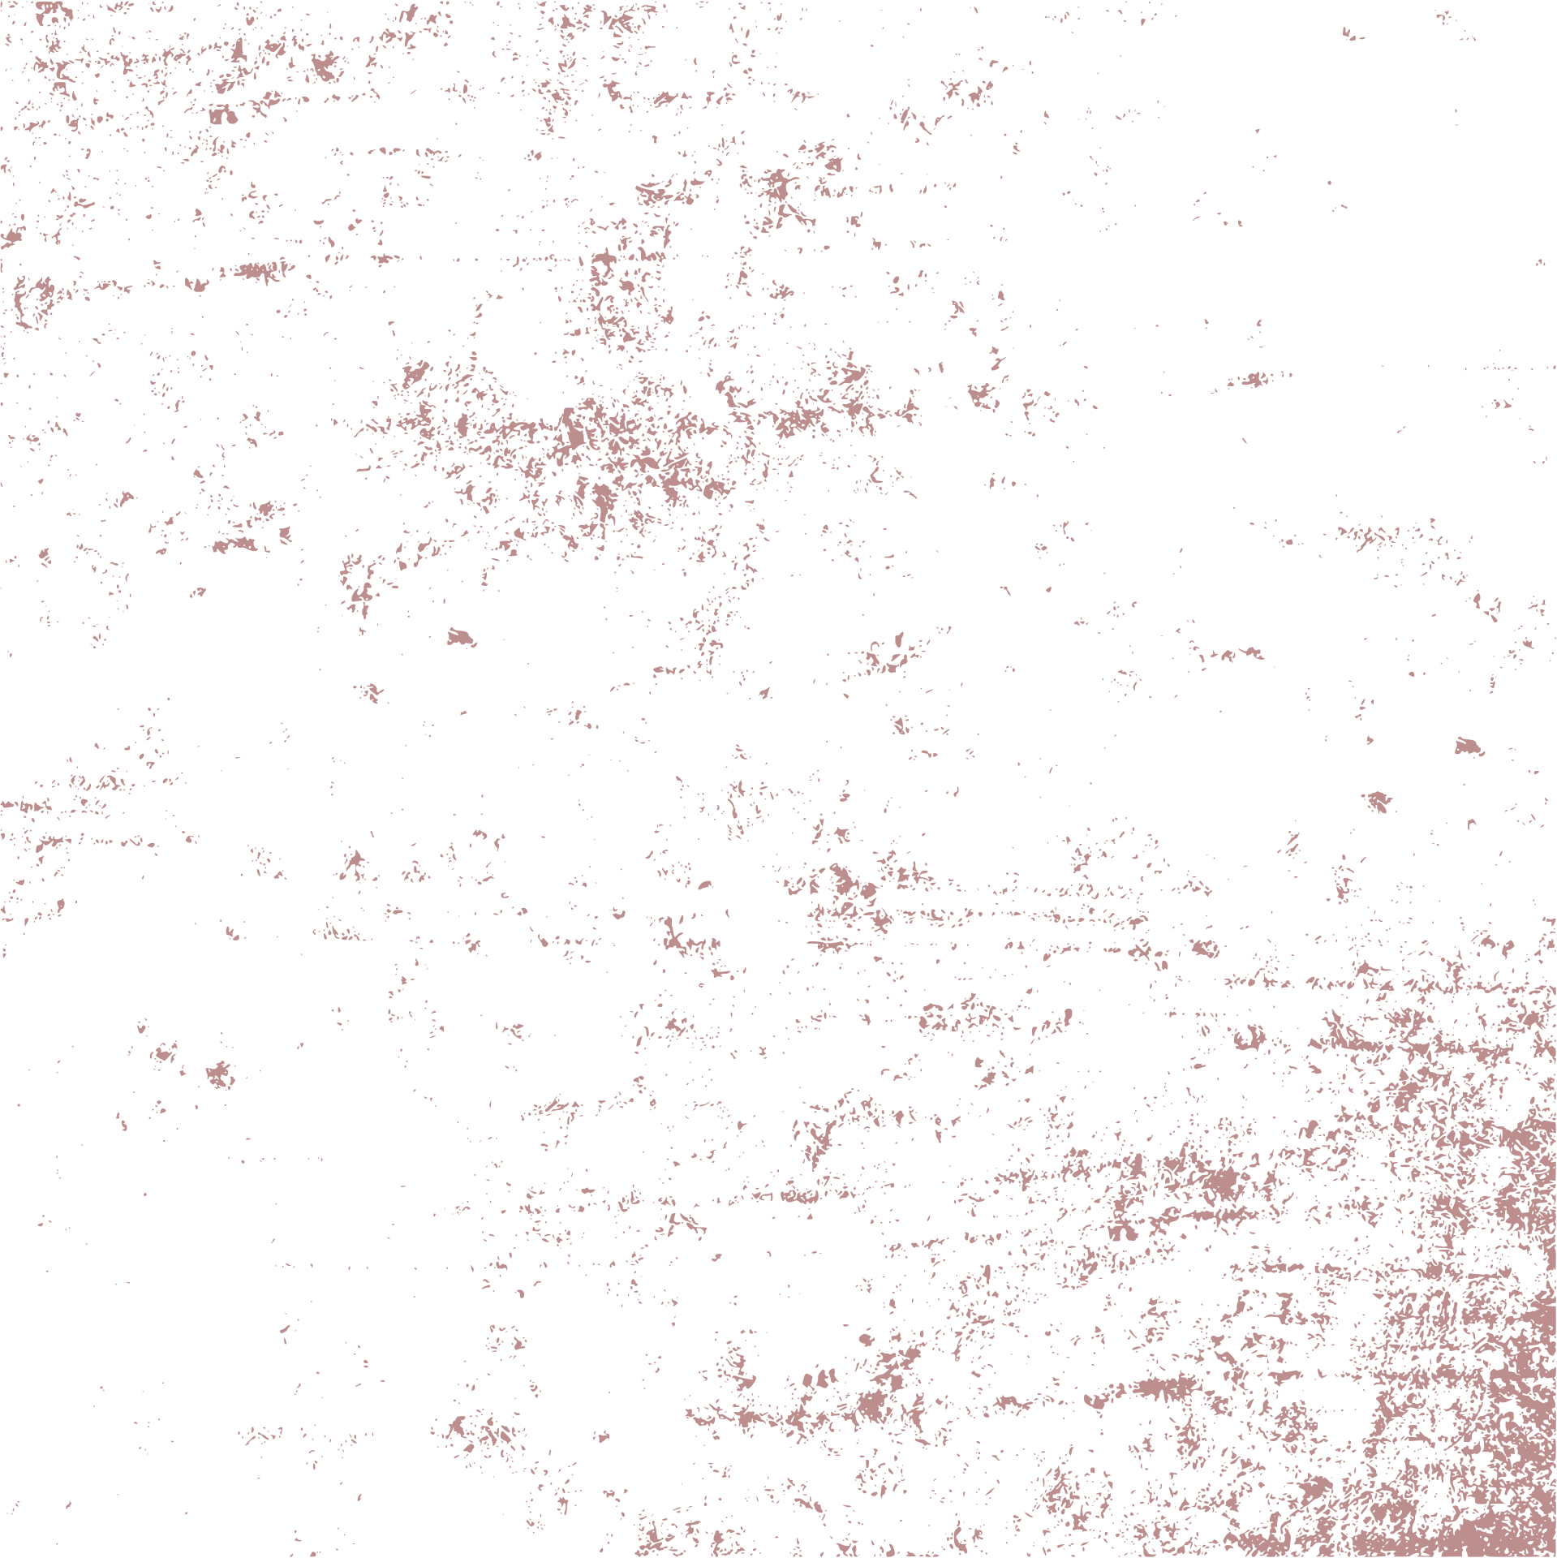
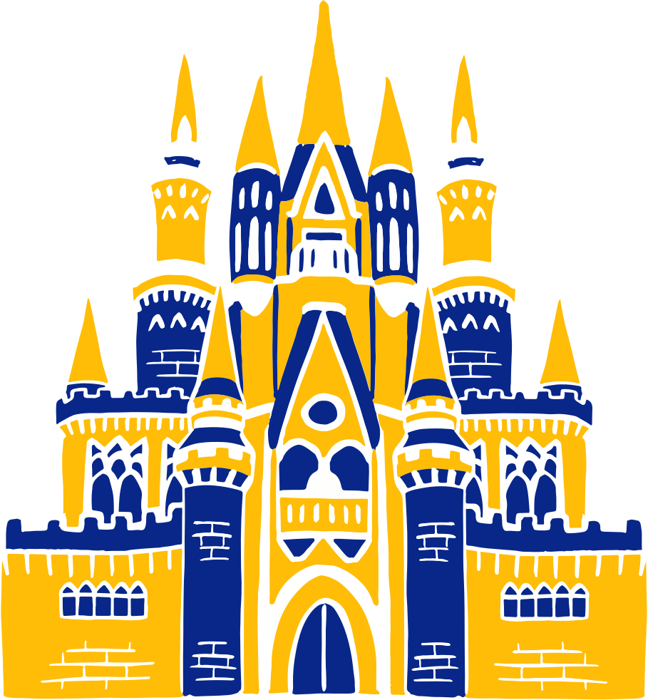



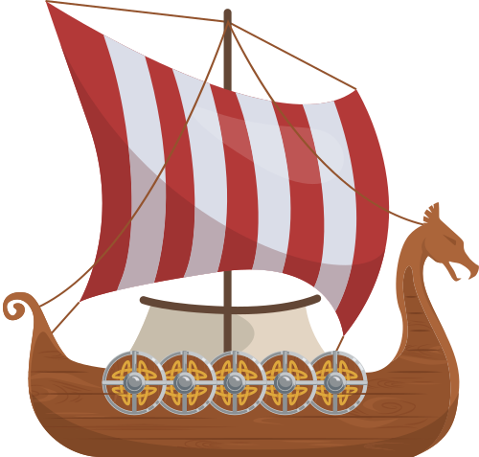
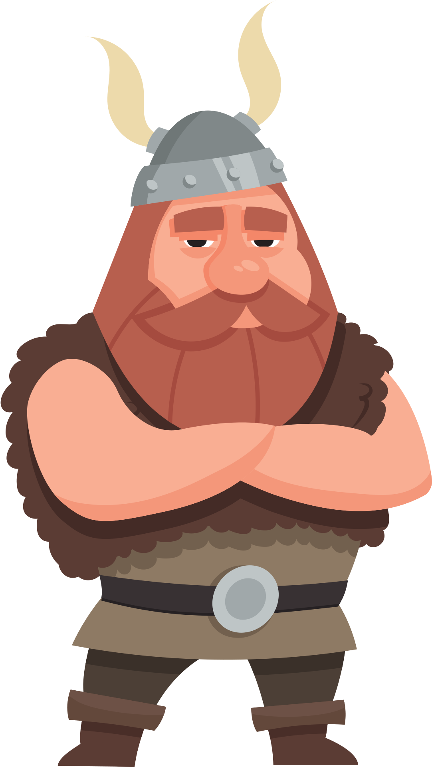
Vikings:
Mythology and legends

Slide 2
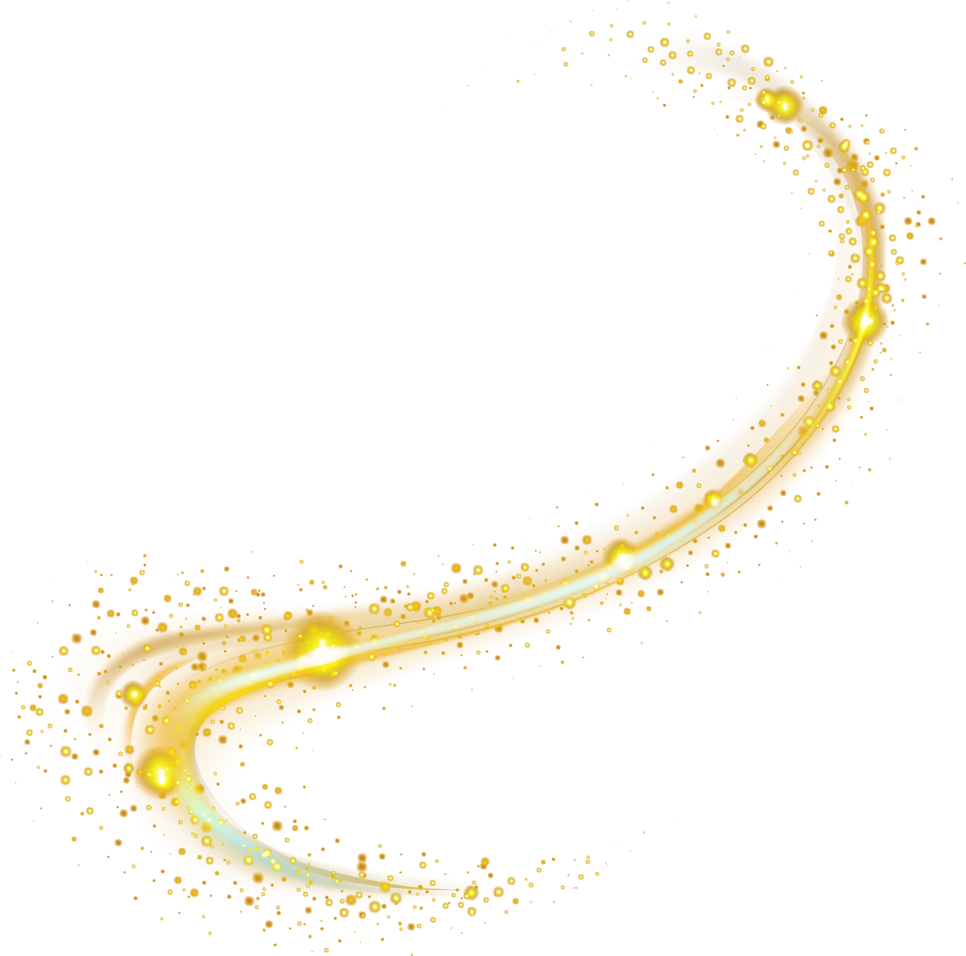
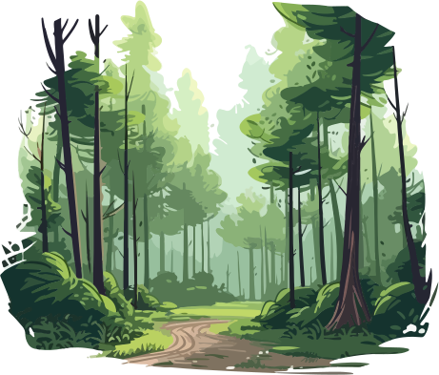
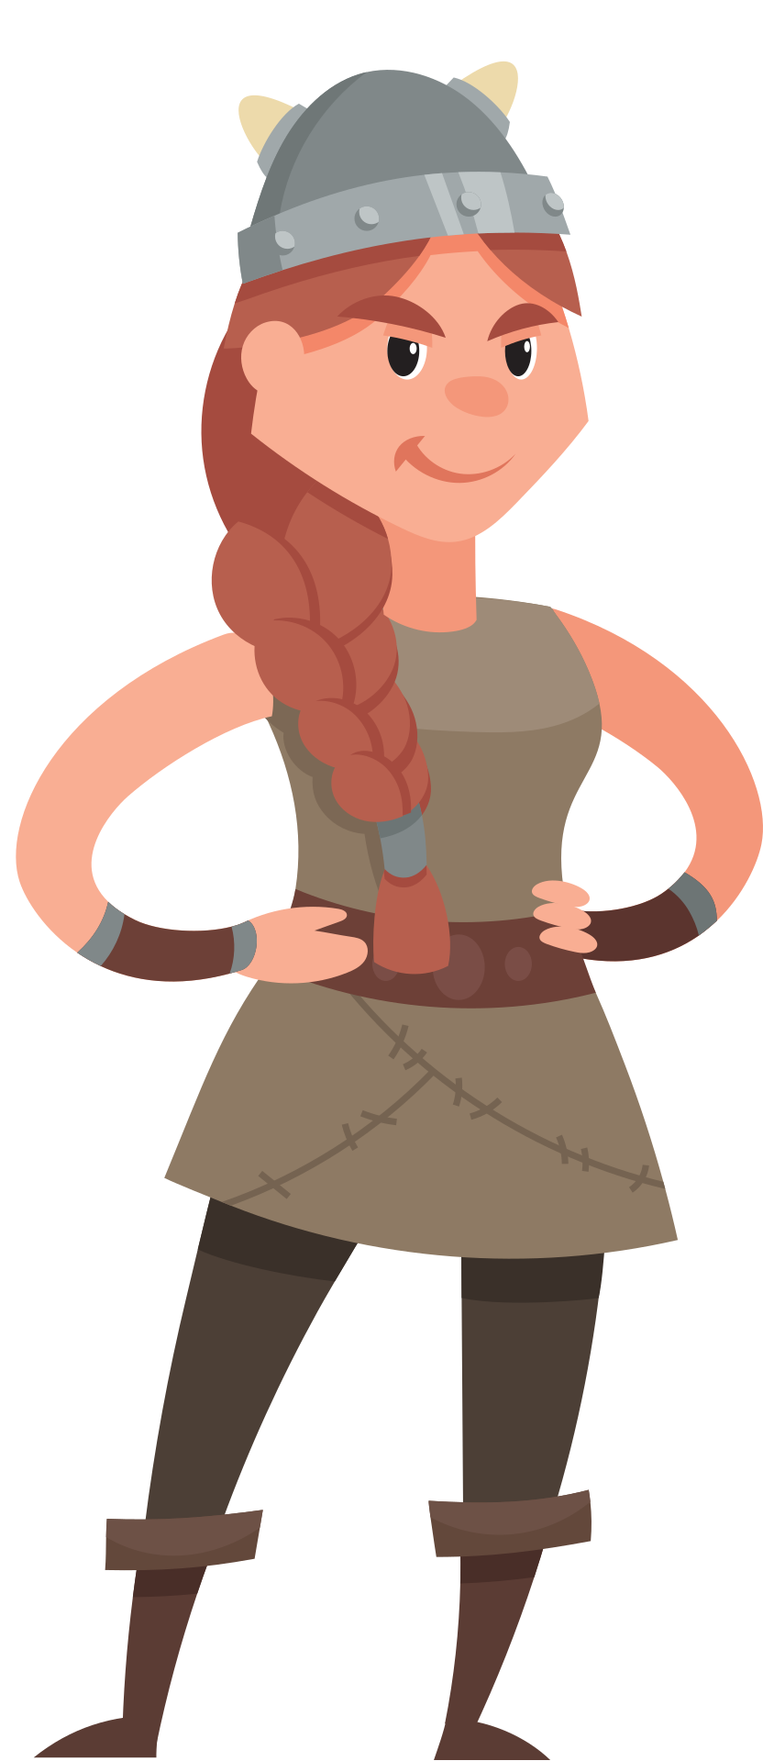
beliefs
Spiritual beliefs were important to everyday life for Vikings
Held ceremonies to honour the gods
Sorcerers/Sorceresses could interact with mythical world and provide guidance
Notes:
The spiritual beliefs of the Vikings were very important to them, and played a large role in everyday life. They held ceremonies to honour the gods and legends, which would usually take place outdoors and included feasting and sacrifices.
Often the local chieftain acted as a group's religious leader, but in some instances there were other people who were especially good at interacting with the gods or other mythical beings. These people, believed to be sorcerers or sorceresses, were sometimes asked to help resolve issues in society or provide guidance.

Slide 3
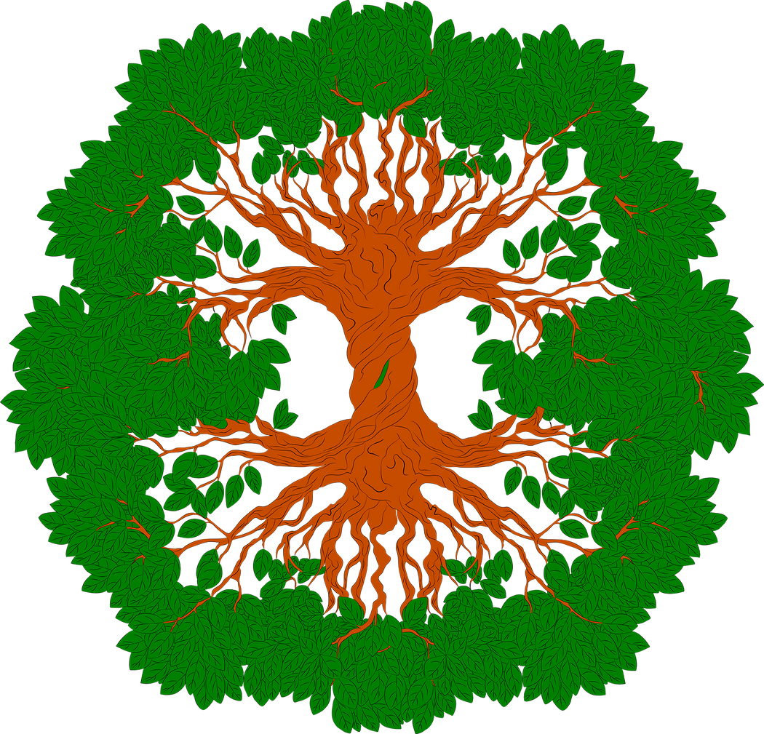

yggdrasil
Tree of Life
Connects the 9 Realms
Notes:
Yggdrasil [eeg-drah-sil] is this immense, nurturing tree that was a central feature and one of the most original creations of the Norse universe. ​
This gigantic, eternally green ash tree in the middle of Asgard covered the entire universe, binding the nine worlds of Norse mythology. ​
This tree connects 9 distinct worlds together, thus creating a universe in which these worlds can interact with each other.​
It extended up and above the heavens and its roots were buried into the depths of various worlds, including Earth.

Slide 4
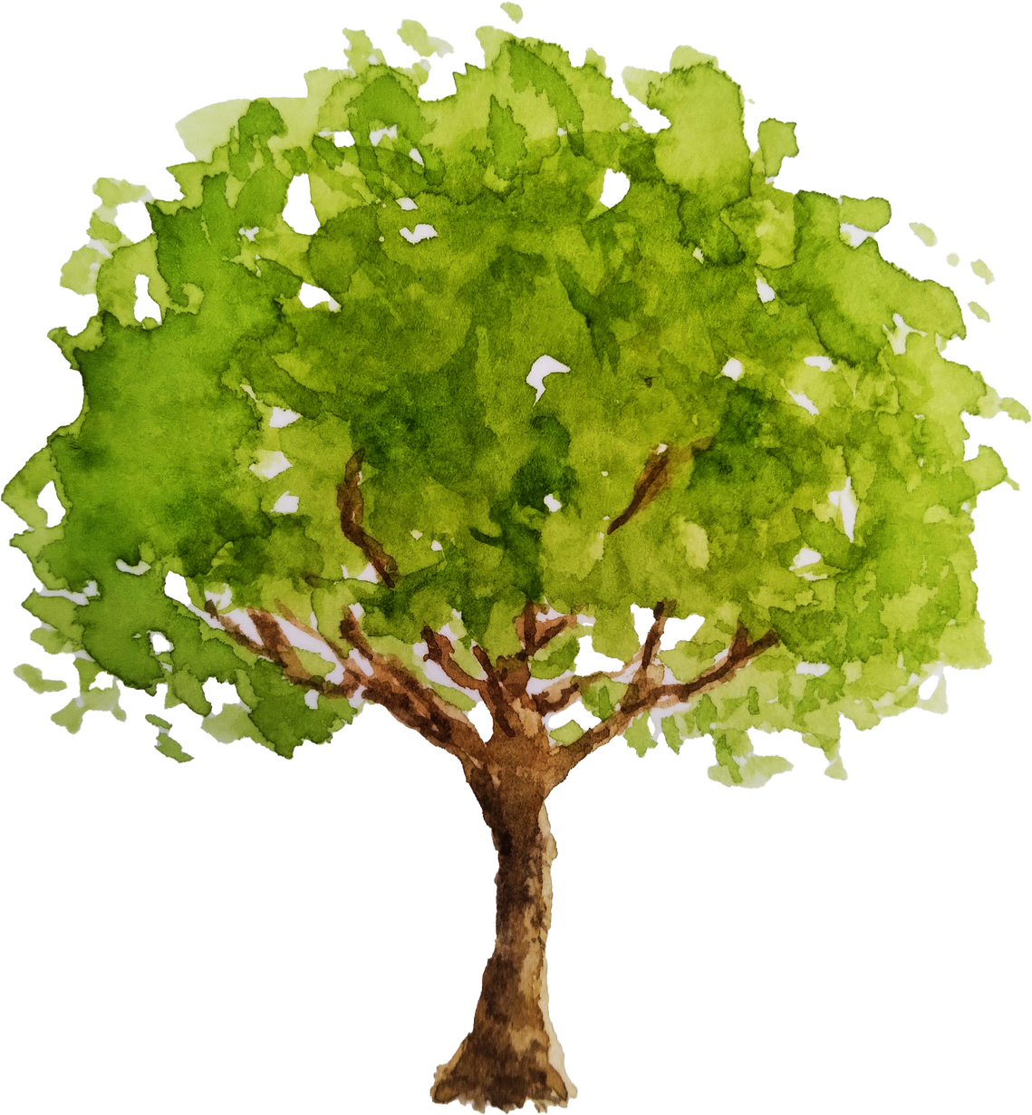
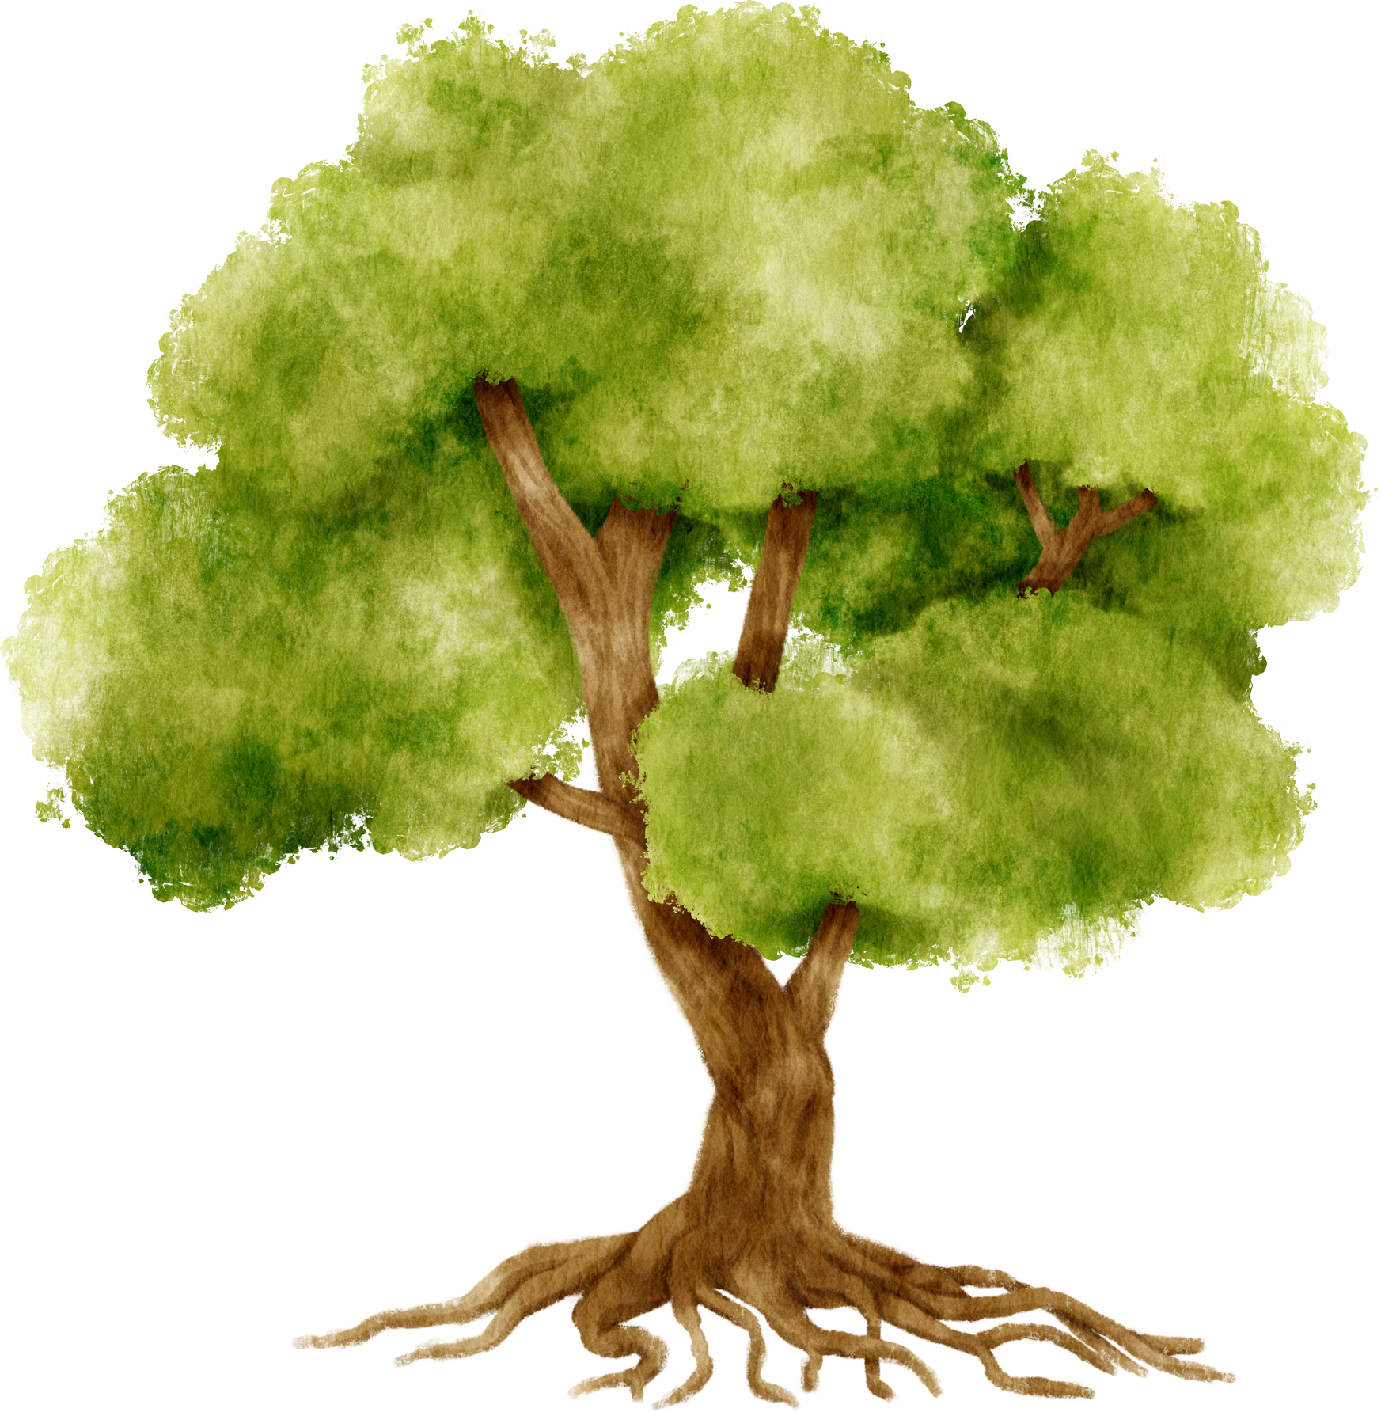
9 realms
Middle Worlds:
Midgard
Jotunheim
Svartalfheim
Nidarvellir
Upper Worlds:
Asgard
Vanaheim
Alfheim
Lower Worlds:
Muspelheim
Niflheim
Notes:
Under the Norse Cosmos there were nine worlds divided into three levels: ​
(Click through animation) The upper worlds included: Asgard, Vanaheim, and Alfheim. ​
(Click through animation) While the middle worlds included: Midgard, Jotunheim, Svartalfheim and Nidarvellir,​
(Click through animation) and finally, the lower worlds inlcuded: Muspelheim and Niflheim

Slide 5

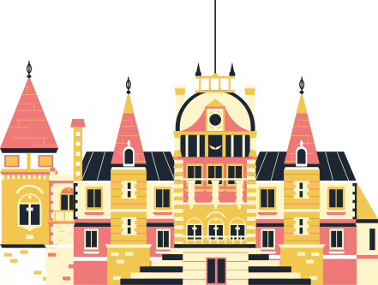


Asgard
Grand palace in the sky, near the top of Yggdrasil
Home of the Gods
Notes:
In the middle of the cosmos, high up in the sky is Asgard. This is the home of the gods.
The male gods in Asgard are called Aesir and the female gods are called Asynjur. Aesir gods were sky gods, who dominated all things. These gods included Odin and his son Thor.

Slide 6
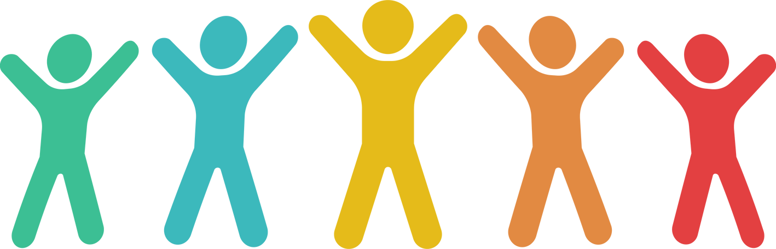
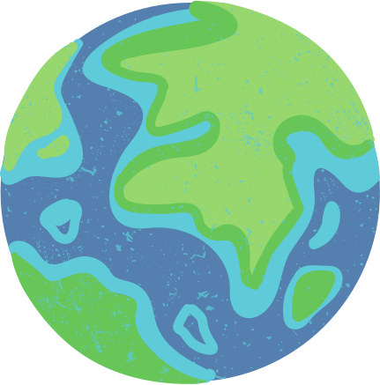
midgard
Earth
Home of Humans
Notes:
Midgard is the world where humans live. This world sometimes goes by the name “middle earth” because Midgard is located in the center of Yggdrasil, below Asgard. Midgard and Asgard are connected by the Bifrost, or the Rainbow Bridge. ​

Slide 7
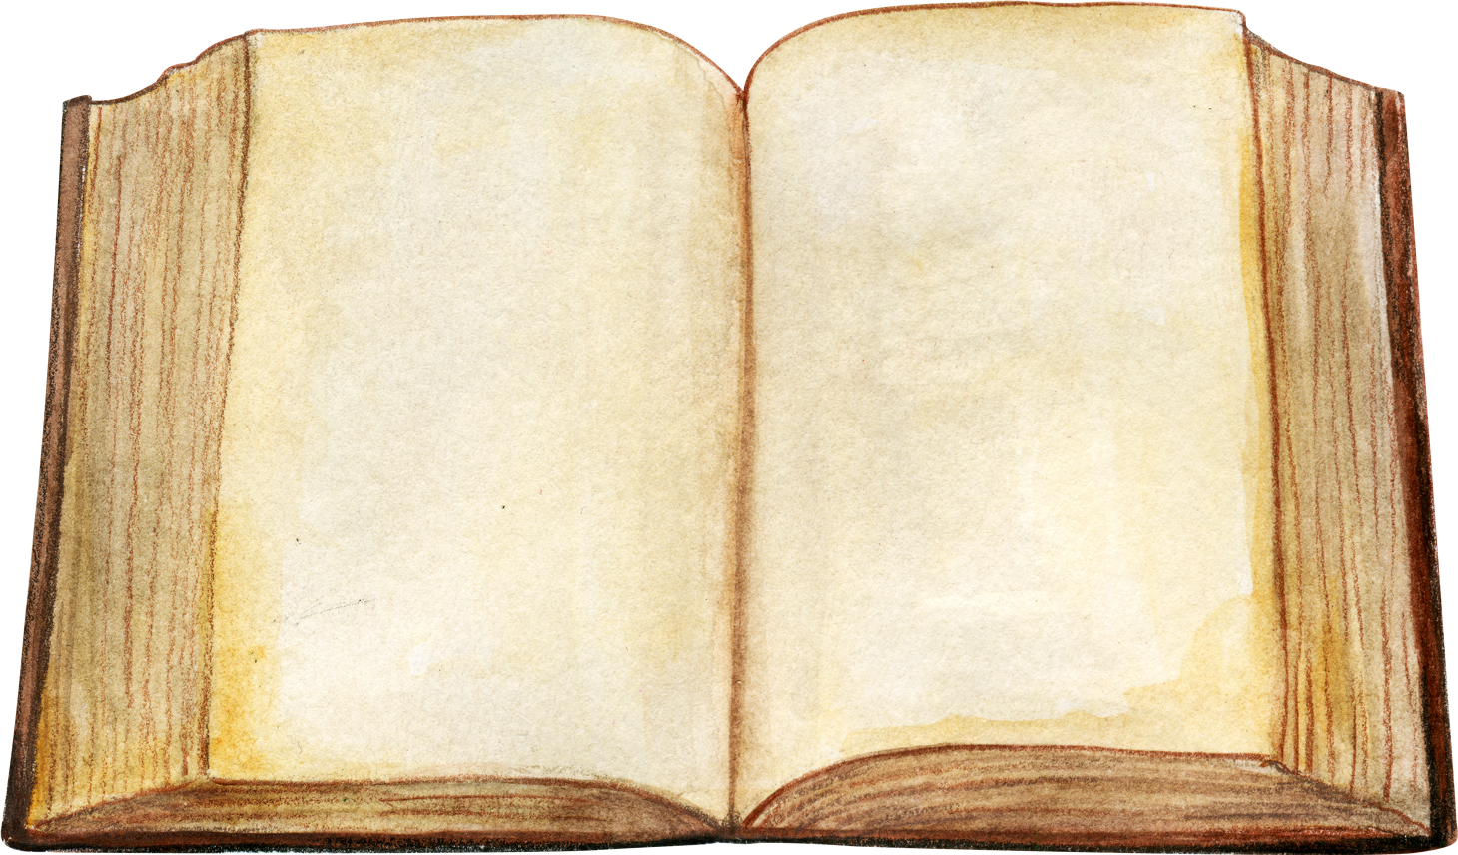
the edda
Two great manuscripts that hold the stories of Norse Mythology.
Recounts the legend of how the world was first created.
Notes:
Edda is a term used to describe two Icelandic manuscripts that were written in the 13th century CE. Together they are the main sources of Norse mythology. The first Edda manuscript was compiled by Snorri Sturluson, an Icelandic poet and historian. The second was written by an unknown author.
Snorri's manuscript includes the Norse legend of how the world was created. Do you want to hear it?

Slide 8

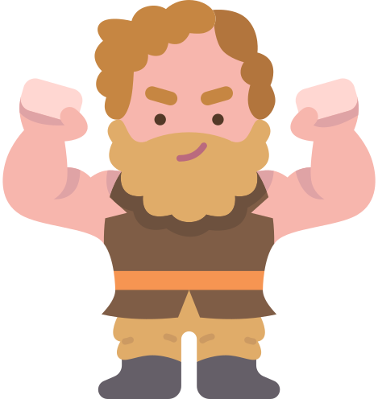
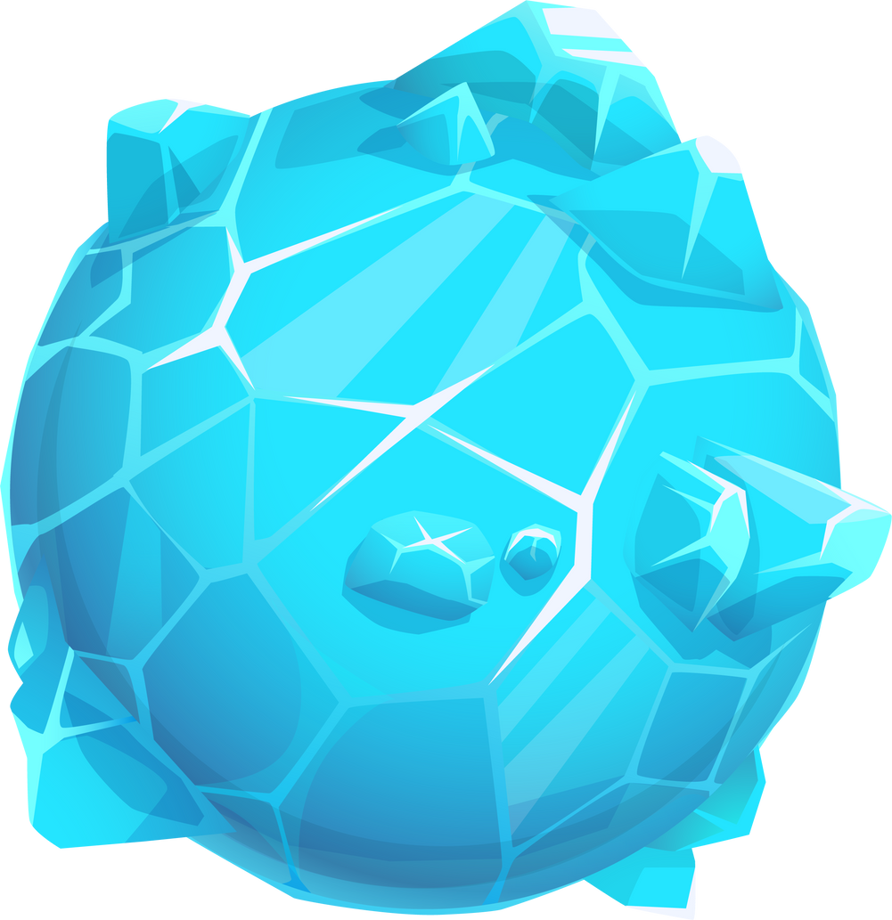
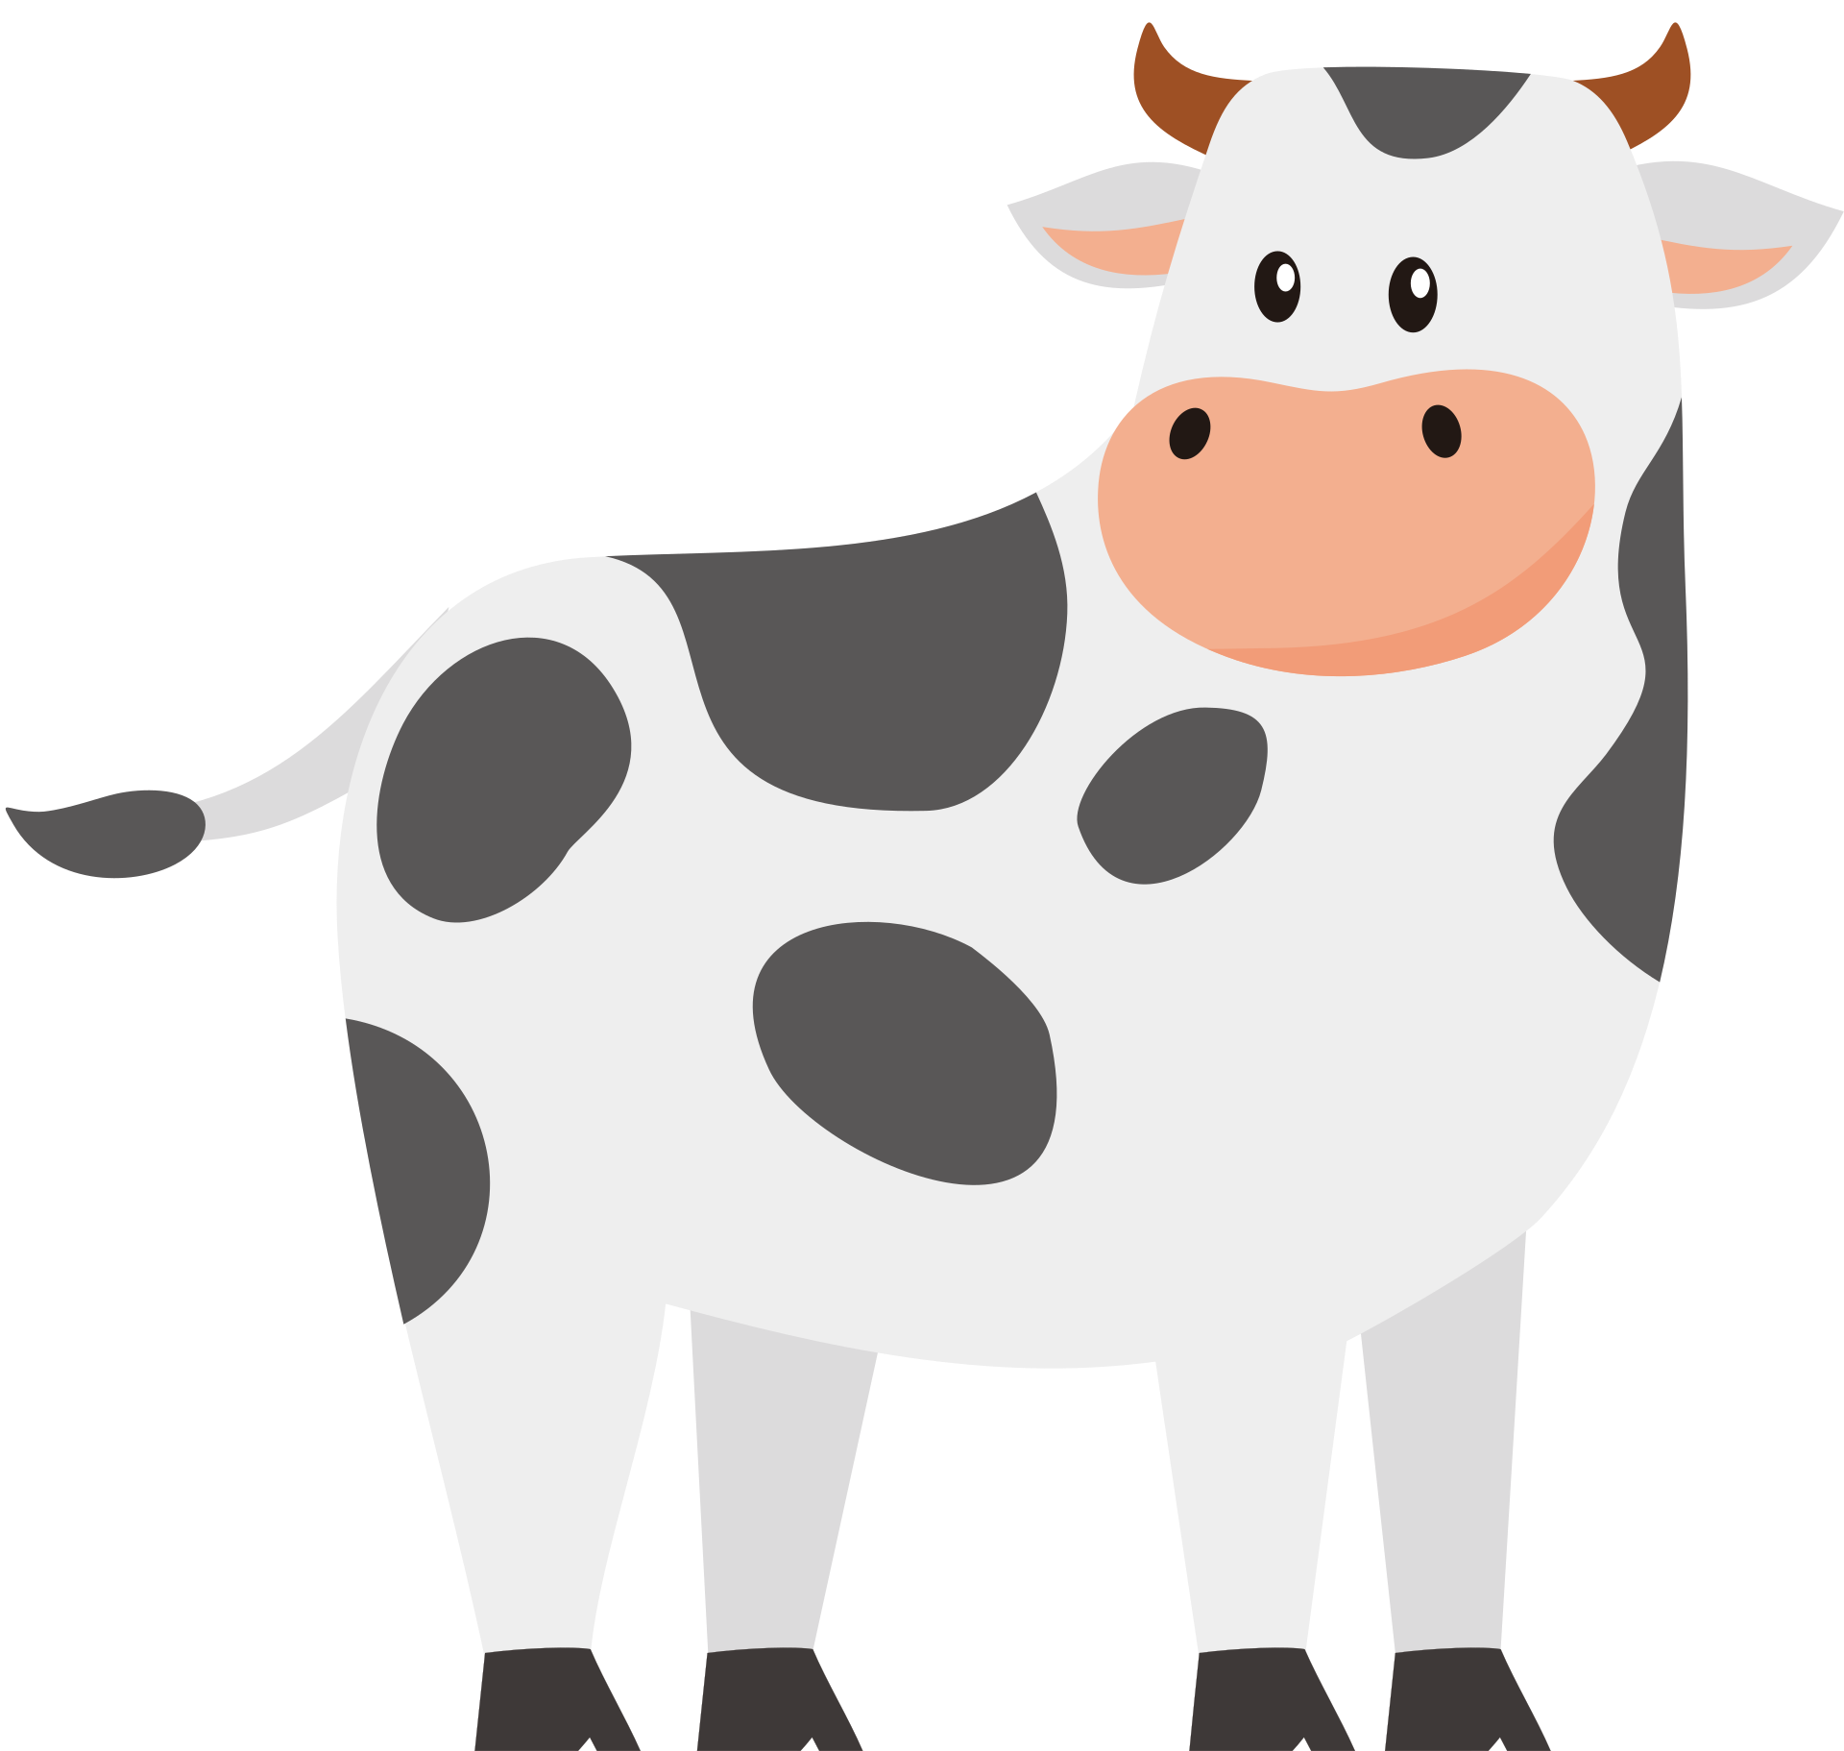
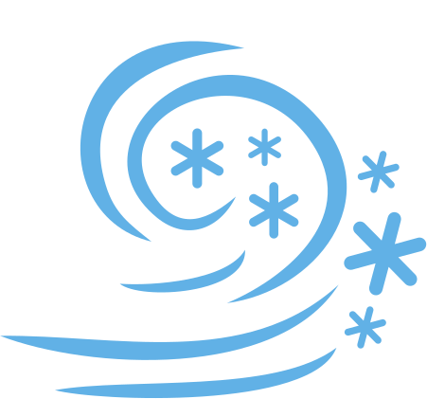
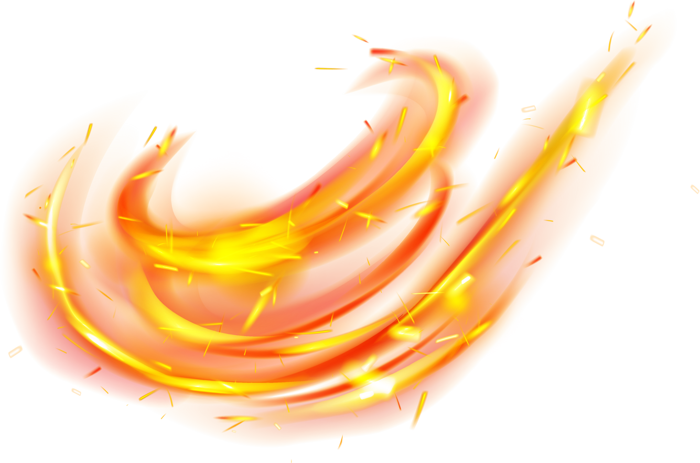
Notes:
Before the Earth or anything else was created, there were only two worlds in existence: the icy Niflheim and the fiery Muspelheim.
Eventually the ice and fire of these two worlds met in the middle, and their combination created [click animation] the giant Ymir and [click animation] the great cow Audhumla.

Slide 9
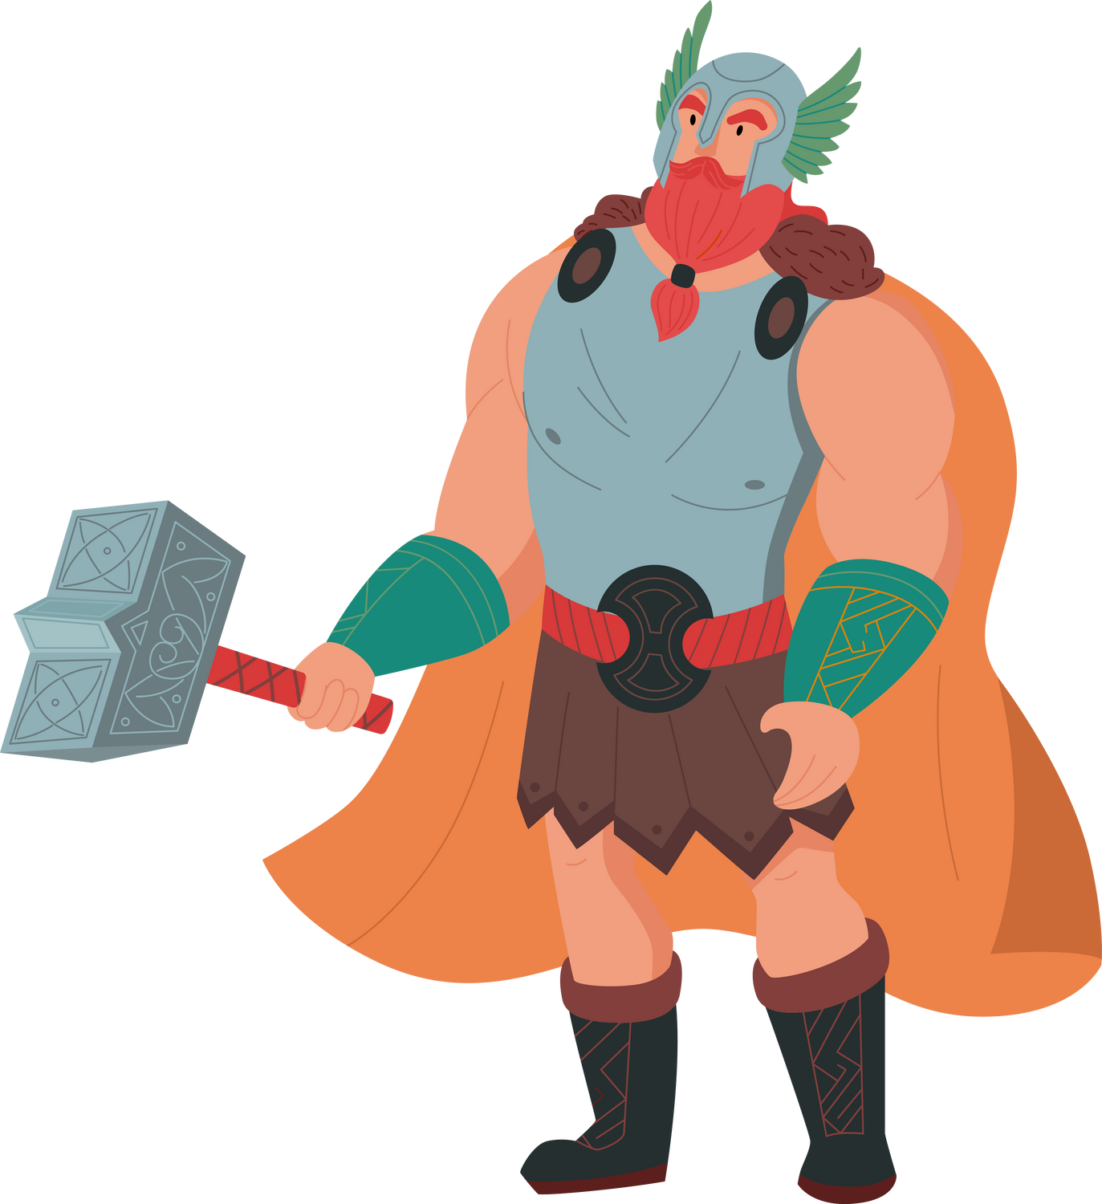
Notes:
Audhumla licked the ice of Niflheim until she eventually uncovered the first gods, who were frozen beneath the world's surface. [click animation]
These gods had children of their own, one of whom was Odin.

Slide 10

Notes:
When Odin and the other young gods grew strong enough, they killed the great giant Ymir and created the world from his body. [click animation]
His flesh was used to create the earth, his skull created the sky, his bones became mountains, and his blood became the sea.

Slide 11
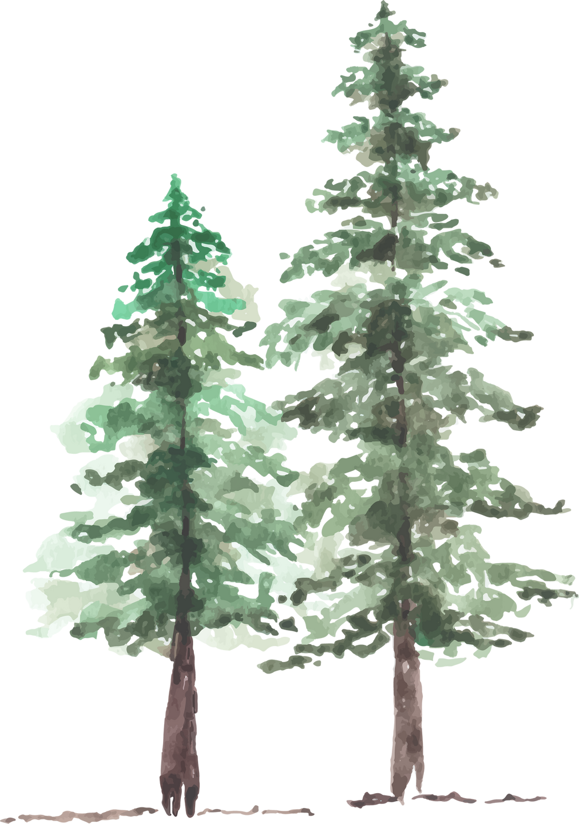
Notes:
Once their world was created, Odin and the other gods realized that it needed life. They fashioned the first human couple, Ask and Embla, from two trees, [click animation 2x] and the age of humanity began!

Slide 12
thanks for listening!
Notes:
Thank you for listening! Does anyone have any questions?

Slide 13
bibliography
Keller, Mary Jo. Hands-On Heritage: Vikings Activity Book. Edupress, 2007.
Murphy, G. Ronald. Tree of Salvation: Yggdrasil and the Cross in the North. Oxford University Press, 2013. ​
Stern, Marjolein and Roderick Dale. The Viking Experience. Carlton Books, 2014.
World History Encyclopedia. “Norse Mythology - A Collection.” Published November 21, 2018. https://www.worldhistory.org/collection/30/norse-mythology---a-collection/.

