Slide 1

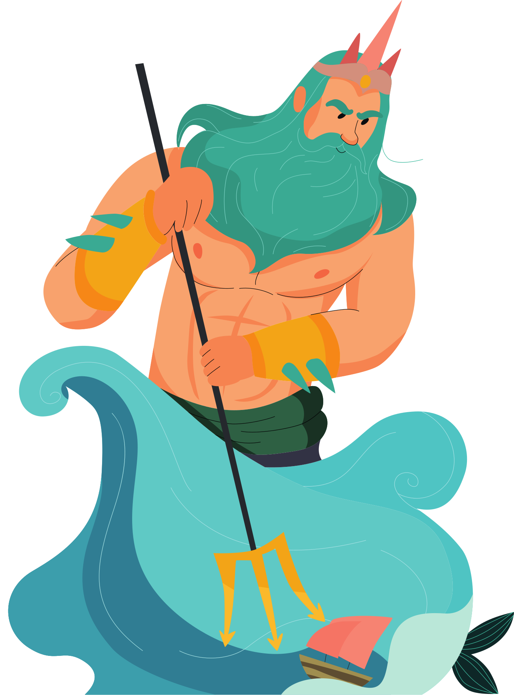
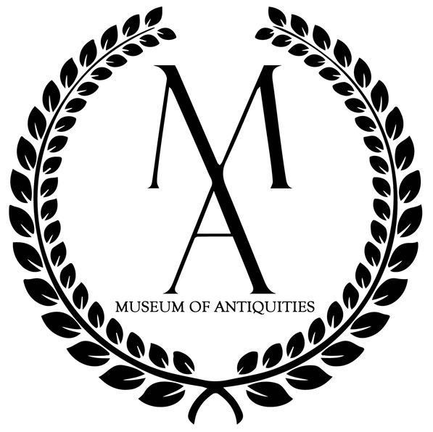

ALL ABOUT
Greek Mythology

Slide 2
What do you already know?:
What do you know about ancient Greece? Modern Greece?
Do you know any Greek myths? Any characters? Any Gods?
Where have you heard of these stories and characters?

Slide 3
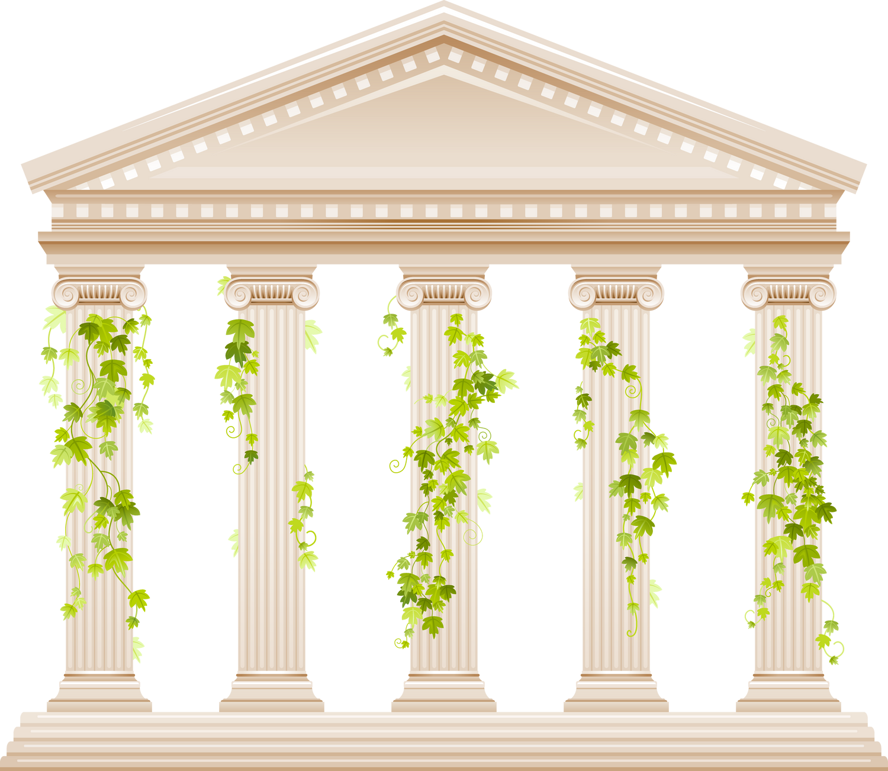
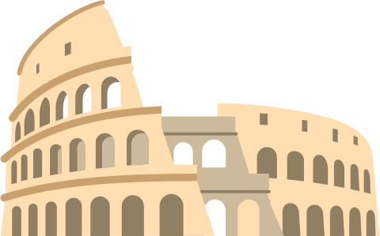
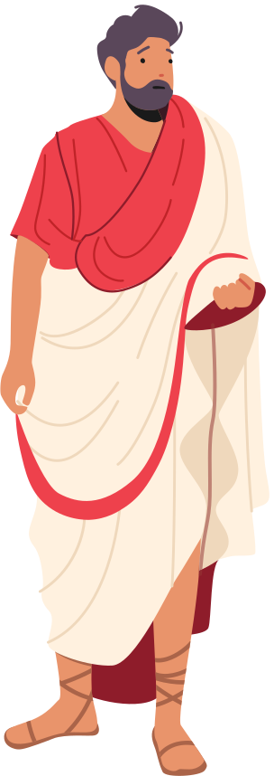
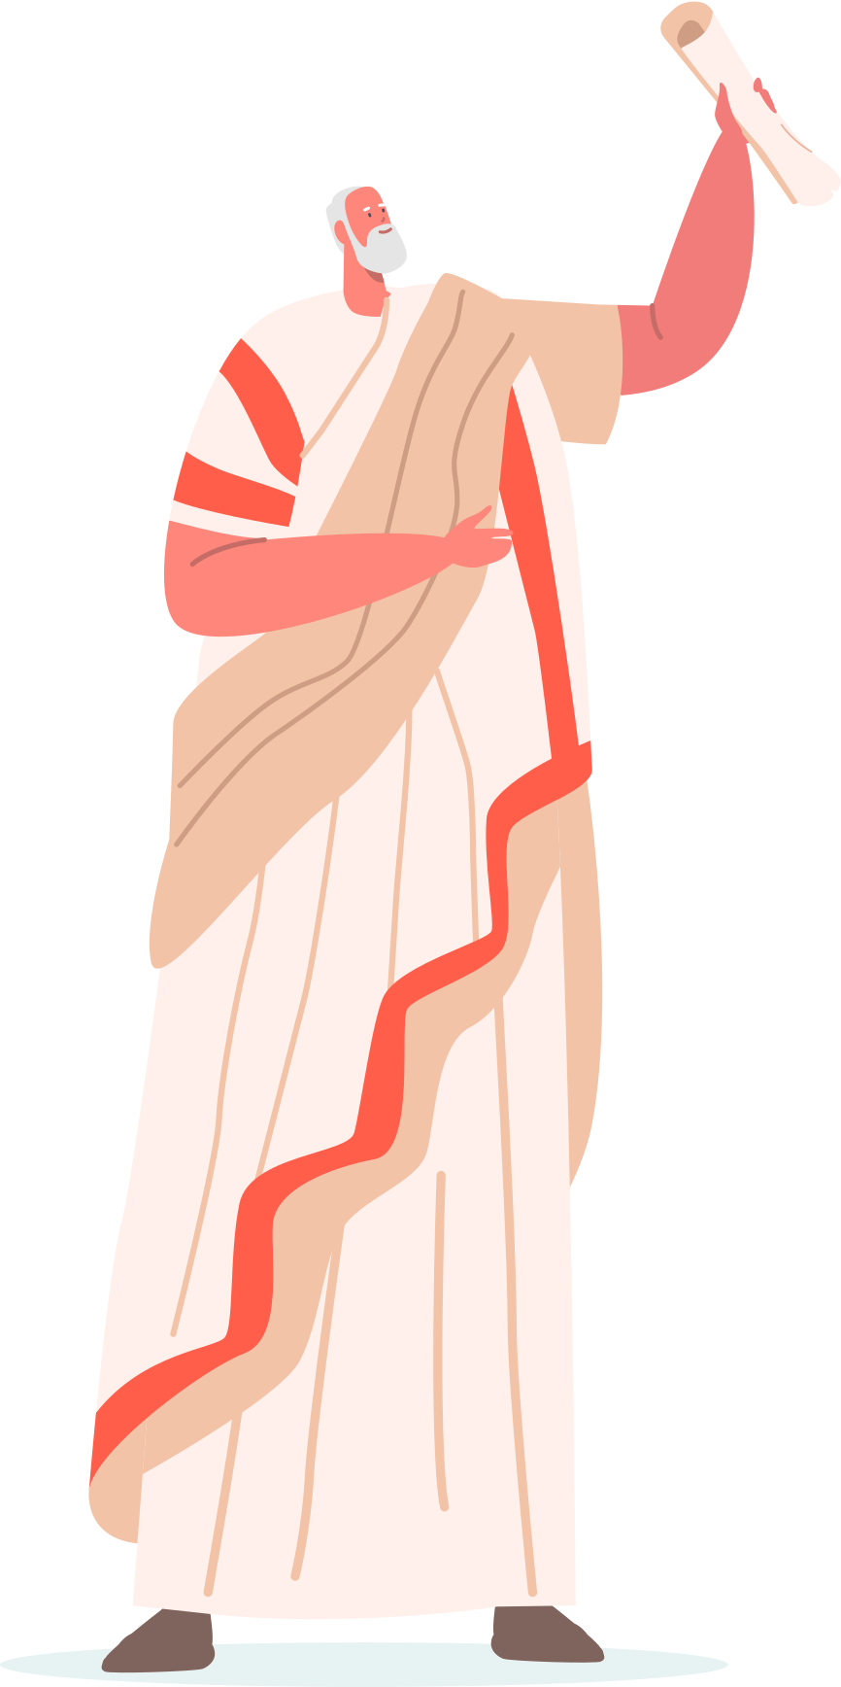
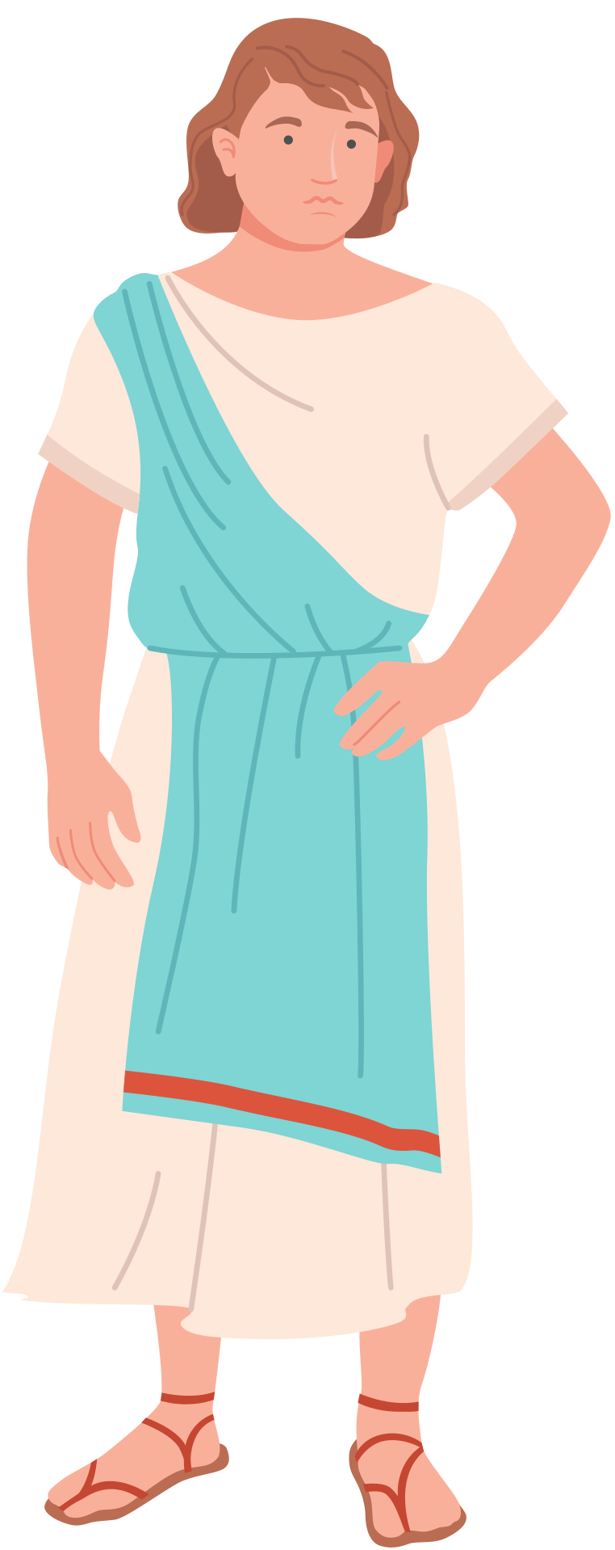
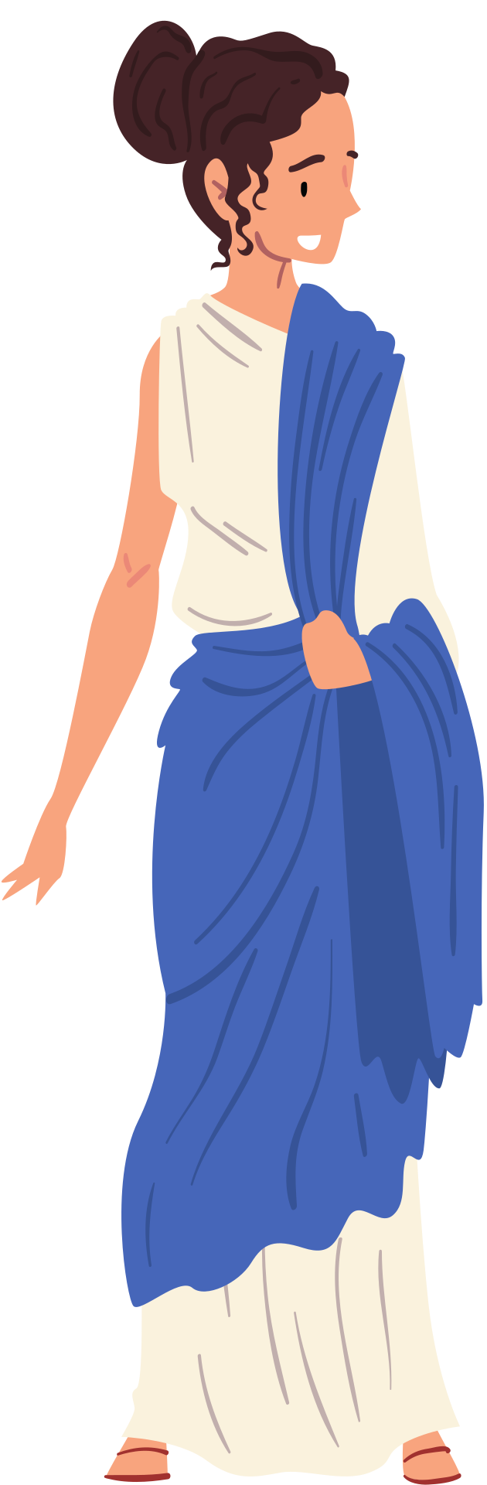
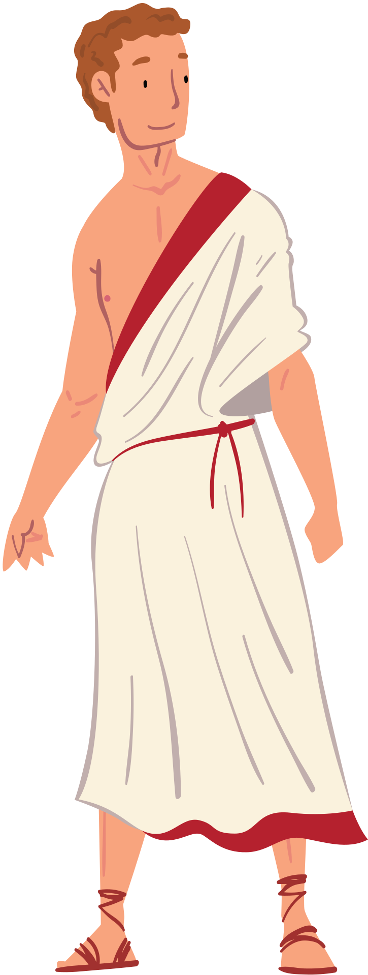
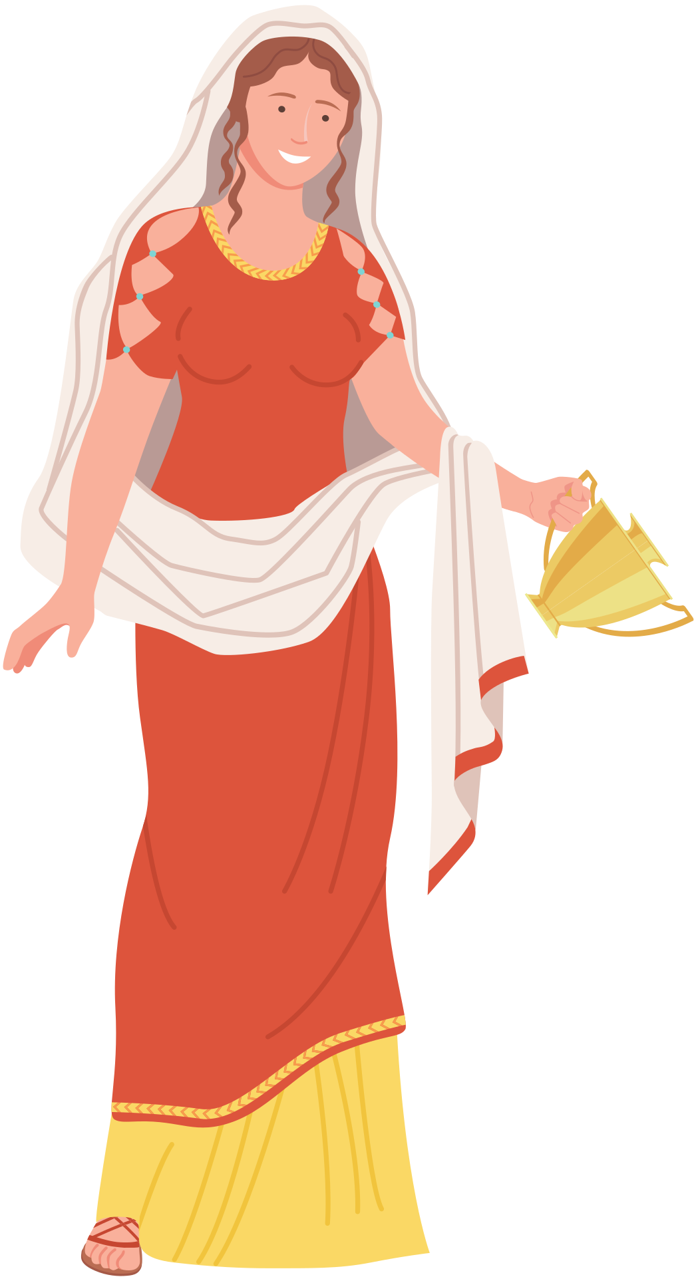
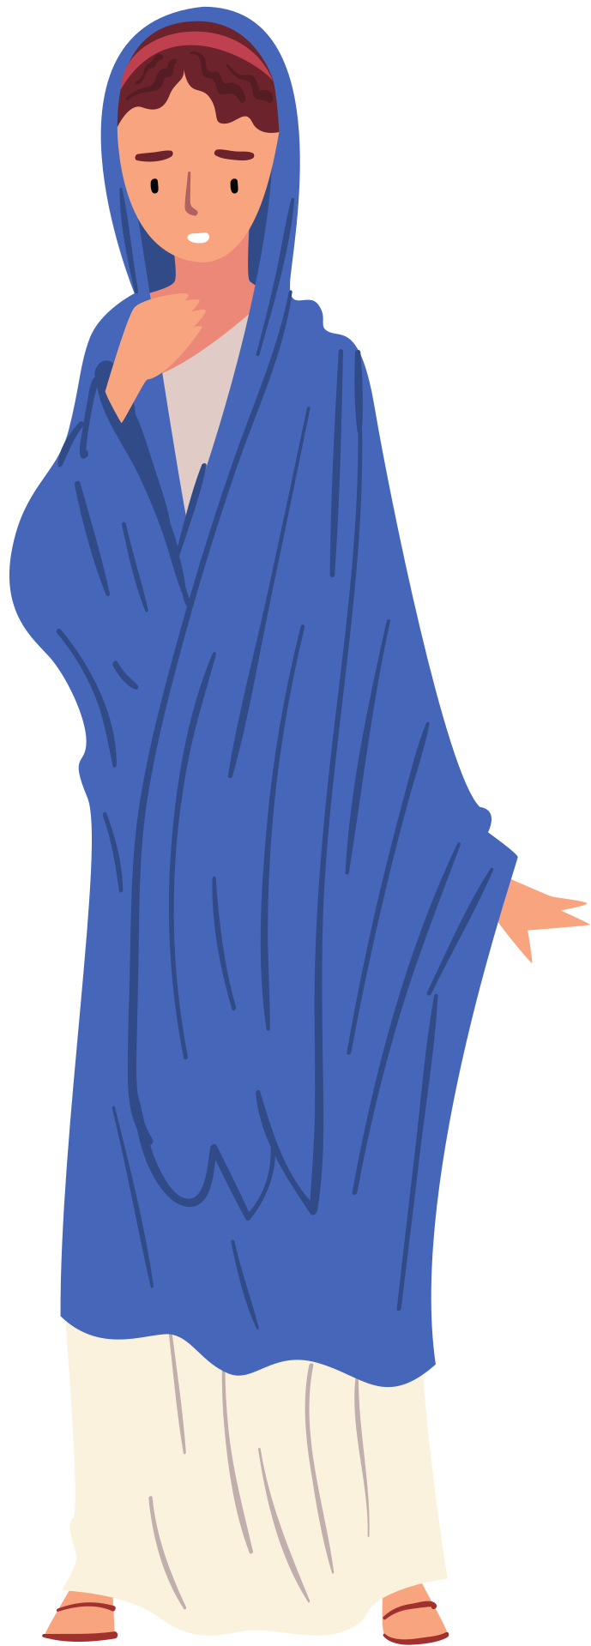
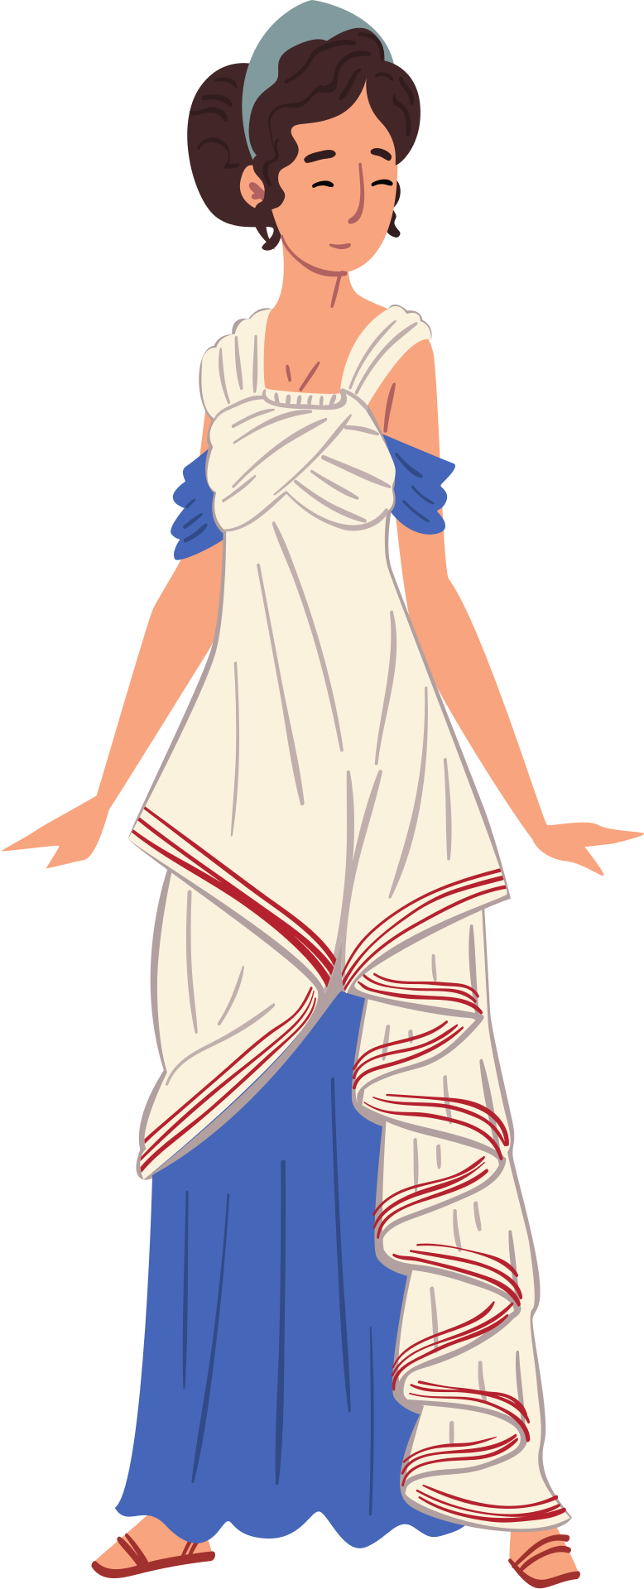
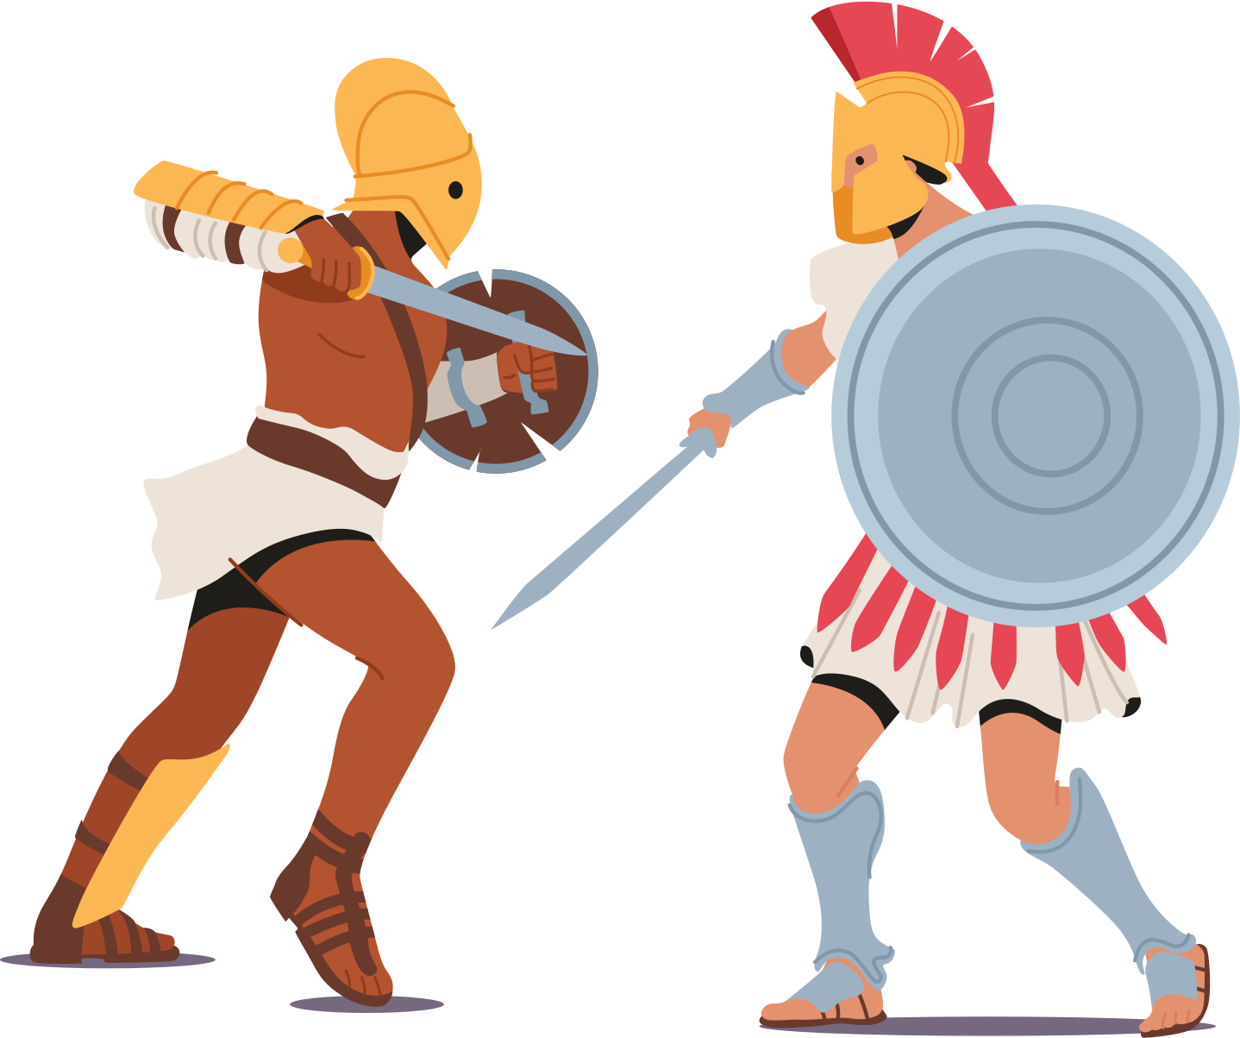


Ancient Greek People
Notes:
https://greece.mrdonn.org/greekgods/truthaboutmyths.html
Ancient Greek people loved telling stories. They were also very religious and believed their gods, goddesses, and other magical creatures really existed. [click]
They believed that gods and goddesses interfered with their daily life to help them or to hurt them. [click]
They built temples to honour their gods and goddesses. [click]
Each temple only honoured one god or goddess so there were a lot of temples
Temple of Olympian Zeus
Temple of Artemis
Temple of Hera
Temple of Apollo

Slide 4
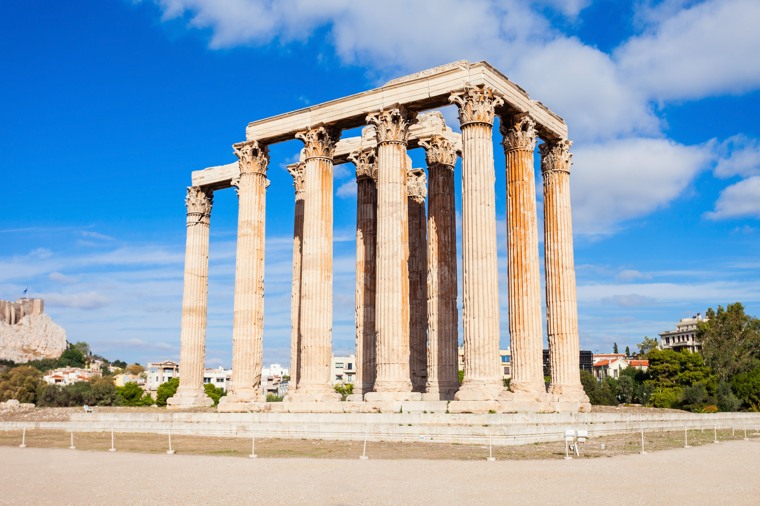
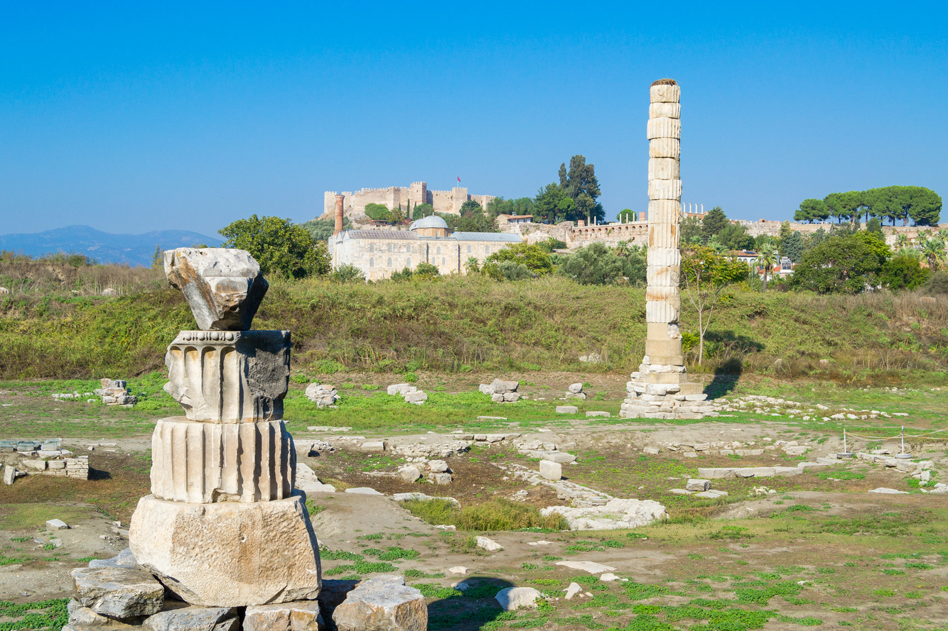
Temple of Olympian Zeus, Olympia, Greece.
What remains of the Temple of Artemis at Ephesus, Greece. One of the wonders of the ancient world!
Notes:
Each temple only honoured one god or goddess so there were a lot of temples
Temple of Olympian Zeus (who is Zeus?)
Temple of Artemis at Ephesus
(who is Artemis? Who is her twin brother Apollo?)

Slide 5
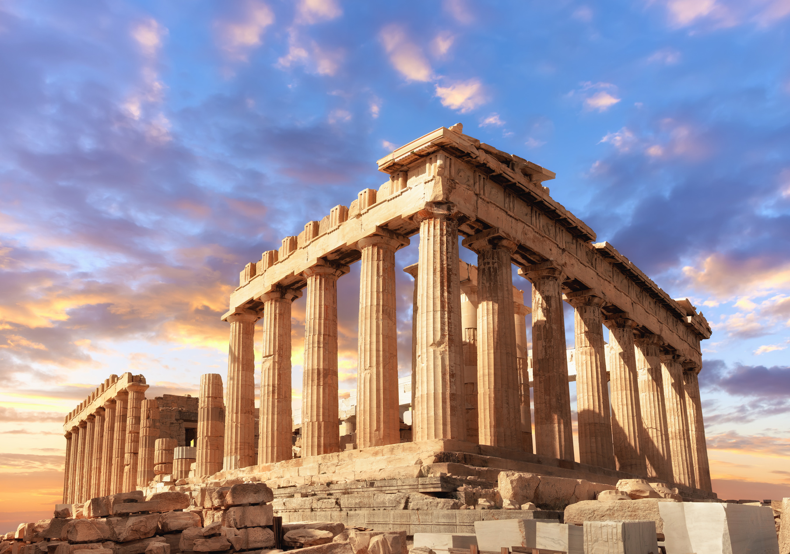
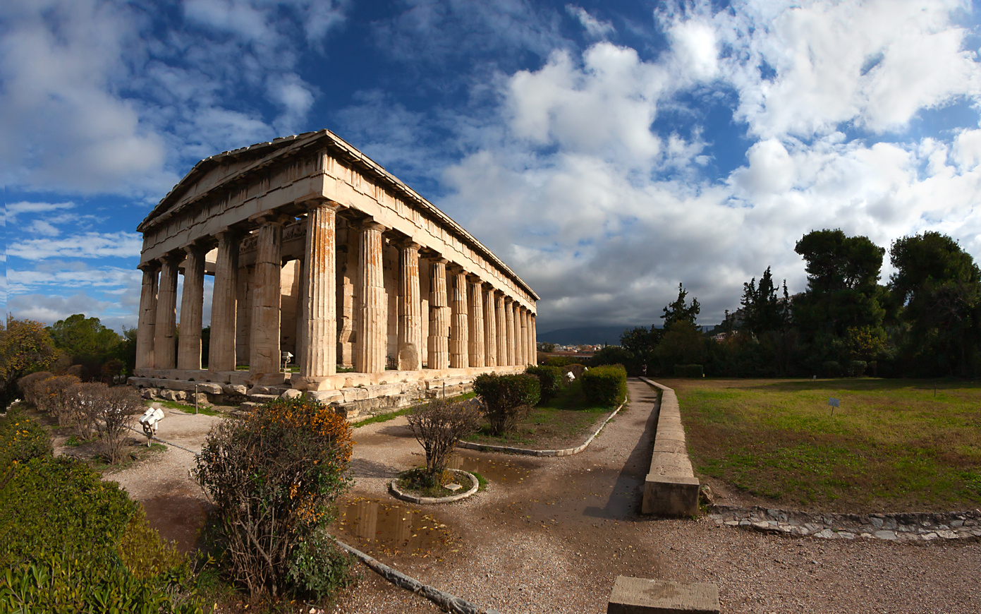
The Parthenon, Athens, Greece.
The Temple of Hephaestus, Athens, Greece.
Notes:
Each temple only honoured one god or goddess so there were a lot of temples
Parthenon, Athens - dedicated to Athena (who is Athena?)
Temple of Hephaestus

Slide 6

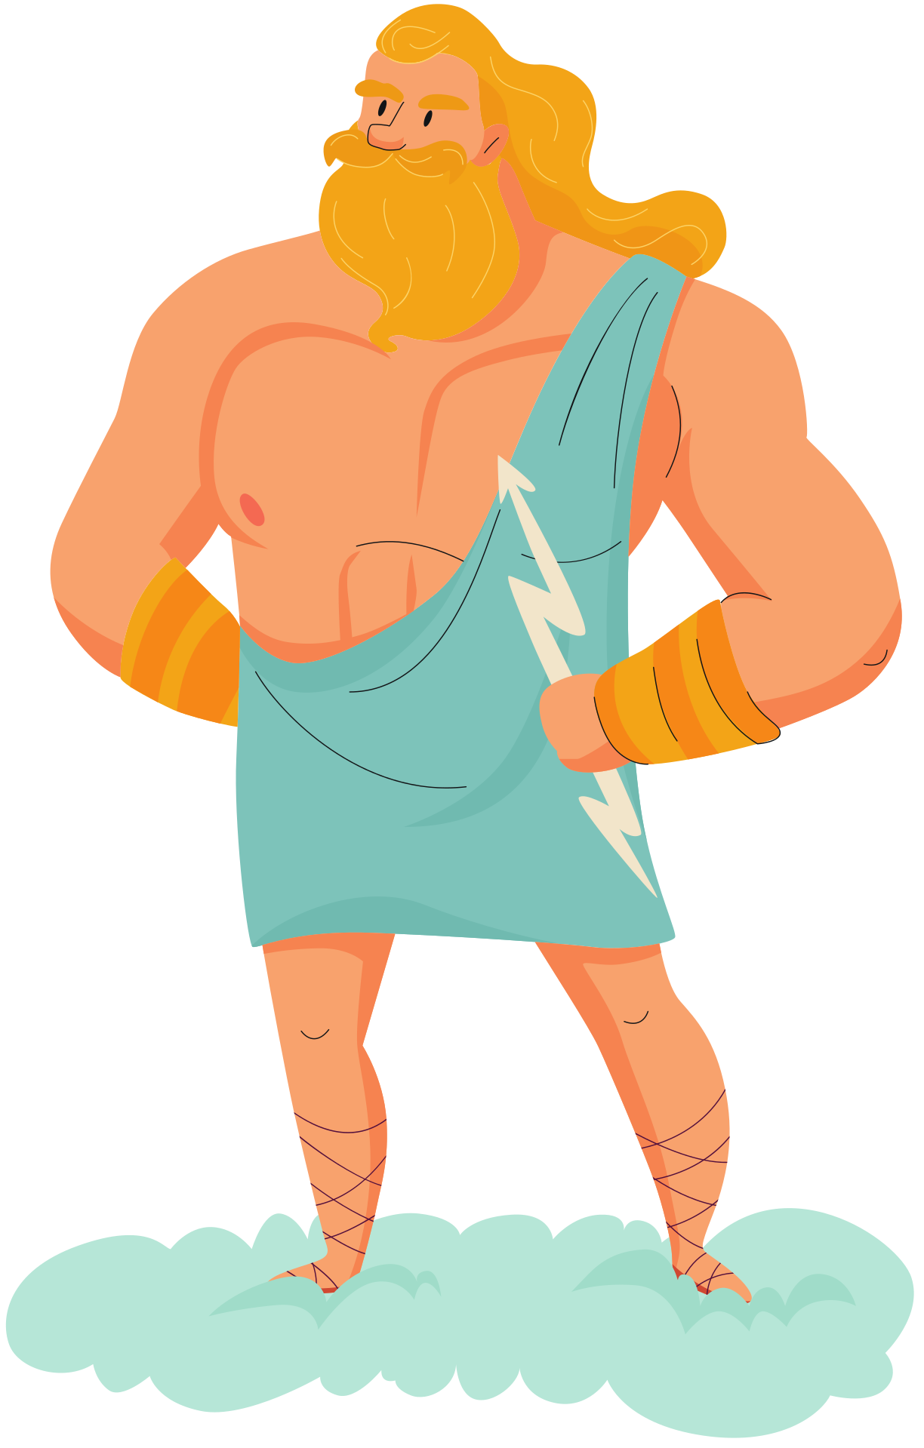

What are Greek myths?
Notes:
Ask the kids first and get a couple of answers of what they think.
https://greece.mrdonn.org/greekgods/truthaboutmyths.html
Greek myths were he stories that Ancient Greeks told about their gods
Some of the adventures in the myths might change depending on who is telling the story but the personalities and powers of the gods remained the same
Zeus always the king of all gods, power = lightening bolt
Hera - Zeus's wife, jealous
Poseidon, ruler of the sea
Hades - Underworld
Demeter - harvest
Hestia - home
Myths are not real - it is just a story.
Do you know any Greek myths?

Slide 7
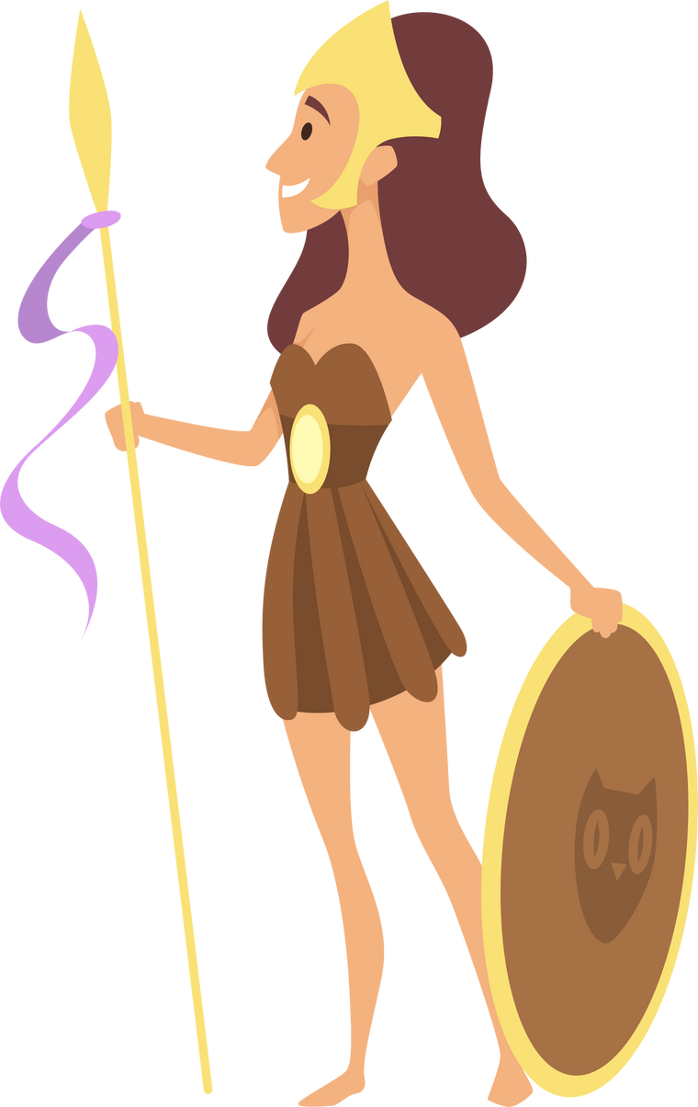
What was the purpose of a myth?
Notes:
The ancient Greek myths about the gods - sometimes thought of as gossip, Ancient Greek people wanted to know what was going on with the gods, and some people made up stories to keep people entertained
Greek myths also were a way for people to explain and understand the origins of the Universe and the creation of humans and animals.
Lastly, myths taught people about important beliefs and lessons.
Mythopedia: Oh My Gods by Megan E. Bryant

Slide 8
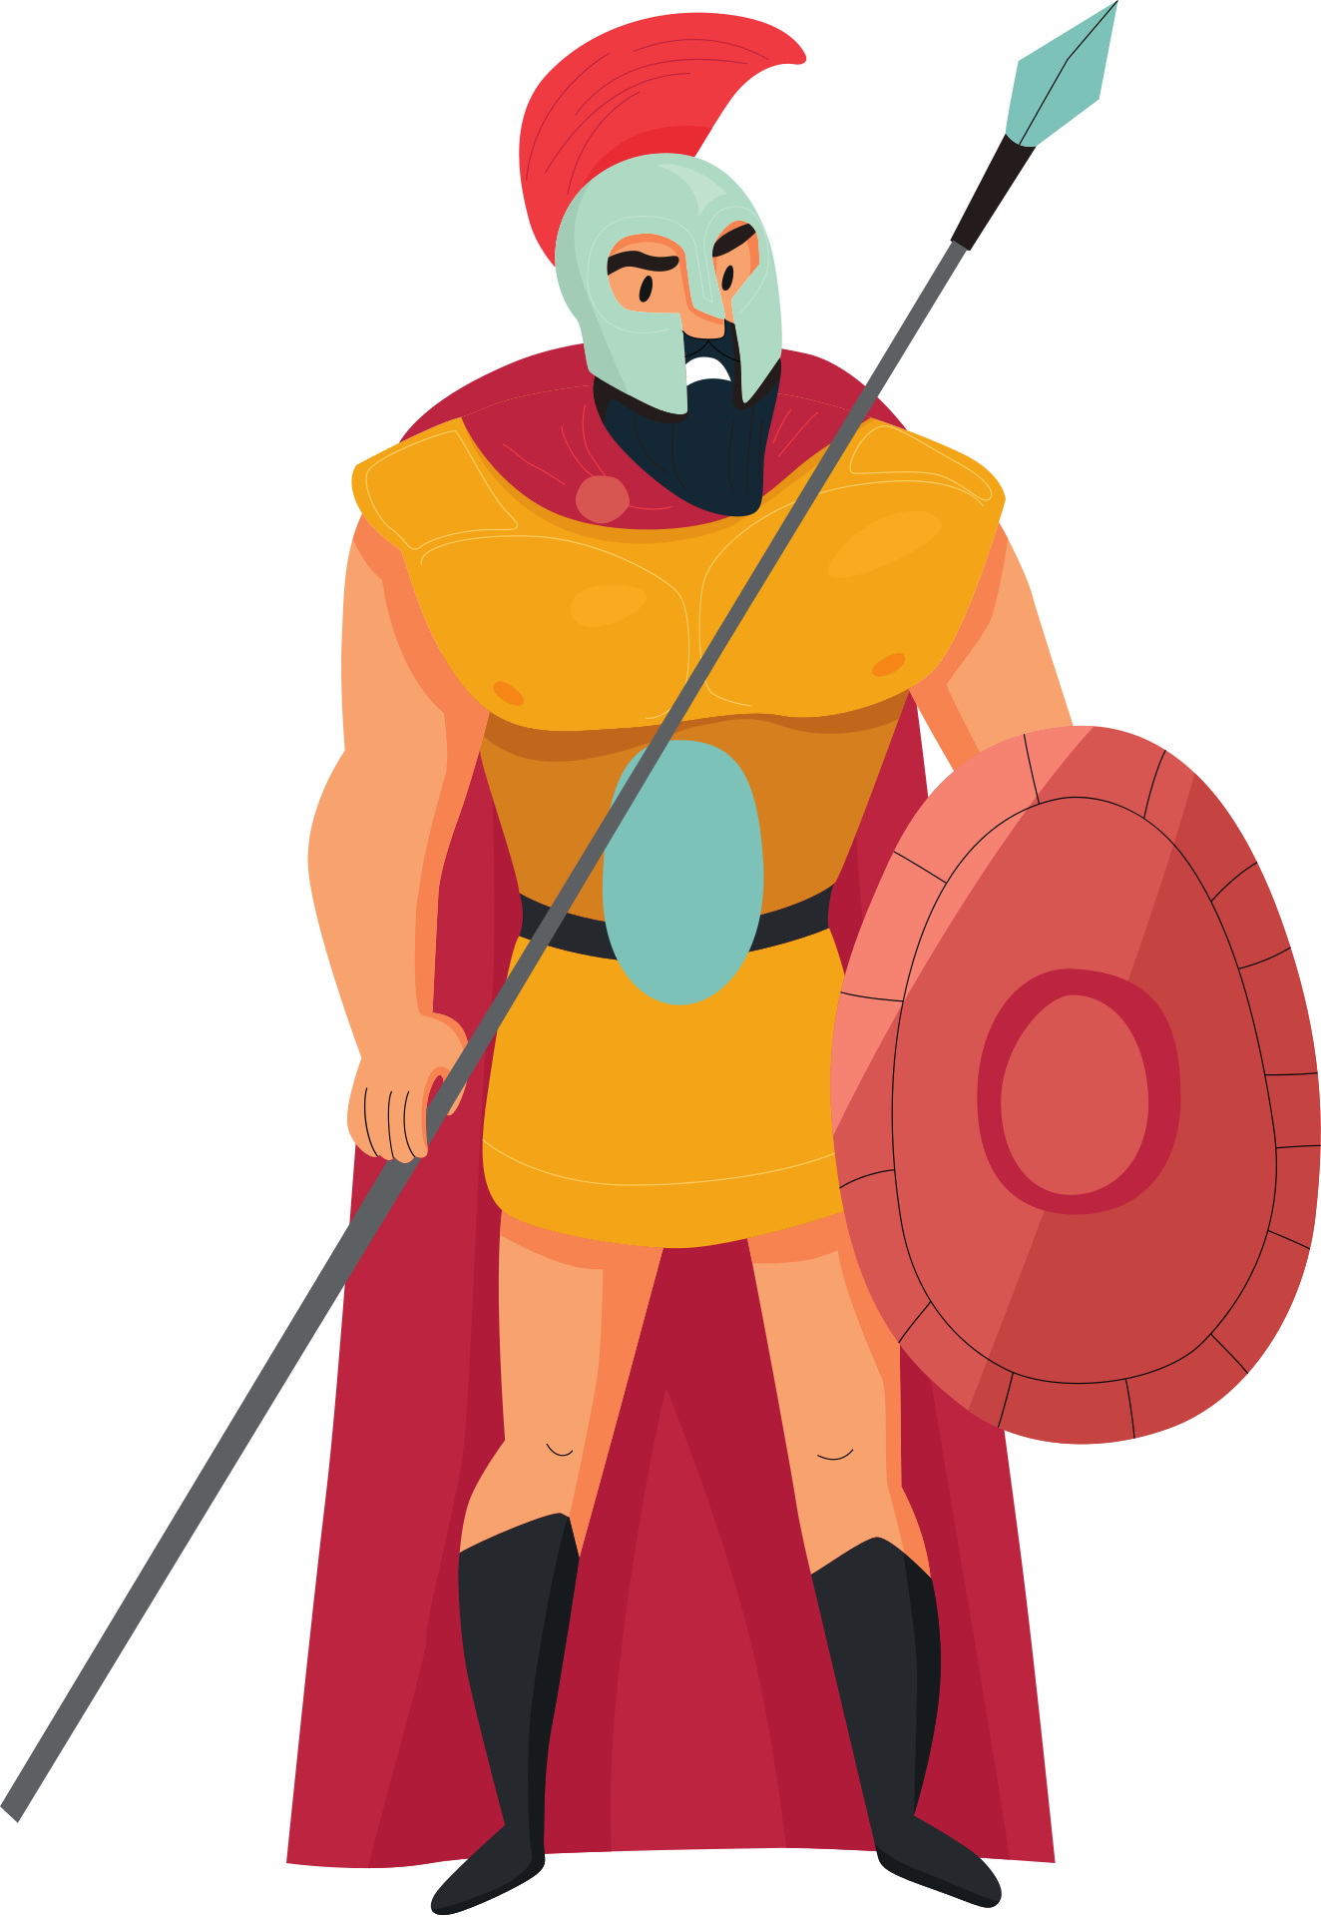
How do we learn these stories?
Notes:
(Ask the kids how they think we know these stories today. These stories are thousands of years old, how do we know?)
https://www.history.com/topics/ancient-greece/greek-mythology#sources-of-greek-mythology
The earliest Greek myths were part of an oral tradition that began in the Bronze age, over 3000 years ago, and were passed down through the generations.
They were gradually written down as written languages developed. Originally they would have been written in languages such as Greek or Latin.
In 700 BCE the poet Hesiod wrote Theogony and it is considered thee first written origin story of Greek mythology.

Slide 9
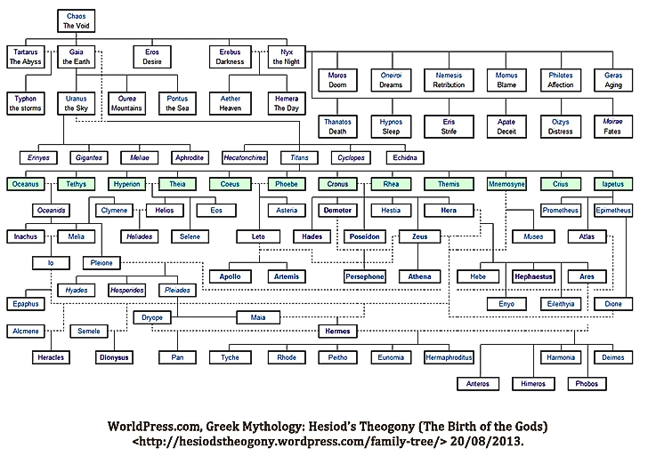
Notes:
https://amusine.typepad.com/the_last_hurrah/hesiod-the-great-uncle-of-natural-history.html
This is a table that shows the family tree of all the gods and the goddesses in Greek mythology, according to Hesiod.
Everything came from Chaos and descended from Gaia (Earth), Ouranos (Sky), Pontos (Sea) and Tartaros (the Underworld).
Then there were Titans and Cyclopes, the famous Titans
Cronus and Rhea, their children Hestia, Demeter, Hades, Poseidon, Zeus and Hera. These gods also had many children including Athena, Persephone, Hermes, Apollo and Artemis.

Slide 10


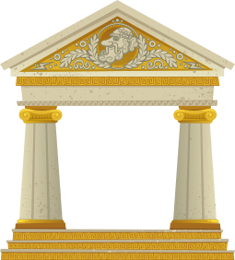
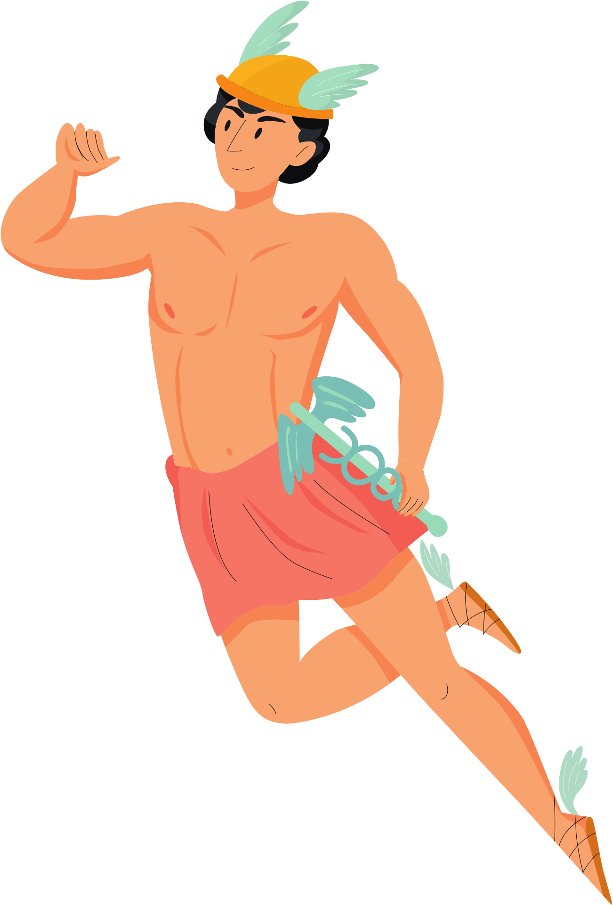
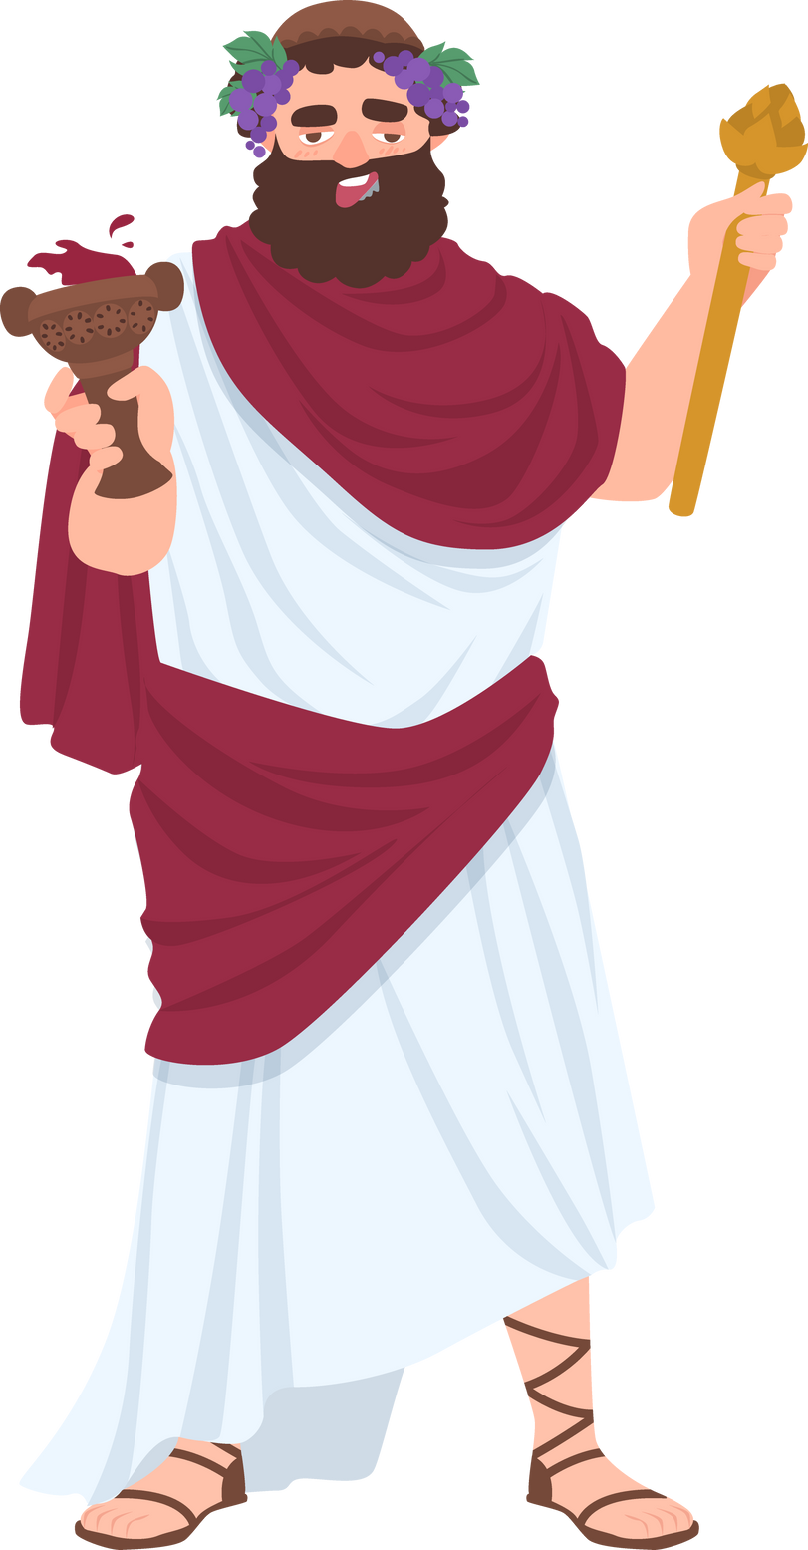
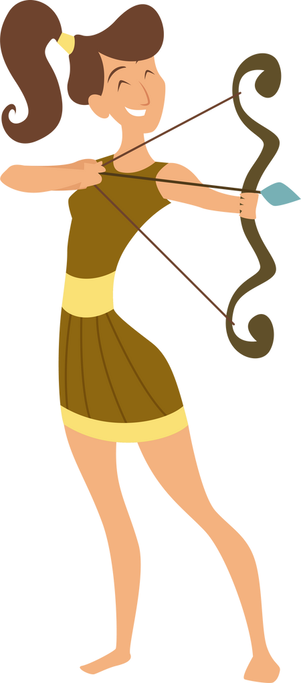
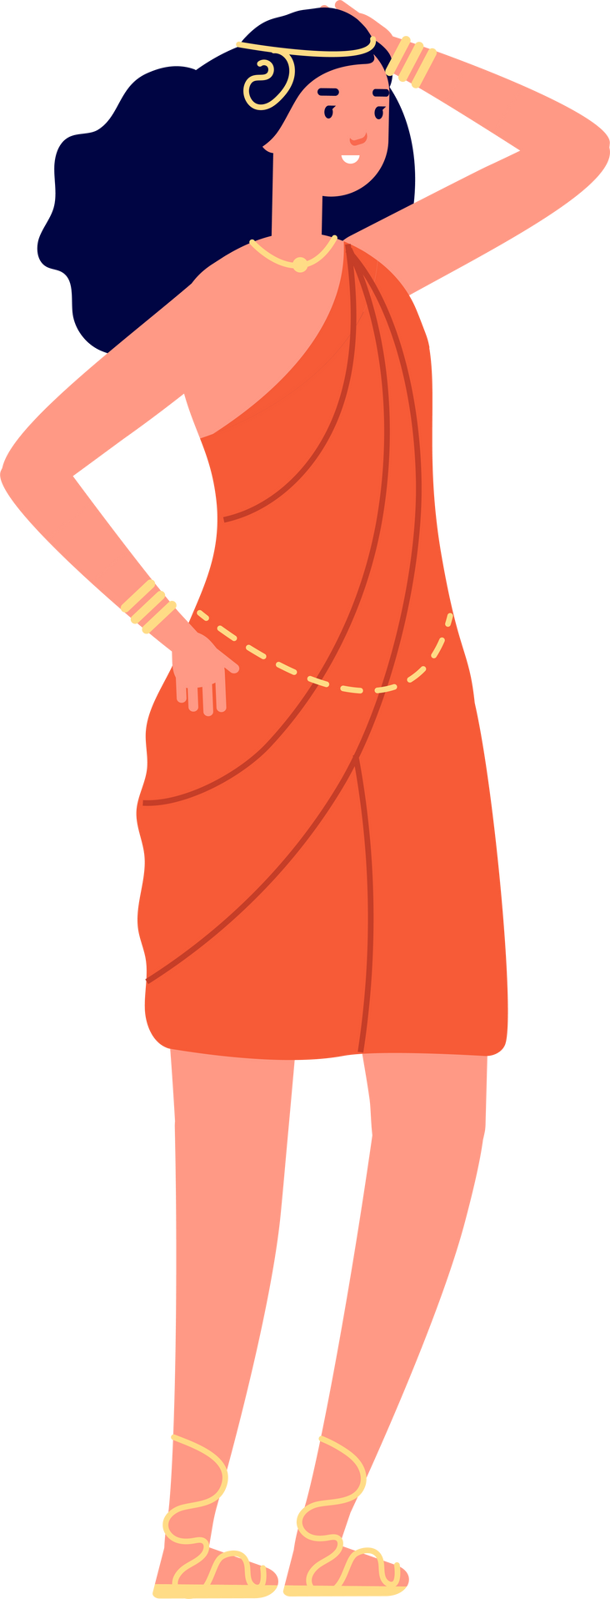
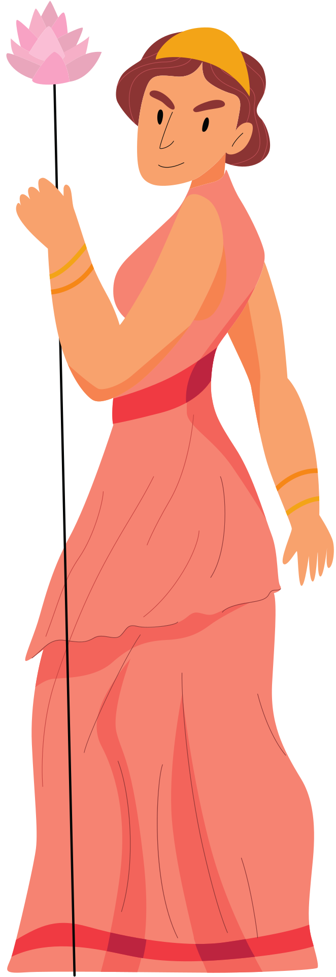
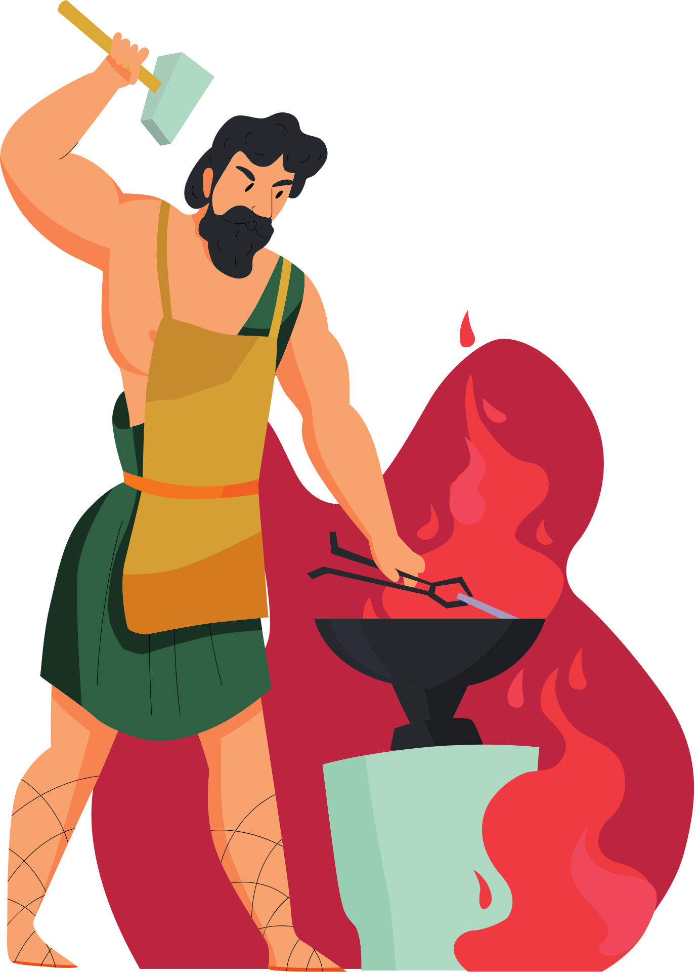
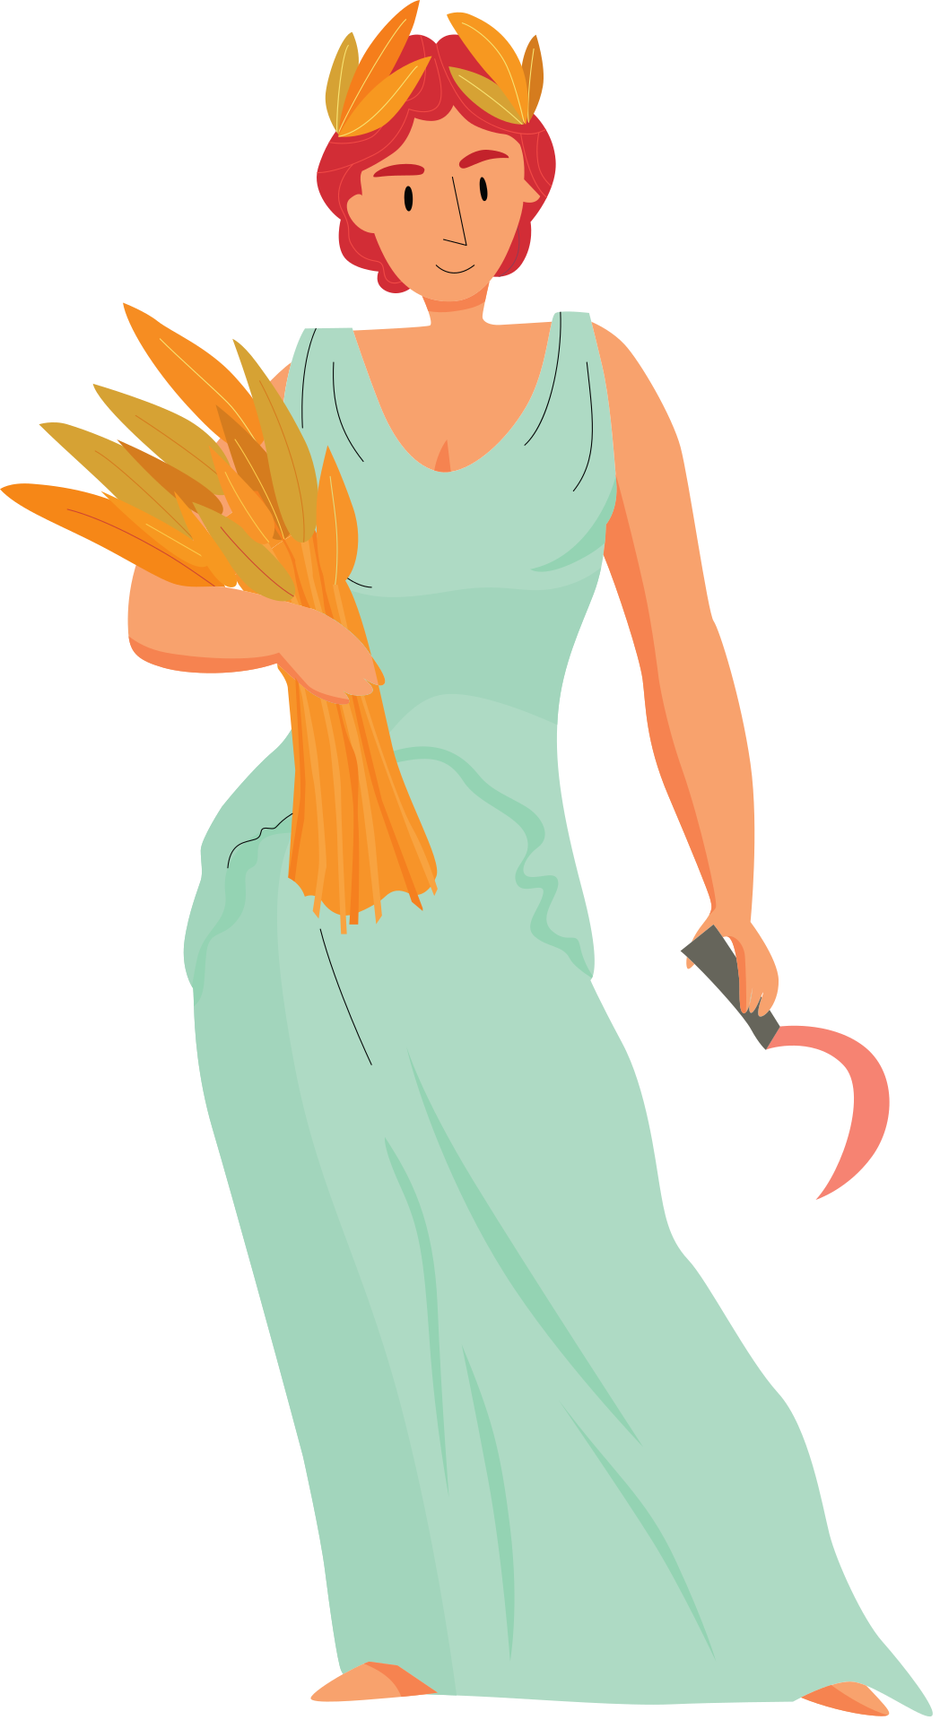
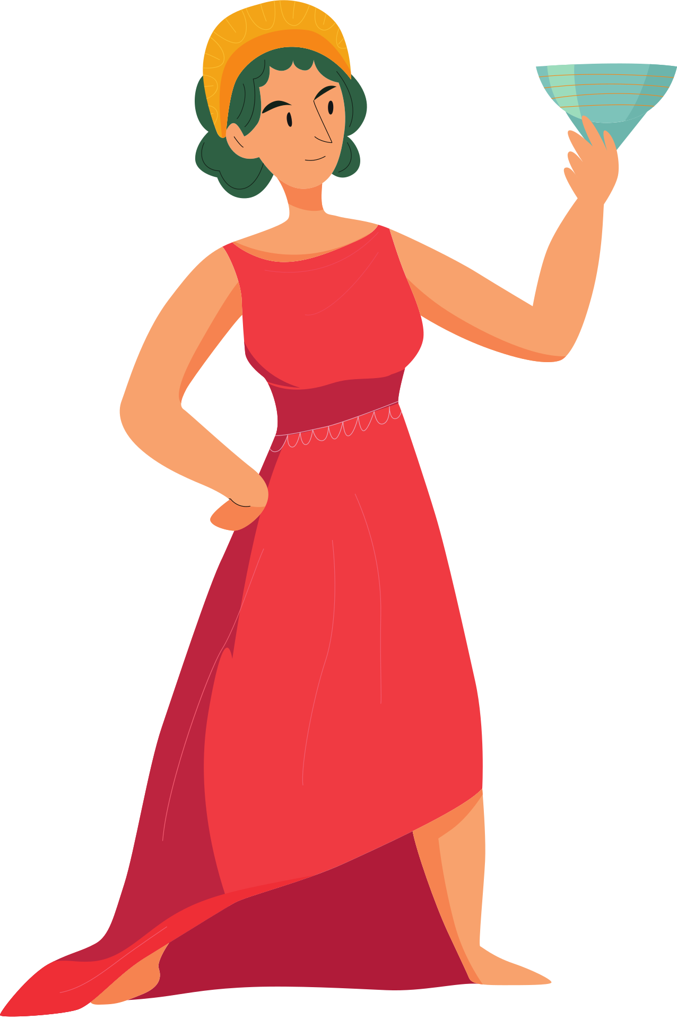
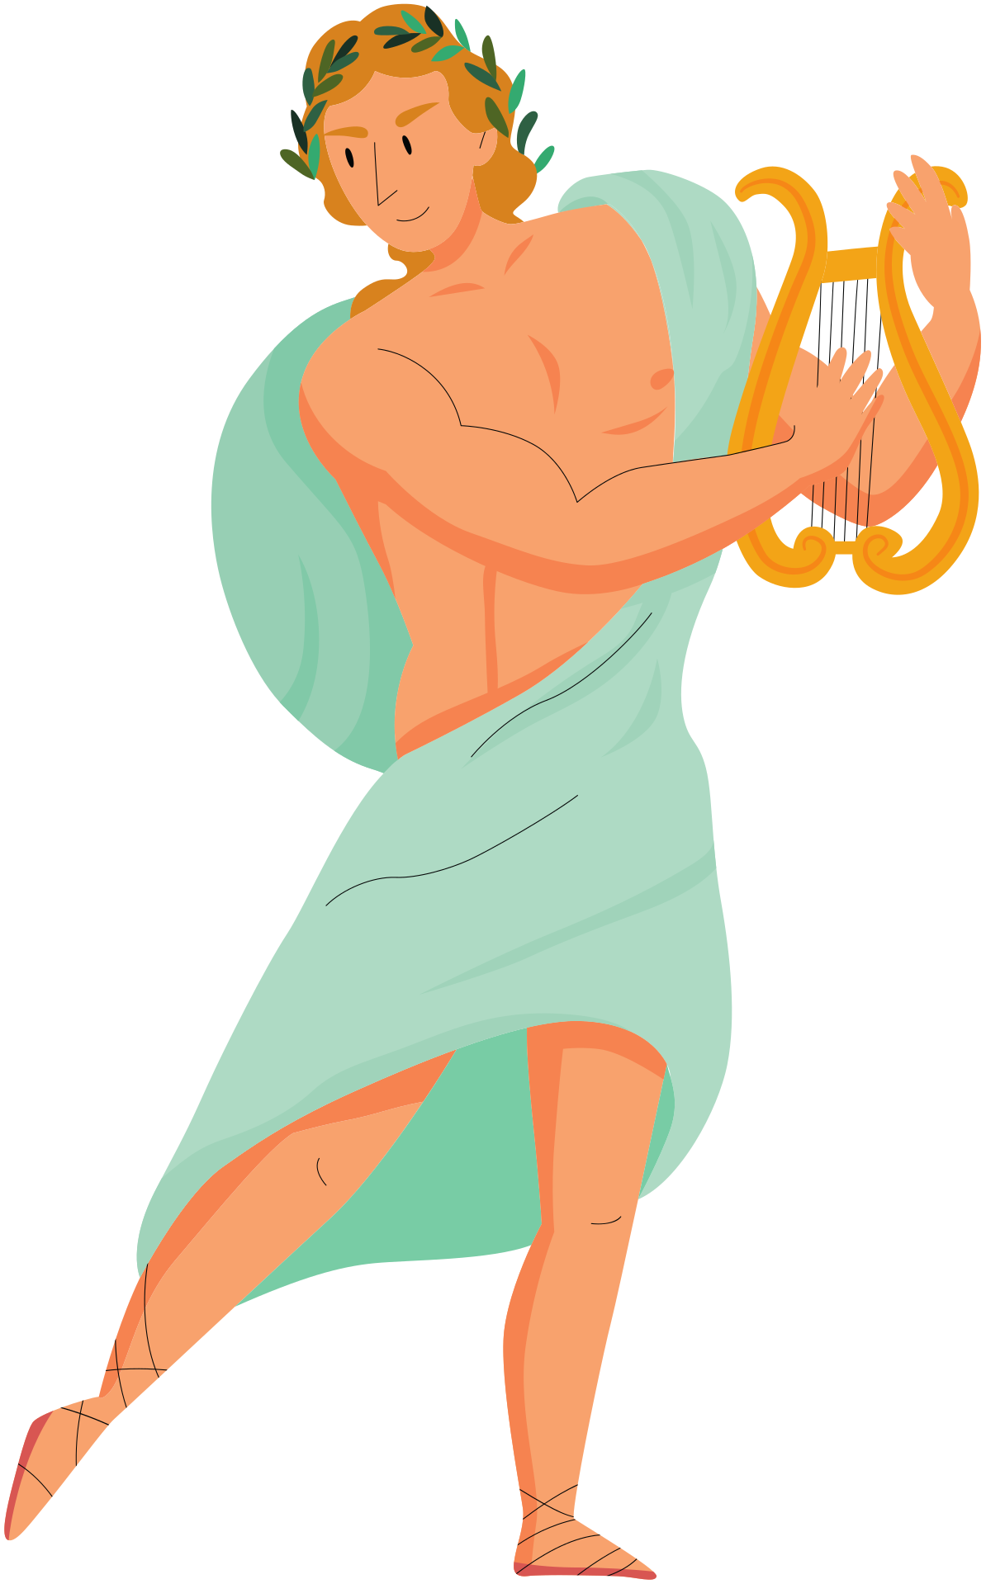
THE OLYMPIAN GODS
Zeus
Hermes
Dionysus
Artemis
Aphrodite
Athena
Apollo
Demeter
Poseidon
Persephone
Ares
Hestia
Hephaestus
Notes:
https://www.history.com/topics/ancient-greece/greek-mythology#greek-gods-and-goddesses
Zeus - the king of all the gods (father to many), god of the weather, law and fate
Hera - the queen of the gods and goddess of women and marriage
Aphrodite - goddess of beauty and love
Apollo - the god of prophecy, music, poetry and knowledge
Ares - god of war
Artemis - goddess of hunting, animals, and childbirth
Athena - goddess of wisdom and defense
Demeter - goddess of agriculture and grain
Dionysus - god of wine, pleasure and festivity
Hephaestus - god of fire, metalworking and sculpture
Hermes - god of travel, hospitality and trade, Zeus's personal messenger
Poseidon - god of the sea

Slide 11

Where do you see Greek Gods Today?
Notes:
Nike - goddess of Victory
Valentine's Day - Cupid or Eros is the god of love
Apollo 13 - first US space missions were named for Apollo, the god of archery and prophecy
https://www.kidsnews.com.au/greek-myths-and-legends/how-greek-mythology-continues-to-have-a-large-influence-on-our-modern-lives/news-story/334bb7fd1e685e99ebe229f5a685bc5c
Amazon - strong group of women warriors - trained in combat and archery
Pandora - jewellery brand - first moral woman in Greek mythology - her name meant all-gifted
Cerberus - Australian Royal Navy
Cereal - named after Ceres, the god of grain
Names from Greek mythology

Slide 12
Activity Time!
Get into groups and choose one of these Greek myths:
Orpheus and Eurydice
Apollo and the Lyre
The Patronage of Athens
The Trojan War
The Odyssey
Theseus and the Minotaur
Research your myth and then, as a group, prepare to tell your myth to the class!

